Slide 1
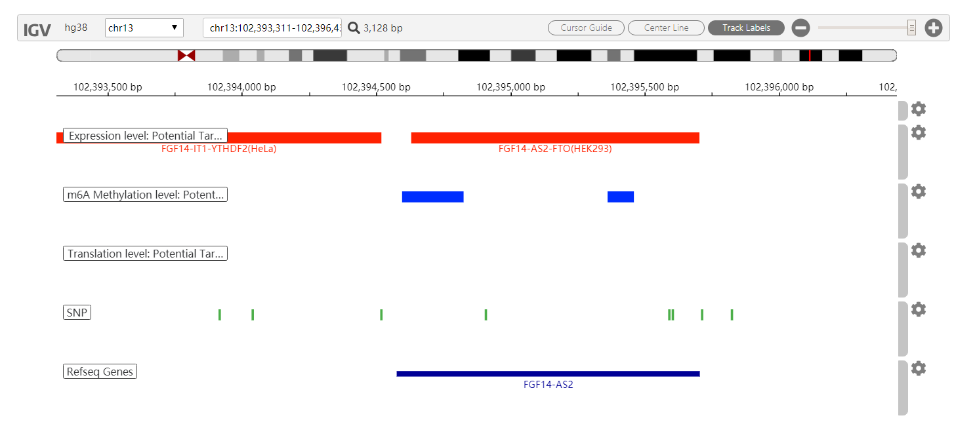
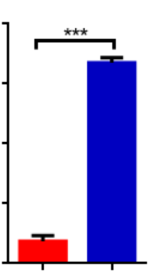
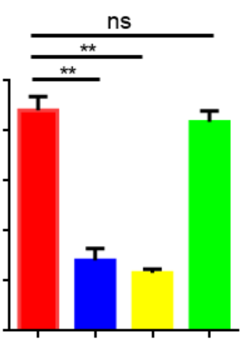
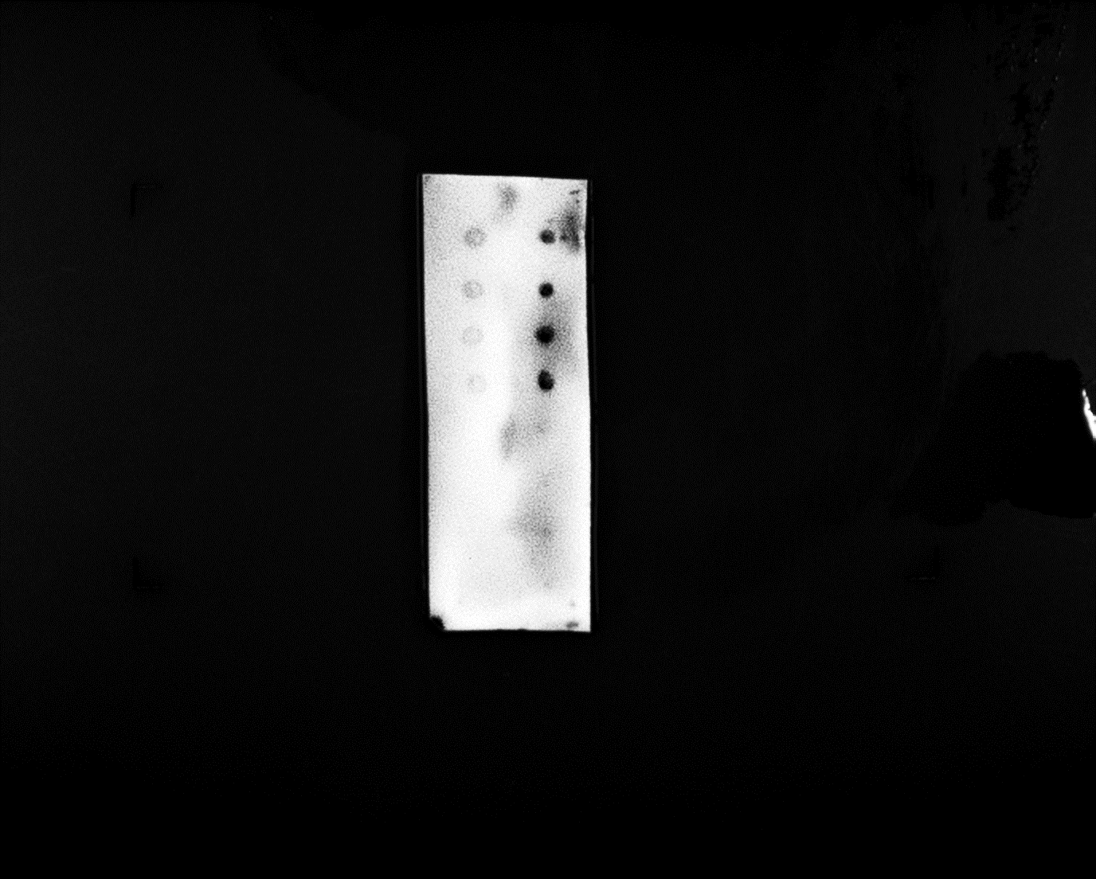
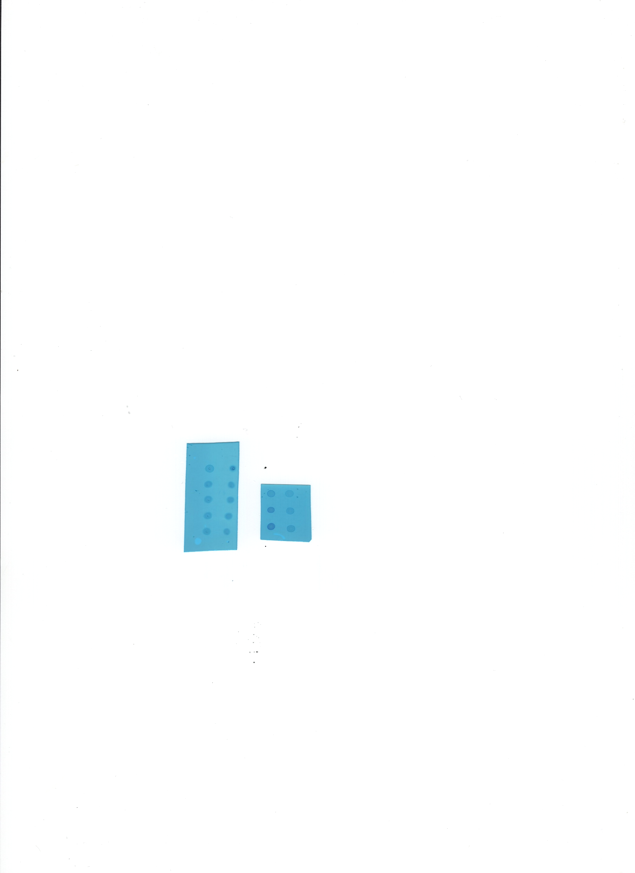
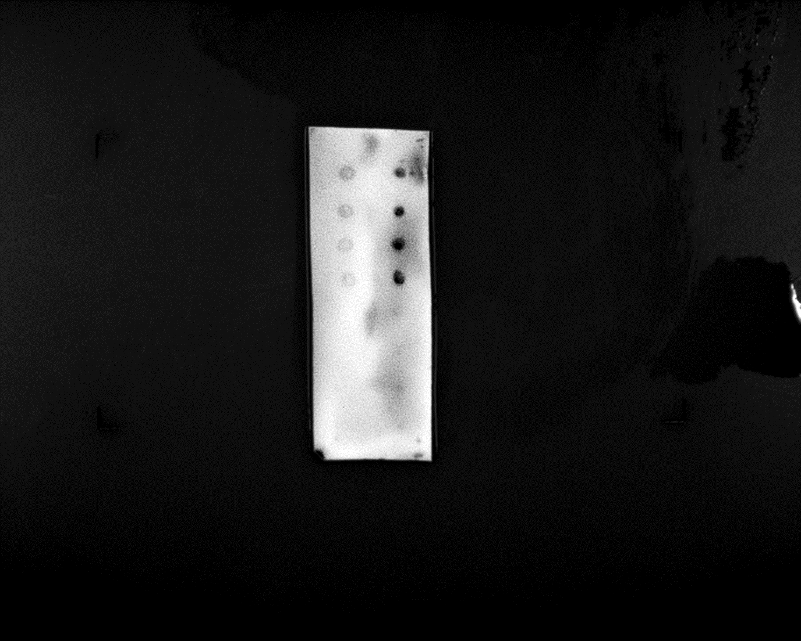

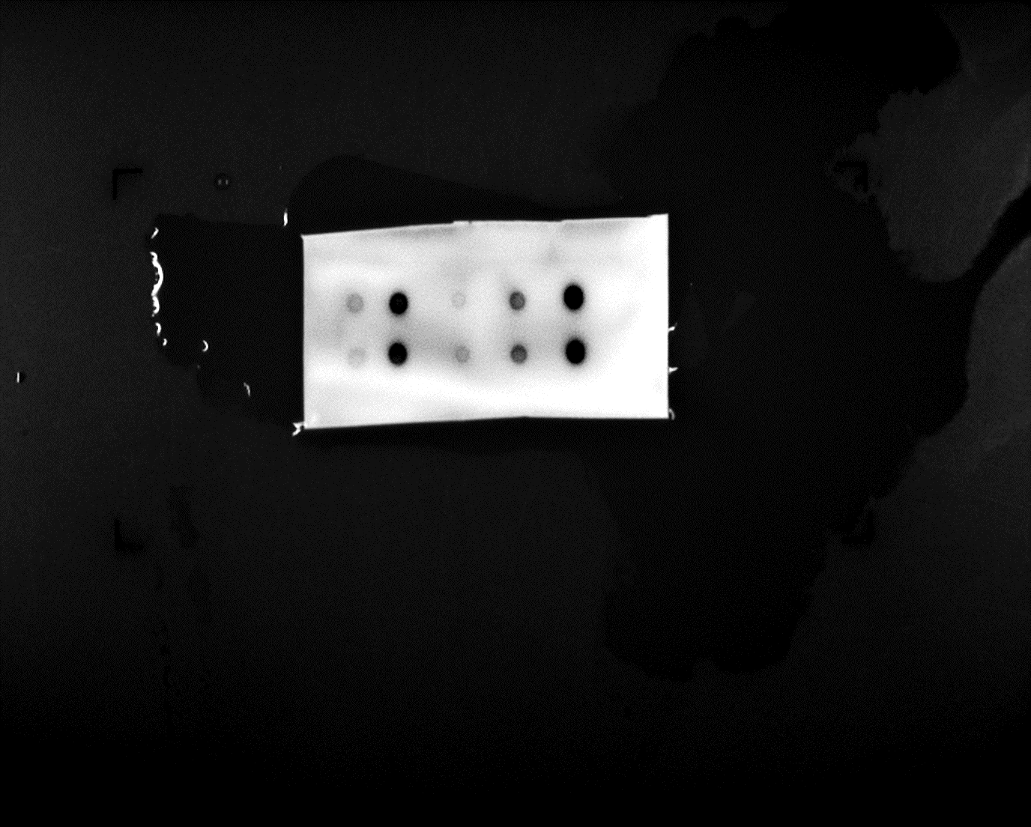


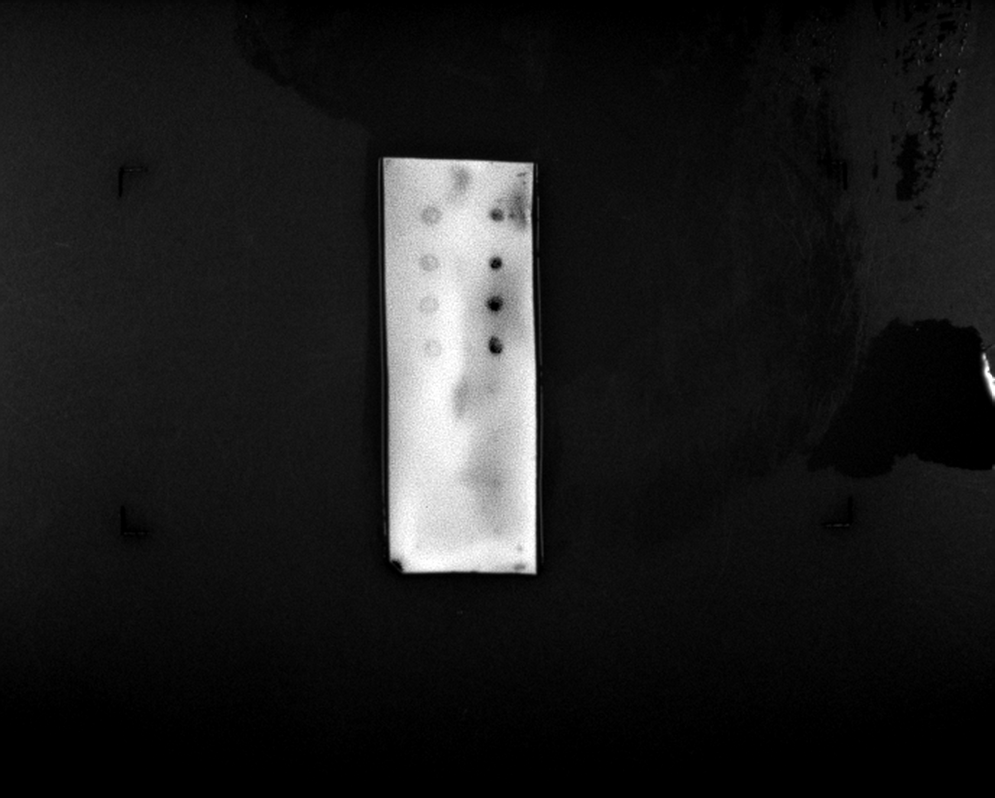
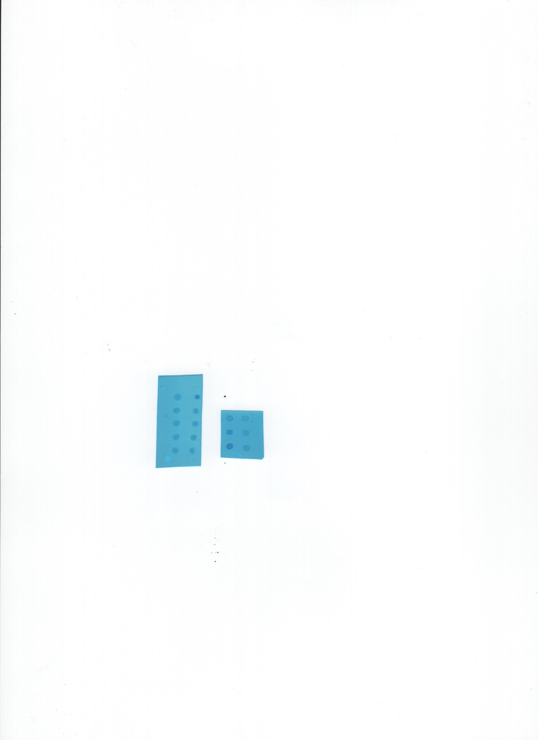
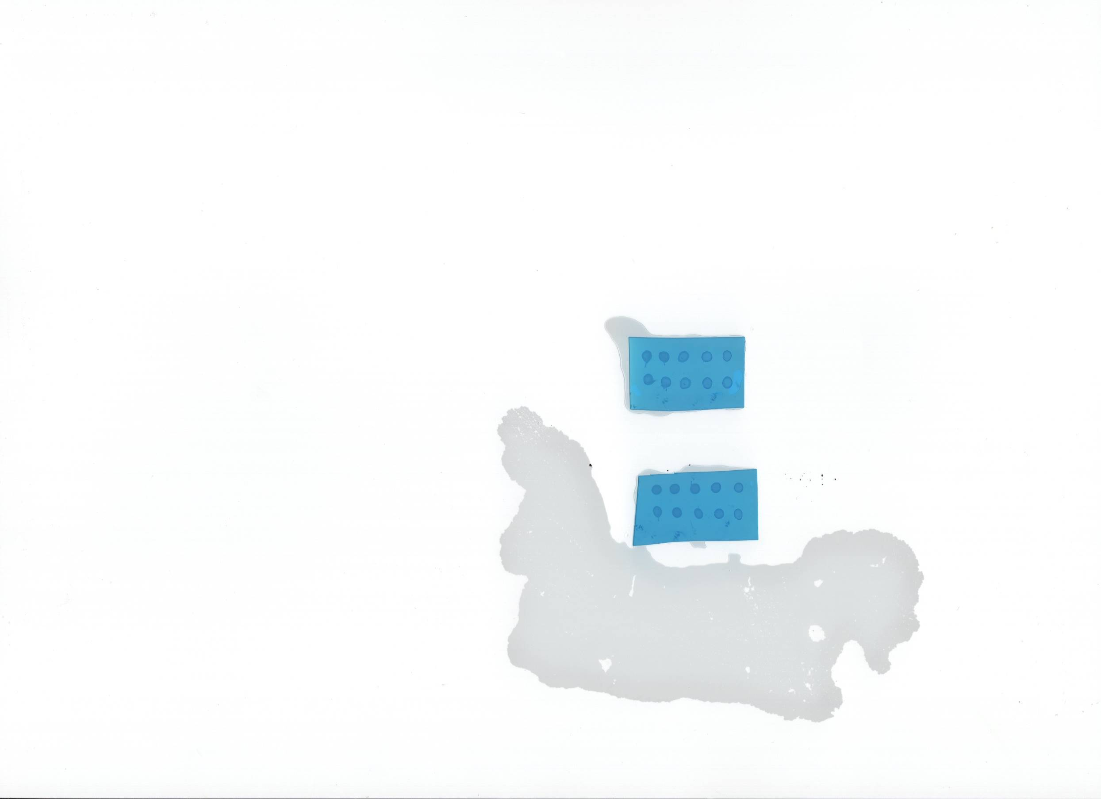
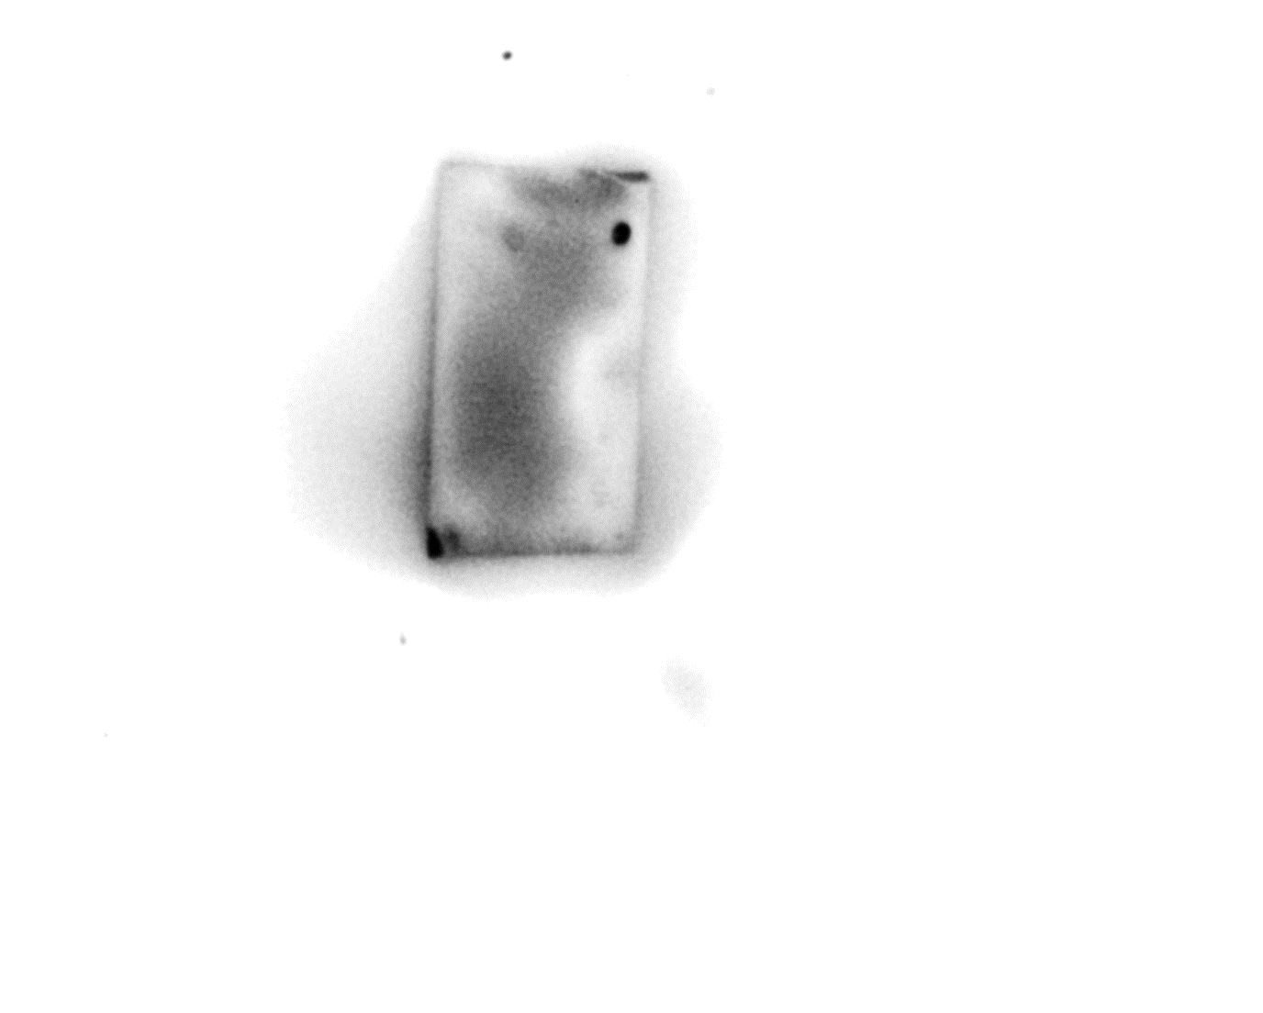
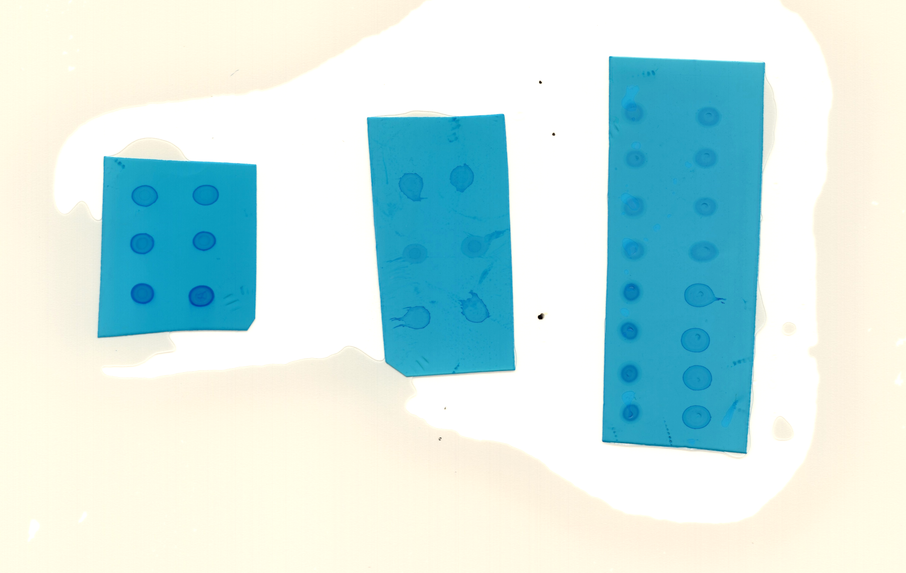
Supplemental Fig. 6
a
b
20.0
15.0
10.0
meRIP/Input(%)
5.0
m6A sites
0.0
IgG
FGF14-AS2
c
FGF14-AS2
m6A site(Low confidence)
1
1074
m6A site(Moderate confidence)
m6A site(High confidence)
m6A site(Very high confidence)
...GGACC...GGACU...
...UGACA...AAACU...GGACA...
...AGACU...AGACU...
81
88
270
323
338
797
812
d
Vector
Luc
e
wt
Luc
1
2
3
4
1.0
mut3
Luc
0.8
mut3-4
Luc
0.6
m6A sites
m6A mutation sites
Relative luciferase activity
FGF14-AS2 mut3-Luc
0.4
Ori:
GTGAACAGTAGACTACAGGCCTTG
0.2
0.0
METTL3+mut3-Luc
METTL3+mut3-4-Luc
Mut to:
GTGAACAGTAGCCTACAGGCCTTG
pcDNA3.1+Luc
METTL3+Luc
FGF14-AS2 mut3-4-Luc
Ori:
GTAGACTACAGGCCTTGAGACTGA
Mut to:
GTCGACTACAGGCCTTGCGACTGA
f
g
MCF-10A
MDA-MB-231
N
C
MB
SKBR3
MCF-7
BT474
P1
P2
P3
m6A
P4
MB
P5

