Slide 1
Supporting information
of
Therapeutic silencing of mTOR by systemically administered siRNA loaded neutral liposomal nanoparticles in DMBA-induced mammary carcinogenesis in Sprague Dawley rats
Roja Sahu¹, Shivesh Jha², Shakti P. Pattanayak^{3,}*
¹Division of Advanced Pharmacology, Department of Pharmaceutical Sciences & Technology, Birla Institute of Technology (BIT), Mesra, Ranchi, Jharkhand-835 215, India
²Division of Pharmacognosy and Phytochemistry, Department of Pharmaceutical Sciences & Technology, Birla Institute of Technology (BIT), Mesra, Ranchi, Jharkhand-835 215, India
^{3,}*Department of Pharmacy, School of Health Science, Central University of South Bihar (Gaya), Bihar- 824 236, India (Government of India)
*1 & 3 contributed equally to this work.
*Address for correspondence:
Dr. Shakti P. pattanayak
Department of Pharmacy, School of Health Science, Central University of South Bihar (Gaya), Bihar- 824 236, India (Government of India)
Phone: +91-9123240698
Email: sppattanayak@cusb.ac.in ; profsppattanayak@gmail.com

Slide 2
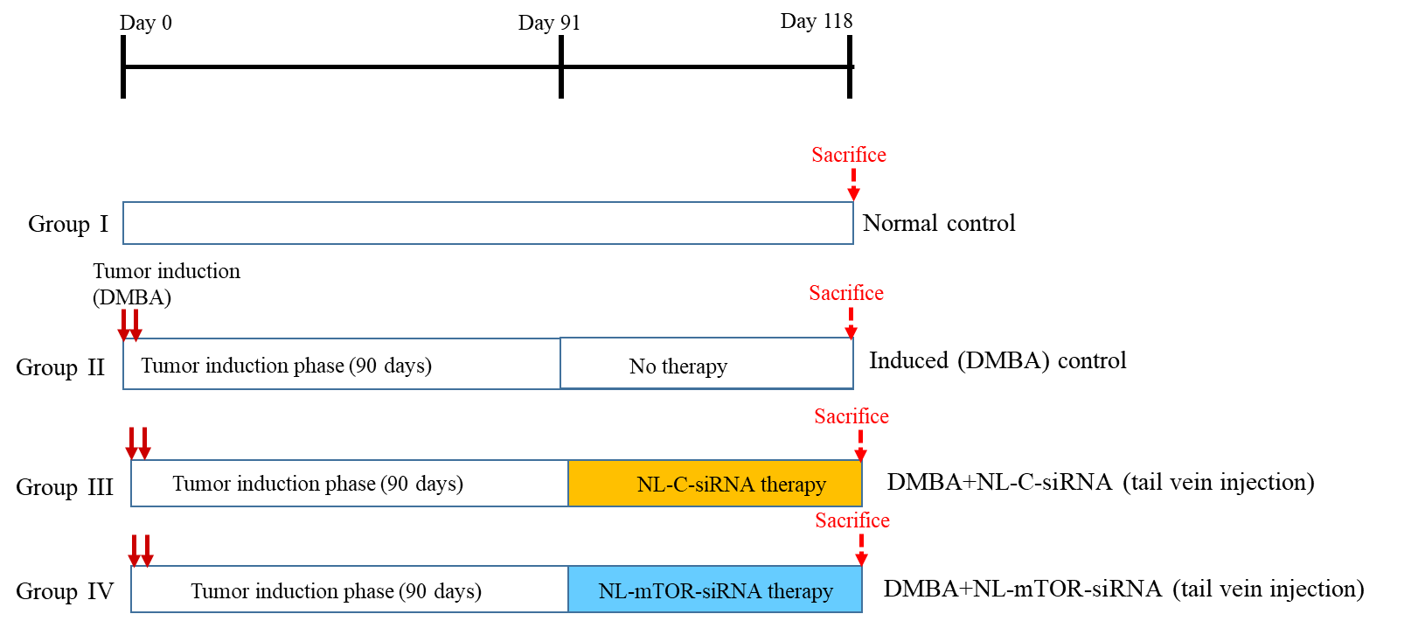
Supplementary Figure 1

Slide 3
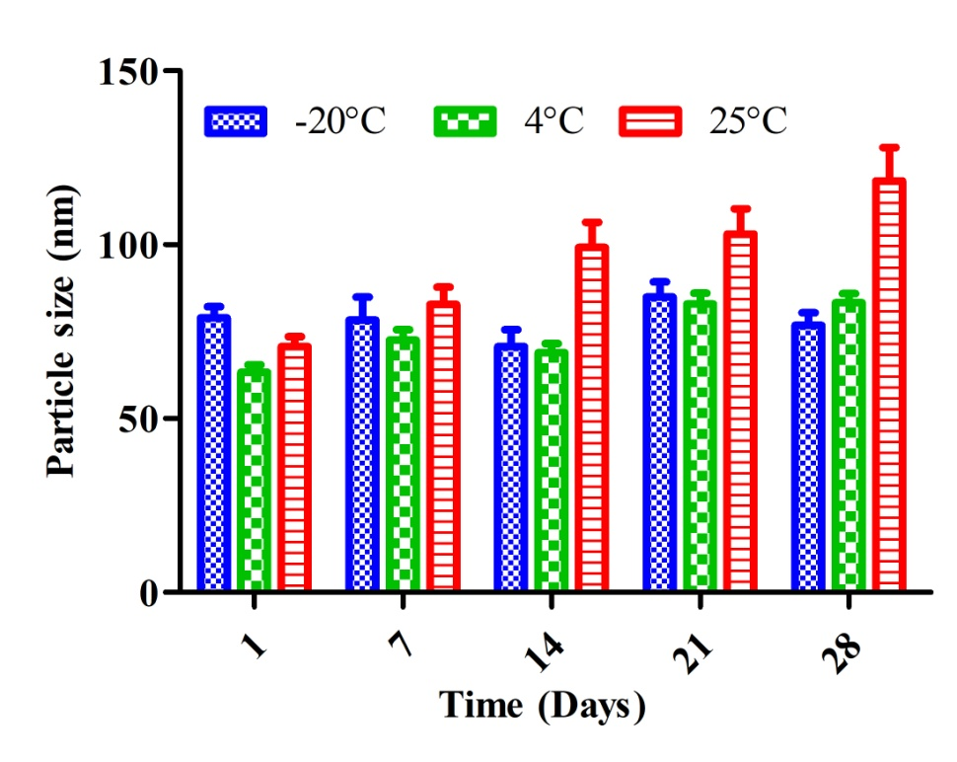
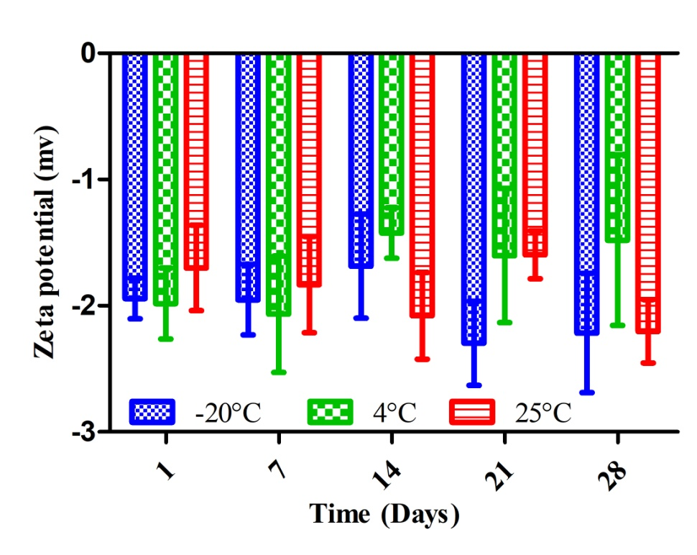
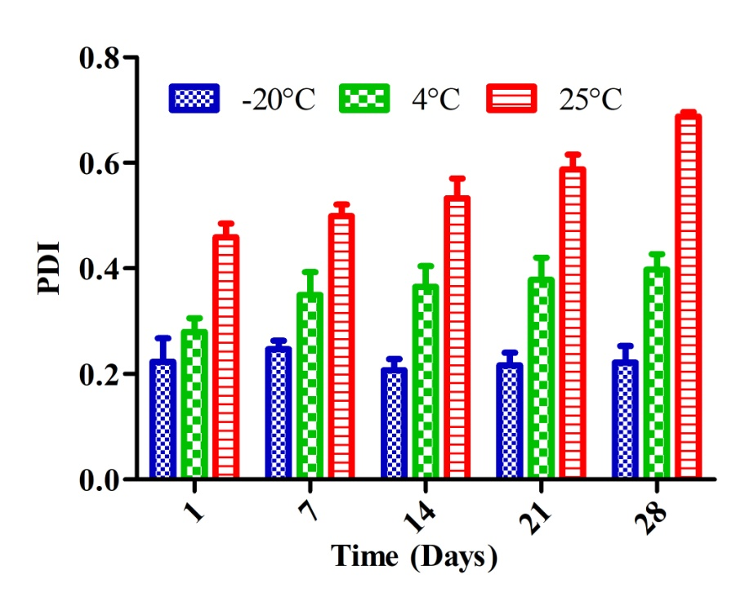
Supplementary Figure 2
A
B
C
D
E
F

Slide 4
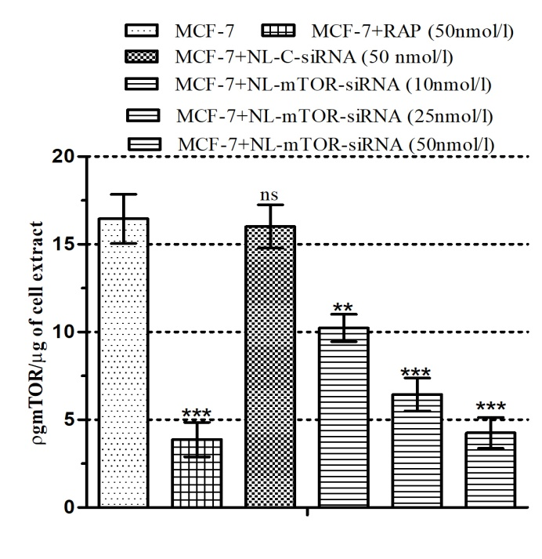
Supplementary Figure 3

Slide 5
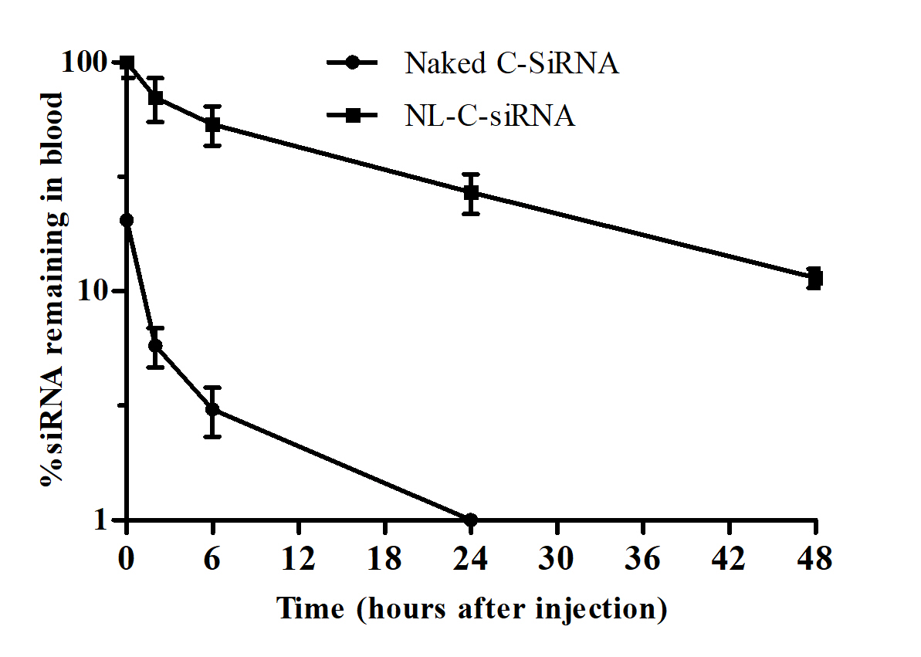
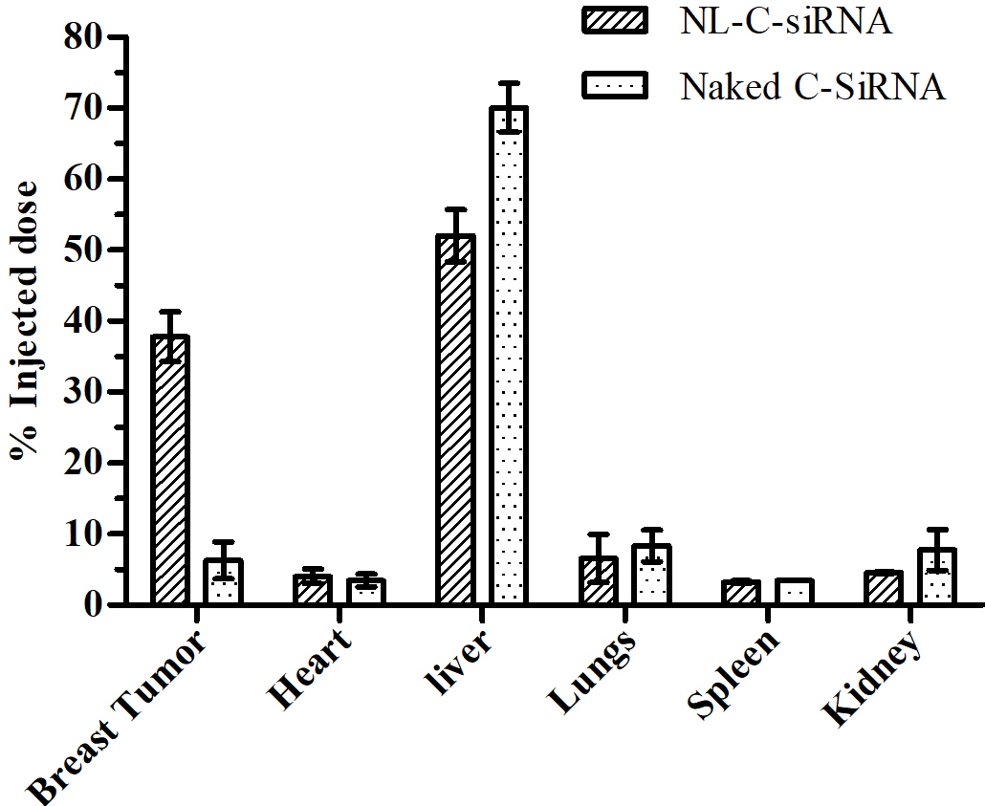
Supplementary Figure 4
A
B

Slide 6
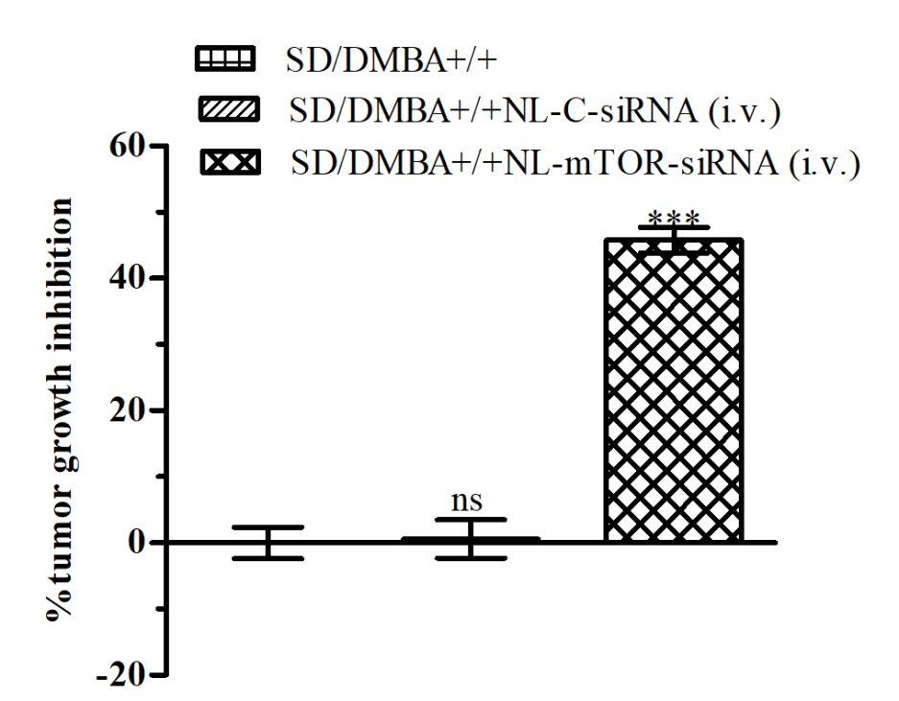
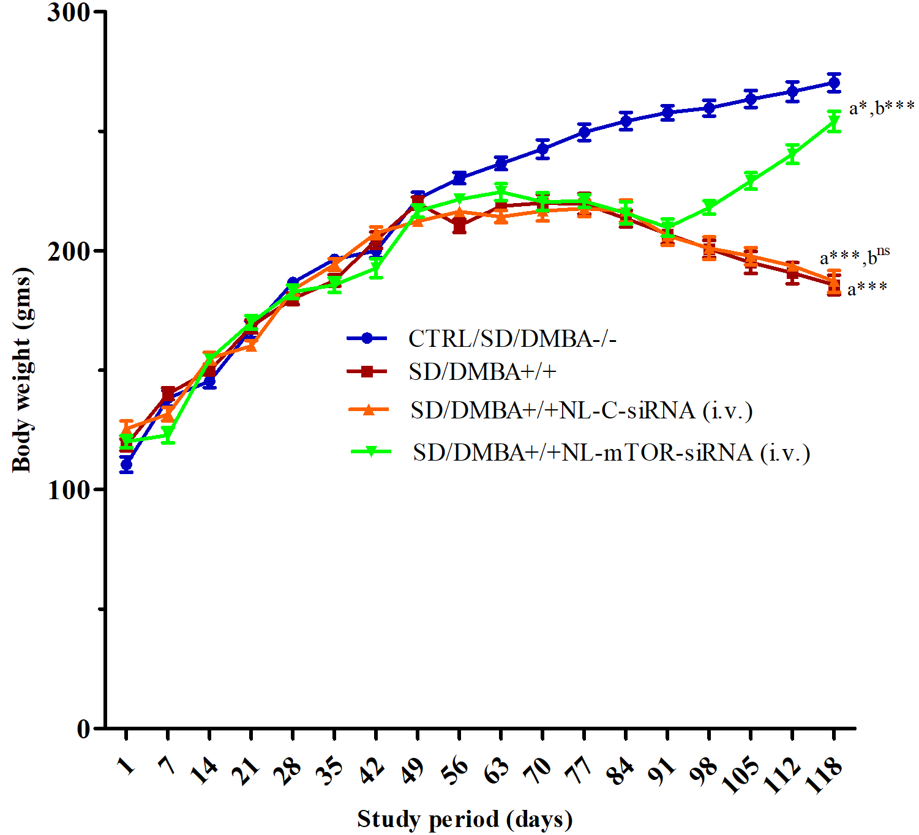
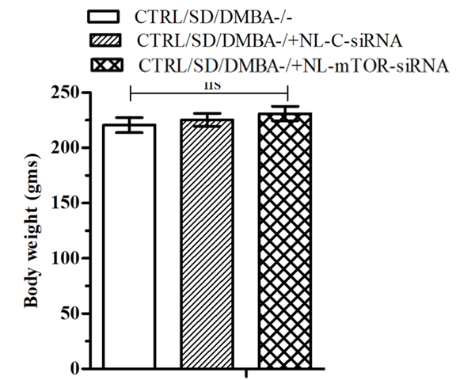
Supplementary Figure 5
A
B
C

Slide 7
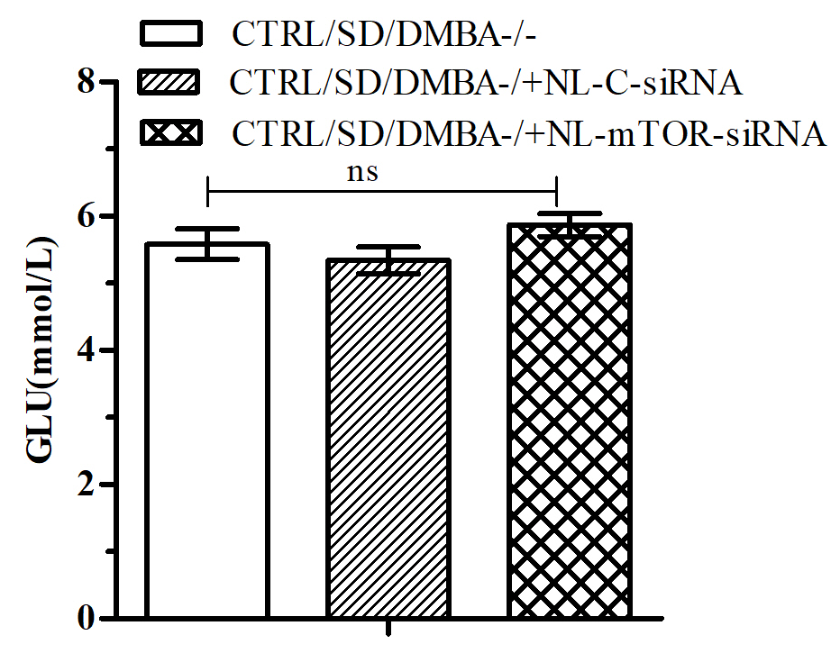
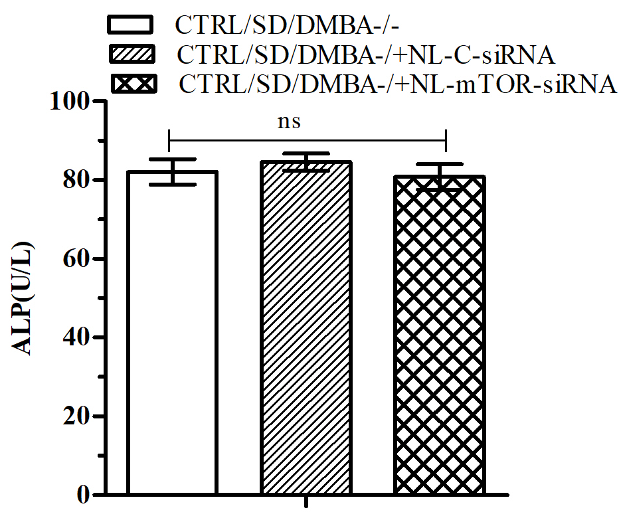
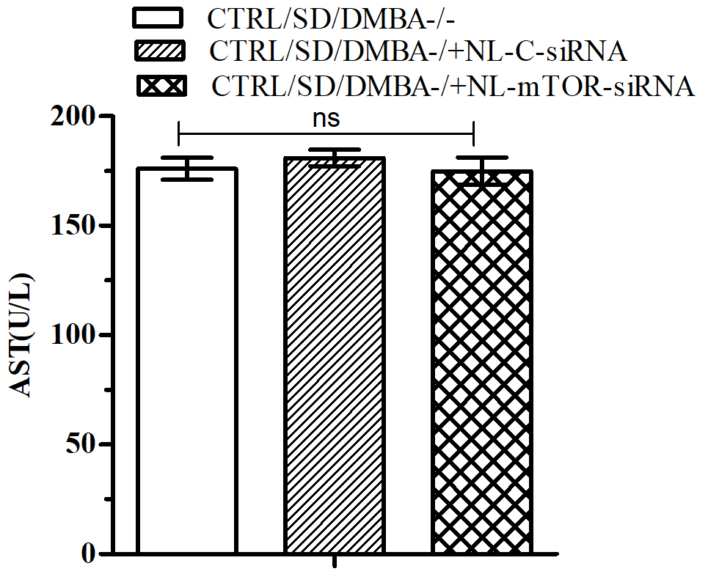
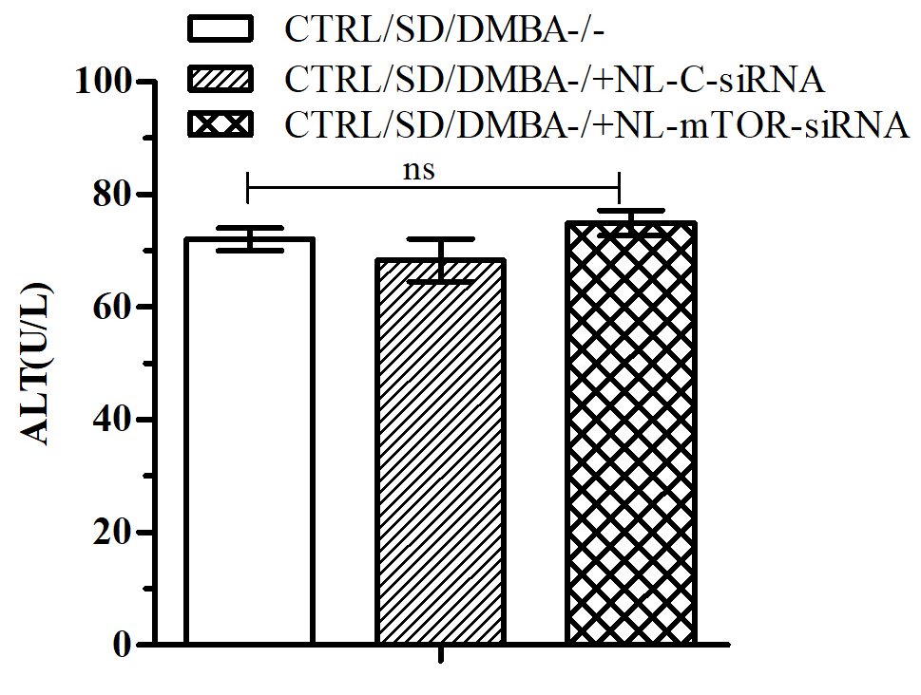
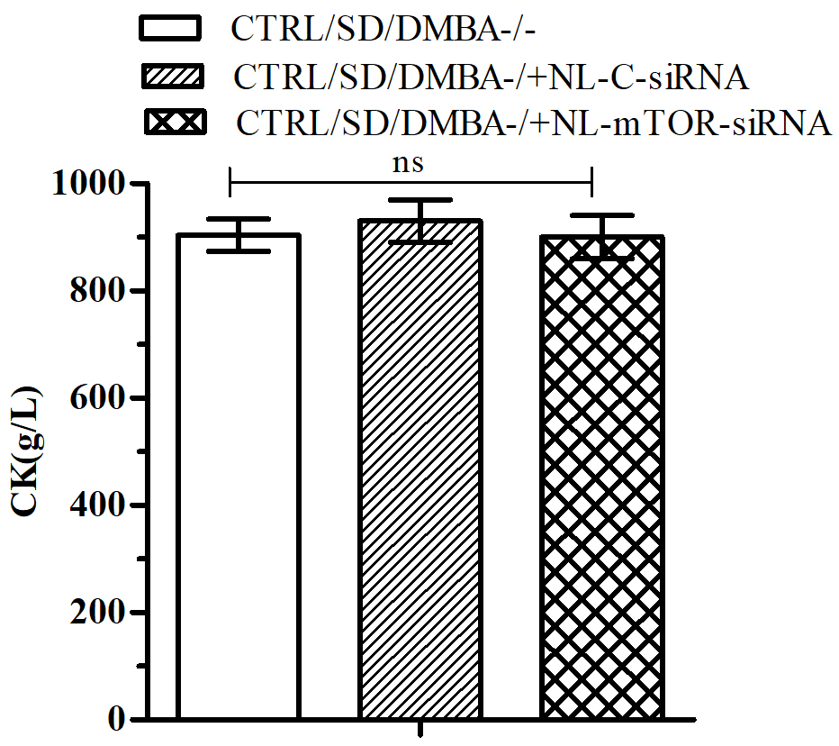
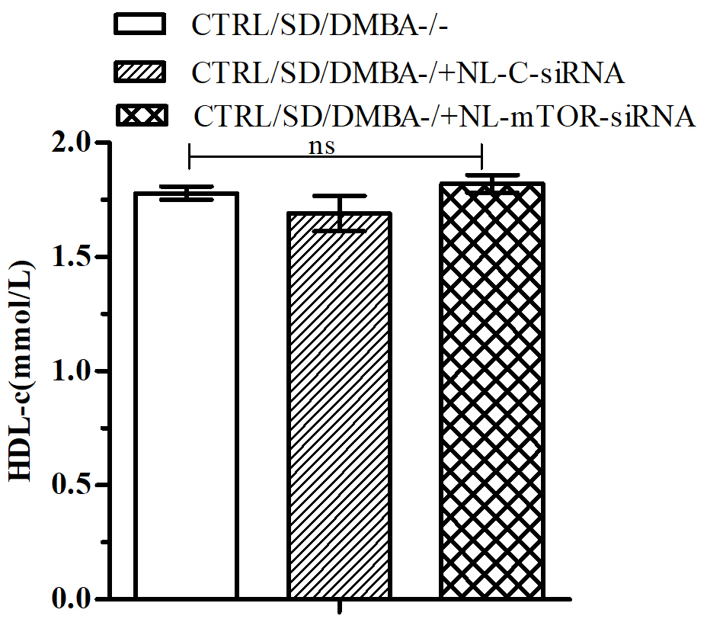
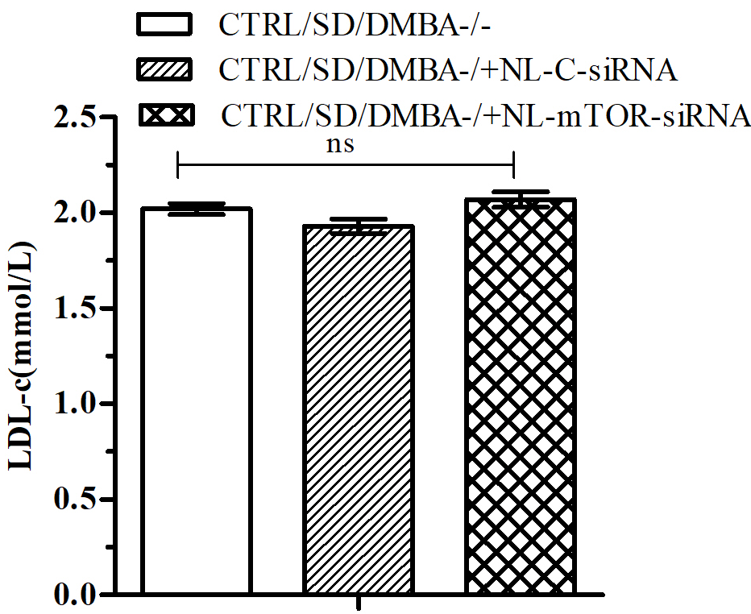
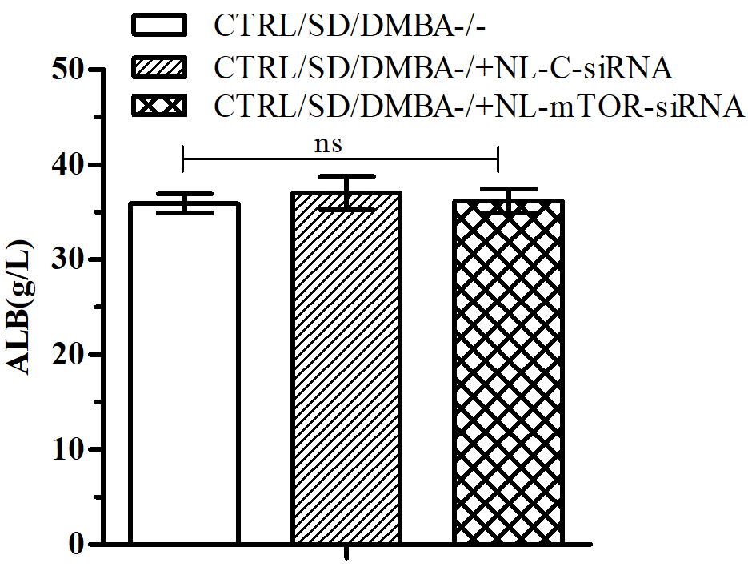
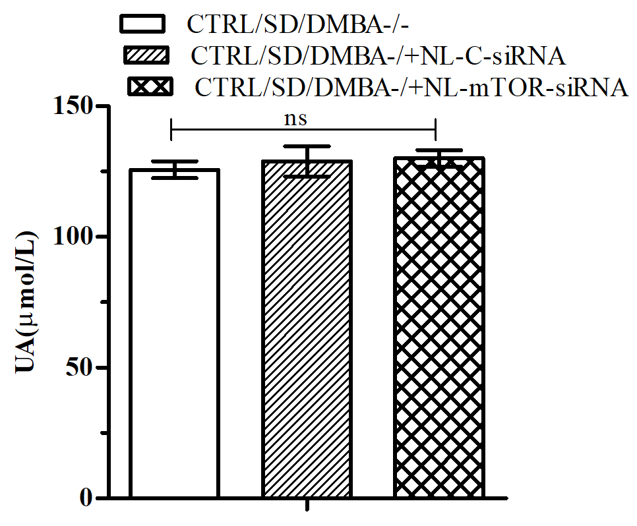
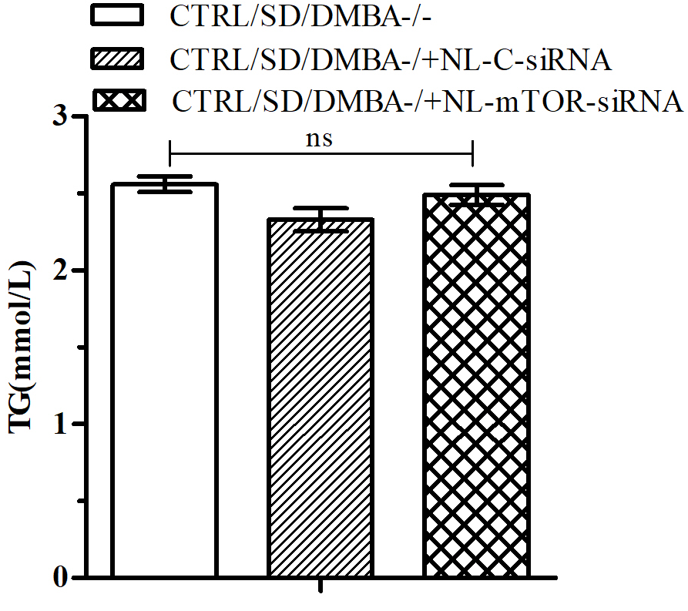
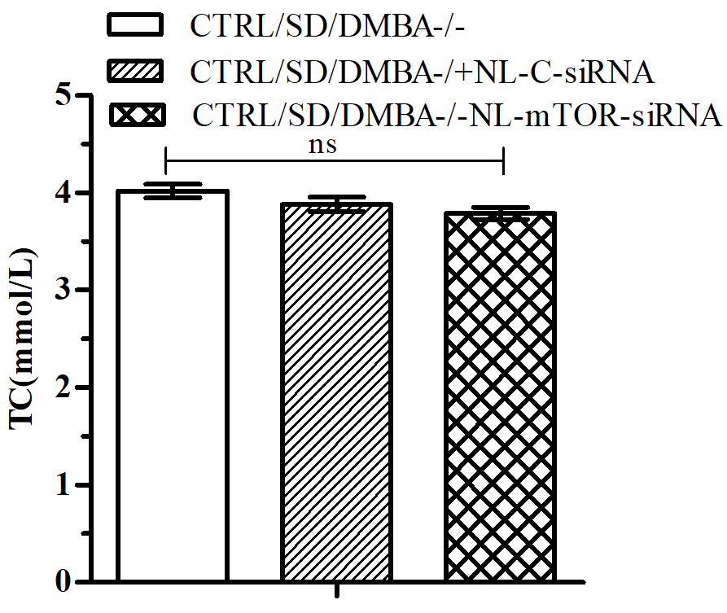
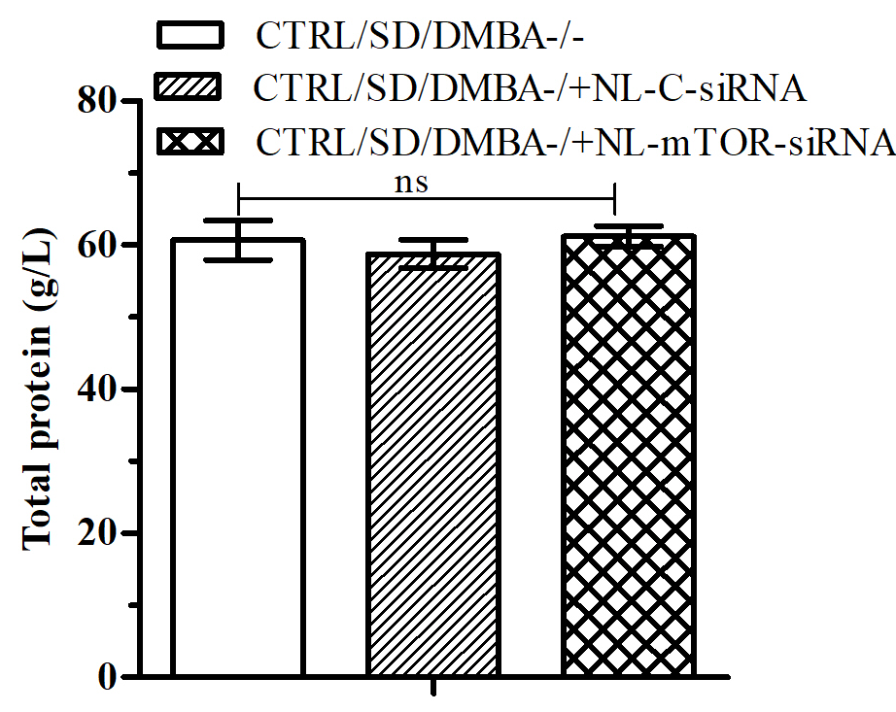
Supplementary Figure 6

