Slide 1
NOZ cells
OCUG-1 cells
Cultured in Exo-free FBS for 24 h
Conditioned medium
Conditioned medium
Conditioned medium
Conditioned medium
Ultracentrifugation-based method
EV isolation
EV isolation
EV isolation
EV isolation
Protein extraction and Trypsin digestion
Protein extraction and Trypsin digestion
Protein extraction and Trypsin digestion
Protein extraction and Trypsin digestion
114
115
iTRAQ labeling
116
117
Pooling of all the four labeled samples
Nano RP-LC-MS/MS analysis
Protein identification
Supplementary Figure. S1
Flow chart showing the experimental design for identification of EV proteins in GBC cell lines. EV- Extracellular vesicles ; GBC- Gallbladder carcinoma. NOZ and OCUG-1 are GBC cell lines.

Slide 2
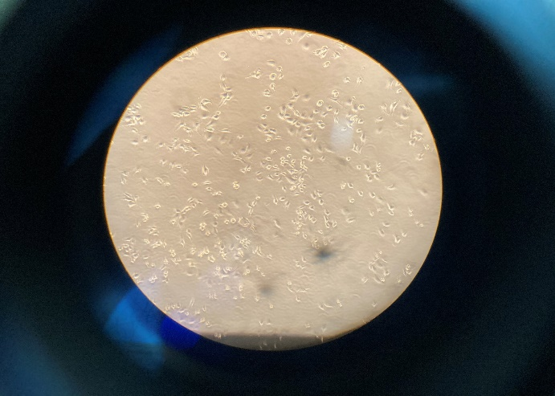
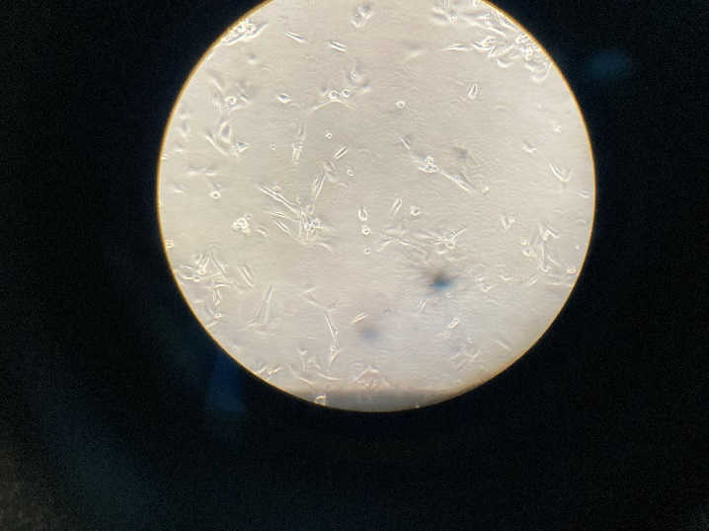
(A)
(C)
MW ladder
kD
EV protein
Cell lysate
NOZ
OCUG-1
NOZ
OCUG-1
150
100
75
50
37
25
15
10
(B)
Supplementary Figure. S2: Full length cell line and gel images of Figure. 2. (A) Full length images of GBC cell lines NOZ and (B) OCUG-1. (C) Full length gel image of Cell lysate and EVs. The cropping of the Cell line and gel images are marked with red dashed line.

