Slide 1
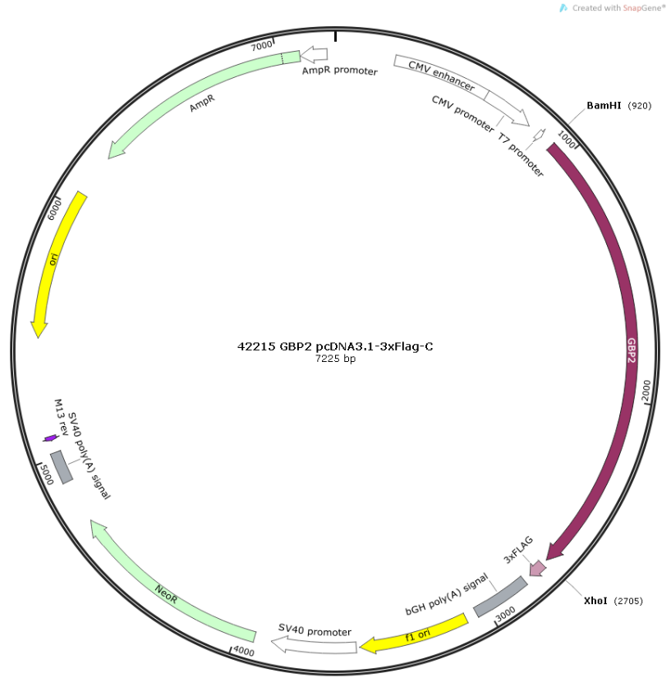
Figure S1. GBP2 expression plasmid structure

Slide 2
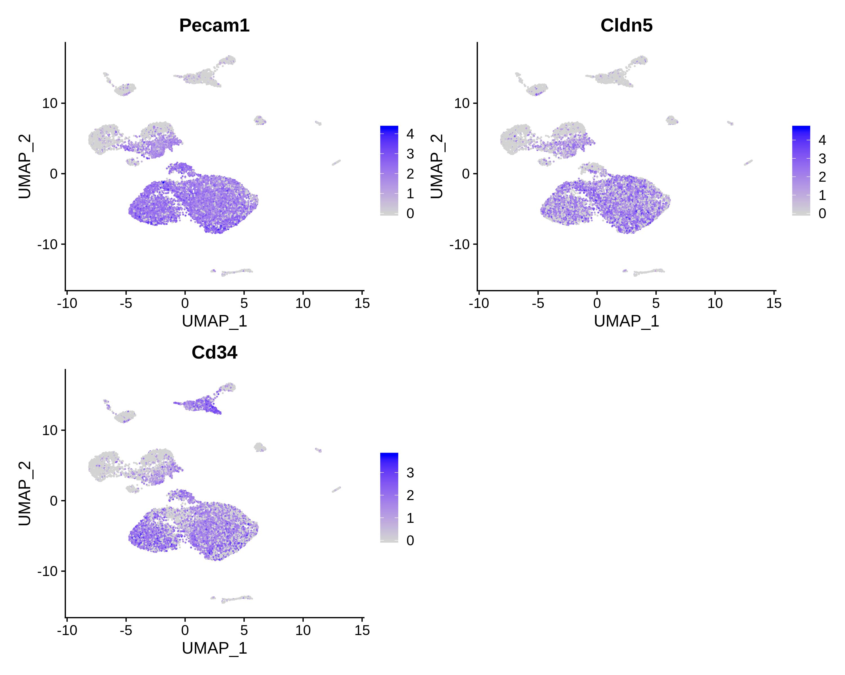
Figure S2A. Marker gene expression in each cell type: Endothelial1

Slide 3
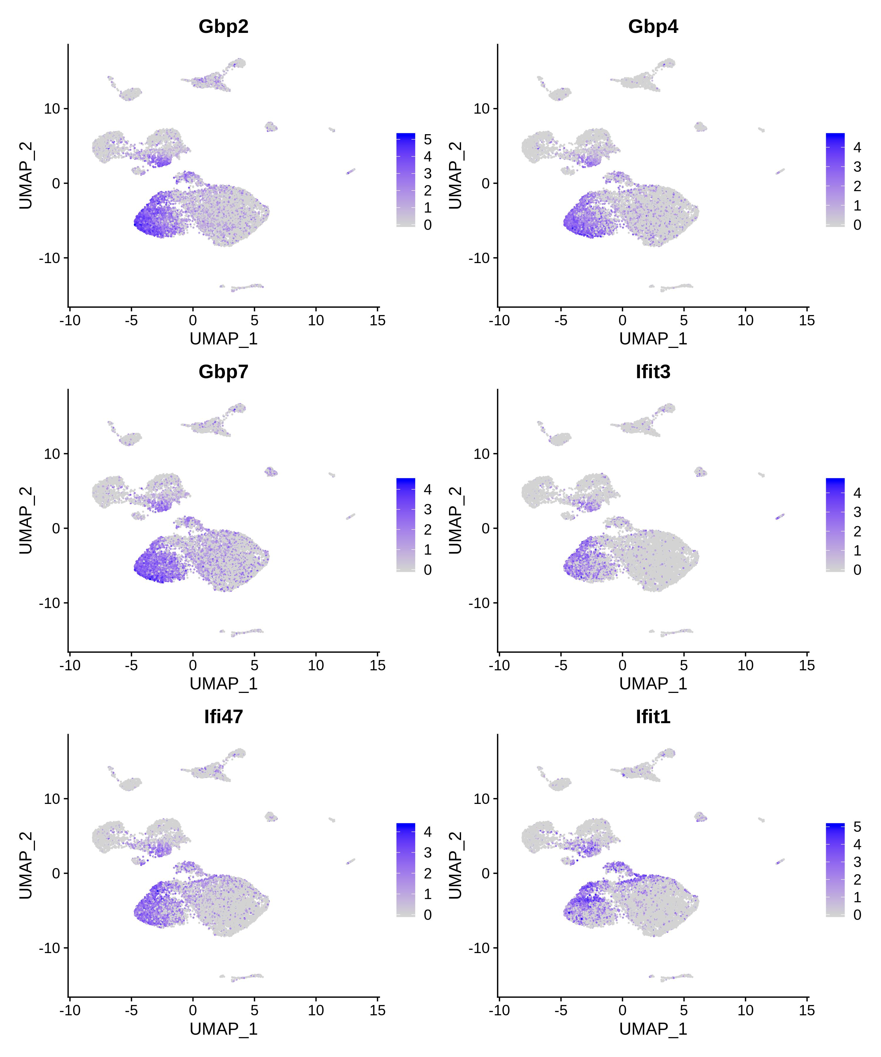
Figure S2B. Marker gene expression in each cell type: Endothelial2

Slide 4
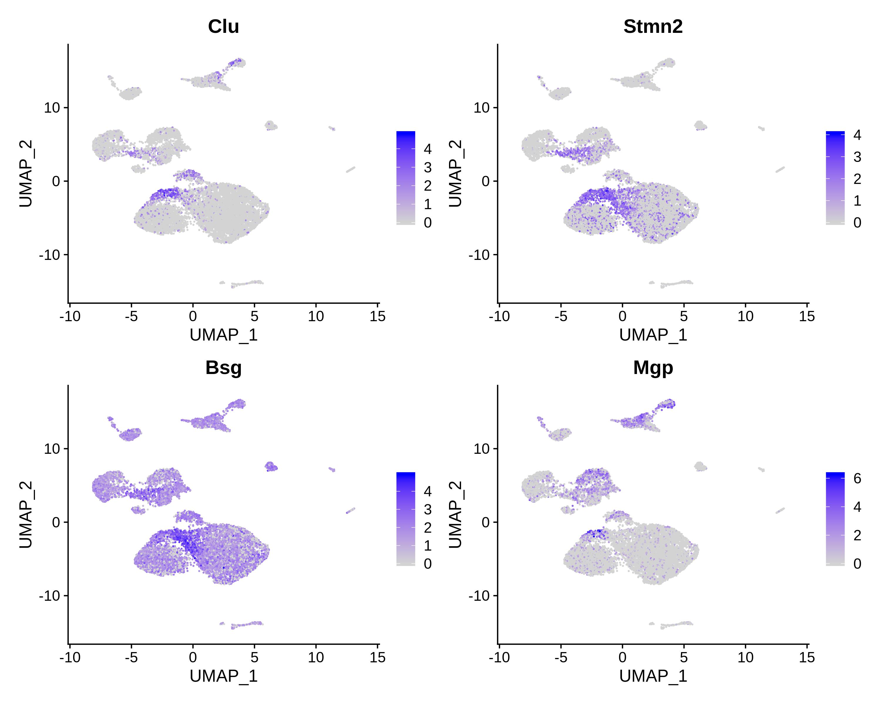
Figure S2C. Marker gene expression in each cell type: Endothelial3

Slide 5
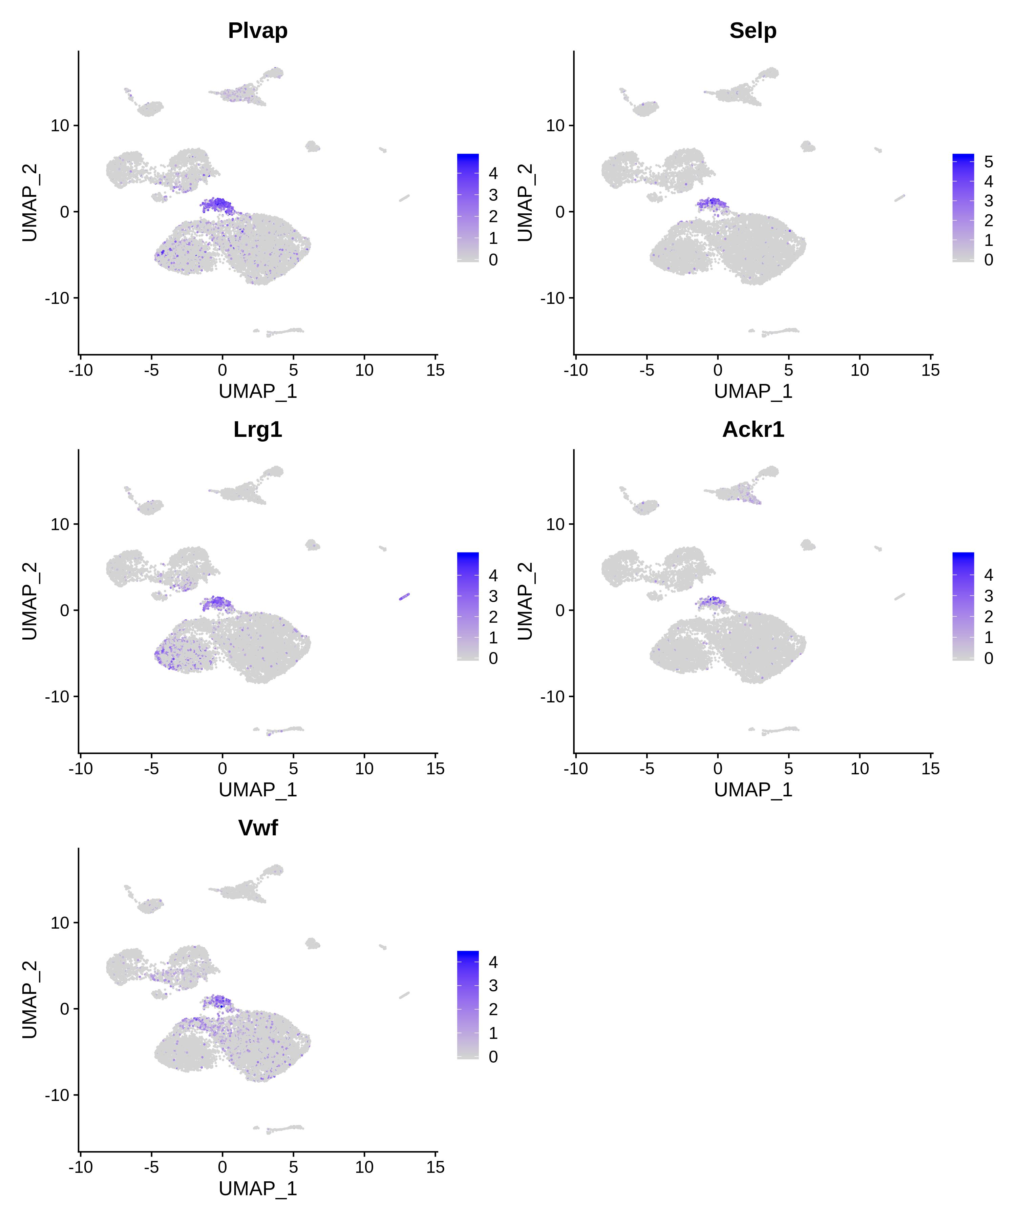
Figure S2D. Marker gene expression in each cell type: Endothelial4

Slide 6
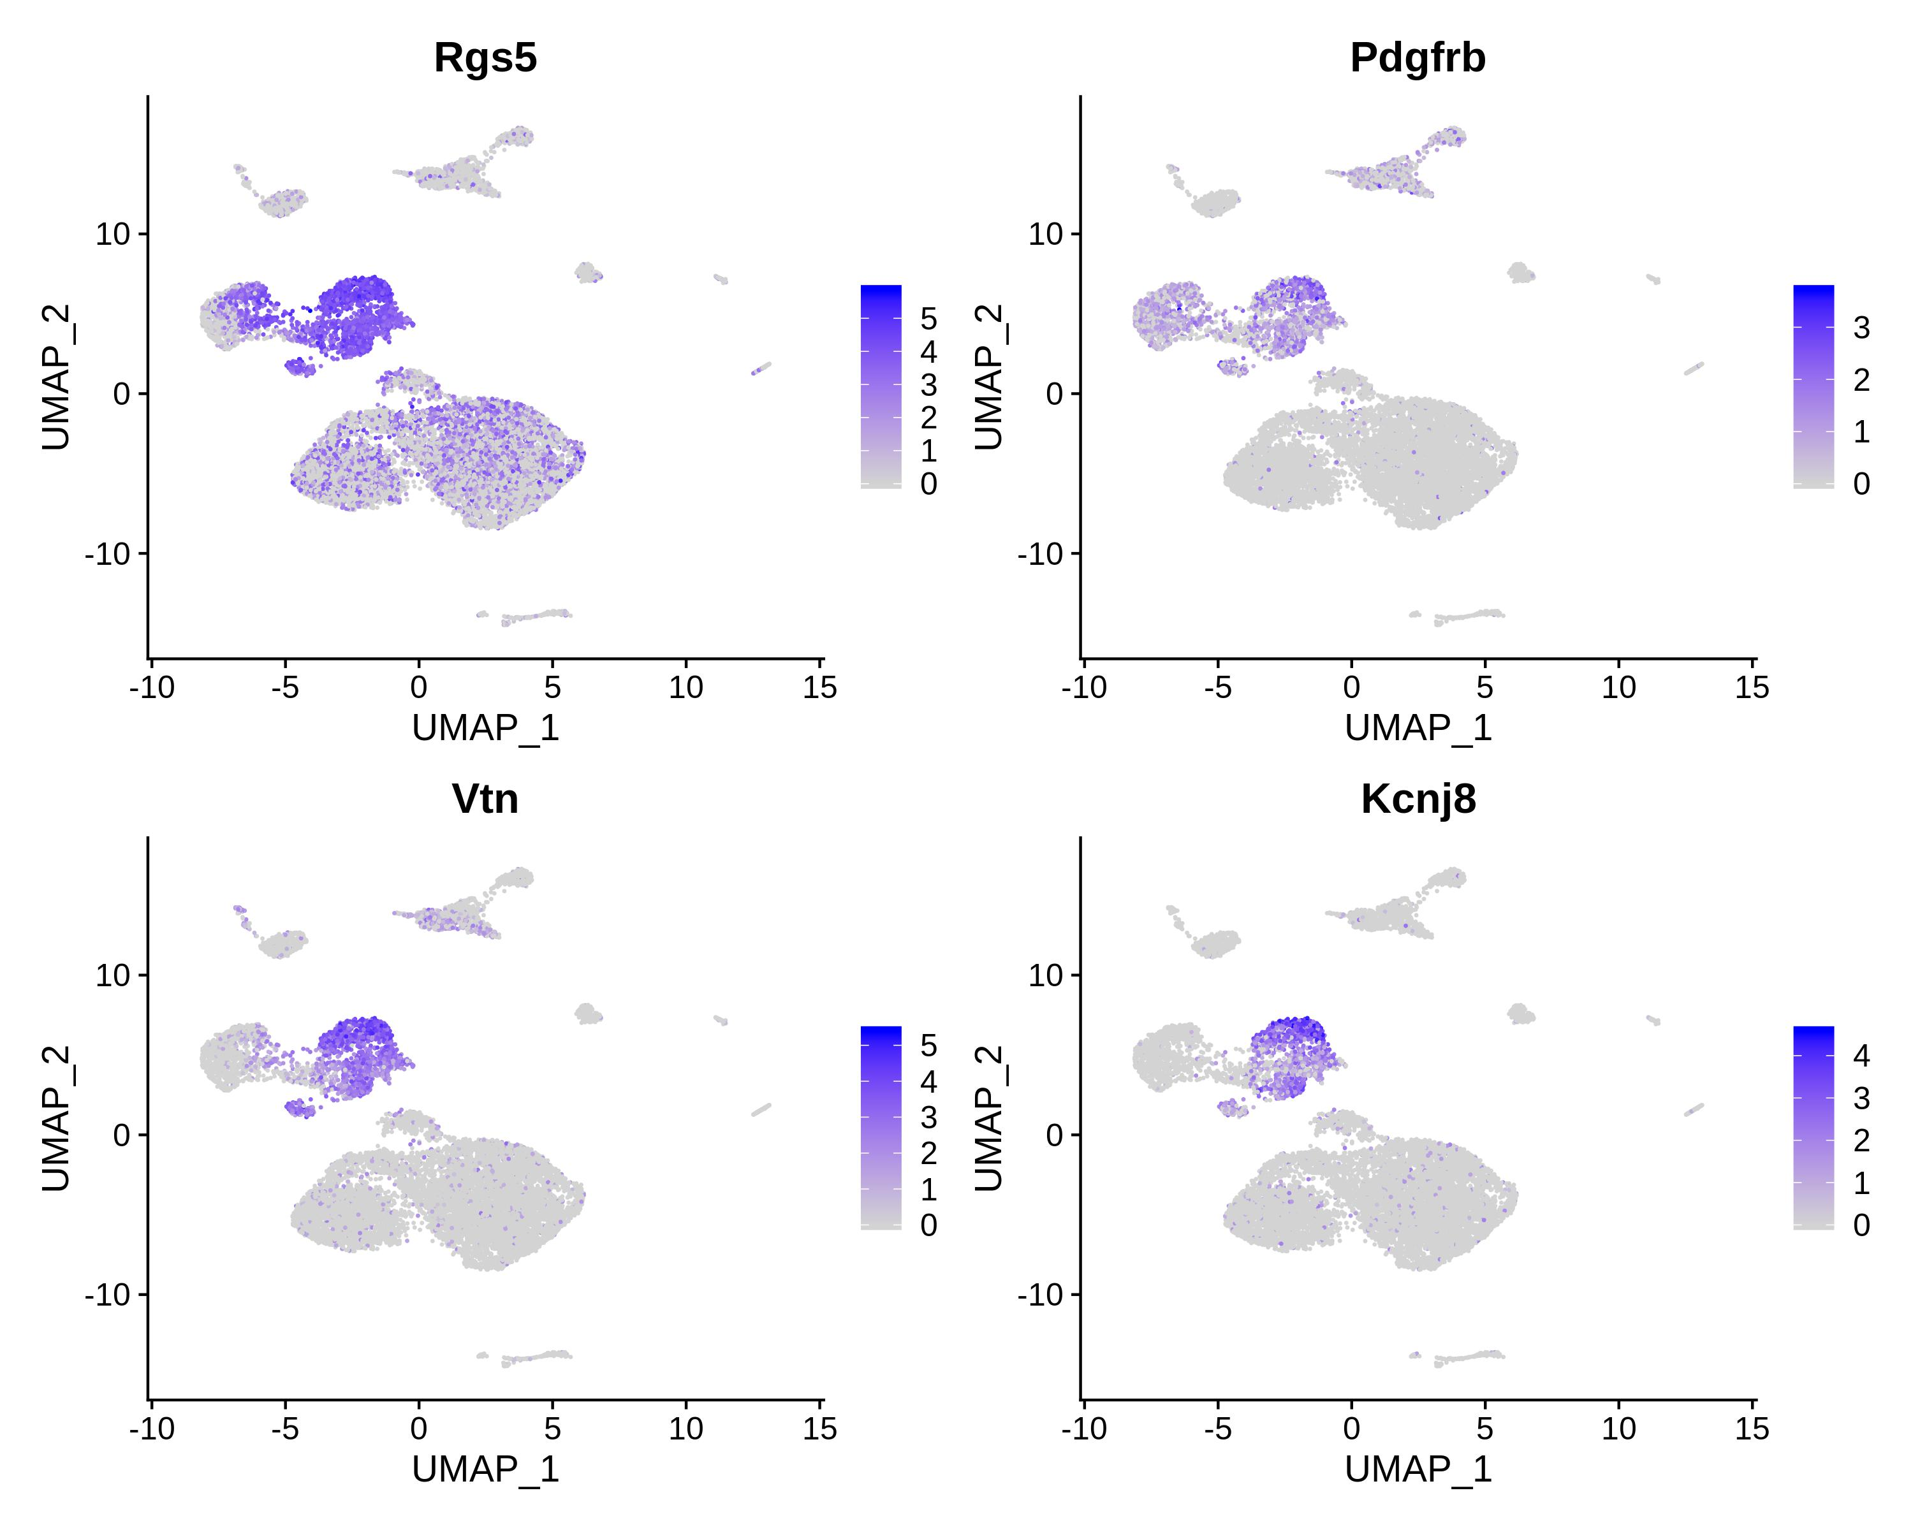
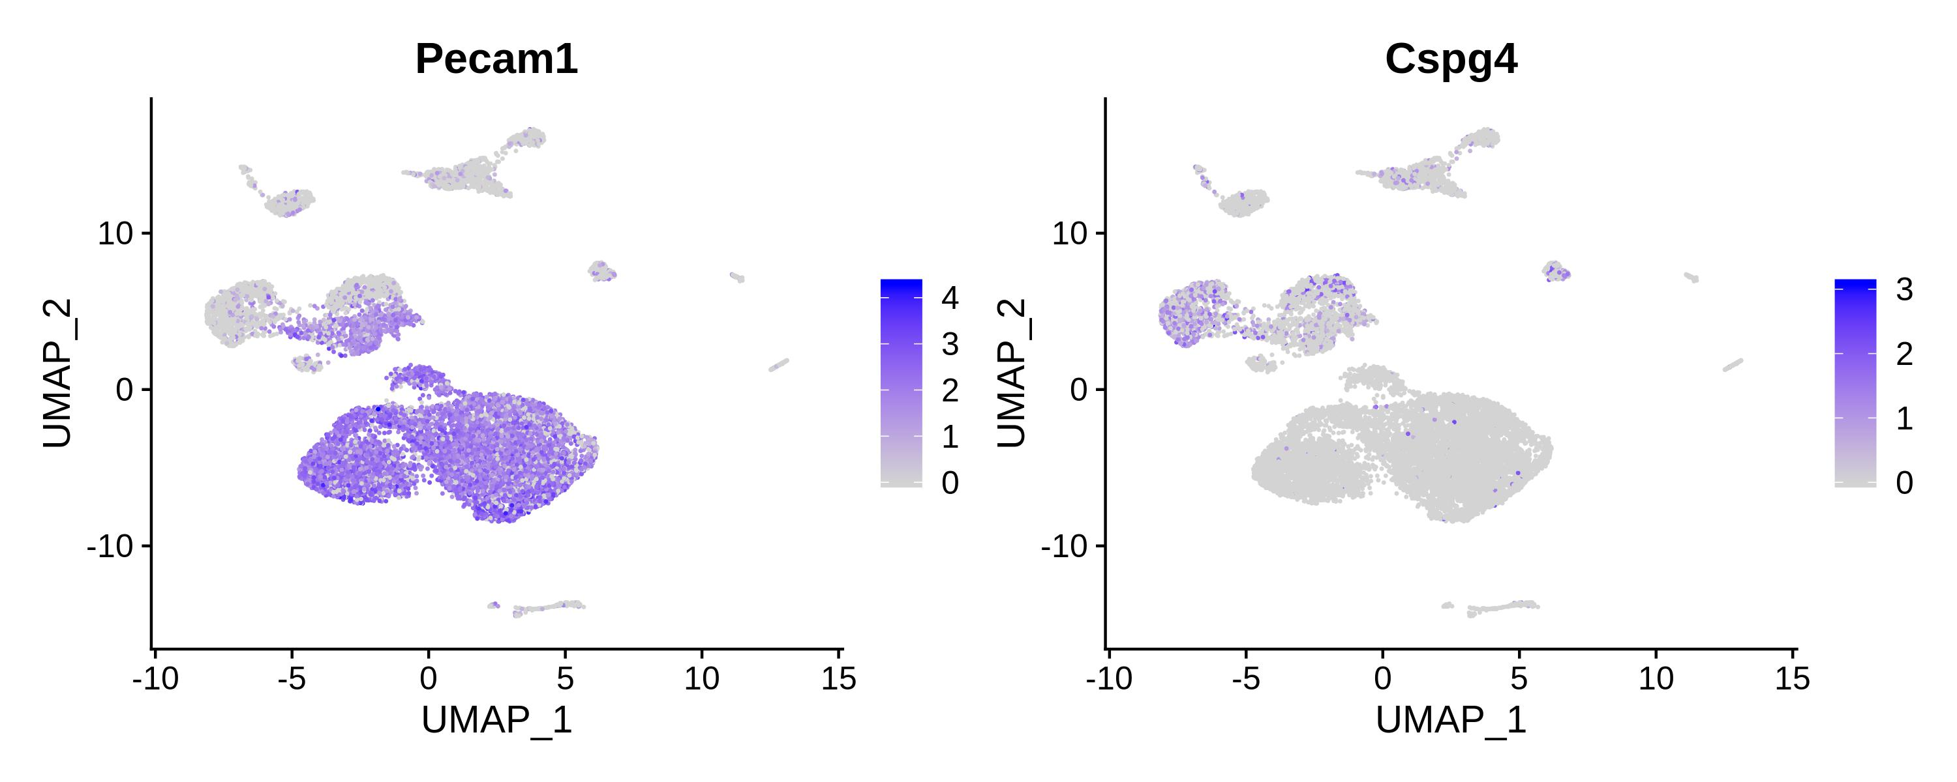
Figure S2E. Marker gene expression in each cell type: Pericyte

Slide 7
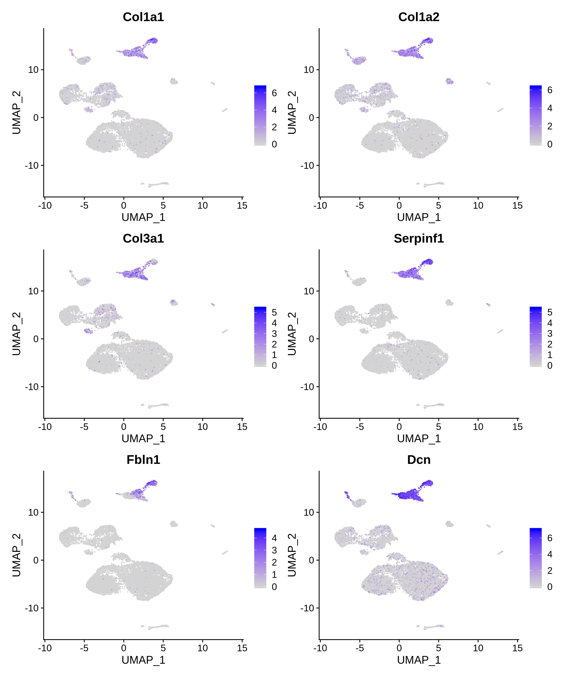
Figure S2F. Marker gene expression in each cell type: Fibroblast

Slide 8
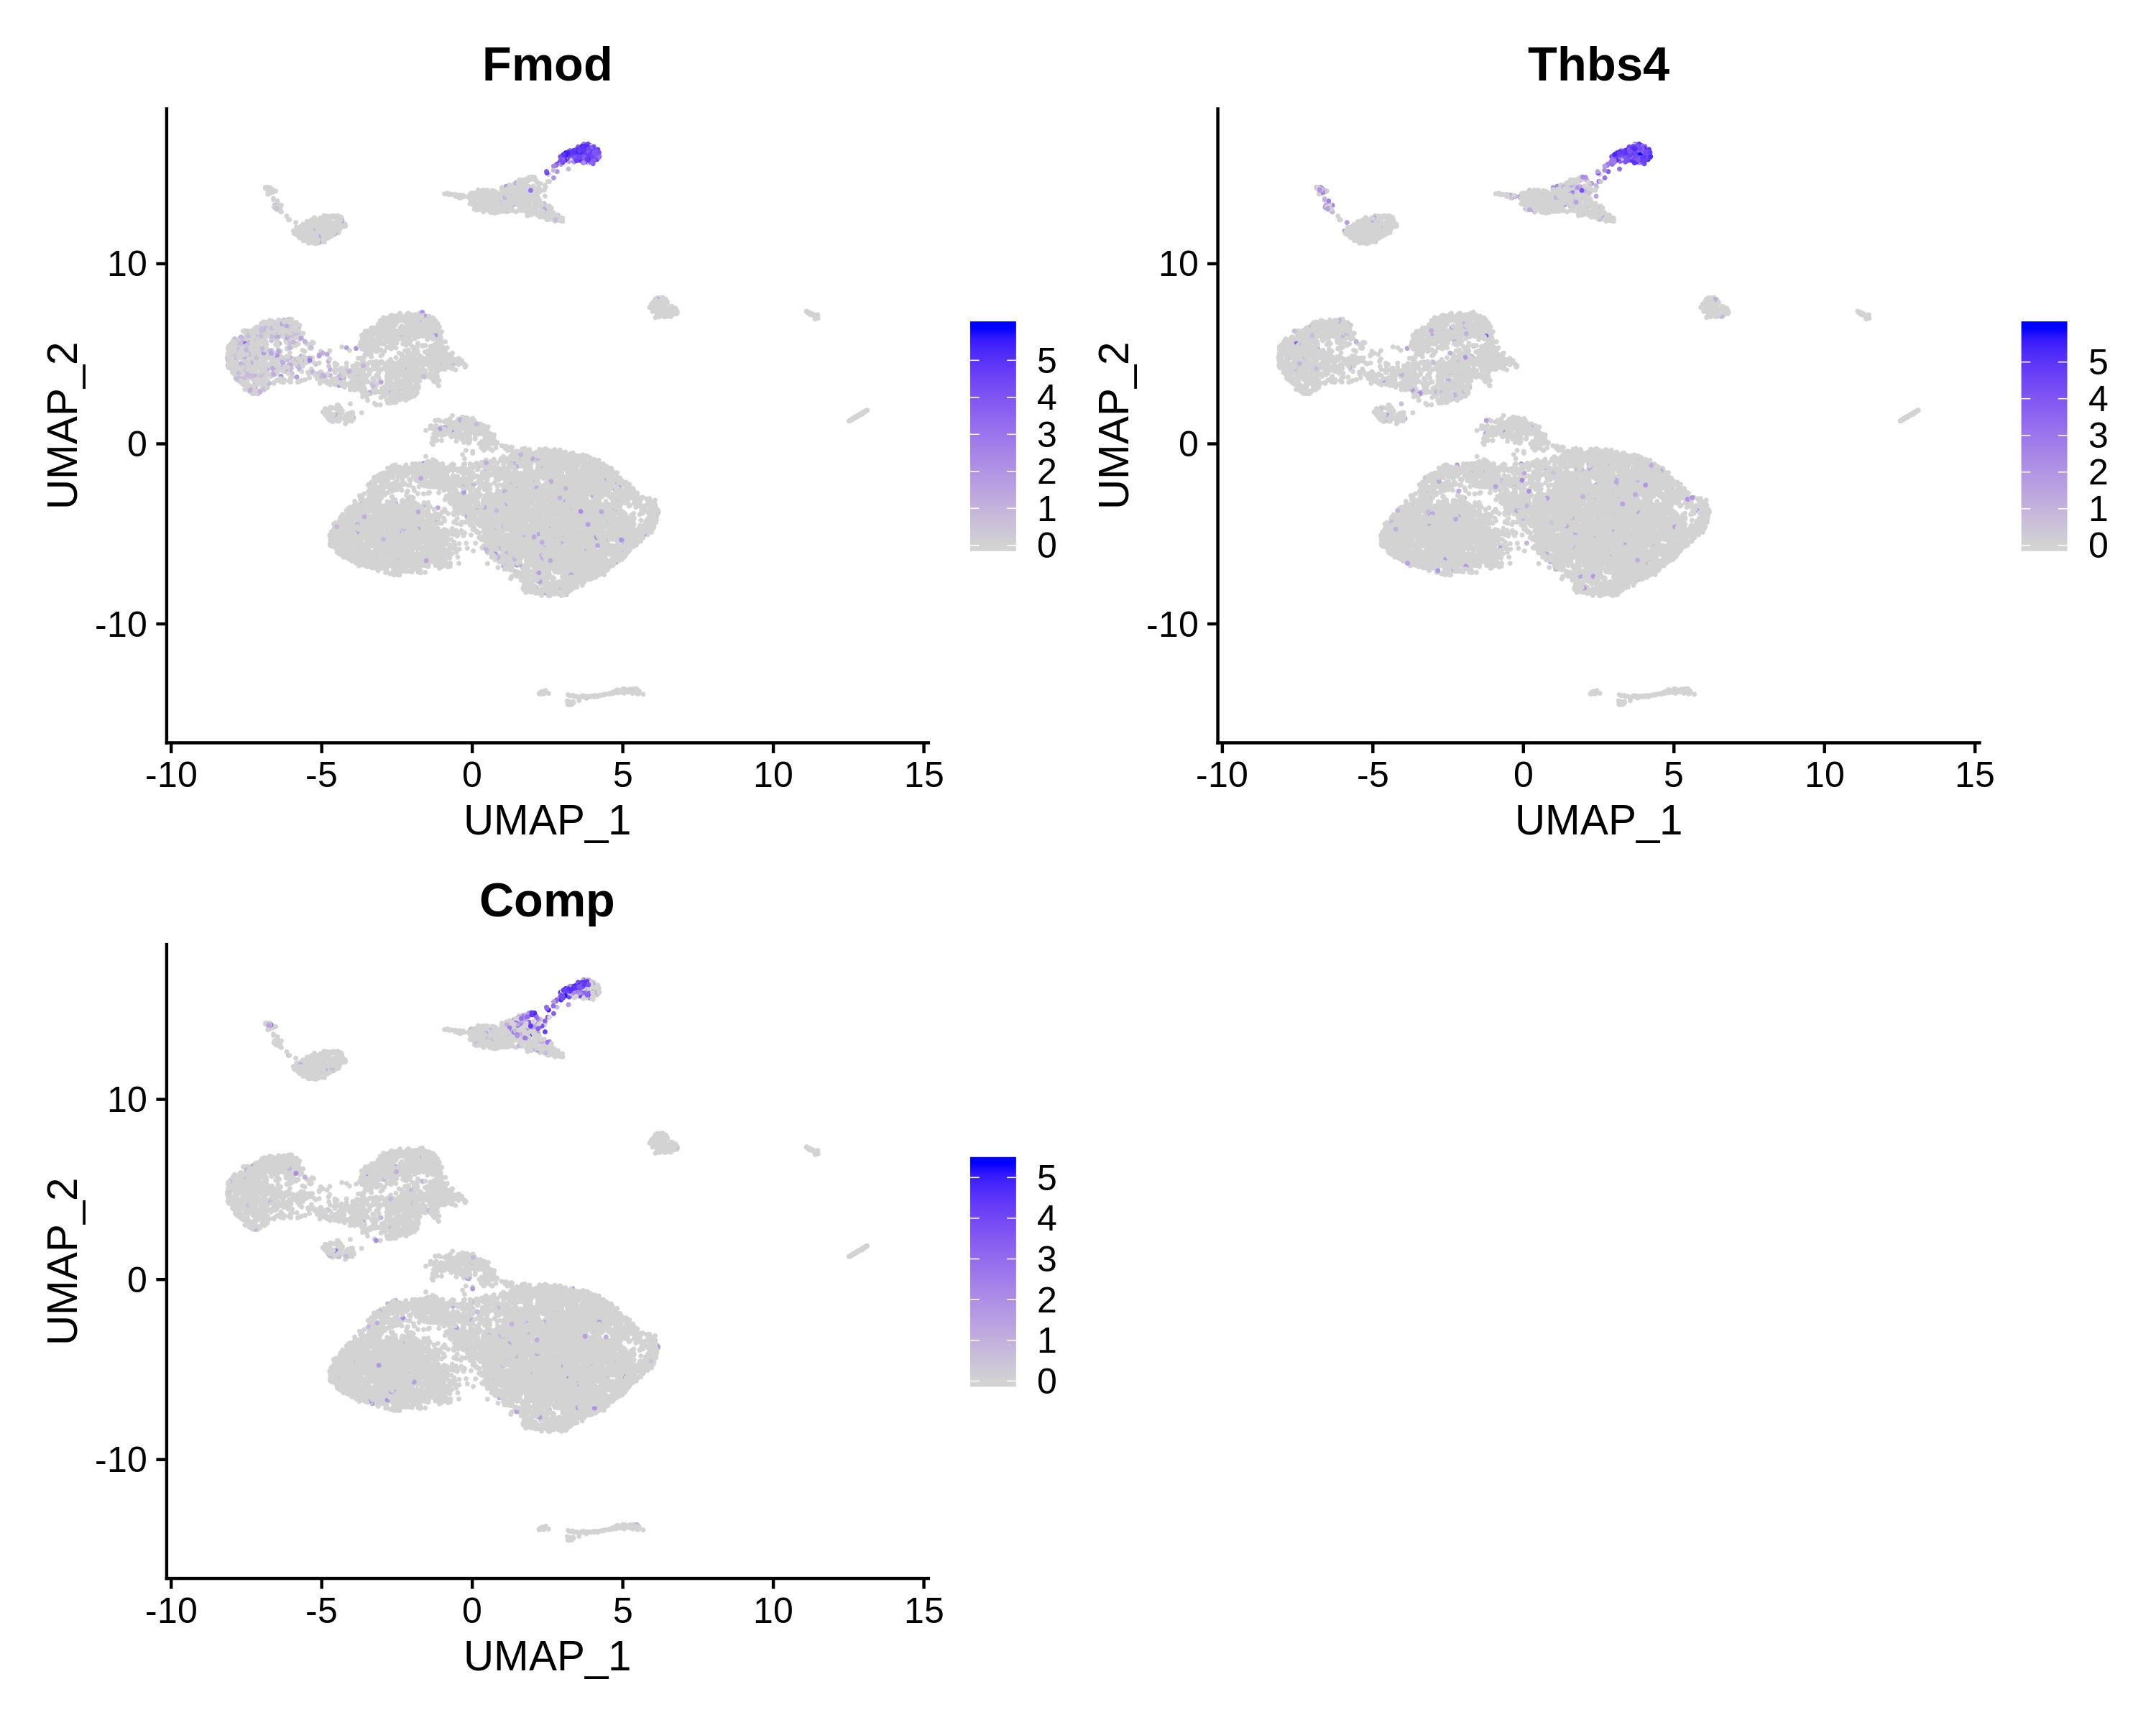
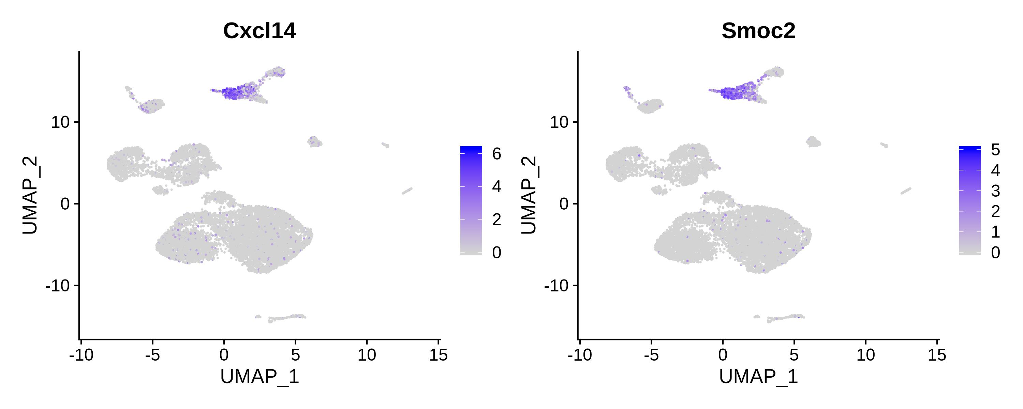
Figure S2F. Marker gene expression in each cell type: Fibroblast (cont)

Slide 9
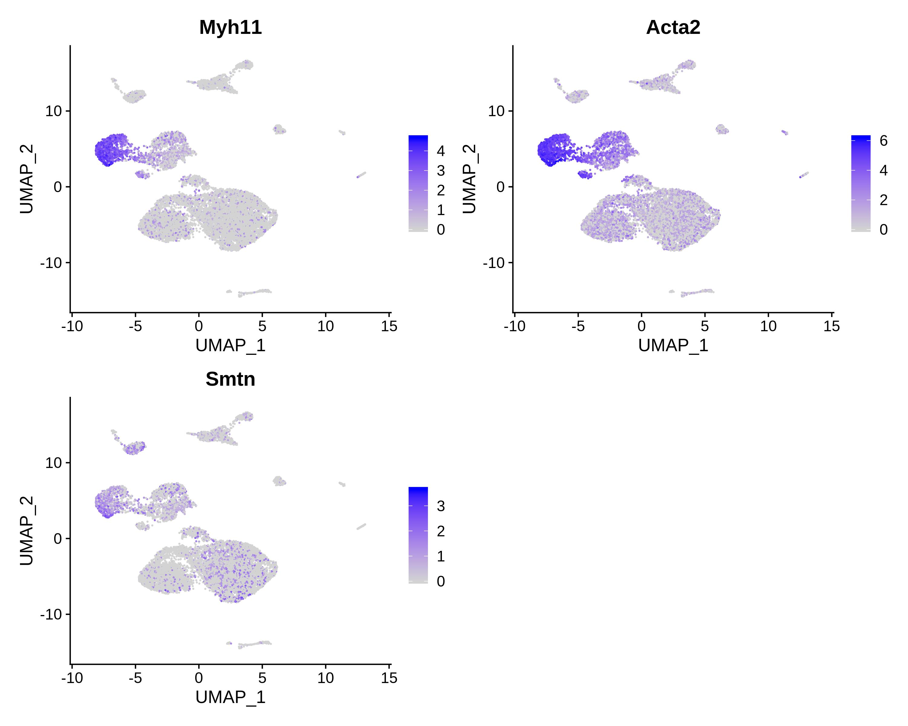
Figure S2G. Marker gene expression in each cell type: Myocyte

Slide 10
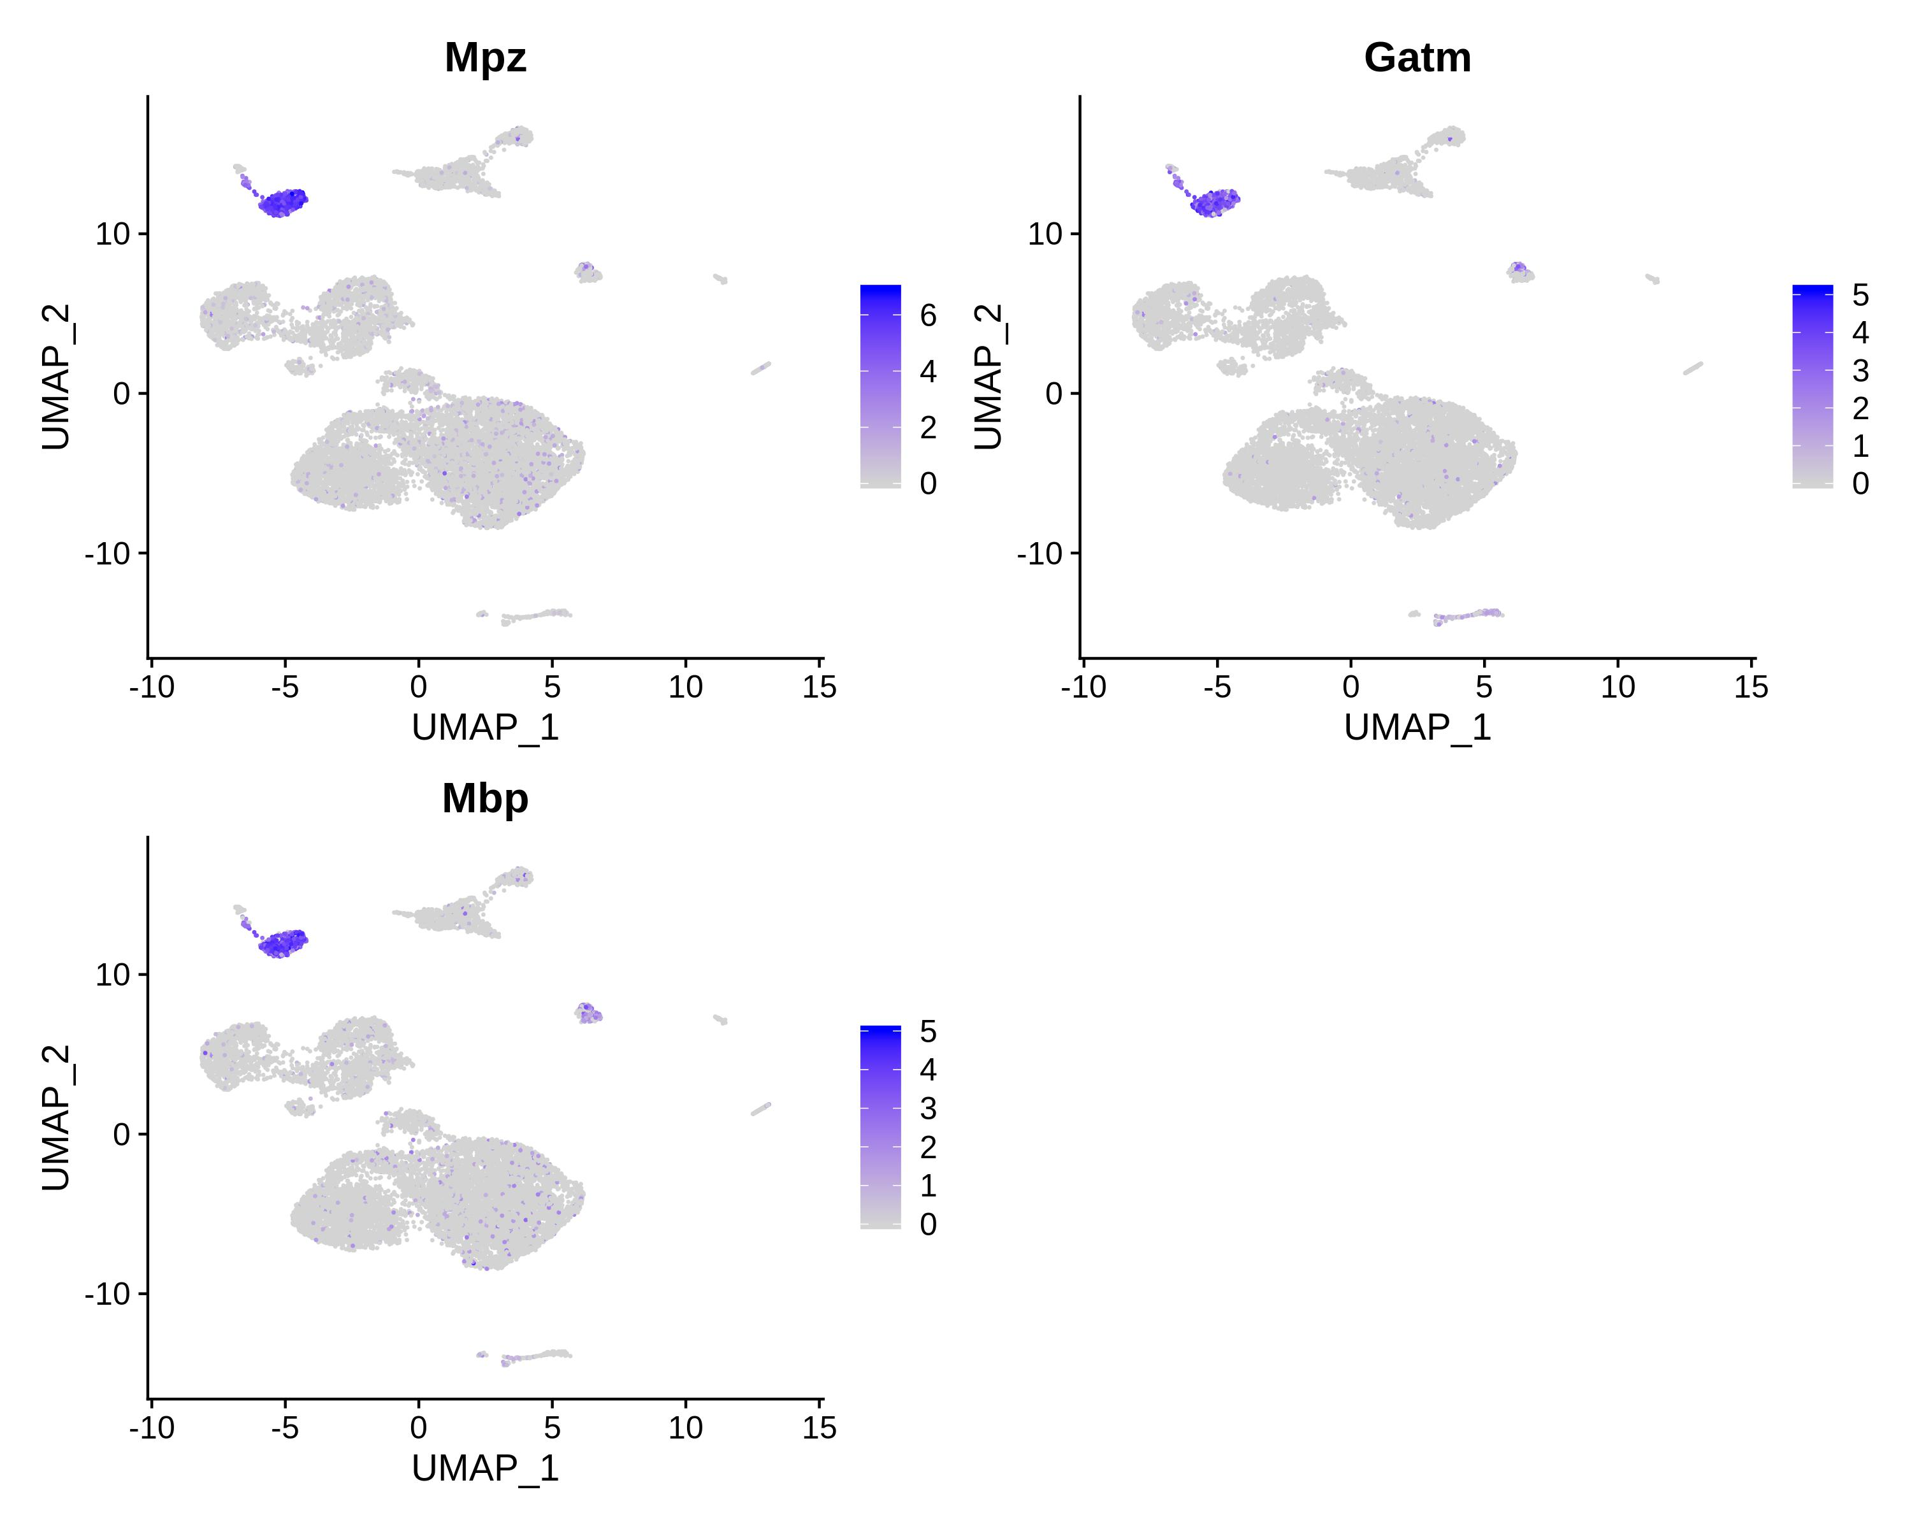
Figure S2H. Marker gene expression in each cell type: Glial

Slide 11
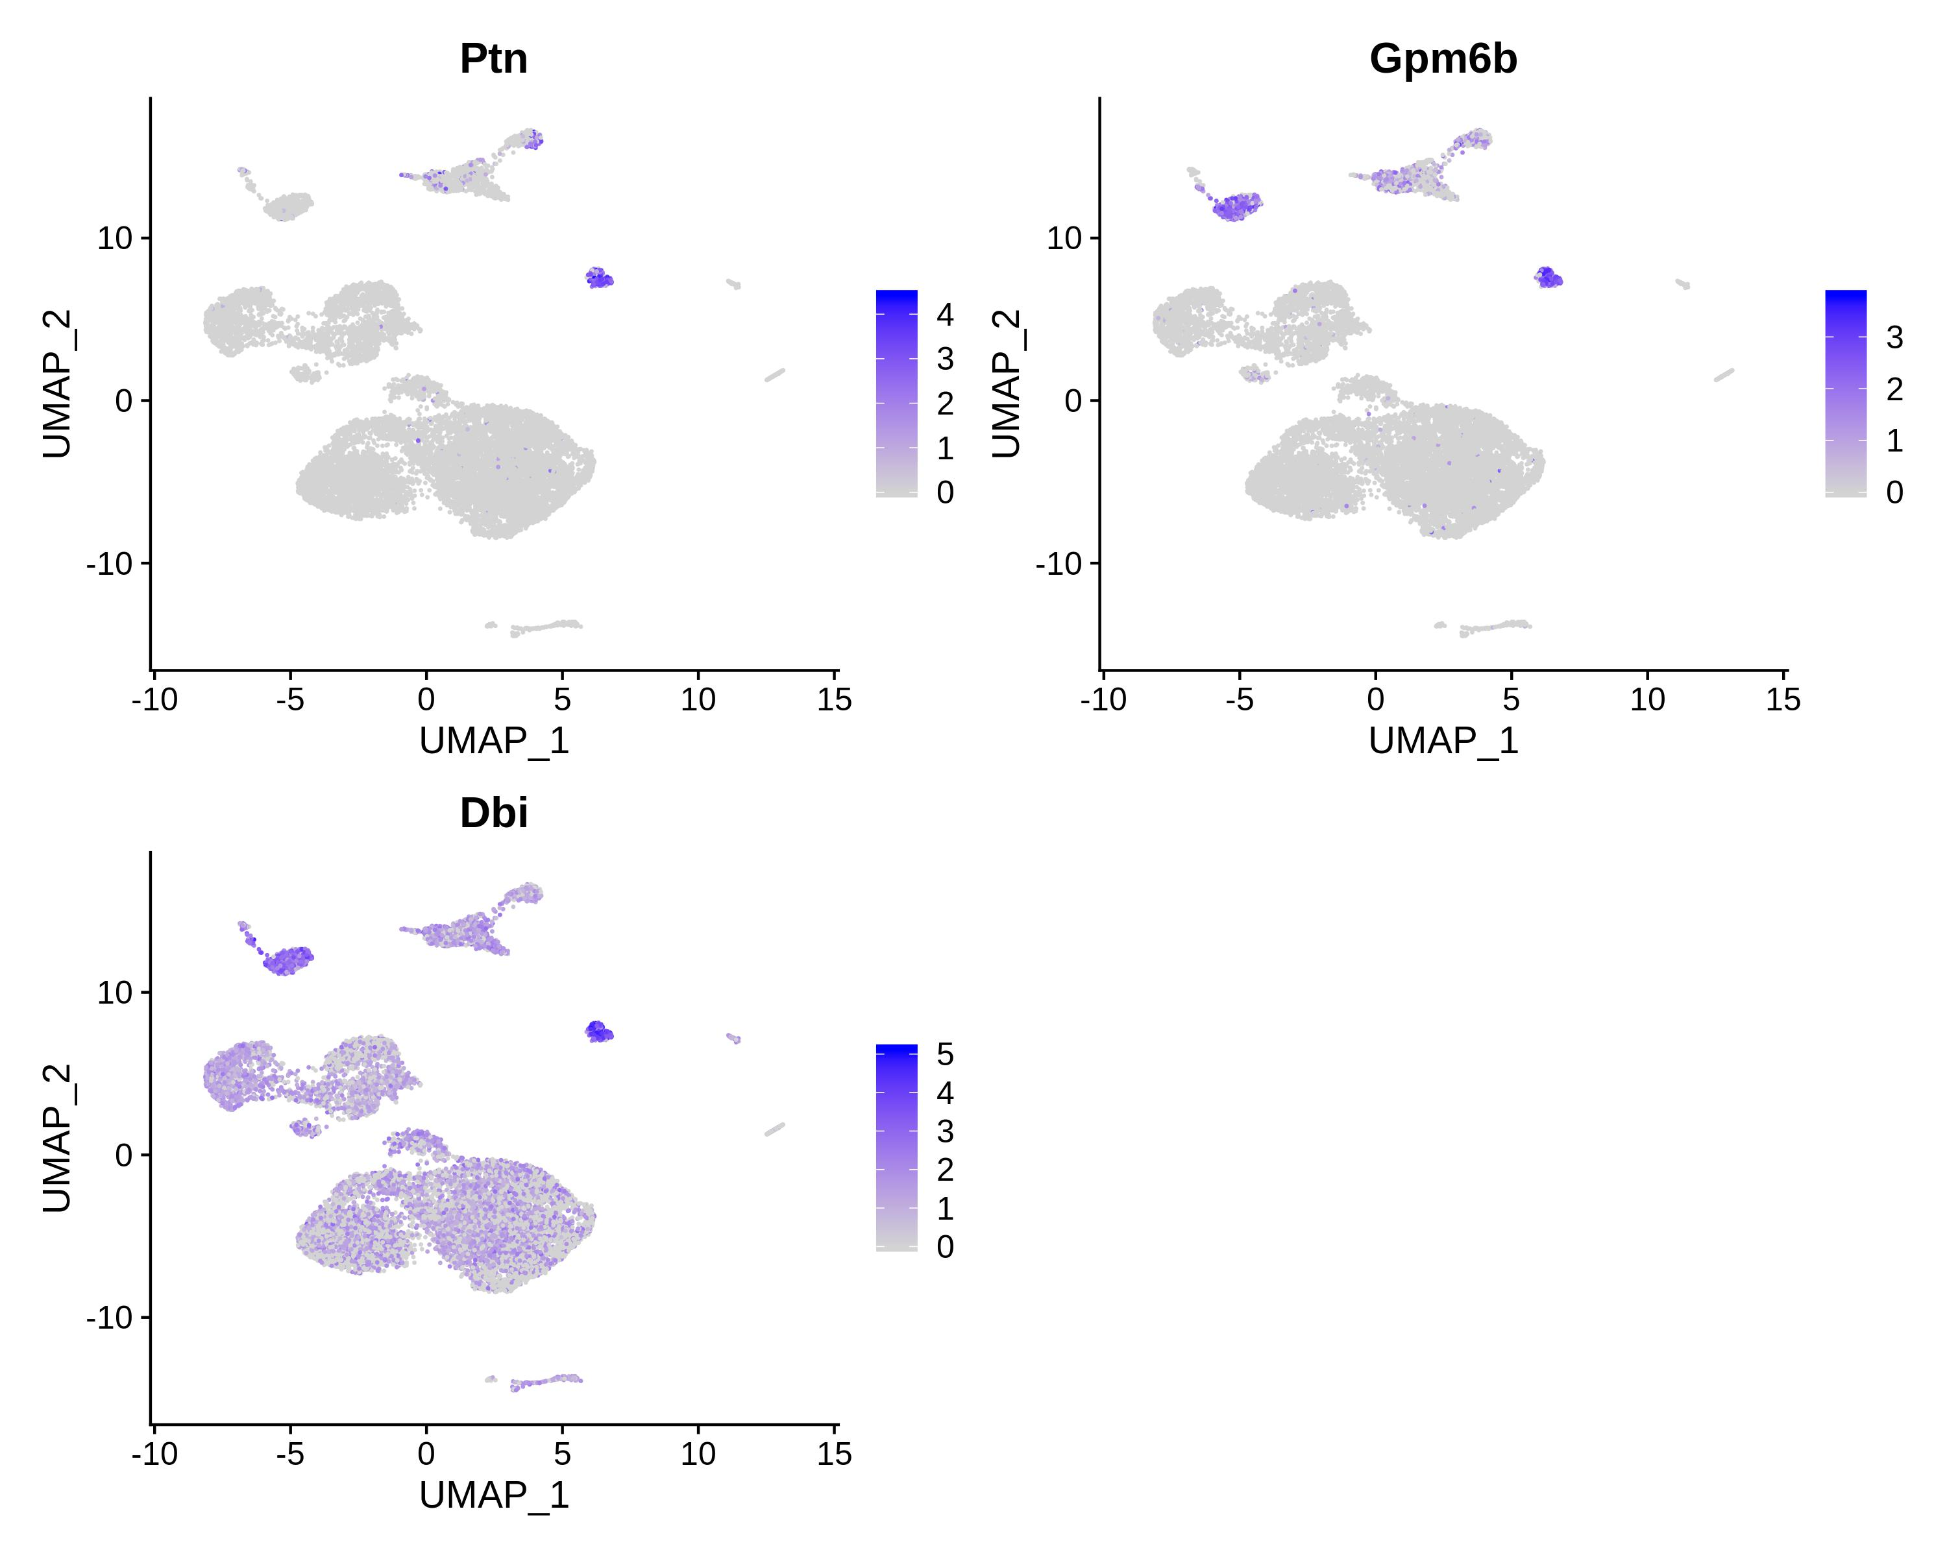
Figure S2I. Marker gene expression in each cell type: Neural

Slide 12
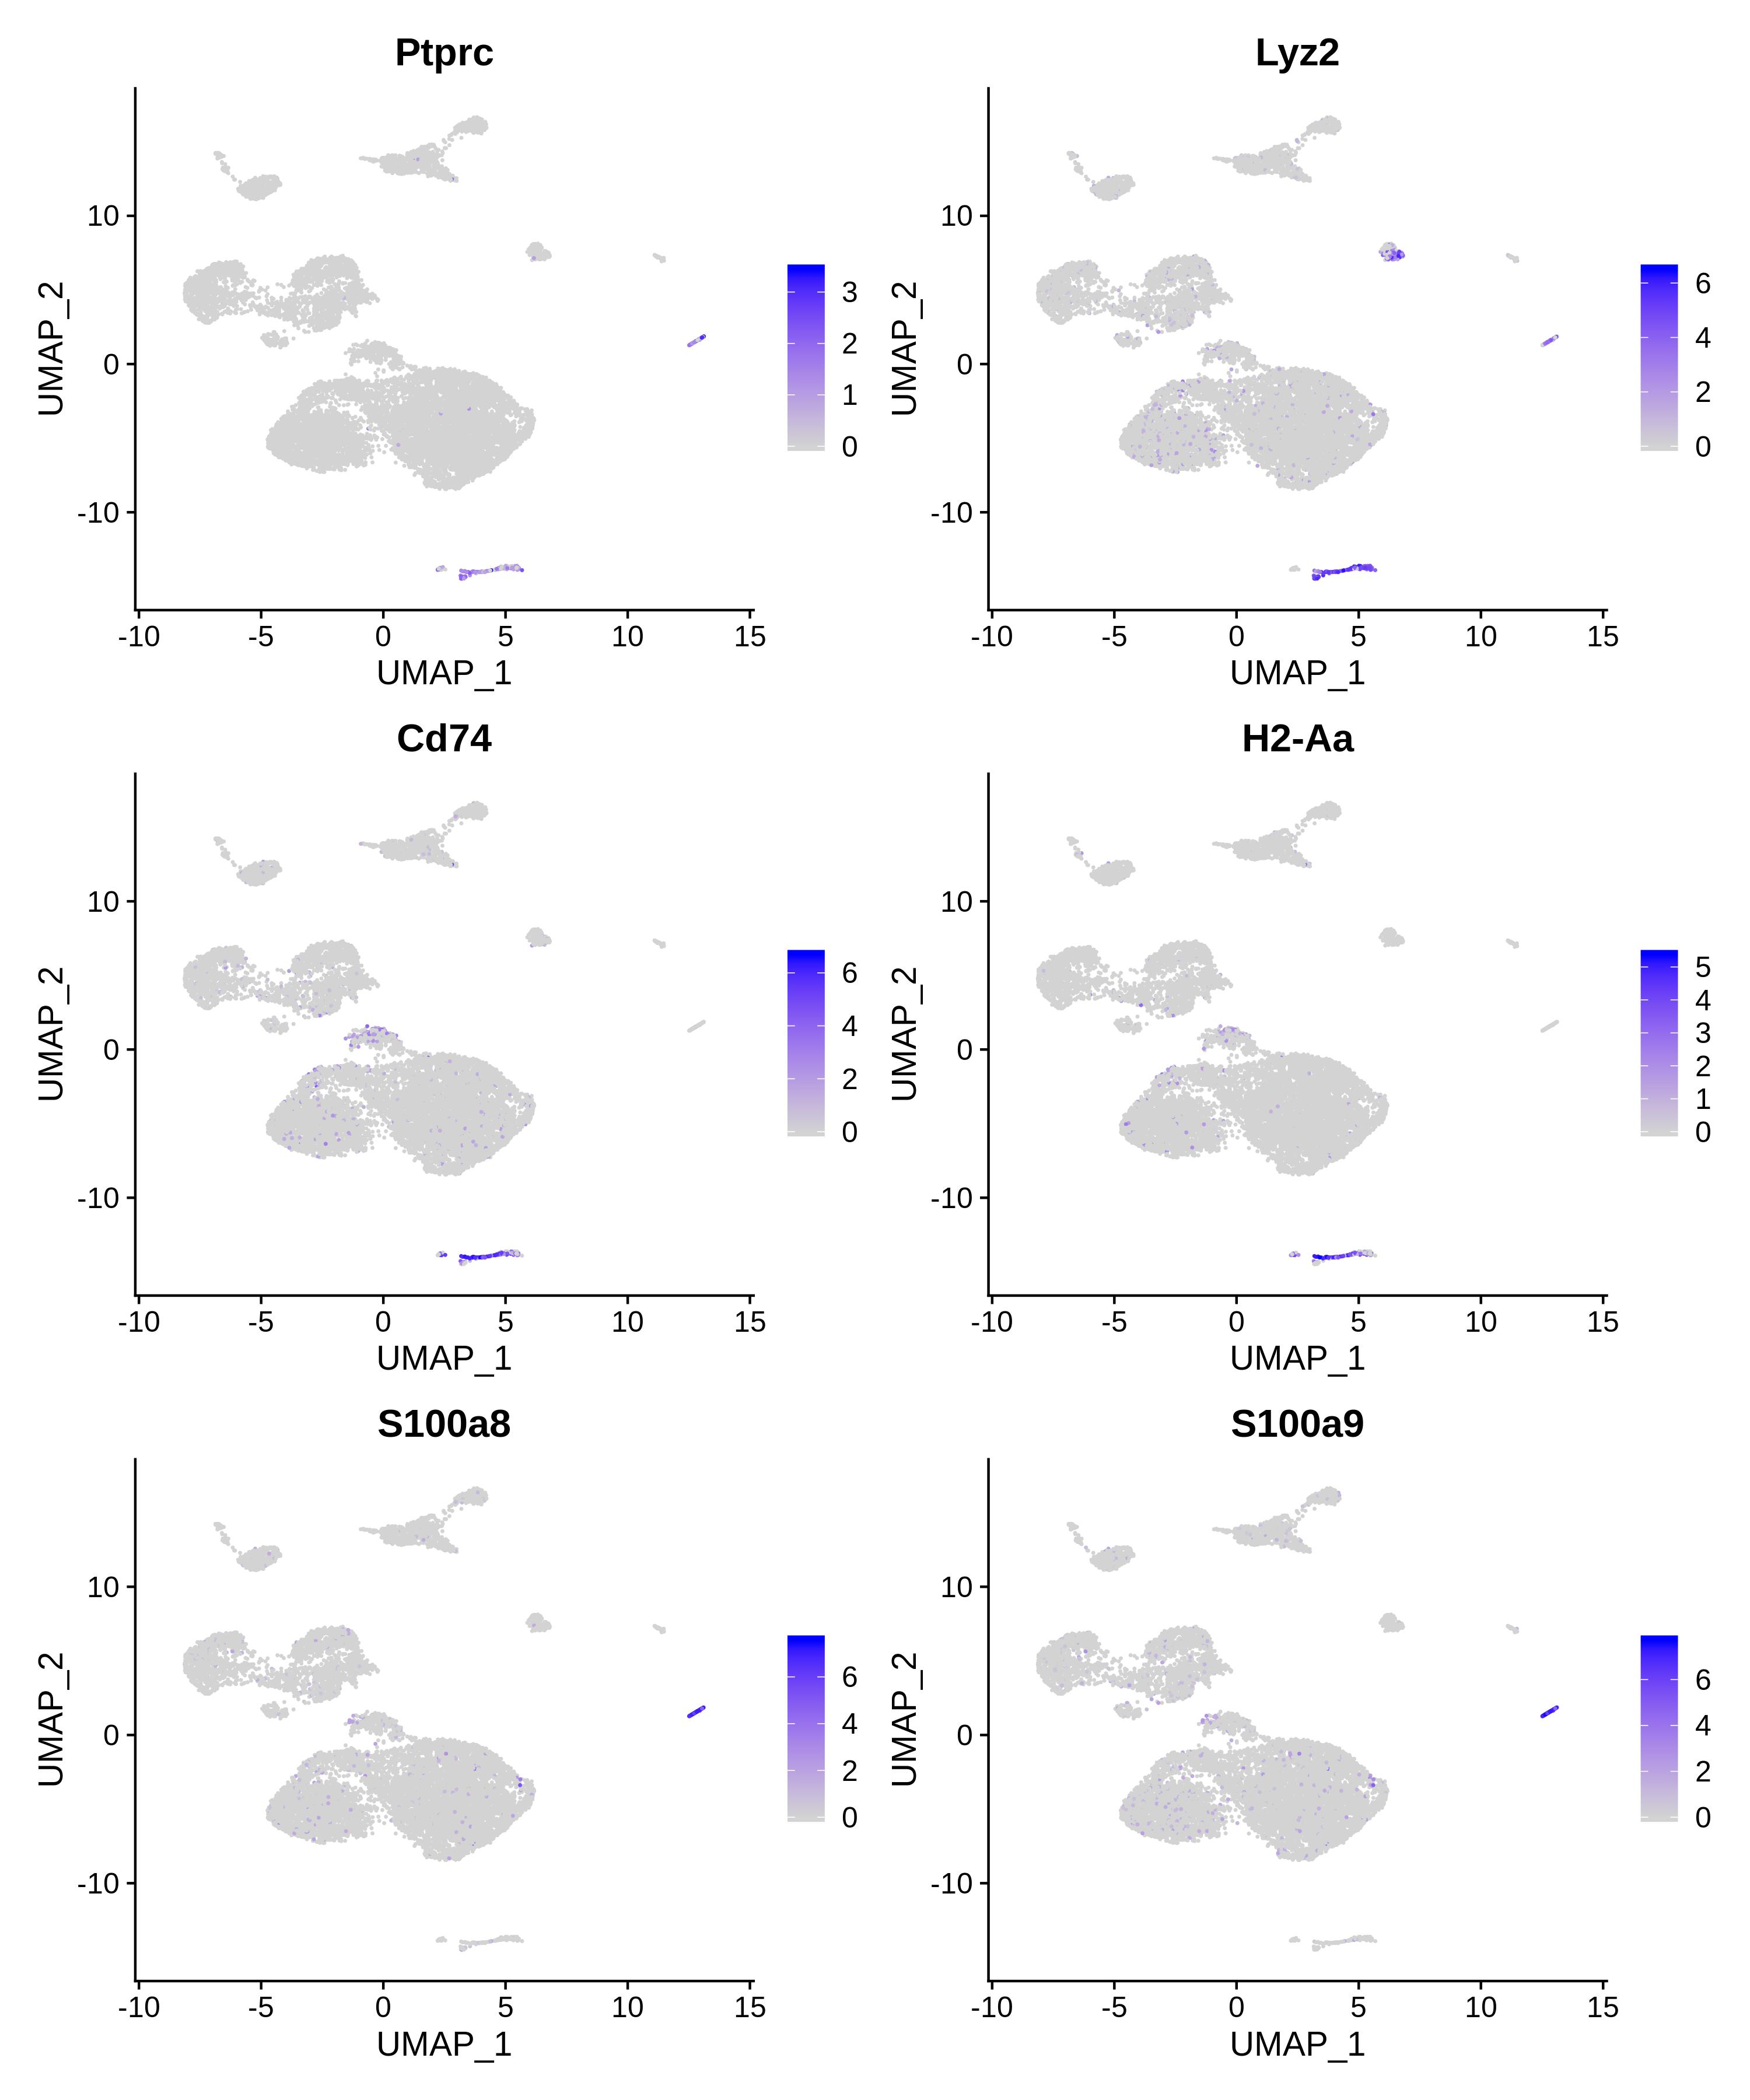
Figure S2J. Marker gene expression in each cell type: Macrophage

Slide 13
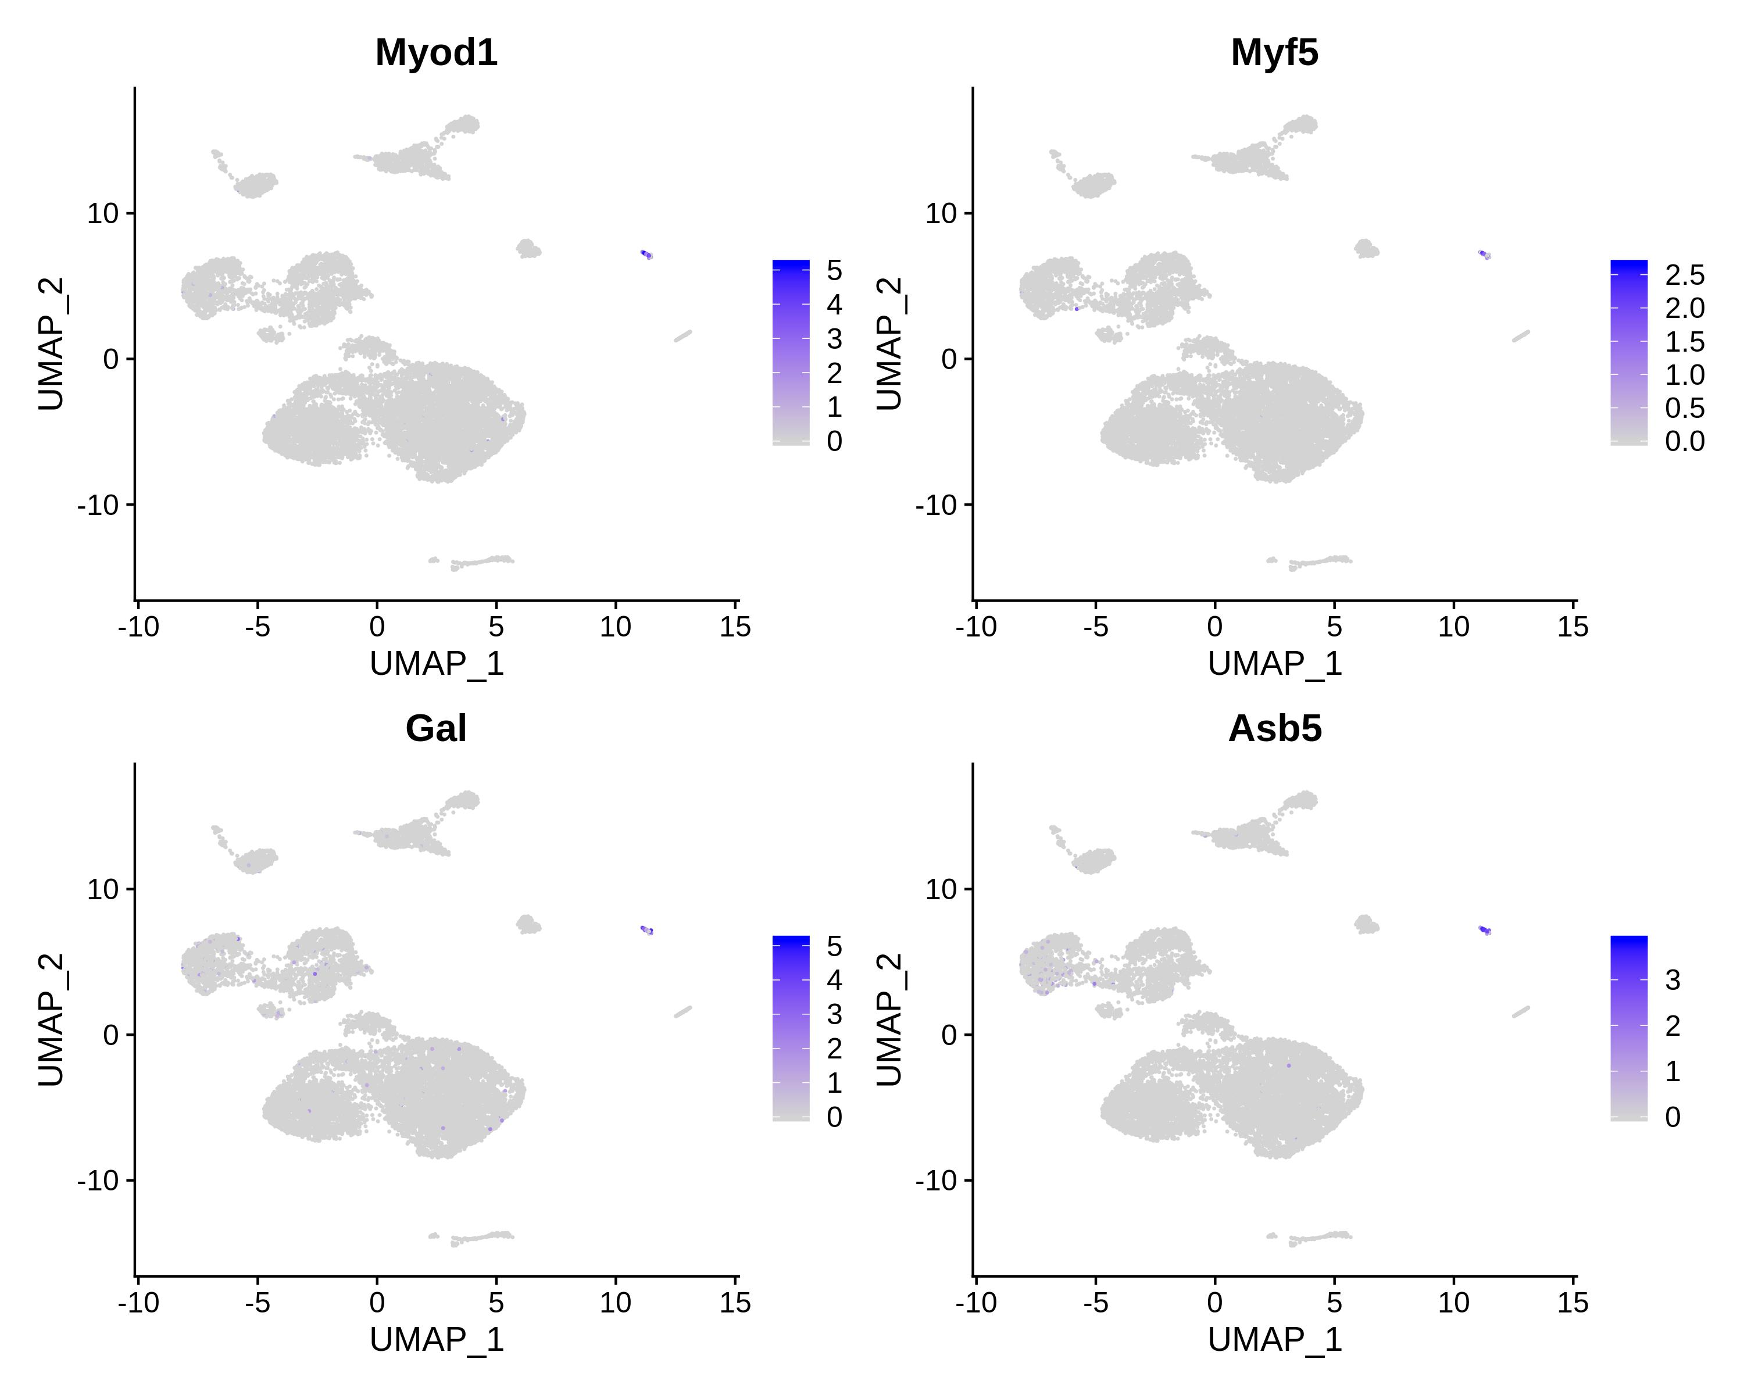
Figure S2K. Marker gene expression in each cell type: MUSC

