Slide 1
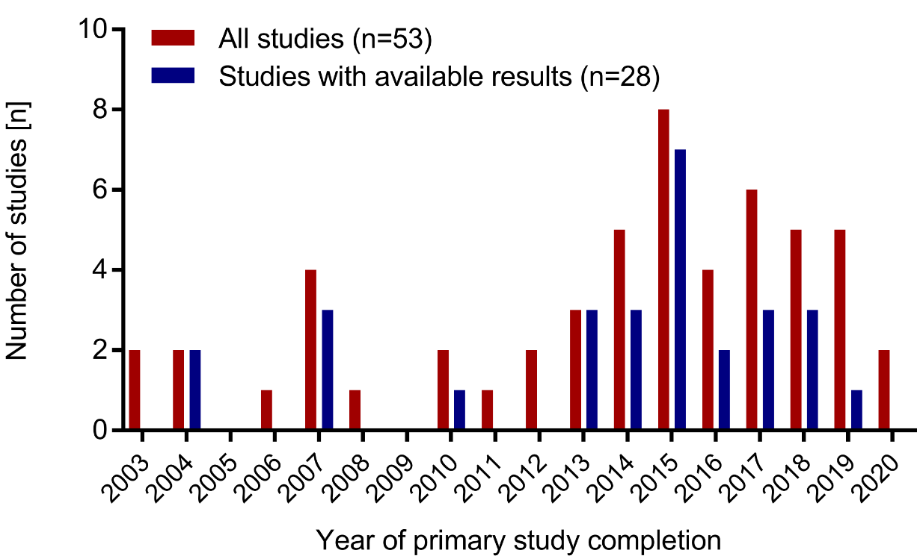
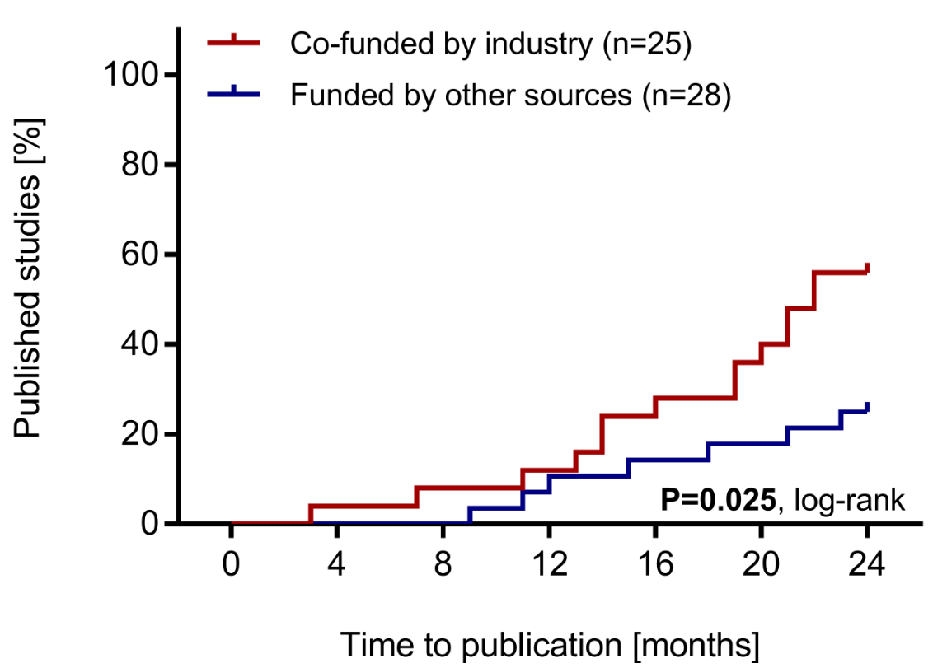
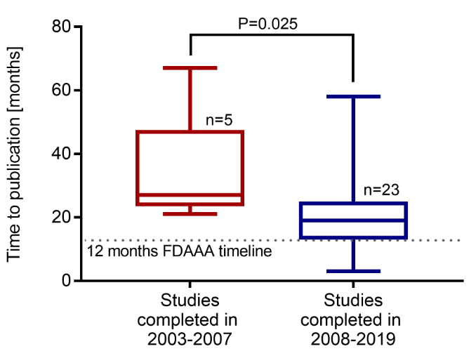
Missing trial results: analysis of the current publication rate of
studies in pediatric dialysis from 2003 to 2020
HYPOTHESIS: Pediatric dialysis studies might be affected by a low rate of- and time to publication.
DESIGN & OUTCOMES:
Access/Search
ClinicalTrials.gov
53 completed ped. dialysis studies
28 published ped. dialysis studies
Analysis of time to publication and influencers on both rate- and time to publication
CONCLUSION: Half of all studies in pediatric dialysis remain unpublished. Time to publication did not meet FDA requirements. Industrial sponsoring and the FDA Amendments Act regulations were associated with a shorter duration until public availability of study results.
Patry et al. 2022

