Slide 1
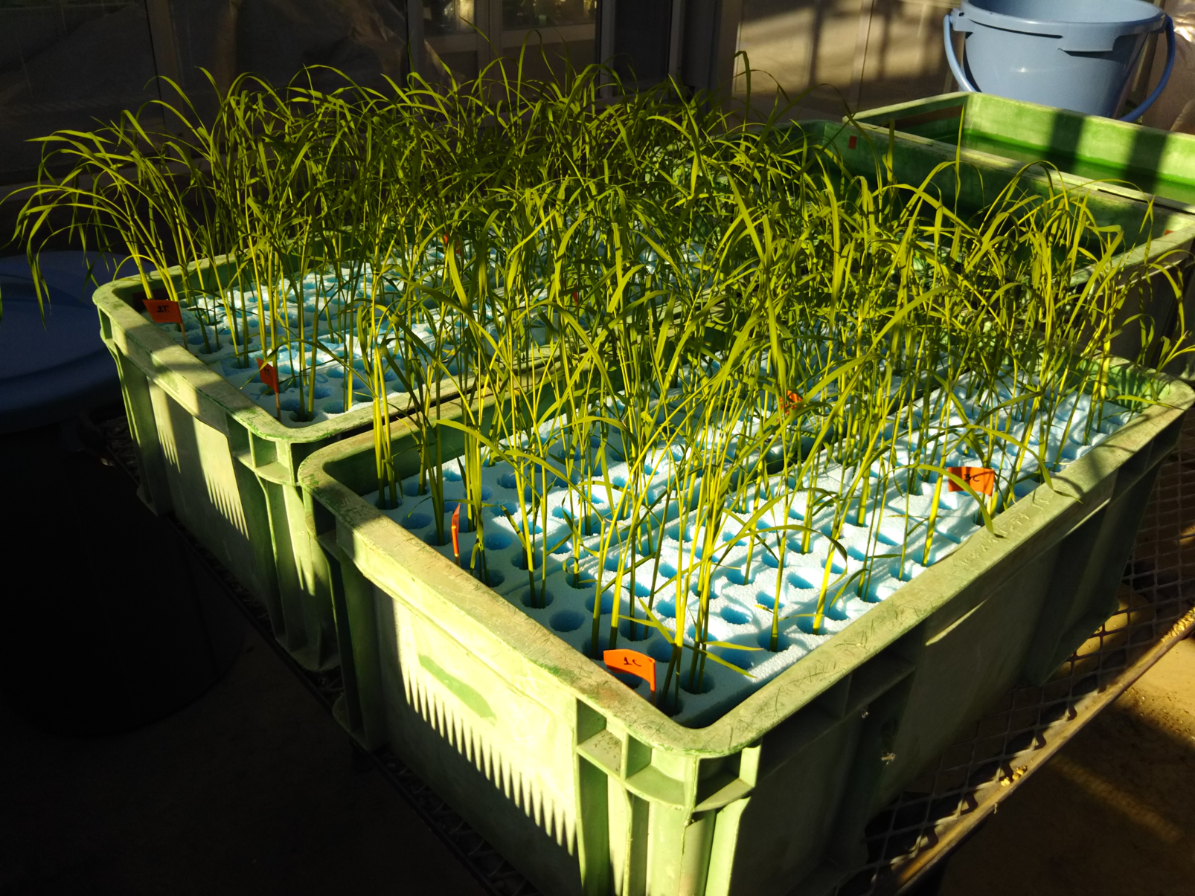
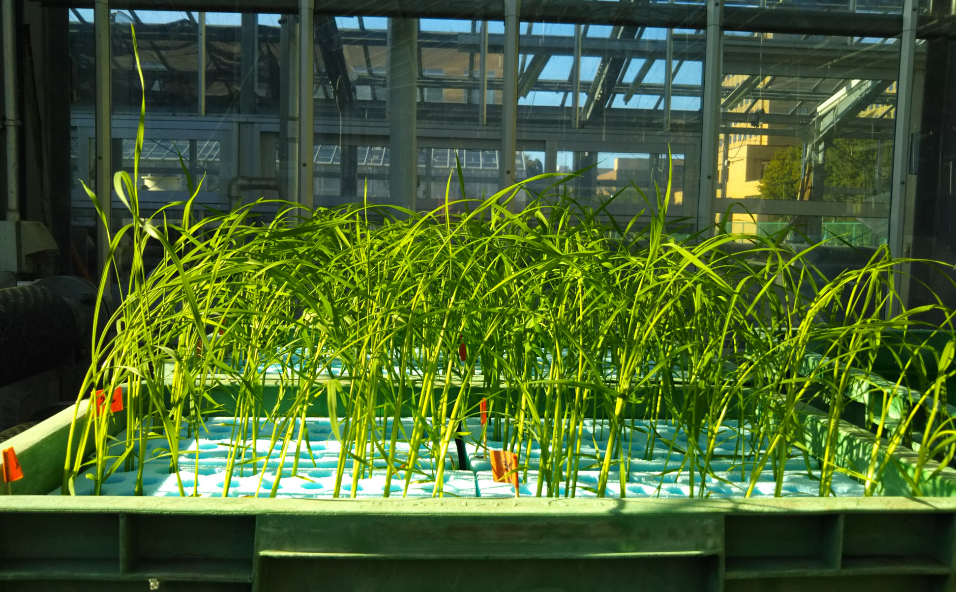
Supplementary Figure 1
Photos of MDI accessions during the salt tolerance test.
Rice seedlings were grown hydroponically in a 40-L container with floating foam material in the greenhouse.

Slide 2
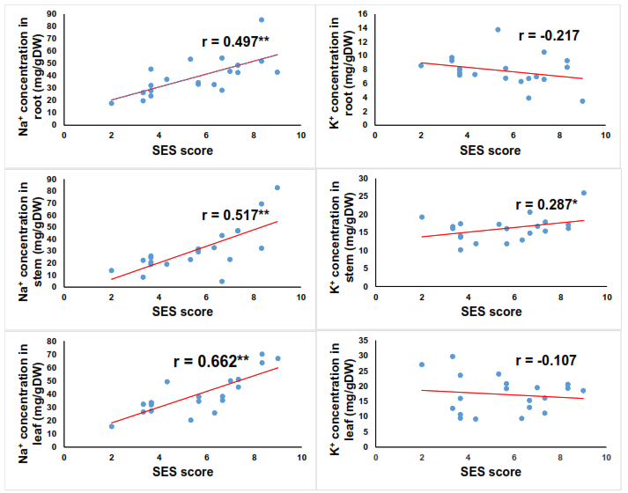
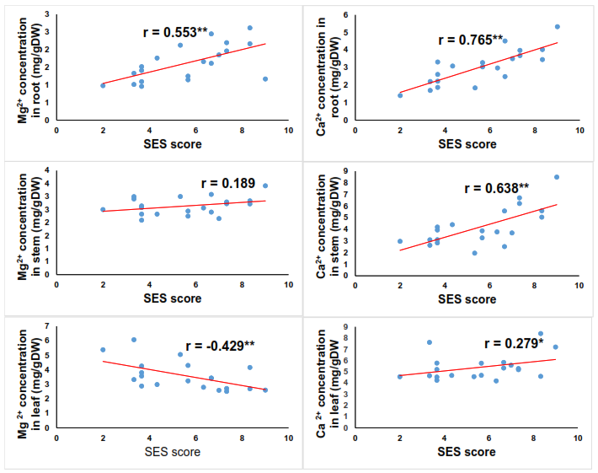
Supplementary Figure 2
Correlations between SES scores at 20 DUT and mineral concentrations of the 20 MDI accessions.
The concentrations and SES of the 20 accessions are plotted for four mineral ions (Na⁺, K⁺, Ca²⁺, Mg²⁺) in root, stem, and leaf. The 20 accessions were treated with 100 mM NaCl at 20 DUT. r indicates the correlation coefficient.
)

