Slide 1
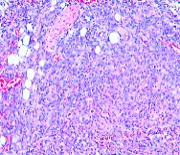

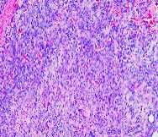
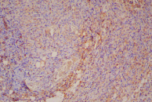
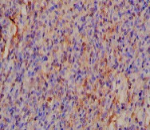
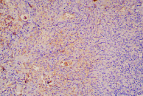
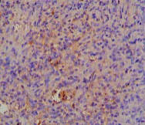
Supplementary Figure
TSC2
-
-
+
Rapa
+
-
-
Supplementary Figure 1. Identification of upregulated sphingosine biosynthesis enzyme in TSC2-deficient cells. (A) Re-analysis of previously published expression array data (Lee et al., 2010).LAM patient derived TSC2-deficient (621-101) and TSC2-addback (621-103) cells treated with rapamycin (20 nM) for 24 h, sphingosine metabolic enzymes were profiled by gene chip technology.
V3
T3
HE
Ki67
Supplementary Figure 2. Xenograft tumors of ELT3-V3 and ELT3-T3 cells in SCID mice. H&E and immunohistochemistry staining of Ki67,were performed in xenograft tumors of rat-derived ELT3-V3 (TSC2-deficient, V3) and ELT3-T3 (TSC2-expression, T3) cells from SCID mice. Representative images of five mice in each group.

Slide 2
1.5
Control
621-101
E2
The intensity of proteins
(relative to ꞵ-actin)
ns
ns
ns
***
ns
1.0
0.5
0.0
pS6
(ser235/236)
ASAH1
SPHK1
S1PR3
p-ERK
Supplementary Figure 3. The protein expressions of ASAH1, SPHK1, S1PR3, p-ERK and pS6(ser235/236) with or without E2 in 621-101cells were quantified using Image J.
A
101
103
B
TSC2⁻
TSC2⁺
The intensity of proteins
(relative to ꞵ-actin)
3.0
101+Rapa
103+Rapa
****
The intensity of proteins
(relative to ꞵ-actin)
5.0
TSC2⁻+Rapa
****
TSC2⁺+Rapa
****
****
****
****
4.0
****
2.0
****
3.0
****
2.0
1.0
1.0
0.0
pS6
(ser235/236)
0.0
pS6
(ser235/236)
Tuberin
SPHK1
ASAH1
Tuberin
SPHK1
ASAH1
Supplementary Figure 4. The protein levels of Tuberin, SPHK1, pS6(ser235/236) and ASAH1 with or without rapamycin in 621-101 and 621-103 cells (A) and TSC2⁻ MEFs and TSC2⁺ MEFs cells (B) were quantified using Image J.

Slide 3


A
V3
T3
B
ELT3 cells
Gene expression
(normalized to ꞵ-actin)
4
V3+Rapa
T3+Rapa
TSC2⁻
TSC2⁺
*
**
Rapa
-
-
+
+
-
-
+
+
200kDa
3
Tuberin
2
**
SPHK1
48kDa
1
pS6
(Ser235/236)
32kDa
ASAH1
13kDa
0
TSC2
SPHK1
ASAH1
β-actin
43kDa
C
****
The intensity of proteins
(relative to ꞵ-actin)
25
****
V3
20
****
V3+Rapa
15
T3
T3+Rapa
10
3.0
2.0
1.0
0.0
Tuberin
SPHK1
pS6
(ser235/236)
ASAH1
Supplementary Figure 5. TSC2 negatively regulates sphingosine metabolism in an mTOR independent manner. (A, B) Rat-derived ELT3-V3 (TSC2-deficient, V3) and ELT3-T3 (TSC2-expression, T3) cells were treated with or without rapamyicin for 24 hours. Gene expression of TSC2, SPHK1 and ASAH1 were determined by RT-qPCR, and protein levels of Tuberin, SPHK1, pS6 (ser235/236), ASAH1 were detected by immunoblotting and were quantified by Image J (C). β-actin was used as loading control. Students t-test, *p<0.05, **p<0.01, ***p<0.001, ****p<0.0001.
The intensity of proteins
(relative to ꞵ-actin)
100
siControl
siTSC2
****
siControl+Rapa
siTSC2+Rapa
50
****
****
10
5.0
****
1.0
0.0
pS6
(ser235/236)
Tuberin
SPHK1
ASAH1
Supplementary Figure 6. The protein levels of Tuberin, SPHK1, pS6(ser235/236) and ASAH1 with siRNA-TSC2 in 621-103 cells were quantified using Image J.

Slide 4
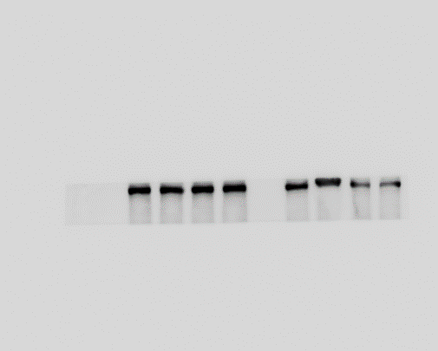
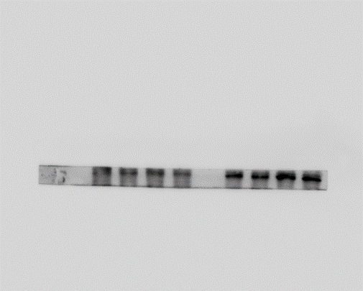
A
B
HEK293T
Gene expression
(normalized to ꞵ-actin)
HEK293T
siTSC2
-
-
+
+
siControl
siTSC2
Tuberin
200kDa
4
**
**
3
SPHK1
48kDa
pS6
(Ser235/236)
32kDa
2
****
ASAH1
13kDa
1
β-actin
43kDa
0
ASAH1
TSC2
SPHK1
C
siControl
The intensity of proteins
(relative to ꞵ-actin)
10
siTSC2
****
8.0
****
6.0
****
4.0
***
2.0
0.0
Tuberin
SPHK1
pS6
(ser235/236)
ASAH1
Supplementary Figure 7. TSC2 negatively regulates sphingosine metabolism in an mTOR independent manner. (A, B) HEK293T cells were transfected with human TSC2 siRNAs or control siRNA for 24 hours. Gene expression of TSC2, SPHK1 and ASAH1 were determined by RT-qPCR, and protein levels of Tuberin, SPHK1, pS6 (ser235/236), ASAH1 were detected by immunoblotting and were quantified by Image J (C). β-actin was used as loading control. Students t-test, *p<0.05, **p<0.01, ***p<0.001, ****p<0.0001.

Slide 5
SPHK1 intensity
(relative to ꞵ-actin)
1.5
****
1.0
0.5
0.0
shSPHK1
- 1# 2#
Supplementary Figure 8. The protein expression of SPHK1 in 621-101shN.C and 621-101shSPHK1 cells was quantified by Image J.
Tuberin intensity
(relative to ꞵ-actin)
2.0
****
**
SPHK1 intensity
(relative to ꞵ-actin)
8.0
****
1.5
ns
***
6.0
1.0
4.0
****
0.5
ns
2.0
0.0
- - + +
- + - +
0.0
TSC2
TSC2
- - + +
- + - +
PF543
PF543
Supplementary Figure 9. The protein expressions of Tuberin and SPHK1 with or without PF543 in TSC2-deficient and TSC2-addback cells were quantified using Image J.
ns
101
The intensity of protein
(relative to ꞵ-actin)
4.0
101+S1P
103
3.0
103+S1P
*
*
2.0
***
*
1.0
ns
ns
ns
ns
ns
0
Tuberin
SPHK1
S1PR3
pS6
(ser235/236)
S1PR1
Supplementary Figure 10. The expression of proteins: Tuberin, SPHK1, S1PR1, S1PR3 and pS6(ser235/236) with or without S1P in TSC2-deficient and TSC2-addback cells were quantified using Image J.

Slide 6
The intensity of protein
(relative to ꞵ-actin)
2.5
101
ns
2.0
101+Rapa
103
**
103+Rapa
ns
1.5
ns
1.0
ns
ns
***
0.5
ns
0.0
pS6
(ser235/236)
Tuberin
S1PR1
S1PR3
Supplementary Figure 11. The expression of proteins: Tuberin, S1PR1, S1PR3 and pS6(ser235/236) with or without rapamycin in TSC2-deficient and TSC2-addback cells were quantified using Image J.
S1PR3 Intensity
(relative to ꞵ-actin)
pS6(ser235/236) Intensity
(relative to ꞵ-actin)
1.5
1.5
****
****
1.0
1.0
0.5
0.5
0.0
0.0
TY52156
- + + + + +
TY52156
- + + + + +
Supplementary Figure 12. The protein expressions of S1PR3 and Ps6(ser235/236) with TY52156 in TSC2-deficient cells were quantified by Image J.
S1PR3 Intensity
(relative to ꞵ-actin)
1.5
****
1.0
0.5
0.0
siS1PR3
- #1 #2 #3
Supplementary Figure 13. The protein expressions of S1PR3 with siS1PR3 in TSC2-deficient cells were quantified by Image J.

Slide 7
shNC
shSPHK1
ns
ns
ns
ns
ns
B
ELT3-T3
ELT3-V3
1.5
Rapa:
- - + + - - -
CQ:
- - - - + + -
1.0
PF543:
- - - + - + +
Gene expression
(normalized to ꞵ-actin)
p62
62kDa
0.5
LC3-Ⅰ
LC3-Ⅱ
14kDa
16kDa
pS6
(Ser235/236)
32kDa
0.0
ATG5
ATG7
ATG12
BECN1
SQSTM1
β-actin
43kDa
C
20
****
T3
V3+CQ
V3
V3+CQ+PF543
The intensity of protein
(relative to ꞵ-actin)
V3+rapa
V3+PF543
15
V3+rapa+PF543
10
****
4.0
3.0
2.0
1.0
0.0
P62
LC3Ⅱ/LC3Ⅰ
pS6
(ser235/236)
Supplementary Figure 14. Inhibition of SPHK1 mediates autophagy in TSC2-deficient cells. (A) 621-101 cells were transfected by shRNA-SPHK1 or negative control (shN.C), gene expression of ATG5, ATG7, ATG12, BECN1 and SQSTM1 were detected by RT-qPCR. (B, c) ELT3-V3 cells were treated with 20 nM rapamycin, 5 µM CQ, with or without 2.5 µM PF543 for 24 h. Levels of tuberin, p62, phospho-S6 (235/236), LC3Ⅰ/LC3Ⅱ were assessed by immunoblotting and were quantified by Image J. ELT3-T3 were added as TSC2-addback control.

Slide 8
103
101+CQ
25
****
101
101+CQ+PF543
The intensity of protein
(relative to ꞵ-actin)
****
101+rapa
101+PF543
The intensity of protein
(relative to ꞵ-actin)
1.5
****
****
20
101+rapa+PF543
****
****
****
15
1.0
10
***
4
****
****
0.5
2
****
*
0
Tuberin
LC3Ⅱ/LC3Ⅰ
SPHK1
cl-caspase 3
0.0
P62
pS6
(ser235/236)
Supplementary Figure 15. 621-101 cells were treated with 20 nM rapamycin, 5 µM CQ, with or without 2.5 µM PF543 for 24 h. the protein Levels of tuberin, p62, phospho-S6 (235/236), LC3 Ⅱ /LC3 Ⅰ, cl-caspase 3, SPHK1 were quantified by image J. 621-103 cells were added as TSC2-addback control.
103
****
101
The intensity of protein
(relative to ꞵ-actin)
100
101siS1PR3#1
101siS1PR3#2
75
101siS1PR3#3
50
ns
1.5
1.0
0.5
0.0
P62
LC3Ⅱ/LC3Ⅰ
Supplementary Figure 16. 621-101 cells were transfected with S1PR3 siRNA or negative control (siControl) and 621-103 cells were added as TSC2-addback control The protein expressions of P62 and LC3Ⅱ/LC3Ⅰ were quantified using Image J.
103
101+CQ
101+CQ
**
****
101
101+CQ+TY52156
103
101+CQ+TY52156
****
14
101+rapa
101+TY52156
15
101
101+TY52156
101+rapa+TY52156
10
101+rapa
12
***
101+rapa+TY52156
10
****
5
*
*
3.0
ns
2.0
**
**
***
2.0
**
****
1.5
***
***
1.0
1.0
0.0
0.5
Tuberin
pS6
(ser235/236)
0.0
S1PR3
P62
LC3Ⅱ/LC3Ⅰ
Supplementary Figure 17. 621-101 cells were treated with 20 nM rapamycin, 5 µM CQ, with or without 2 µM TY52156 for 24 h. The protein Levels of tuberin, p62, phospho-S6 (235/236), LC3 Ⅱ /LC3 Ⅰ, S1PR3 were quantified by image J. 621-103 cells were added as TSC2-addback control.

Slide 9
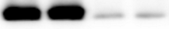
A
B
PF543
- + + -
TY52156
- + + -
Rapa
- - + +
Rapa
- - + +
Tuberin
200kDa
Tuberin
200kDa
SPHK1
48kDa
S1PR3
48kDa
p-S6
(ser235/236)
32kDa
p-S6
(ser235/236)
32kDa
β-actin
43kDa
β-actin
43kDa
p-ERK
42/44kDa
p-ERK
42/44kDa
ERK
42/44kDa
ERK
42/44kDa
p-AKT
60kDa
p-AKT
60kDa
AKT
60kDa
AKT
60kDa
β-actin
43kDa
β-actin
43kDa
C
D
Control
PF543
Rapa+PF543
Rapa
Control
TY62156
Rapa+TY52156
Rapa
The intensity of protein
(normalized to control)
1.5
ns
ns
The intensity of protein
(normalized to control)
1.5
ns
ns
1.0
1.0
0.5
0.5
0.0
0.0
p-AKT/AKT
p-ERK/ERK
p-AKT/AKT
p-ERK/ERK
Supplementary Figure 18. Effective of inhibition of SPHK1 and S1PR3 in TSC2-deficient cells. 621-101 cells were treated with 20 nM rapamycin, 2 µM PF543 (A and C), 2 µM TY52156 (B and D) alone or combination for 24 h. Levels of tuberin, SPHK1, S1PR3, phospho-S6 (235/236), AKT, p-AKT, ERK, p-ERK were assessed by immunoblotting and quantified by Image J.

Slide 10
A
B
Control
2.5
Control
2.5
TY52156
The intensity of protein
(relative to ꞵ-actin)
PF543
**
The intensity of protein
(relative to ꞵ-actin)
2.0
*
2.0
1.5
*
ns
1.5
*
**
ns
*
1.0
1.0
0.5
0.5
0.0
0.0
p62
pS6
(ser235/236)
S1PR3
p62
pS6
(ser235/236)
SPHK1
LC3Ⅱ/LC3Ⅰ
LC3Ⅱ/LC3Ⅰ
Supplementary Figure 19. The protein levels of SPHK1 or S1PR3, p62, LC3Ⅰ/LC3Ⅱ, and pS6 (ser235/236) of xenograft tumors treated with vehicle control, PF543 (A) or TY52156 (B) were quantified by image J.

