Slide 1
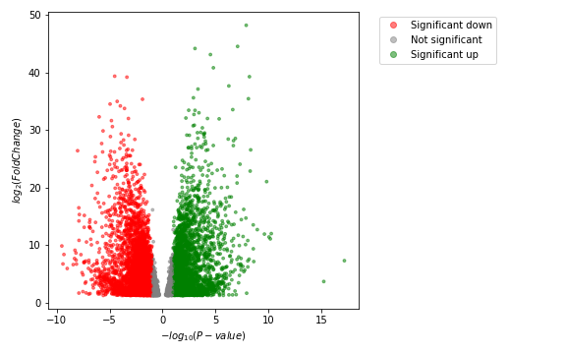
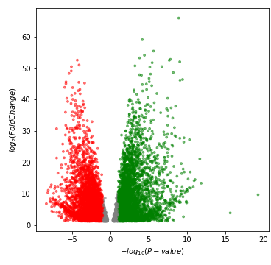
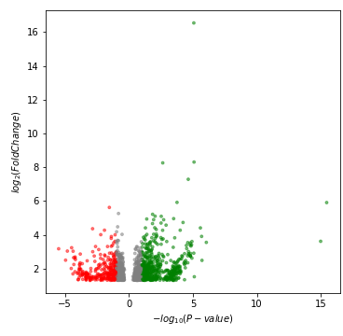
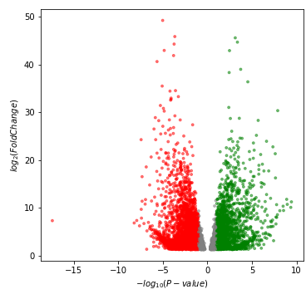
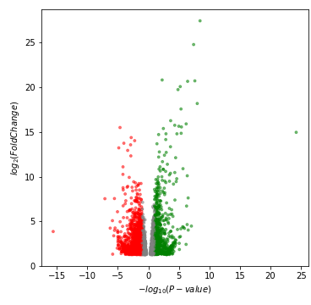
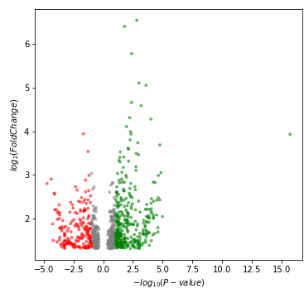
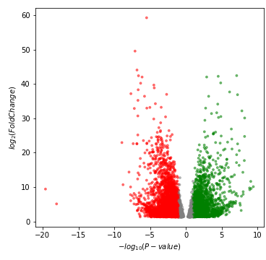
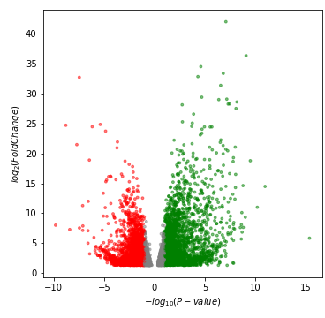
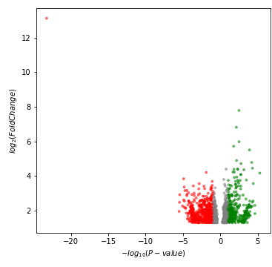
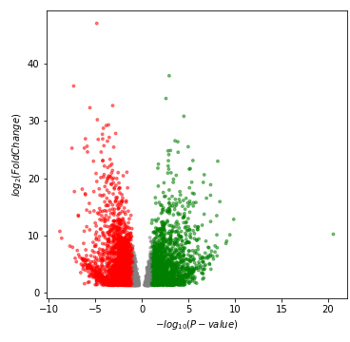
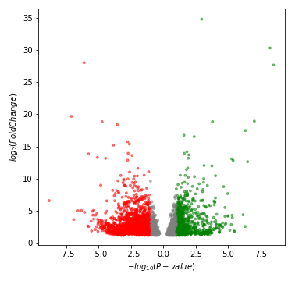
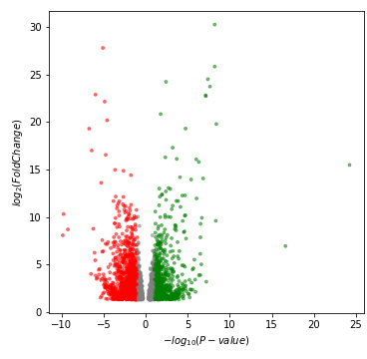
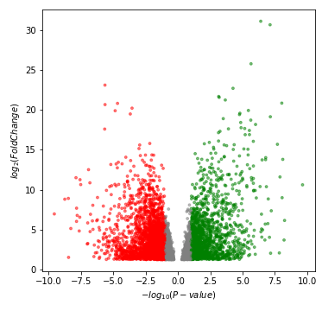
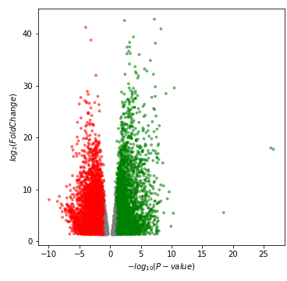
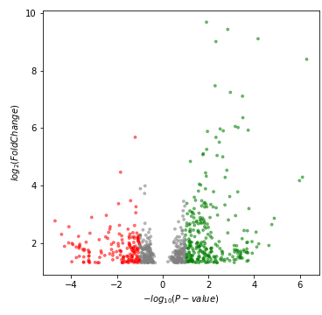
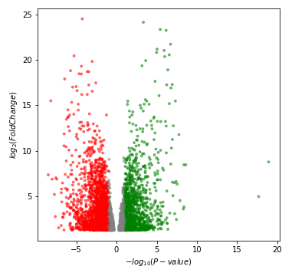
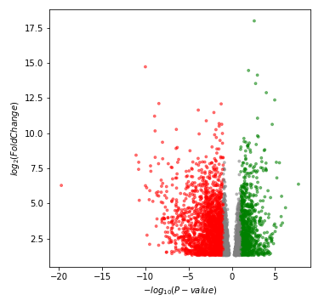
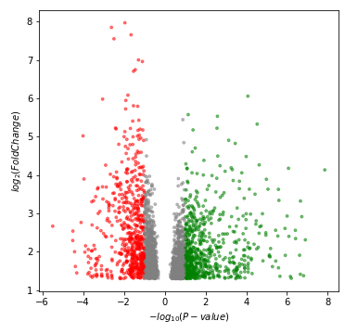
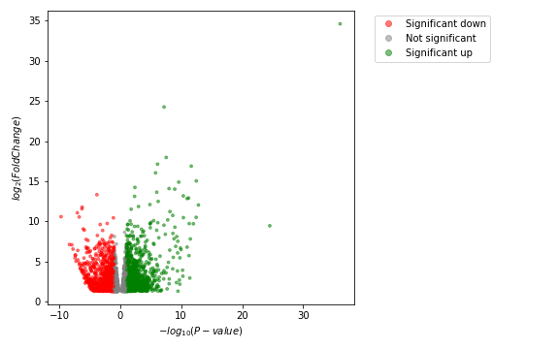
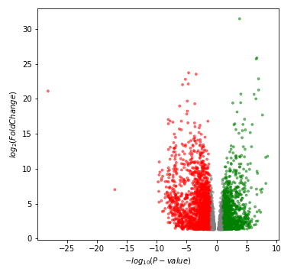
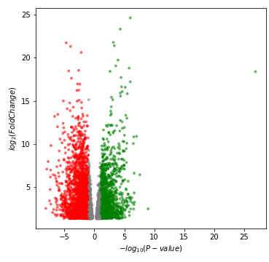
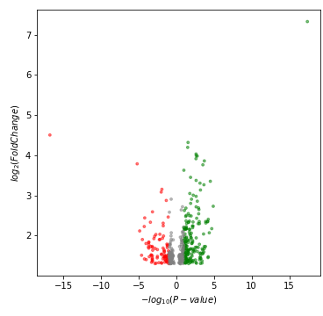
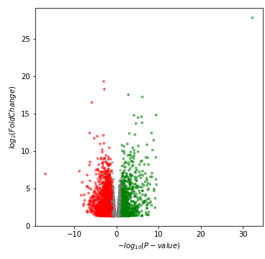
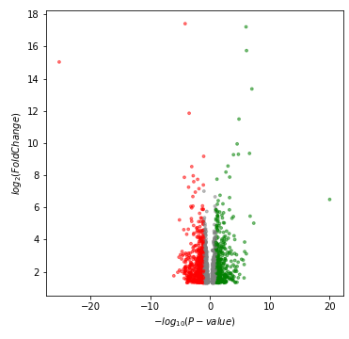
G1-Fl-CS
G5-Fl-CS
G1-Fl-DR
G5-Fl-DR
G1-Fl-HT
G5-Fl-HT
O1-Fl-CS
O5-Fl-CS
O1-Fl-DR
O5-Fl-DR
O1-Fl-HT
O5-Fl-HT
G1-HD-CS
G5-HD-CS
G1-HD-DR
G5-HD-DR
G1-HD-HT
G5-HD-HT
O1-HD-CS
O5-HD-CS
O1-HD-DR
O5-HD-DR
O1-HD-HT
O5-HD-HT
Supplementary figure 1: Volcano plots depicting DEGs for each treatment (CS: combined stress; DR: Drought; HT: Heat), time (1 or 5) for Golden Promise (G) and Otis (O). Up-regulated
DEGs are indicated by green dots, down-regulated DEGs are indicated by red dots. DEGs that do not exceed the threshold of log2FC| >1 and FDR ≤1% are depicted in grey.

