Slide 1
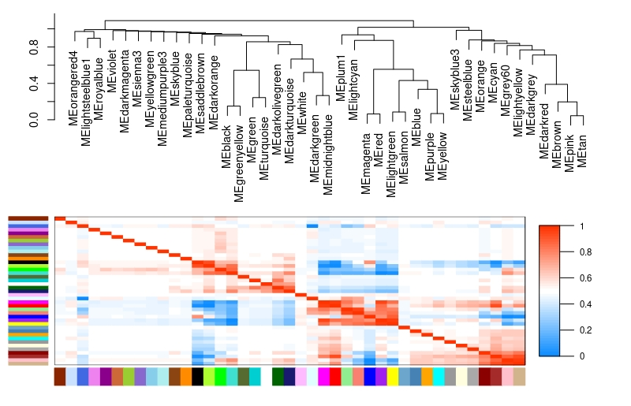
Supplementary Figure 2: Eigengene adjacency heatmap based on the adjacency matrix. Elements of this matrix encode the connection strengths between nodes of the network and lie between 0 (unconnected) and 1 (fully connected). Using the RNA-seq from this study, 41 modules were generated. These color modules were used for generating the module-trait relationships presented in Figure 9.

