Slide 1
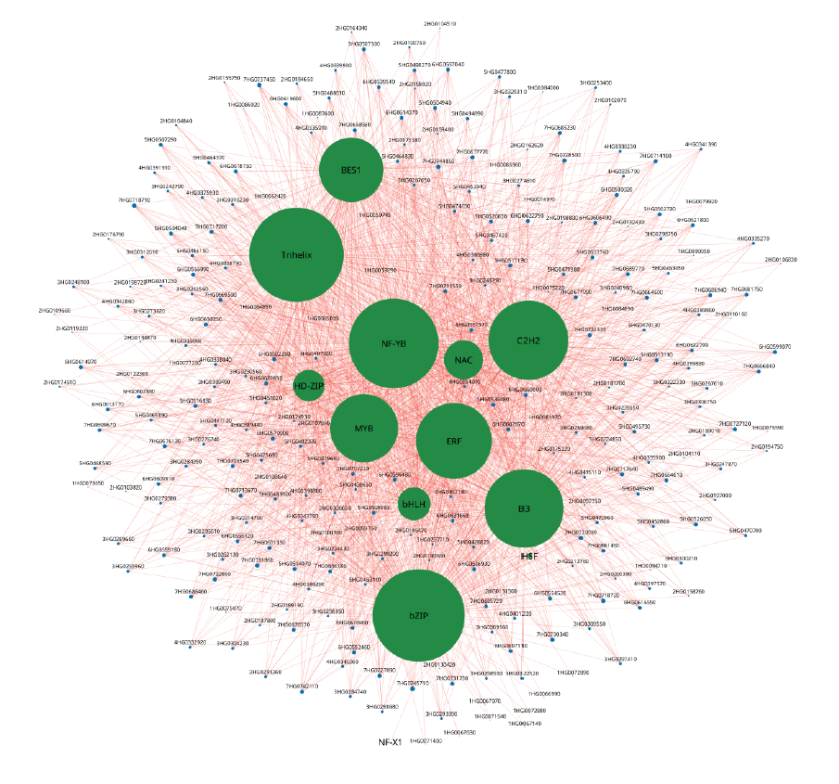
Supplementary Figure 7: Gene networks for DEGs involved under
heat and drought stress in tan module. Size of the node represent
the degree. 13 transcription factors are represented in turquoise
color and all other 267 interacting nodes are represented in blue
color. All the edges are represented in darksalmon.

