Slide 1
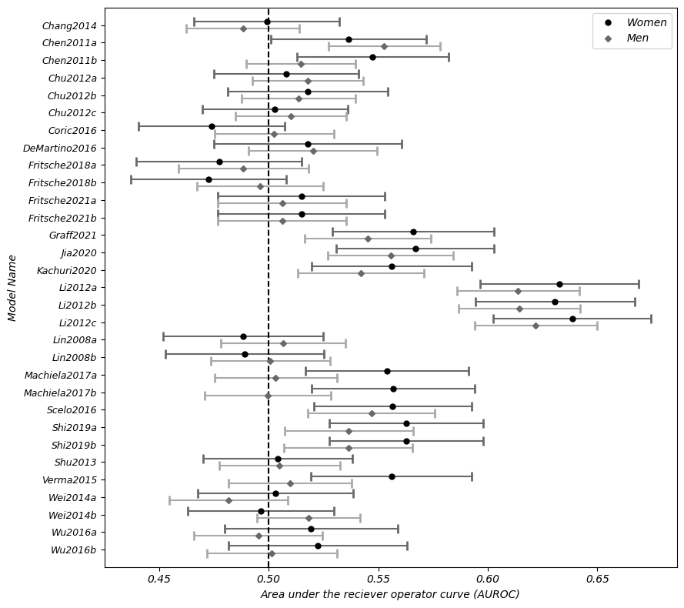
Figure S1a: Sensitivity analysis comparing the model discrimination (AUROC) in men and women.

Slide 2
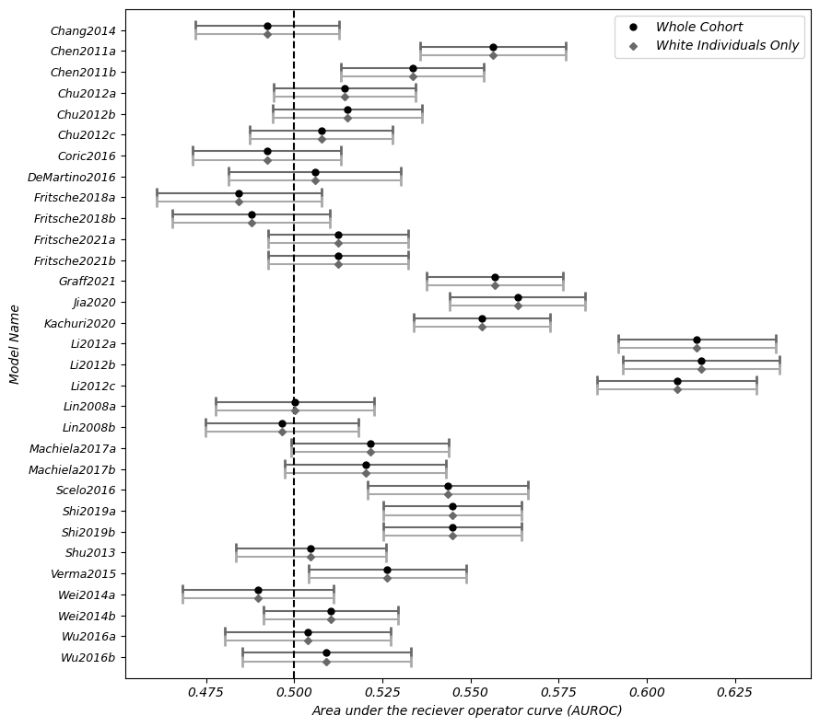
Figure S1b: Sensitivity analysis comparing the model discrimination (AUROC) in the whole cohort and the white-only cohort.

Slide 3
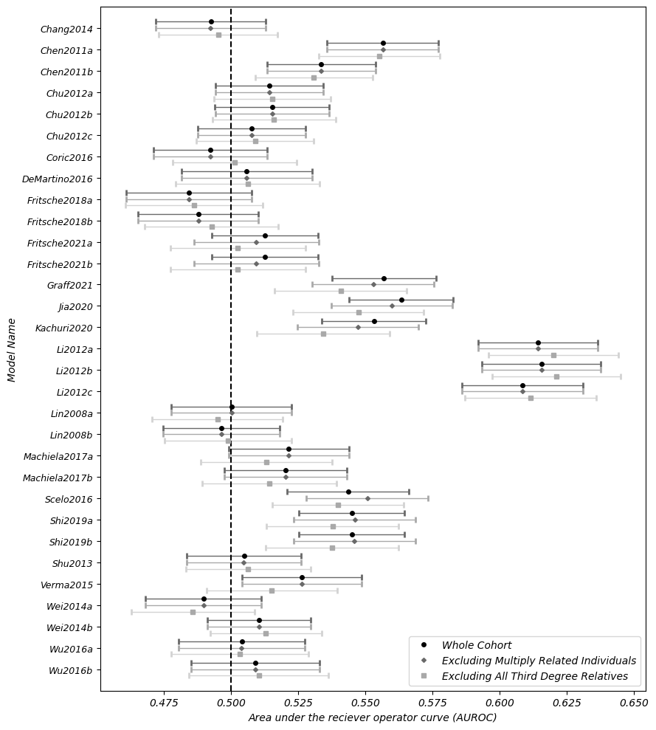
Figure S1c: Sensitivity analysis comparing the model discrimination (AUROC) in the whole cohort and cohorts excluding individuals with multiple close relatives and individuals with any 3rd degree relatives.

Slide 4
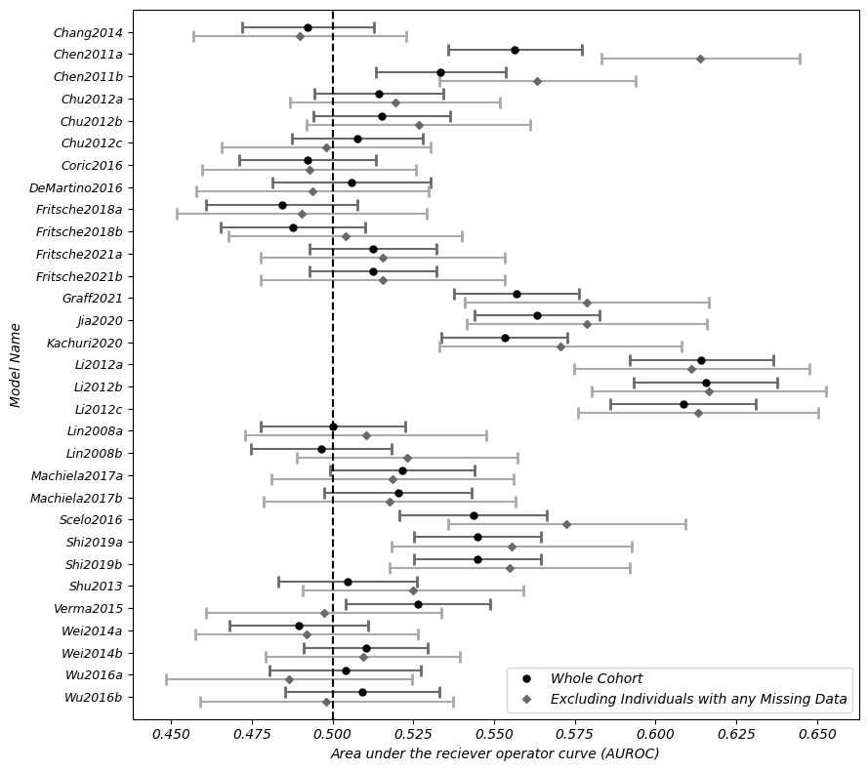
Figure S1a: Sensitivity analysis comparing the model discrimination (AUROC) in the primary analysis, to that in a cohort using only individuals with no missing data for any of the models.

Slide 5
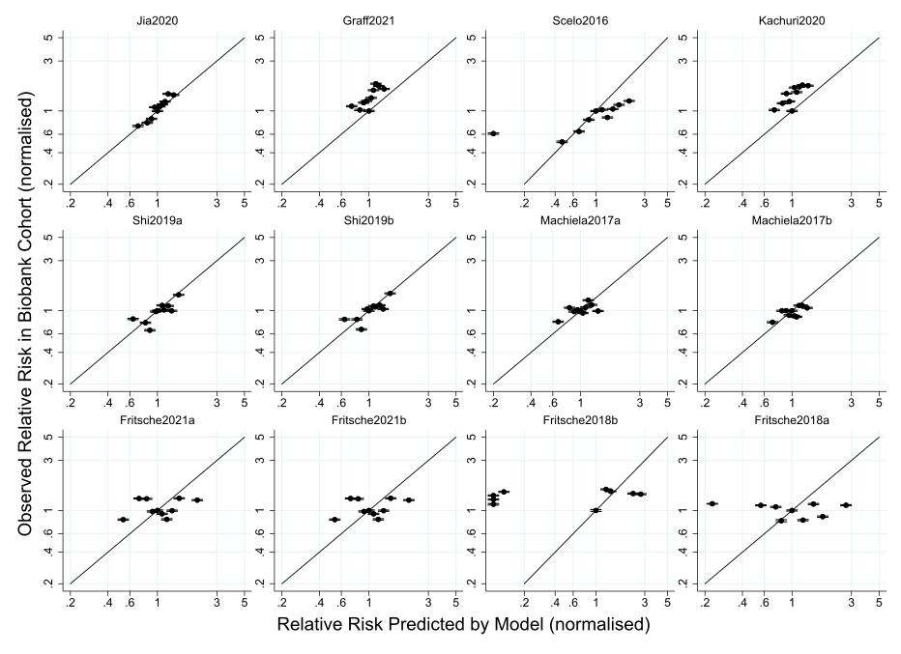
Figure S2a: Calibration plots for GWAS models.

Slide 6
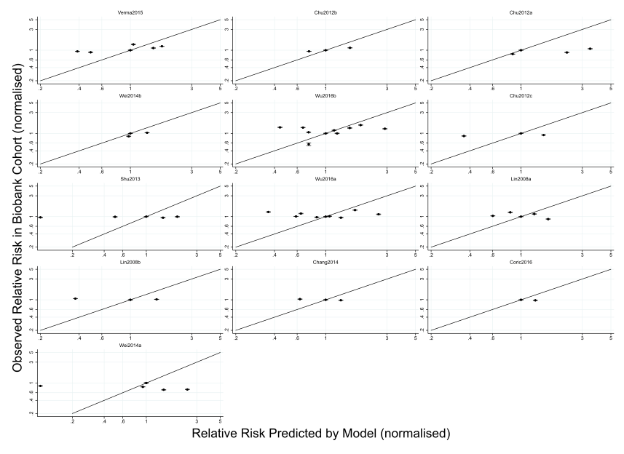
Figure S2b: Calibration plots for causal gene models.

Slide 7
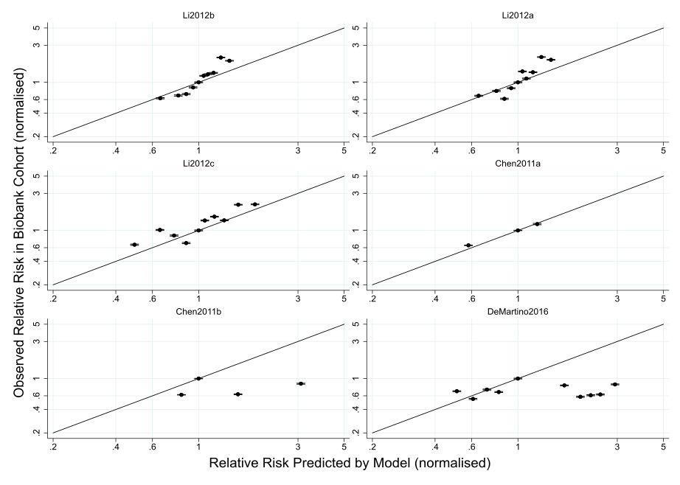
Figure S2c: Calibration plots for mixed genetic and phenotypic models.

Slide 8
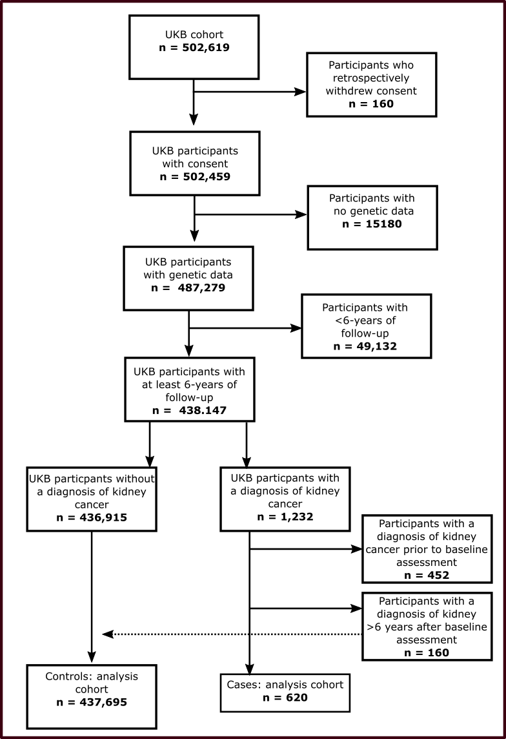
Figure S3: Selection process of UKB cohort for primary analysis.

