Slide 1
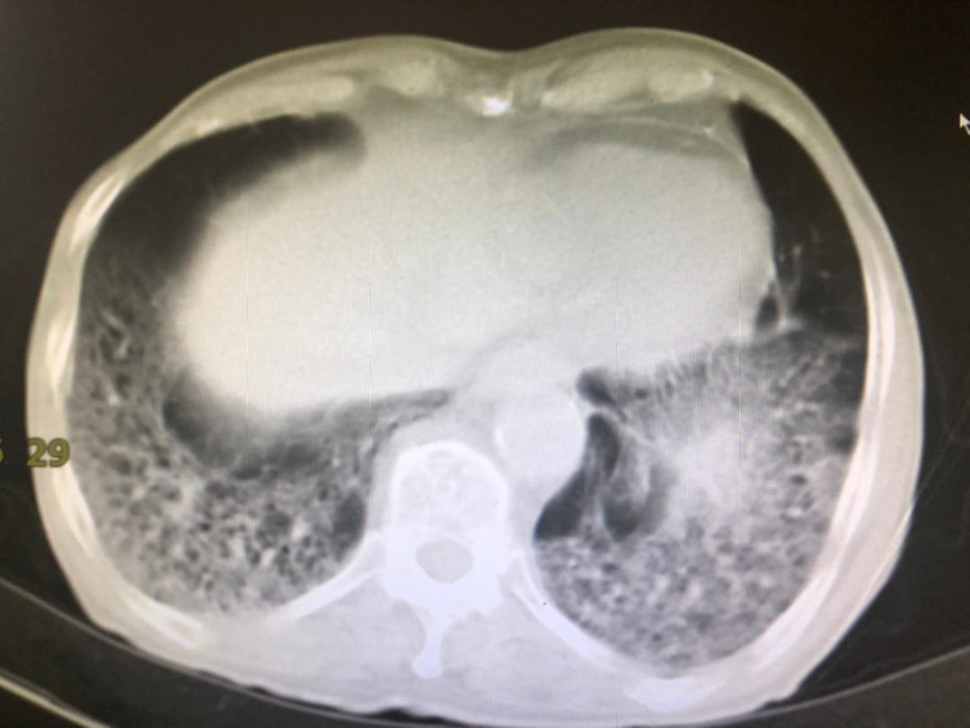
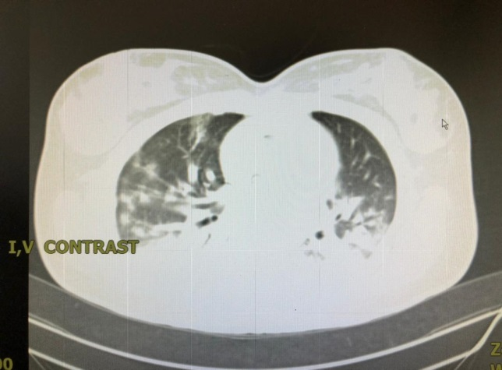
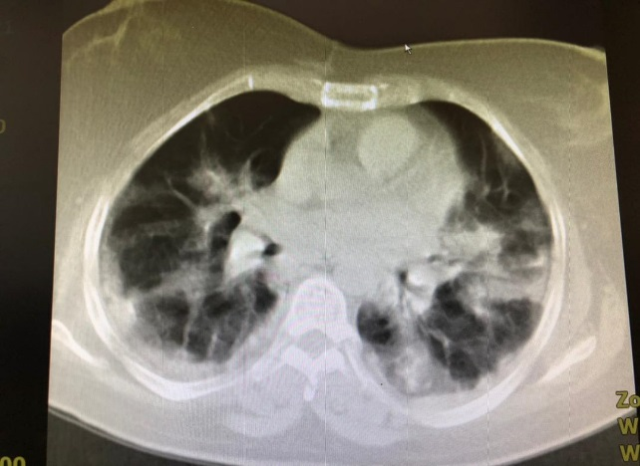
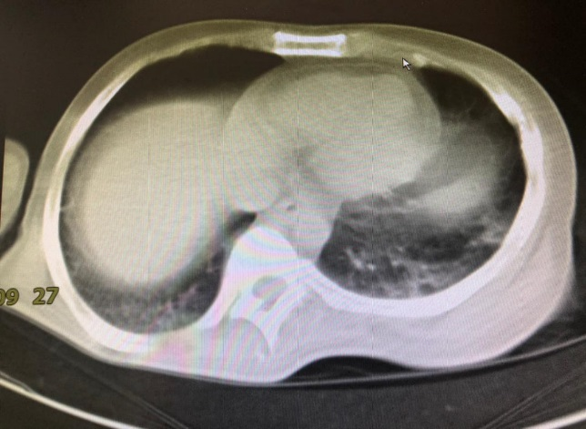
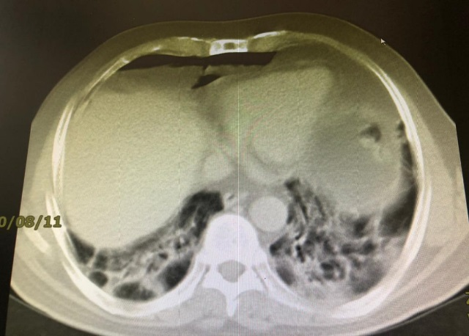
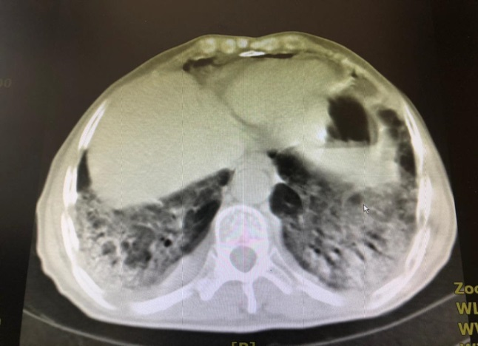
Supplementary
Fig. 1
A
B
C
D
E
F

Slide 2
Supplementary
Fig. 2
A
B
C
D

Slide 3
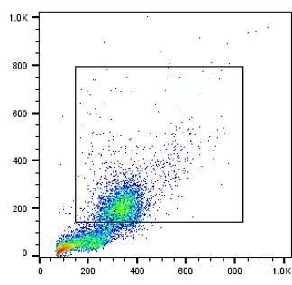
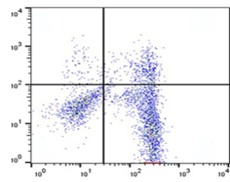
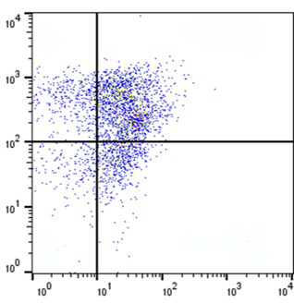
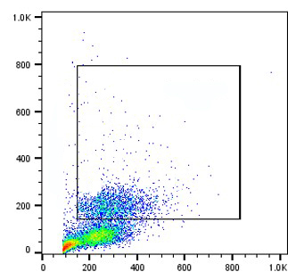
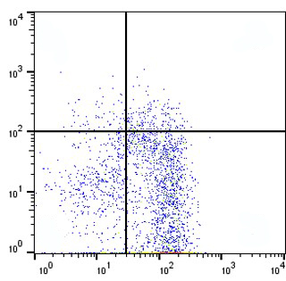
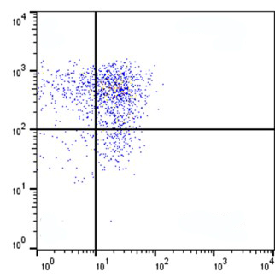
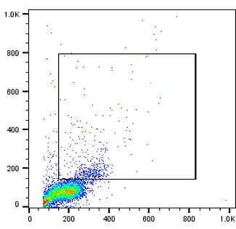
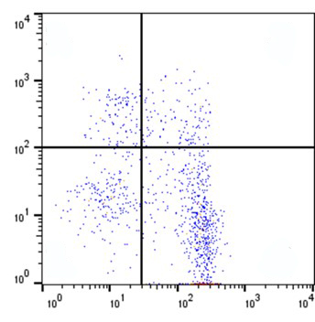
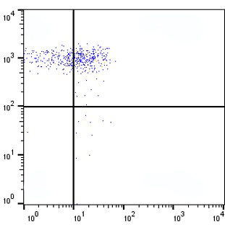
Supplementary
Fig. 3
Granulocyte
Gated on granulocyte
Gated on CD11b⁺ HLA-DR ^{-/low}
TGF-β+ M-MDSCs
S
TGF-β+ non-M-MDSCs
SSC-H
HLA-DR
CD14
TGF-β+ M-MDSCs
M
TGF-β+ non-M-MDSCs
TGF-β+ M-MDSCs
HC
TGF-β+ non-M-MDSCs
FSC-H
CD11b
TGF-β

Slide 4
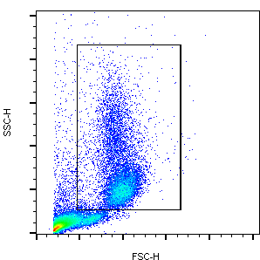
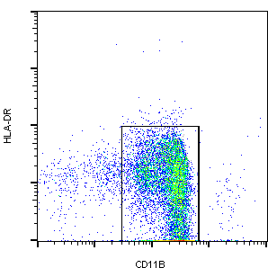
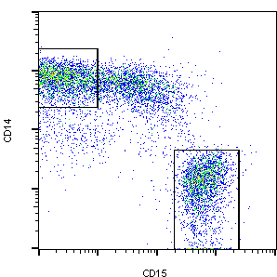
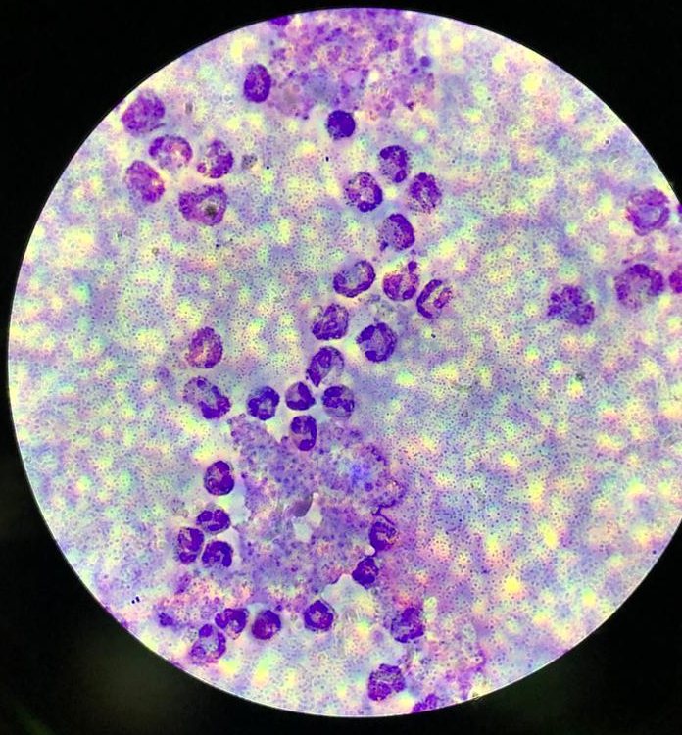
Supplementary
Fig. 4
A
M-MDSC
P-MDSC
B

Slide 5
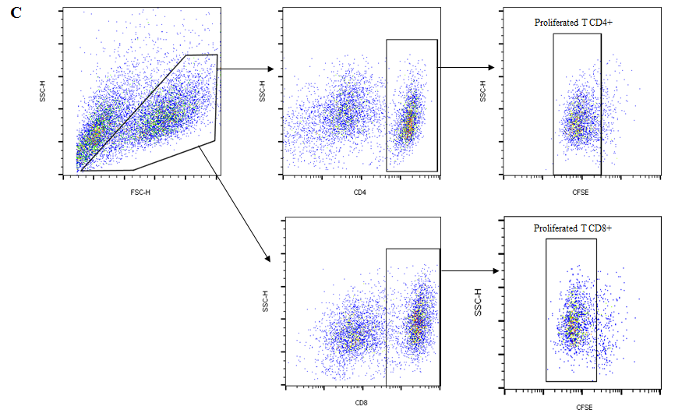
Supplementary
Fig. 5
MDP + PHA

Slide 6
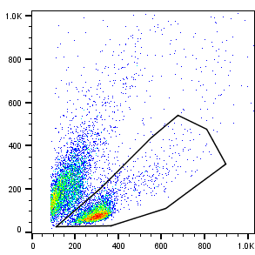
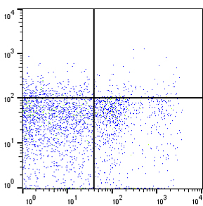
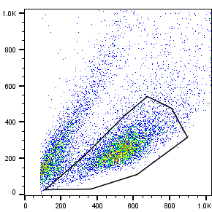
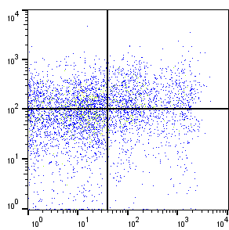
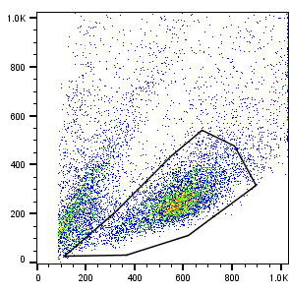
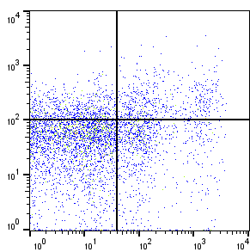
Supplementary
Fig. 6
A
Lymphocytes
Gated on Lymphocytes
MDP
SSC-H
IFN-γ
MDP + PHA
MDP+PHA+ MDSC
FSC-H
CD4

Slide 7
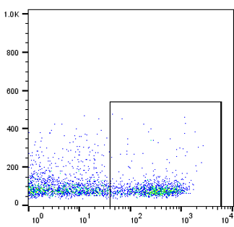
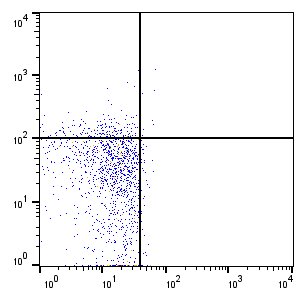
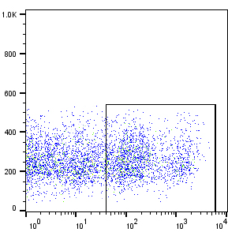
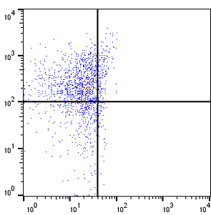
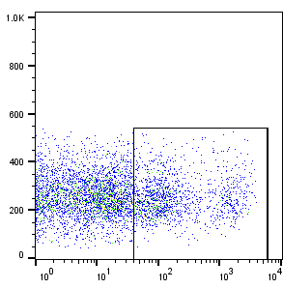
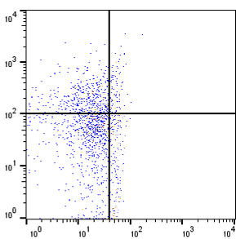
Supplementary
Fig. 7
Lymphocytes
Gated on Lymphocytes
Gated on CD4+
MDP
SSC-H
SSC-H
CD25
MDP + PHA
MDP+PHA+ MDSC
FSC-H
CD4
Foxp3

