Slide 1
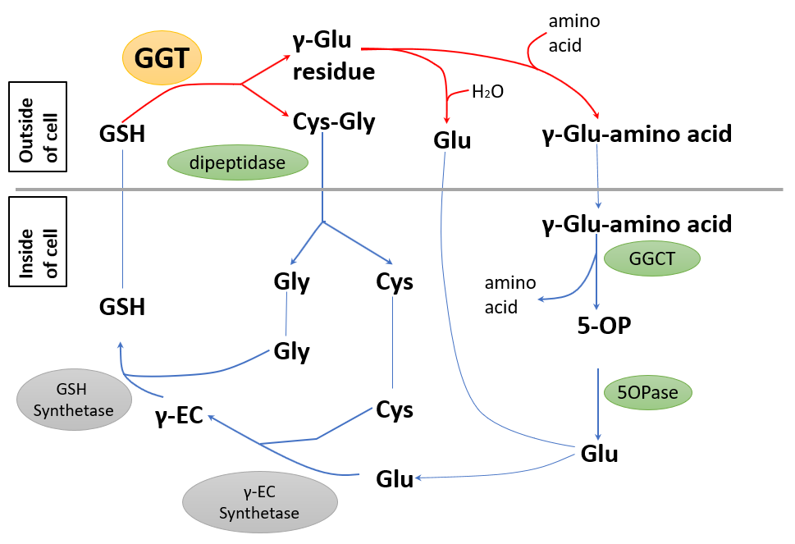
Figure S1. The γ-glutamyl cycle proposed in mammals. GGT; γ-glutamyl transpeptidase, GGCT; γ-glutamyl cyclotransferase, 5OPase; 5-oxoprolinase, GSH; glutathione, γ-EC; γ-glutamyl cysteine, 5OP; 5-oxoproine

Slide 2
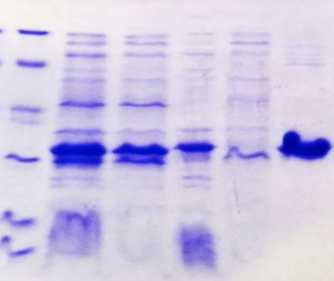

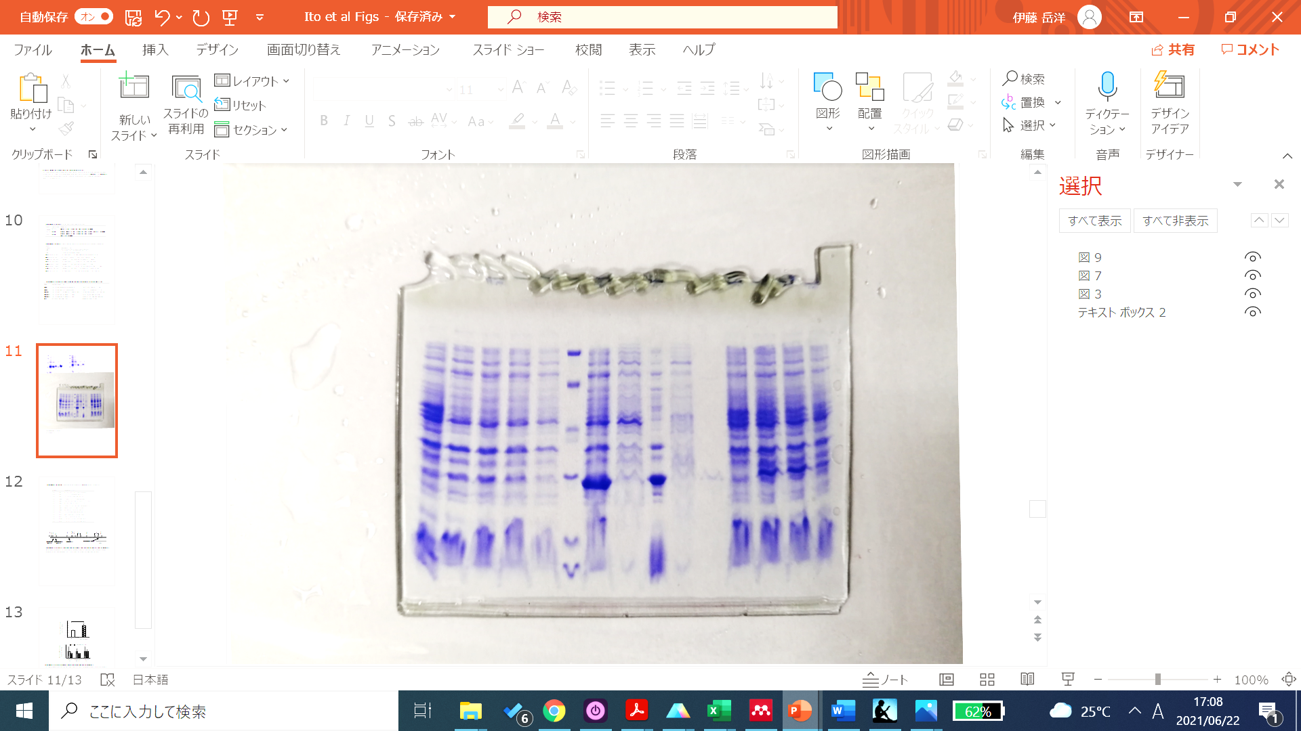
GGP1
GGP3
GGCT2;3
kDa
M
1
2
3
4
5
M
1
2
3
4
5
M
1
2
3
4
5
97.2
66.4
44.3
*
*
29.0
*
20.1
14.3
Figure S2. Confirmation of the result of protein purification by SDS-PAGE. N-terminal His tagged proteins were expressed in E. coli and purified with nickel columns. M: marker; lane 1: crude protein extract; lane 2: soluble fraction; lane 3: insoluble fraction; lane 4: flow-through; lane 5: purified protein. Asterisks indicate the size of the purified proteins.

Slide 3
(a)
GGP3
GGCT2;2
GGCT2;3
(b)
Figure S3. Gene expression in the ggp1/ggct2;1 mutant after buthionine sulfoximine (BSO) treatment. (a) Time-dependent changes in the relative expression of GGP3, GGCT2;2, and GGCT2;3. (b) The expression of GSH1 and GSH2 at 0 h. The values and error bars represent the mean and standard deviation of five biological replicates. Asterisks indicate significant differences from the wild-type plant (Student’s t-test, *P < 0.05).

Slide 4
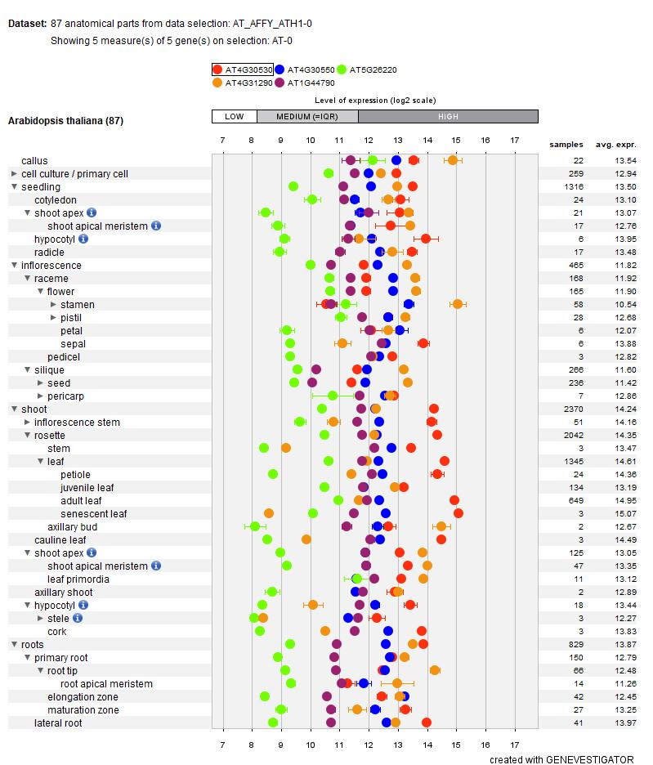
Figure S4. Expression analysis based on a public microarray database. The expression levels of GGP1 (AT4G30530), GGP3 (AT4G30550), GGCT2;1 (AT5G26220), GGCT2;2 (AT4G31290) and GGCT2;3 (AT1G44790) were visualized by Genevestigator. Error bars represent standard errors.

Slide 5
C100
Q104
H192
E194
R206
Y212
Figure S5. Amino acid sequence alignment of GGP1 and its homologs. GGP1, GGP3, homologs in soybean (GLYMA_17G070700), rice (Os_09g0424200), and Physcomitrium patens (spreading-leaved earth moss, PHYPADRAFT_89514), and glutamine amidotransferases from Methanococcus janashii (MjGATase), E. coli (EcTrpD), and S. marcescens (SmTrpG) are shown. IDs or accession numbers of UniProt, GenBank, or MEROPS are also shown. The secondary structure of the AlphaFold-predicted GGP1 structure is shown above the sequences. Multiple sequence alignment was prepared using Clustal Omega (Madeira et al., 2019) and ESPript 3.0 (Robert and Gouet, 2014).

Slide 6
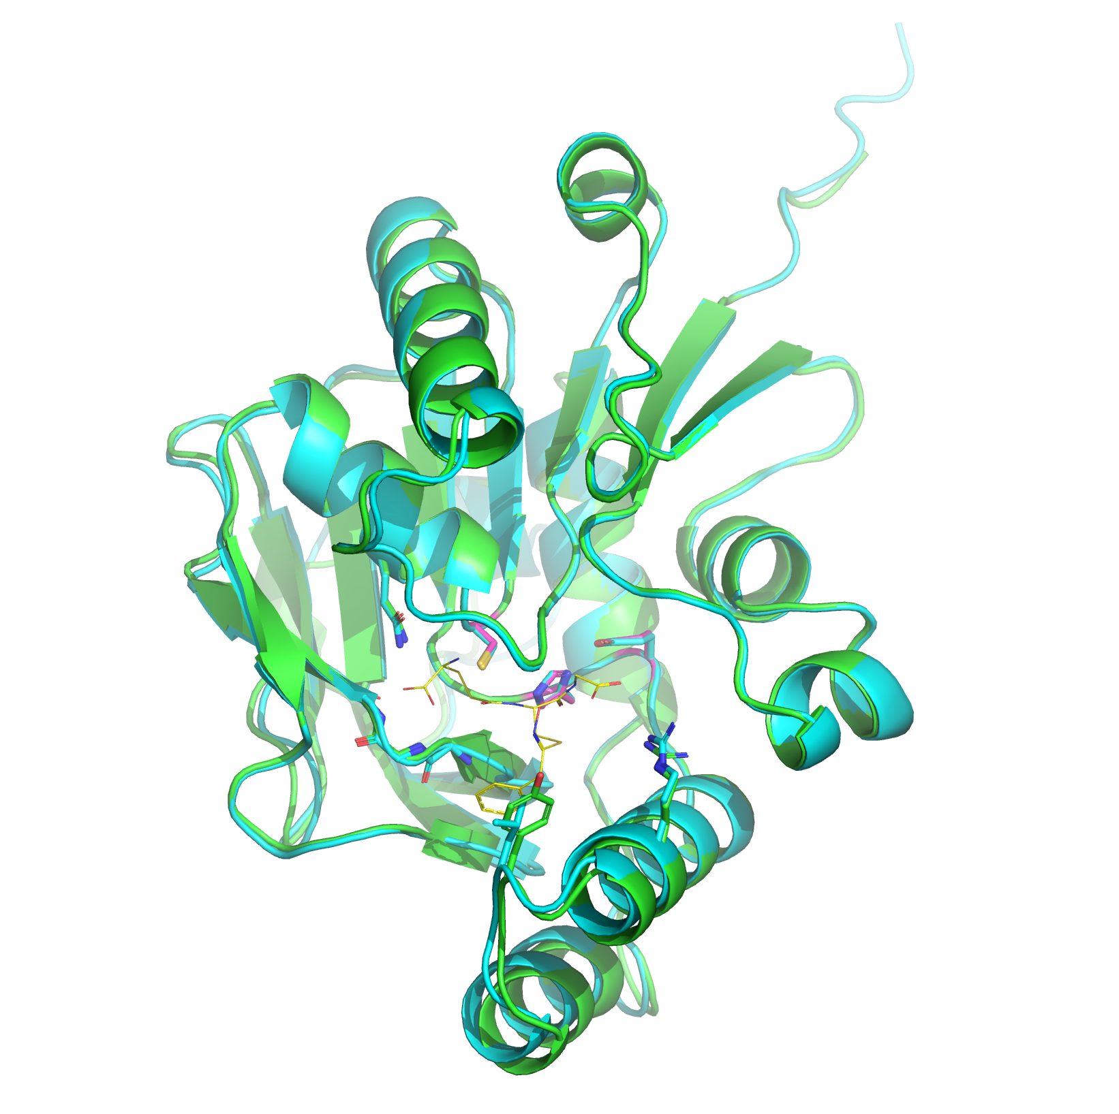
GGP1/GGP3
Q104
Q107
R206
R210
Y212
L216
Figure S6. Superimposition of the predicted protein structures of GGP1 (green) and GGP3 (cyan). The catalytic triad residues of GGP1 are shown as magenta sticks. GS-B model is shown as yellow thin lines.

