Slide 1
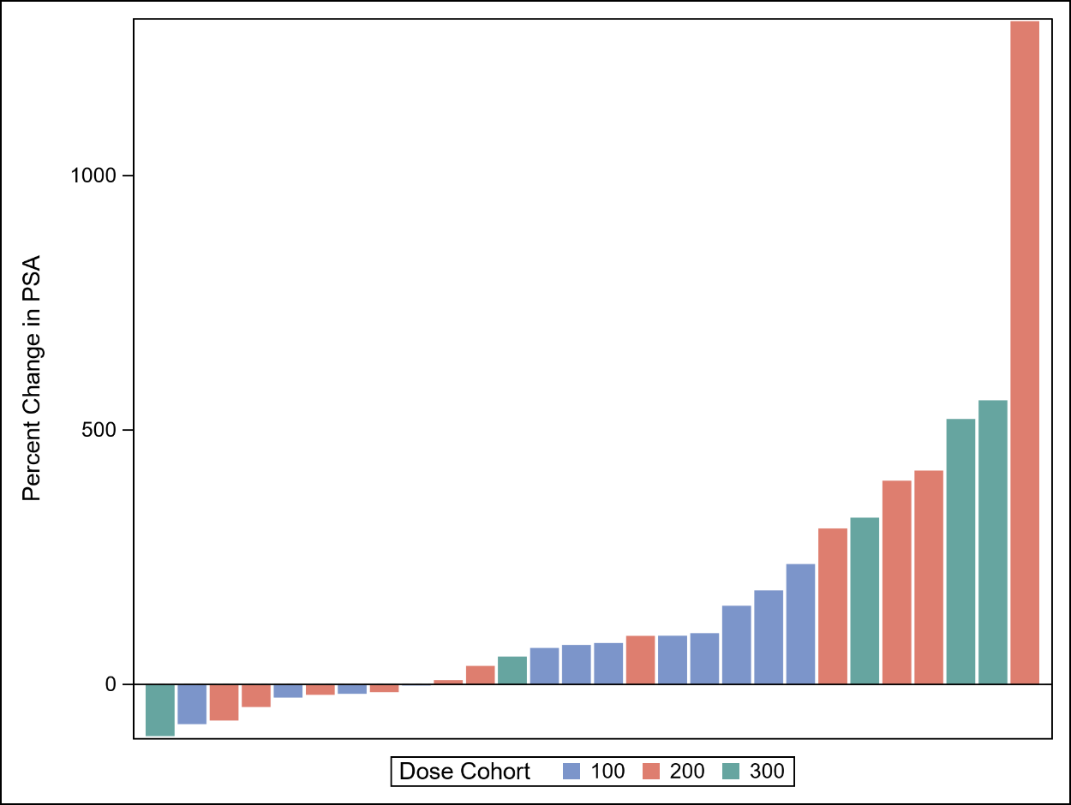
Supplemental Figure 1: Waterfall plot of PSA change

