Slide 1
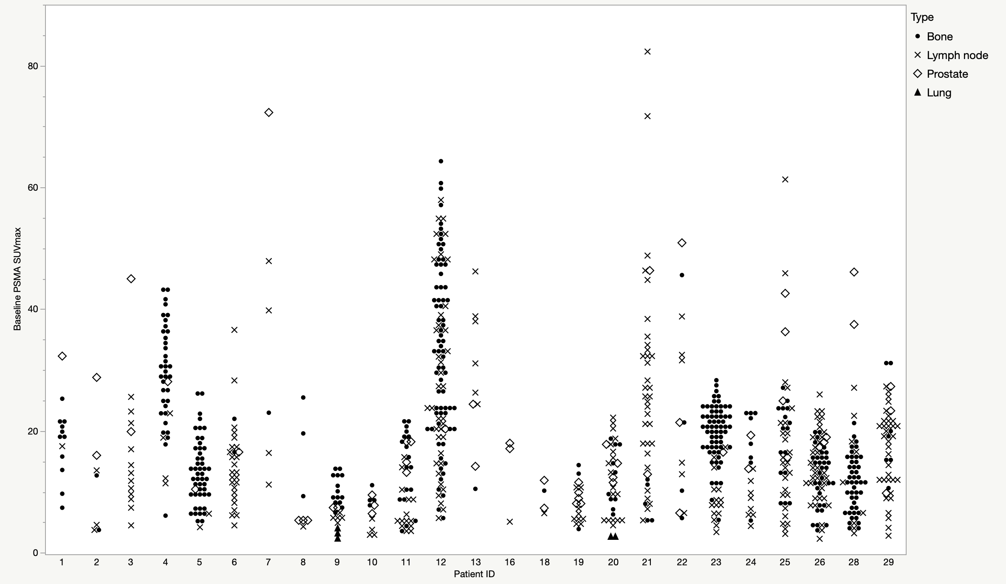
Suppl Fig 1 Baseline PSMA SUVmax of PCa lesions at the patient level

Slide 2
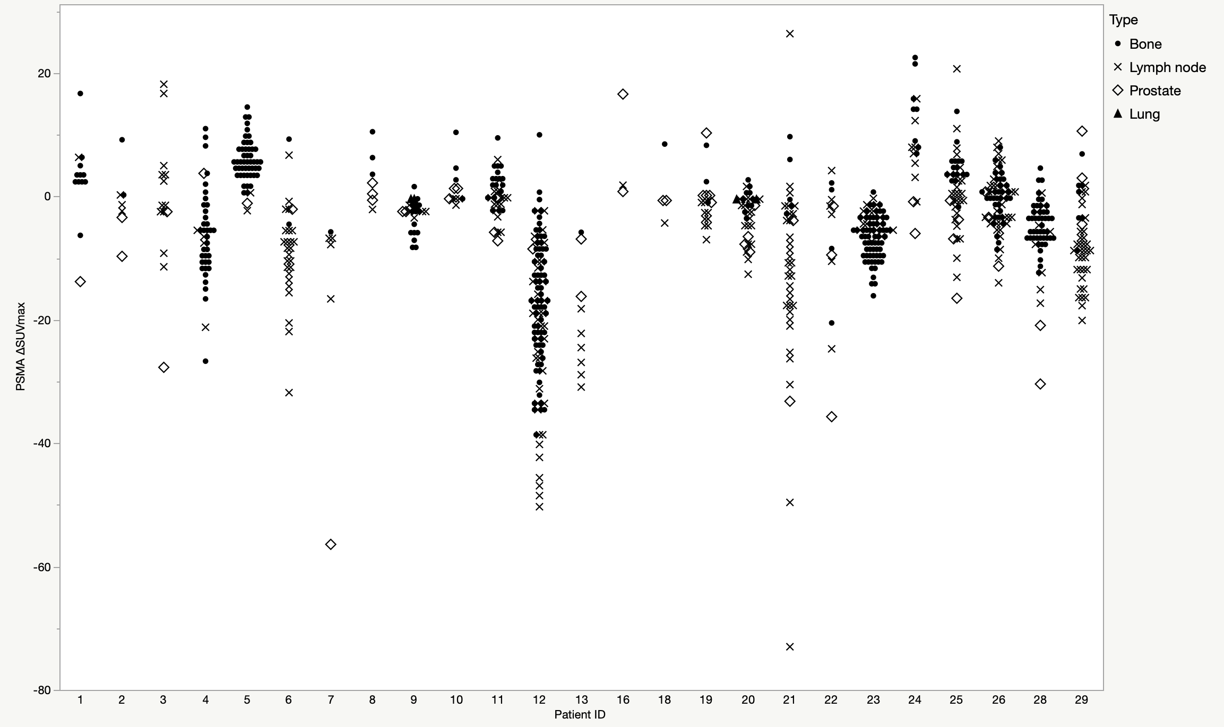
Suppl Fig 2 PSMA ΔSUVmax of PCa lesions at the patient level

Slide 3
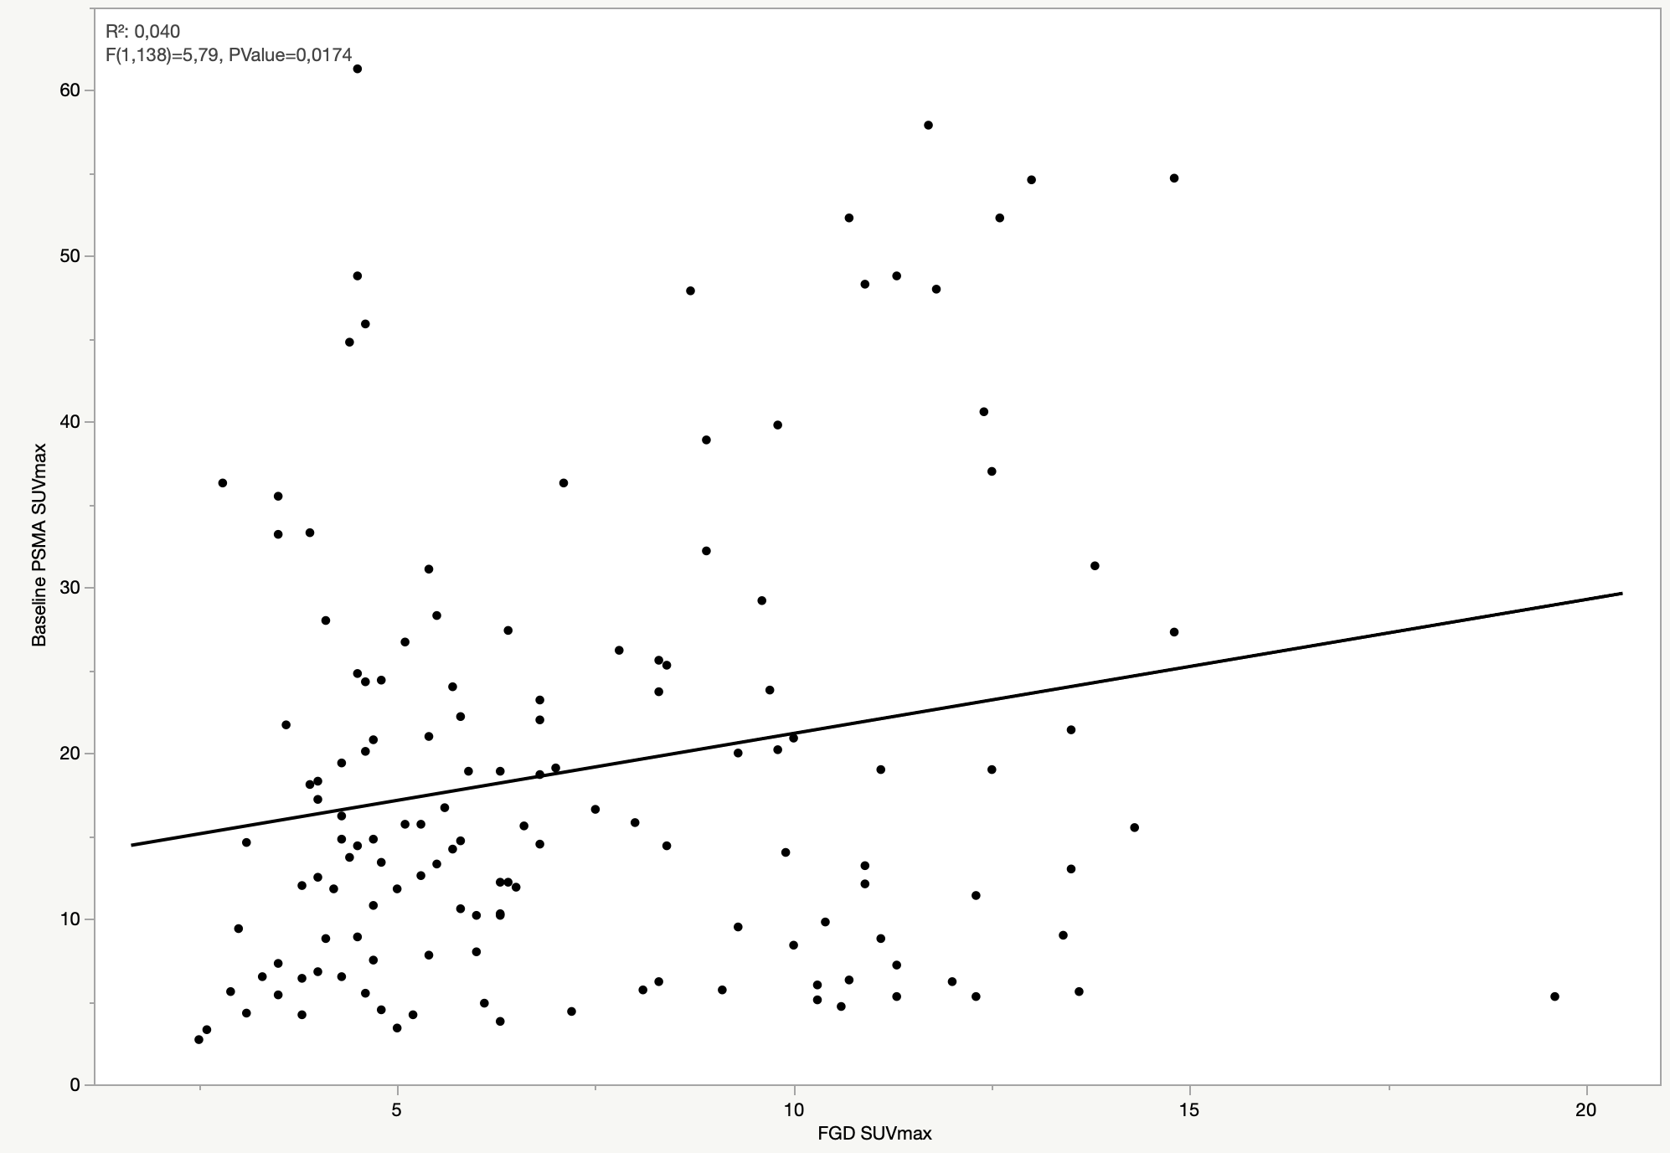
Suppl Fig 3 Correlation between baseline PSMA SUVmax and FDG SUVmax in lymph node lesions

Slide 4
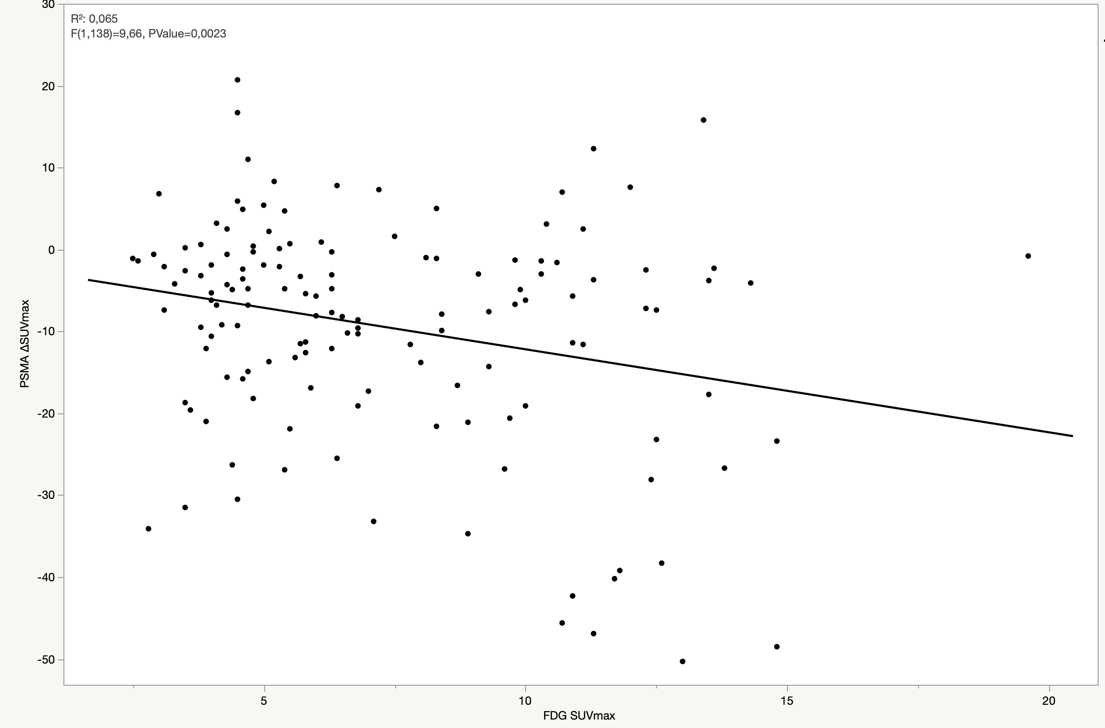
Suppl Fig 4 Correlation between PSMA ΔSUVmax and FDG SUVmax in lymph node lesions

Slide 5
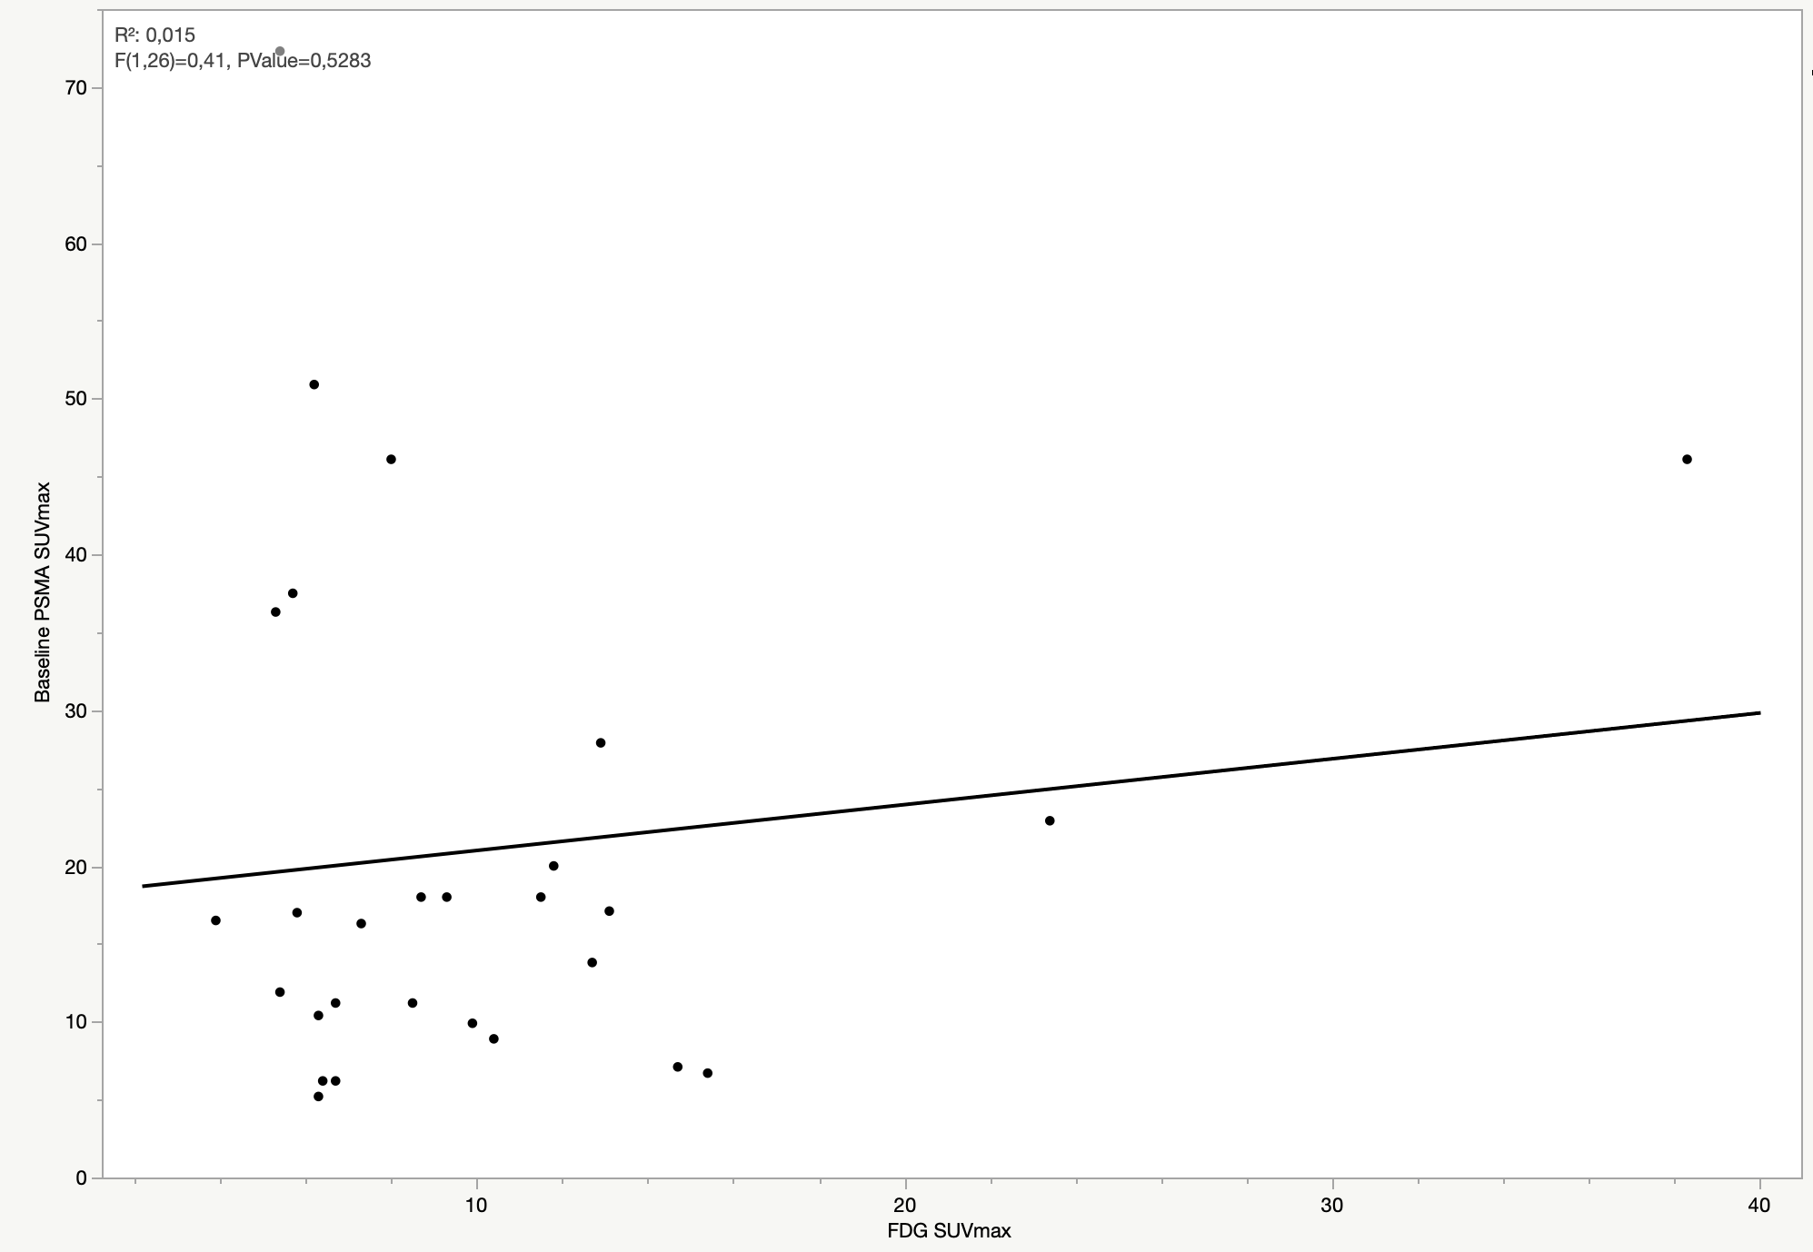
Suppl Fig 5 Correlation between baseline PSMA SUVmax and FDG SUVmax in prostatic lesions

Slide 6
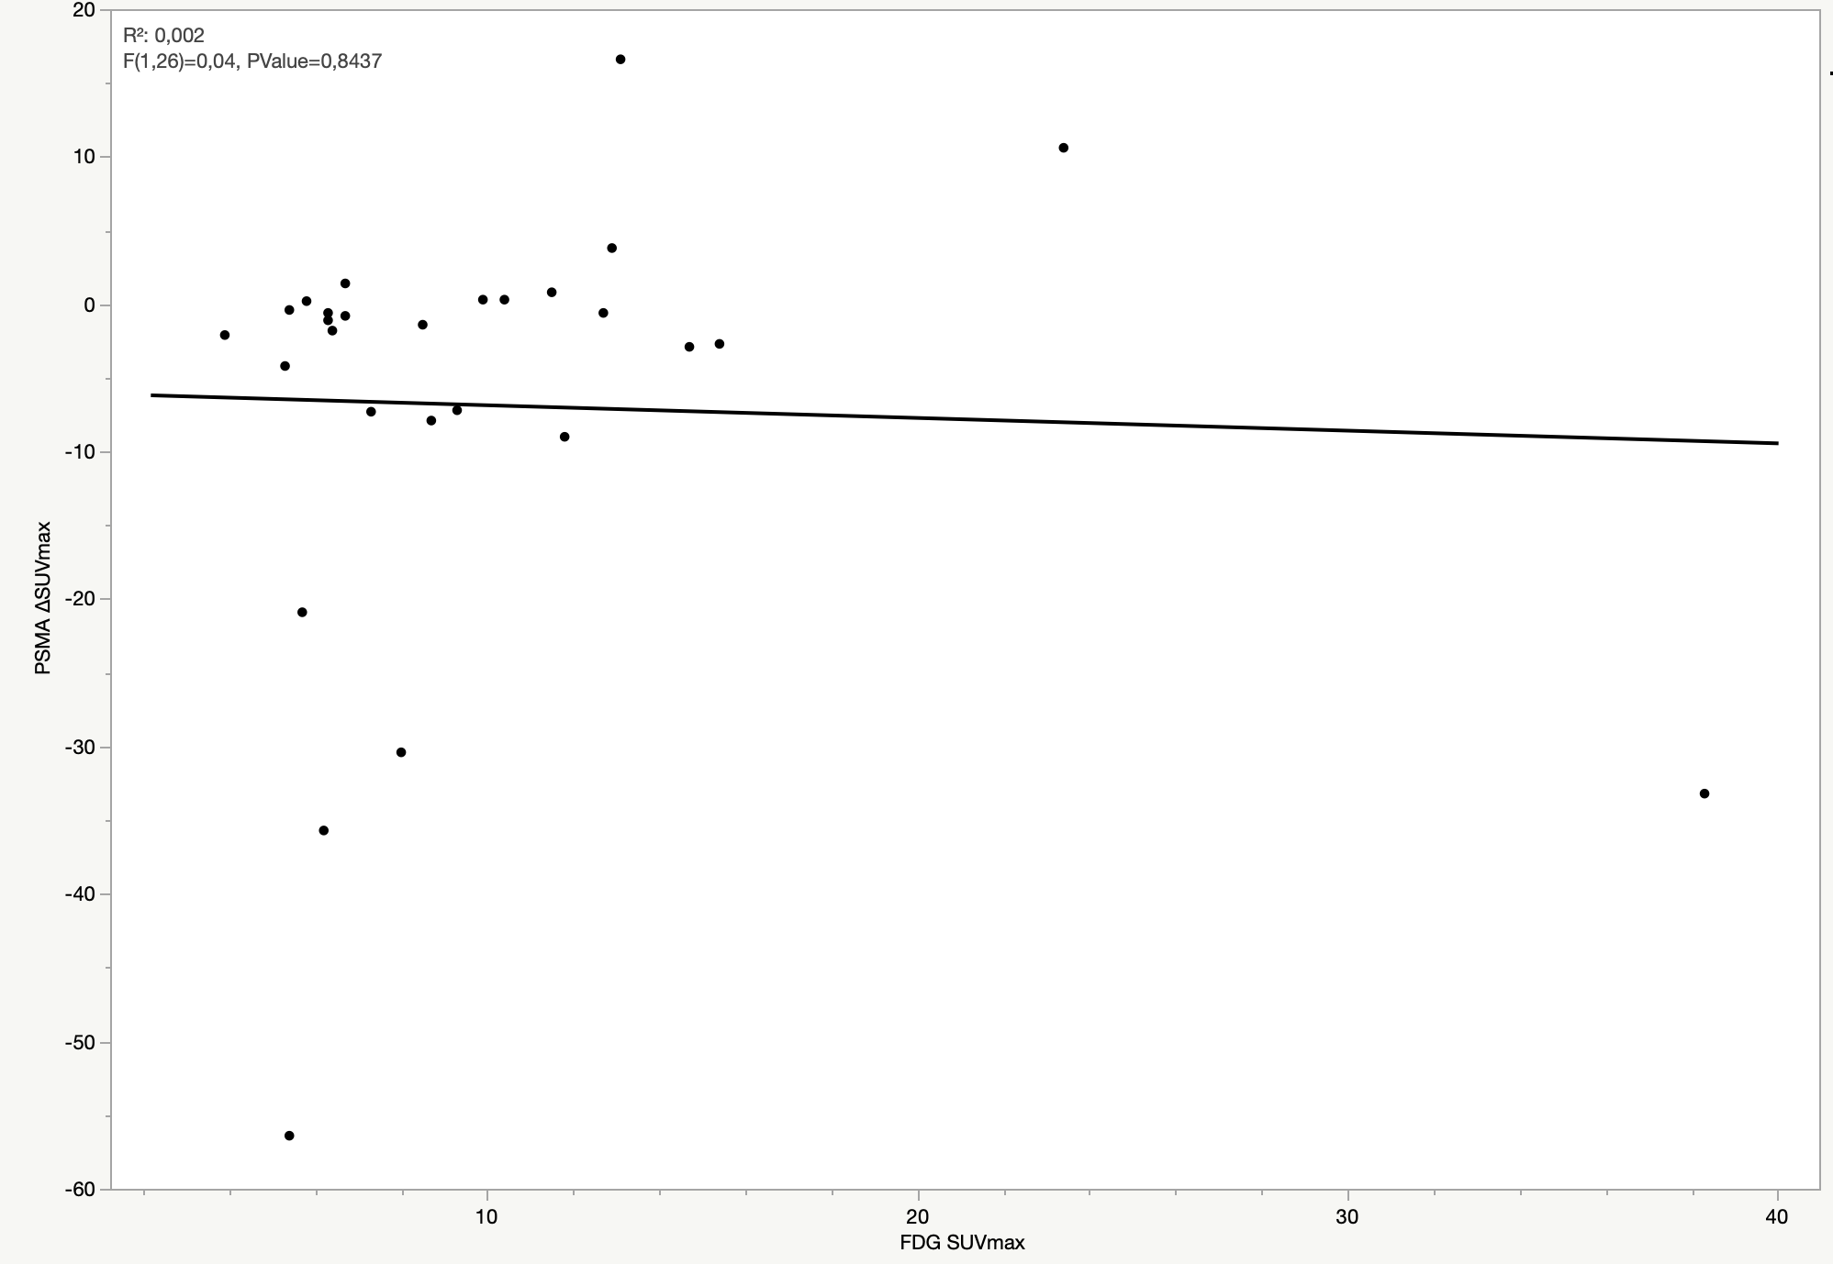
Suppl Fig 6 Correlation between PSMA ΔSUVmax and FDG SUVmax in prostatic lesions

Slide 7
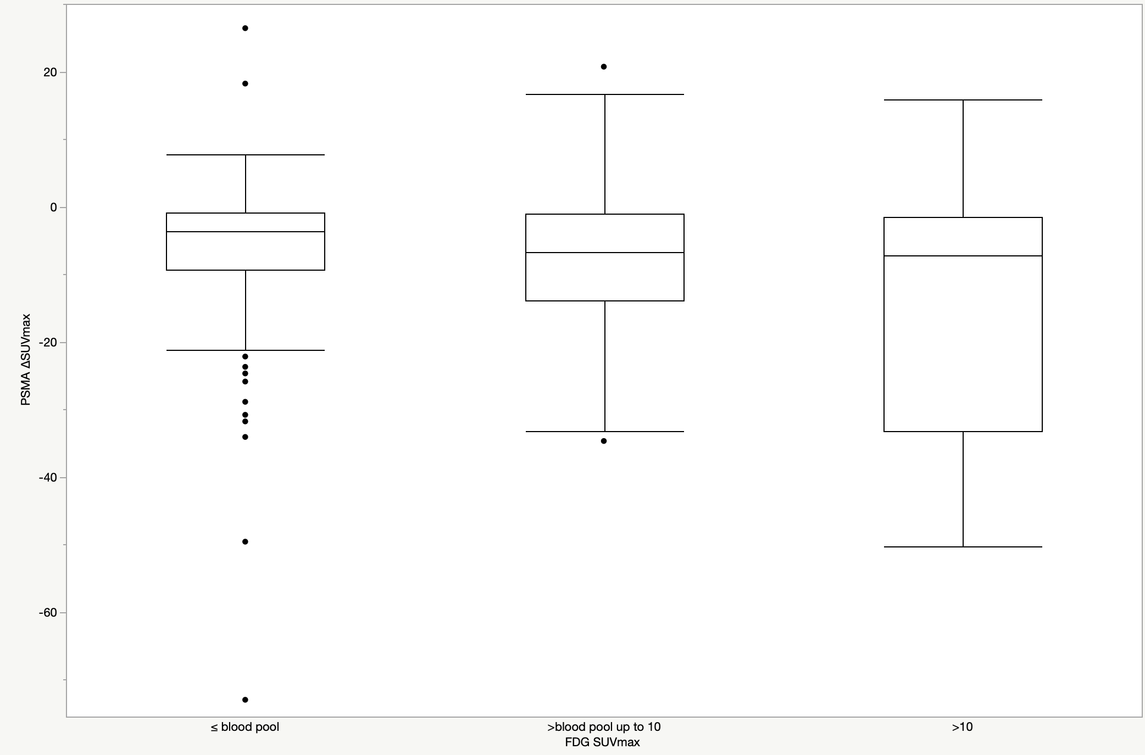
Suppl Fig 7 Box plot for PSMA ΔSUVmax according to FDG SUVmax in lymph node lesions
*
*
*p<0,0001

Slide 8
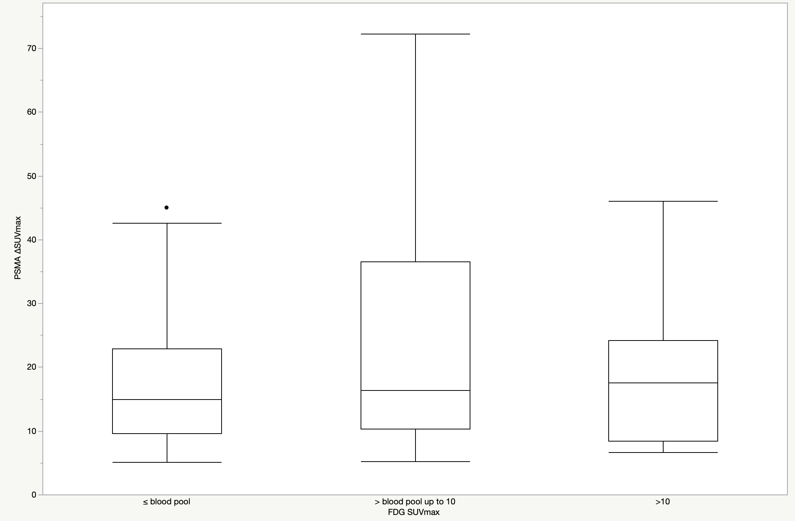
Suppl Fig 8 Box plot for PSMA ΔSUVmax according to FDG SUVmax in prostatic lesions

