Slide 1
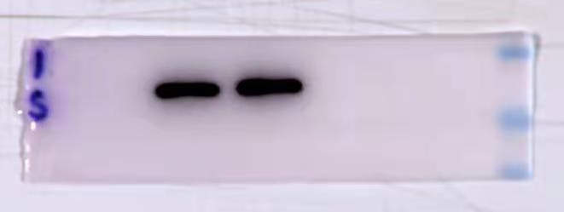
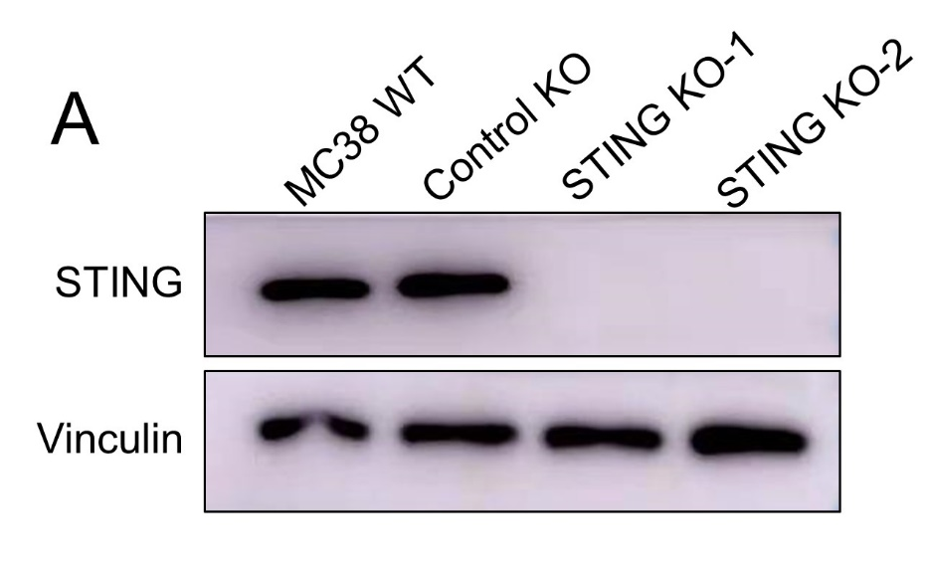
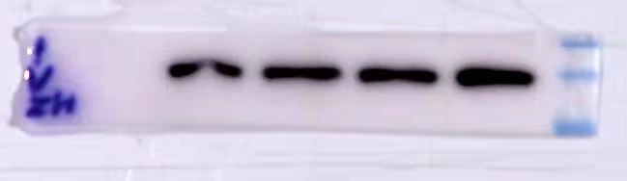
Figure 1A
43 kD
34 kD
26 kD
STING (37 kD)
180 kD
130 kD
95 kD
Vinculin (120 kD)

Slide 2
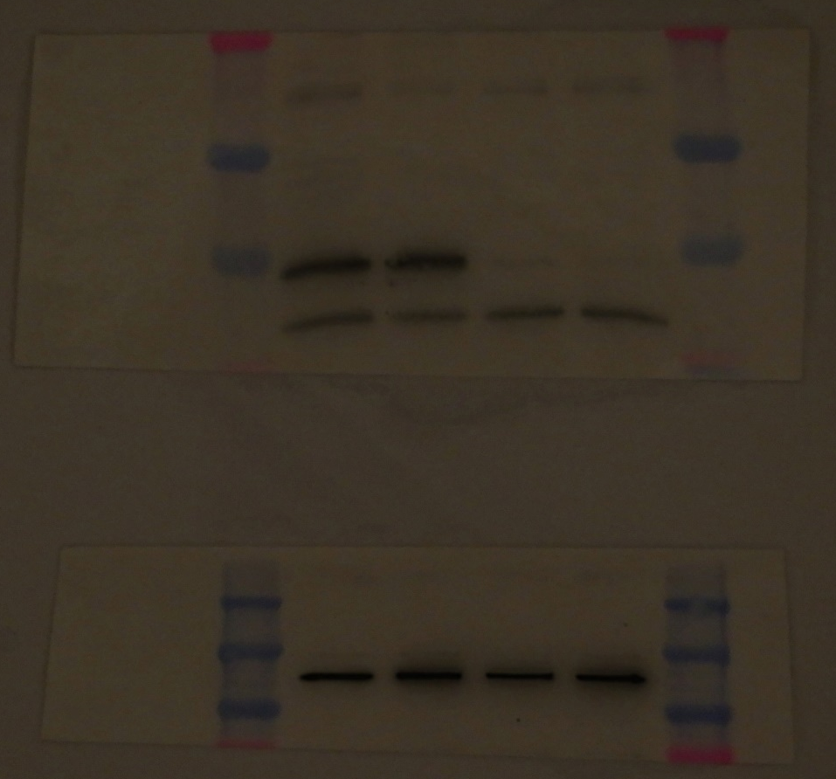
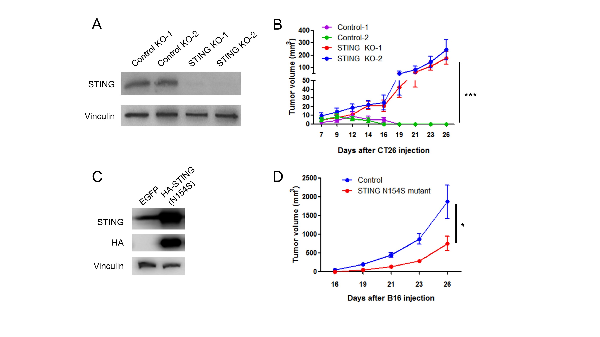
Figure 2
STING (37 kD)
75 KD
50 KD
37 KD
250 KD
150 KD
100 KD
75 KD
Vinculin (120 kD)

Slide 3
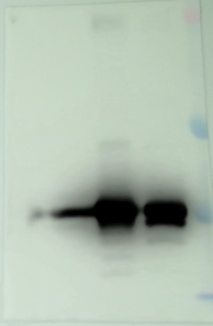
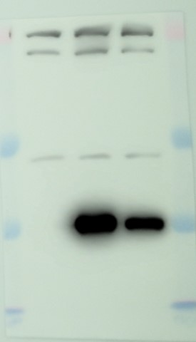
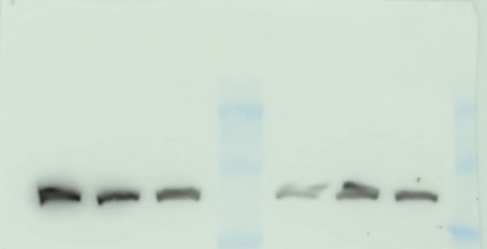
HA-STING
(N154S)
HA-STING
(N154S)
Figure 2
EGFP
EGFP
75 KD
75 KD
50 KD
50 KD
37 KD
37 KD
STING (37 kD)
HA-STING
(N154S)
HA tag (37 kD)
EGFP
250 KD
150 KD
100 KD
Vinculin (120 kD)

Slide 4
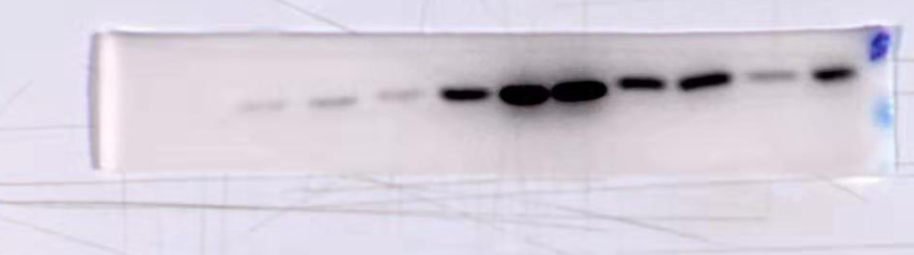
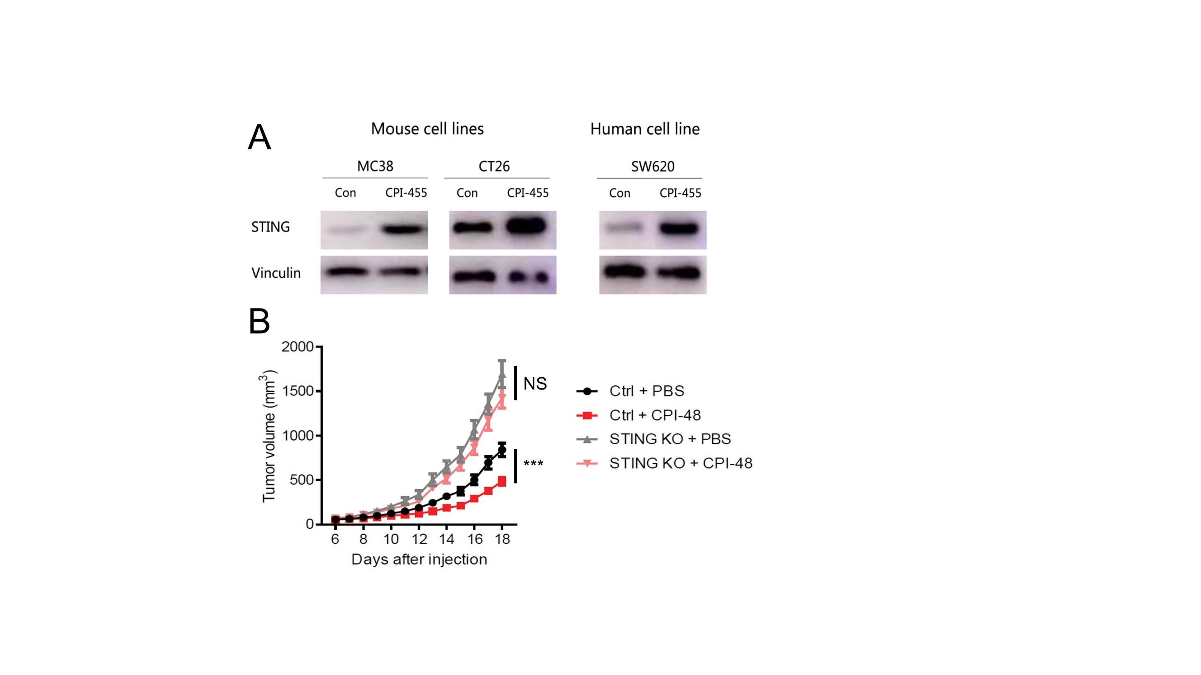
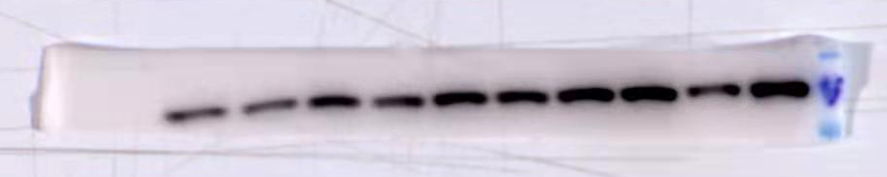
Figure 6
43 kD
34 kD
26 kD
STING (37 kD)
180 kD
130 kD
95 kD
Vinculin (120 kD)

Slide 5
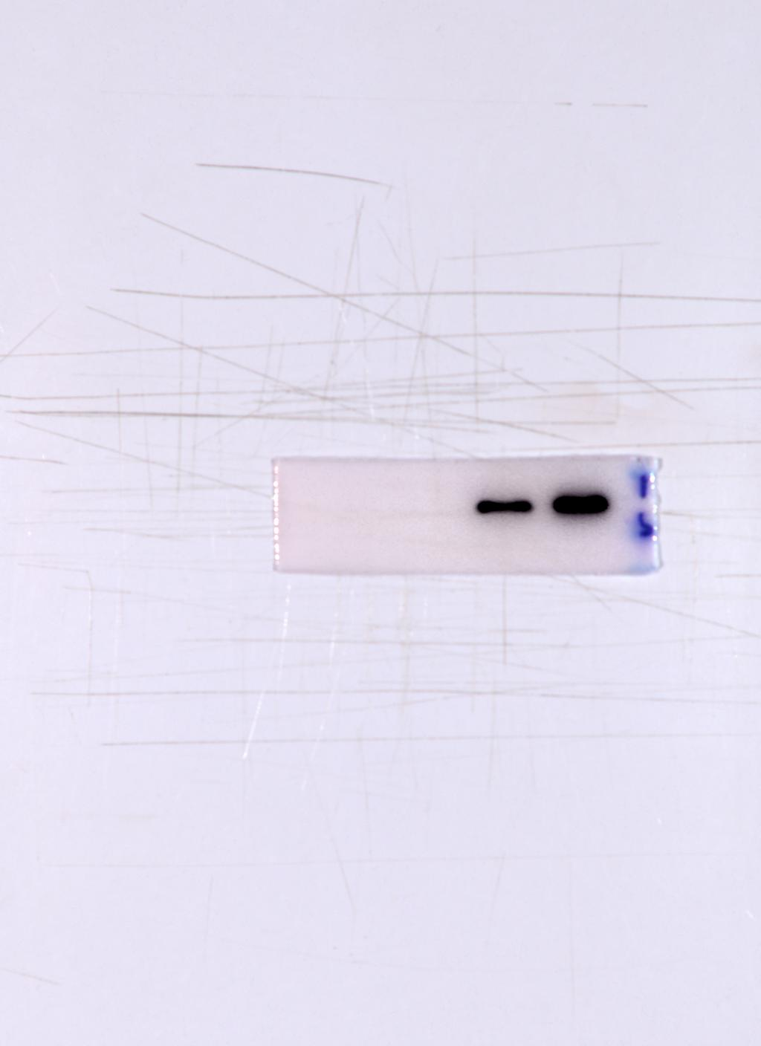
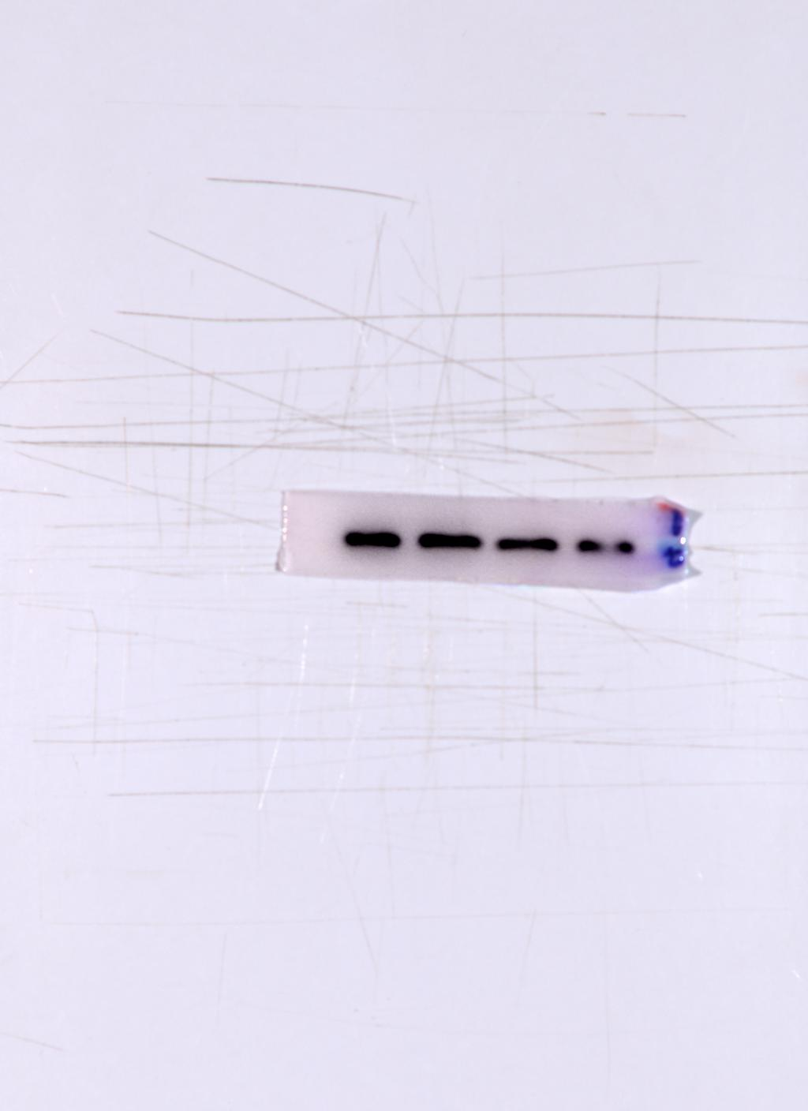
Figure 6
43 kD
34 kD
26 kD
STING (37 kD)
130 kD
72 kD
Vinculin (120 kD)

