Slide 1
Additional File 4: Table S3. Manually excluded false positive off-target sites from Digenome-seq and Extru-seq WGS data visualized using IGV.

Slide 2
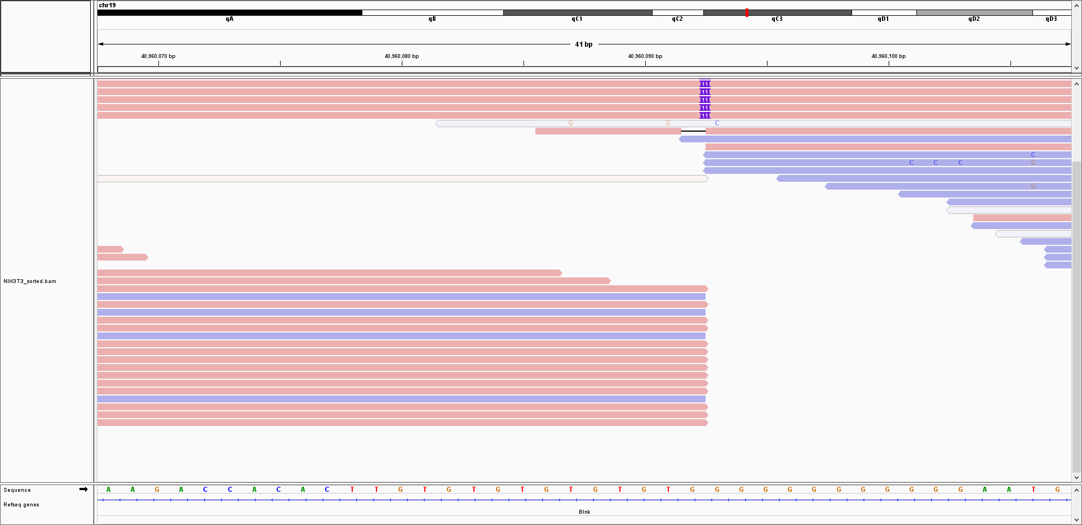
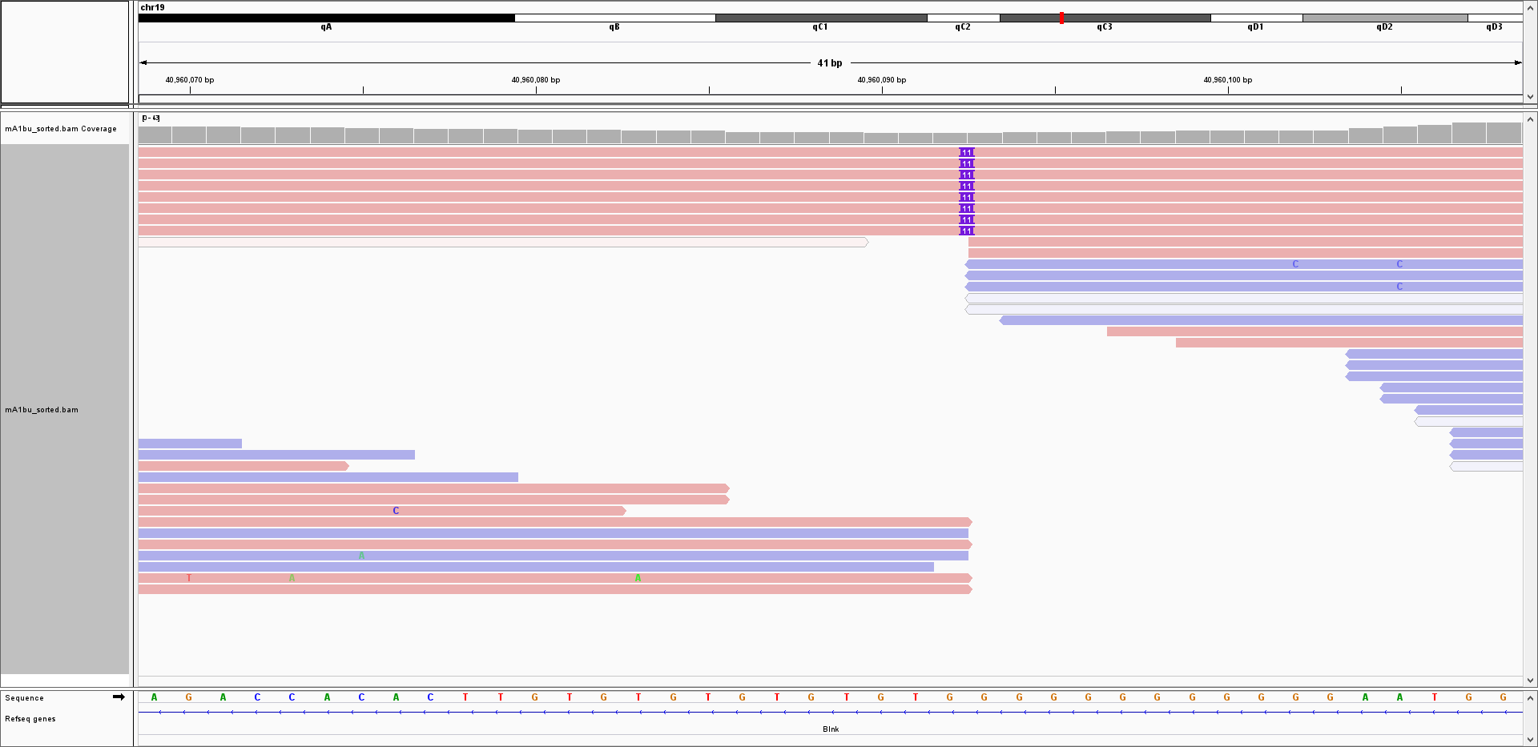
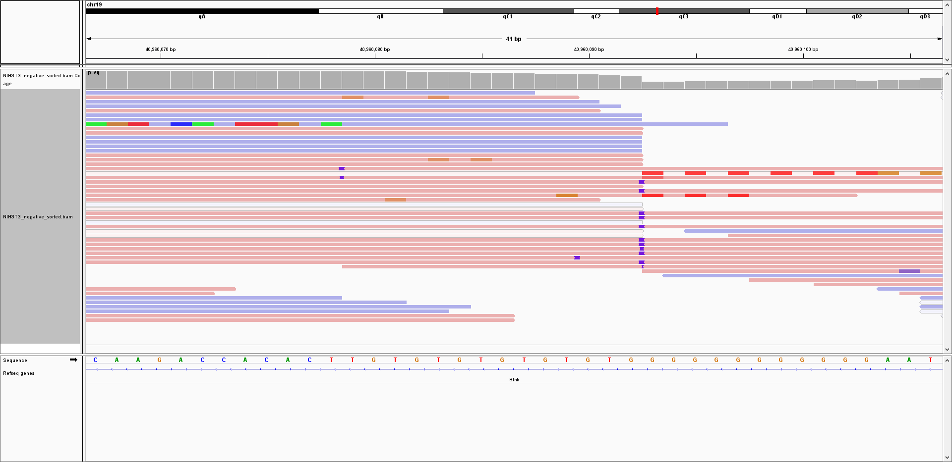
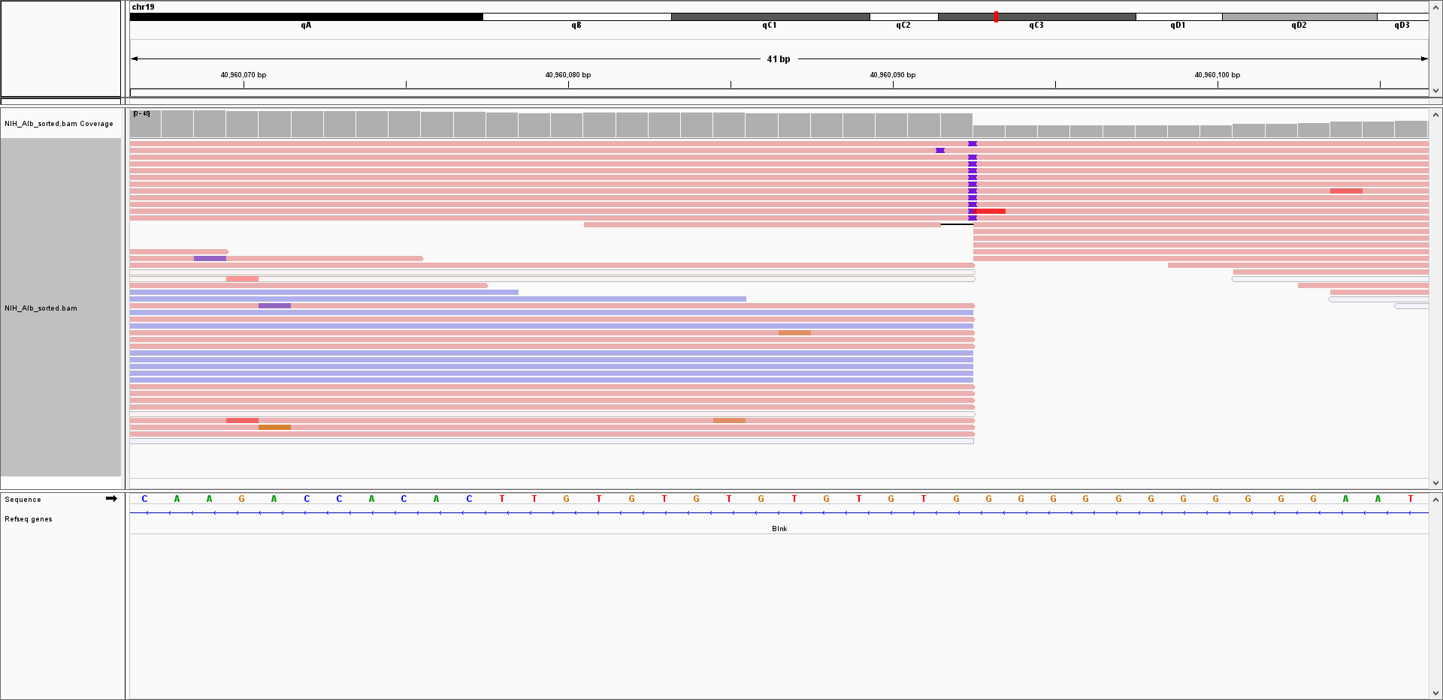
○ Mouse Albumin chr19:40960093
Digenome-seq
Control
Digenome-seq
Extru-seq
Control
Extru-seq
ACtTGtgTgTGTgTGTGgGGGG
ACtTGtgTgTGTgTGTGgGGGG
ACtTGtgTgTGTgTGTGgGGGG
ACtTGtgTgTGTgTGTGgGGGG
Position | Target | Mismatch | Bulge | Bulge type | Cleavage score
 |  |  |  |  | Dignome-seq Control | Digenome-seq | Control | Extru-seq
chr19:40960093 | ACtTGtgTgTGTgTGTGgGGGG | 6 | 0 | X | -0.026 | 0.202803 | -0.094 | 0.5536

Slide 3
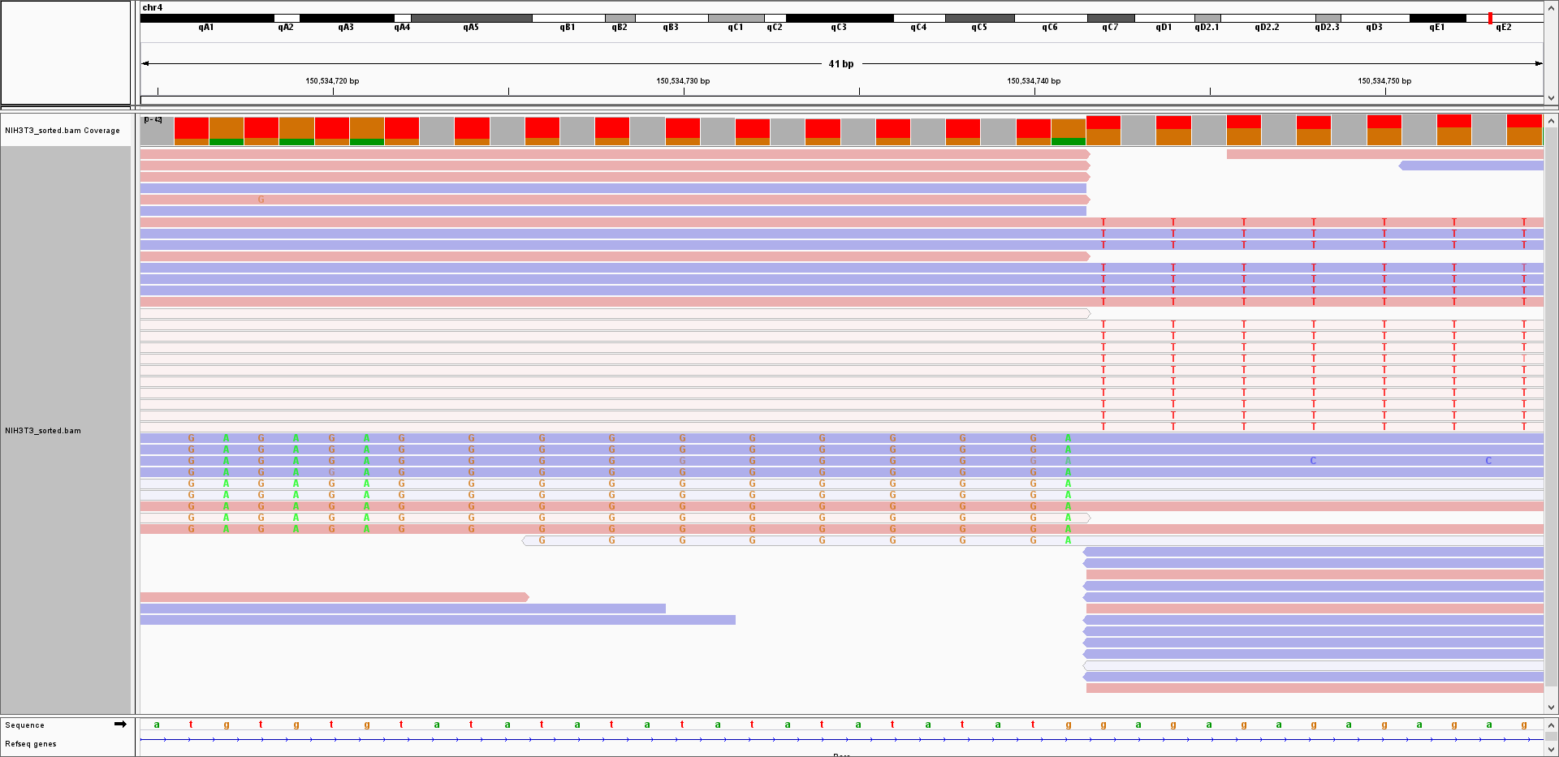
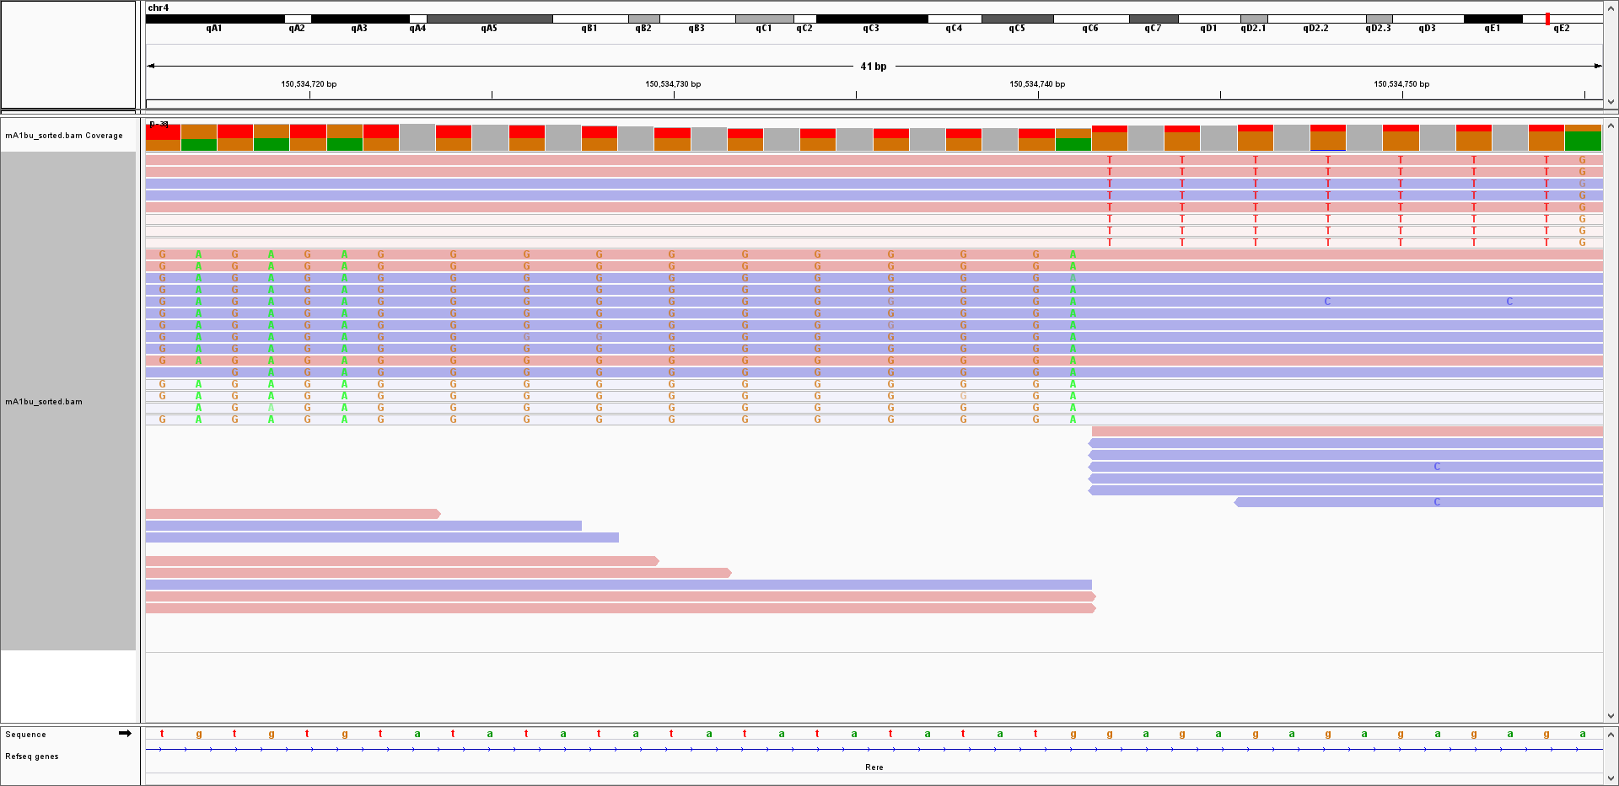
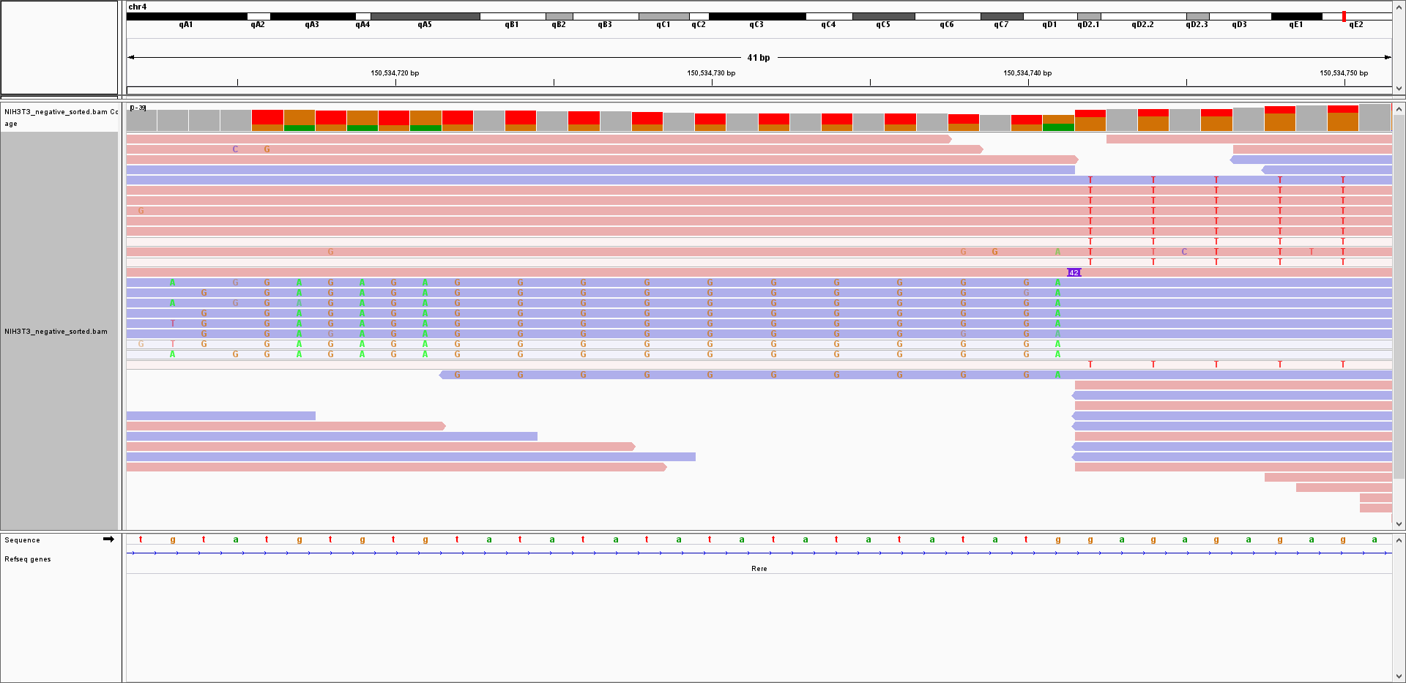
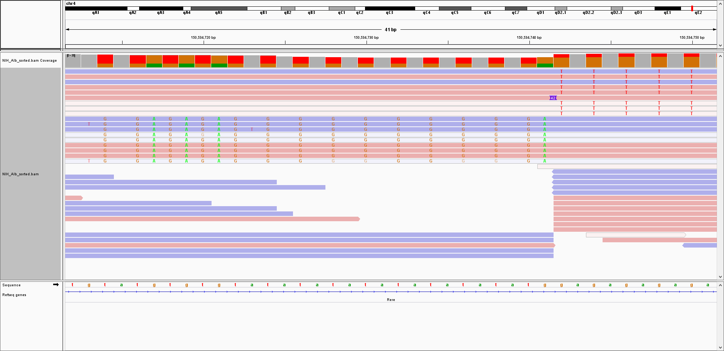
○ Mouse Albumin chr4:150534742
Digenome-seq
Control
Digenome-seq
Extru-seq
Control
Extru-seq
AtAT--ATATATaTATaTaTGGAG
AtAT--ATATATaTATaTaTGGAG
AtAT--ATATATaTATaTaTGGAG
AtAT--ATATATaTATaTaTGGAG
Position | Target | Mismatch | Bulge | Bulge type | Cleavage score
 |  |  |  |  | Dignome-seq Control | Digenome-seq | Control | Extru-seq
chr4:150534742 | AtAT--ATATATaTATaTaTGGAG | 4 | 2 | RNA | 0.210884 | 0.000 | -0.011 | 0.485347

Slide 4
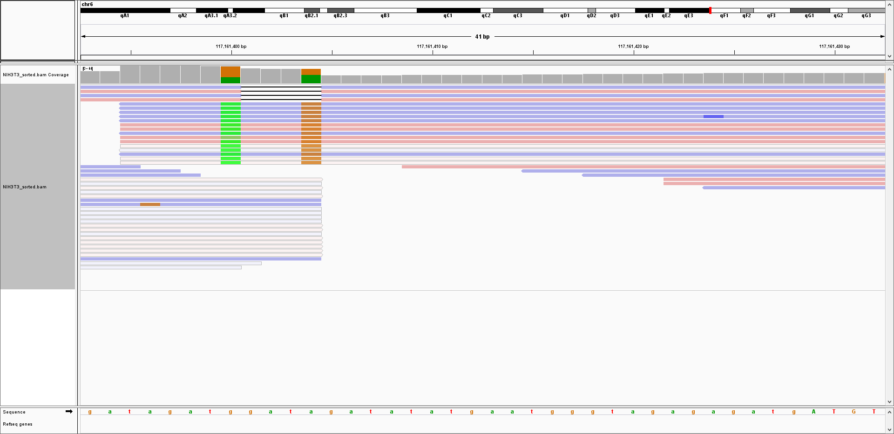
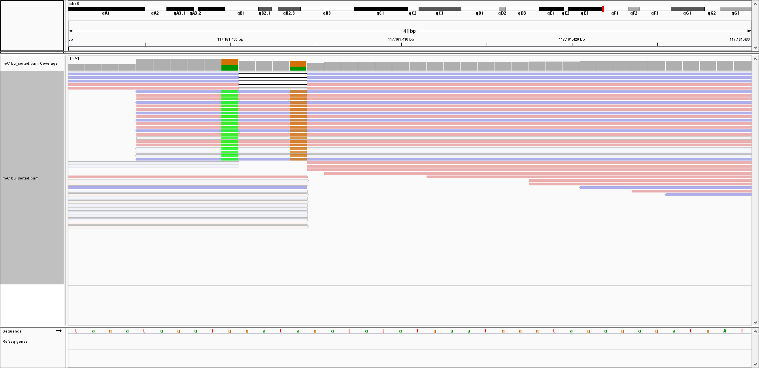
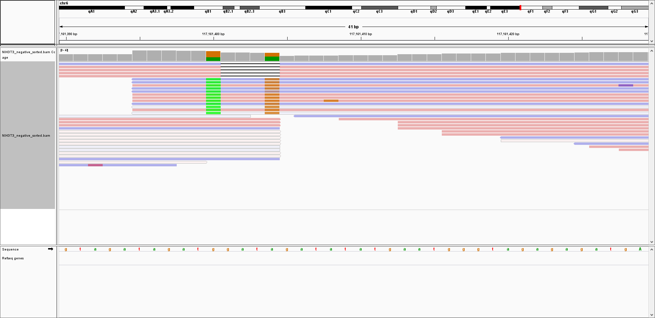
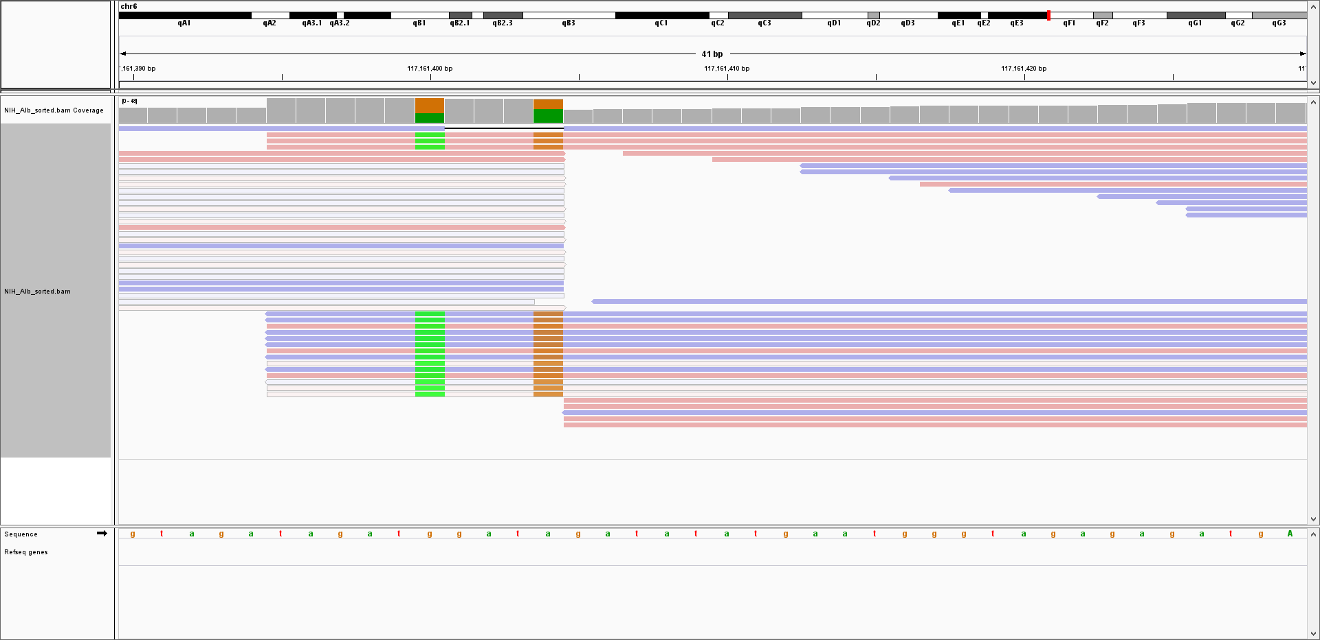
○ Mouse Albumin chr6:117161405
Digenome-seq
Control
Digenome-seq
Extru-seq
Control
Extru-seq
TAgAT--ATATATGaATGgGTaGAG
TAgAT--ATATATGaATGgGTaGAG
TAgAT--ATATATGaATGgGTaGAG
TAgAT--ATATATGaATGgGTaGAG
Position | Target | Mismatch | Bulge | Bulge type | Cleavage score
 |  |  |  |  | Dignome-seq Control | Digenome-seq | Control | Extru-seq
chr6:117161405 | TAgAT--ATATATGaATGgGTaGAG | 4 | 2 | RNA | -0.568 | 0.138 | -0.089 | 0.082502

