Slide 1
Supplementary file 1:
Title: TEM1 up-regulates MMP-2 and promotes ECM remodeling for facilitating invasion and migration of uterine sarcoma
Authors: Chenghao Wu1, Wenhuizi Sun, Dongsheng Shen, Huaifang Li, Xiaowen Tong, Yi Guo*

Slide 2
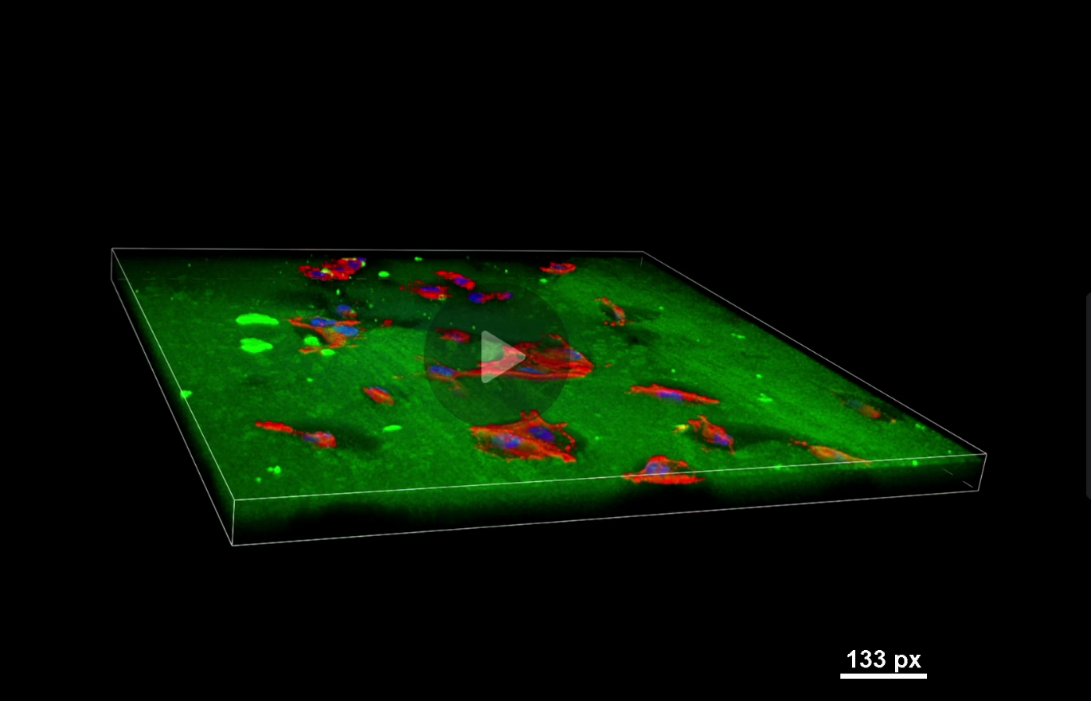
MDA-MB-231
Supplementary Video1: Breast cancer cell line MDA-MB-231 was included as a positive control (PC) . After 12 hours of incubation, black areas of degradation were shown underneath the cell body and cells were found within the degraded areas, as shown by two-dimensional and (left) three-dimensional (right) images.

Slide 3
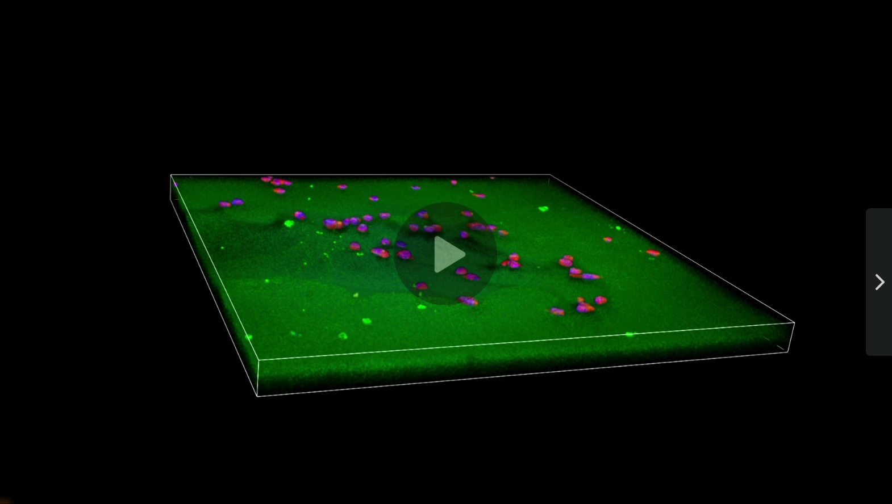
hTEM1 MES-SA
Supplementary : Video 2: A three-dimensional (3D) video of gelatin degradation by hTEM1 MES-SA cells. (Left) A two-dimensional (2D) image of a pool-like black degradation area with cells close to the matrix boundaries. (Right) The corresponding three-dimensional (3D) image depicted the depth of degraded gelatin inside a pool with cells presented on different layers.

Slide 4
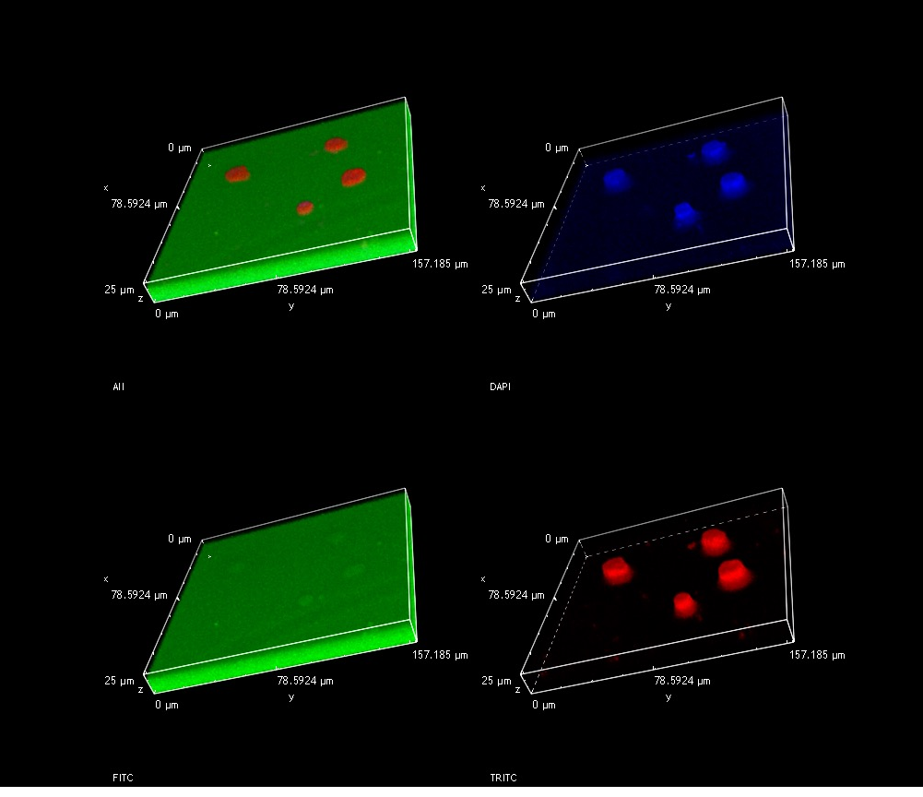
Three-dimensional images of gelatin degradation
NC
hTEM1
shRNA-TEM1
A
Merged
DAPI
B
Merged
DAPI
C
Merged
DAPI
Merged
FITC
Phalloidin
FITC
Phalloidin
FITC
Phalloidin
Supplementary : images: Three-dimensional images of gelatin degradation. (A) Representative images of NC-MES-SA cells on gelatin (Enlarged). (B) Representative images of hTEM1-MES-SA cells on gelatin (Enlarged). (C) Representative images of shRNA-TEM1-MES-SA cells on gelatin (Enlarged).Cells can be seen inside of the degraded areas (yellow arrows). Different layers of degradation are shown (gray arrows).

