Slide 1
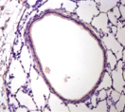
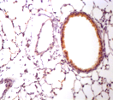
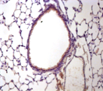
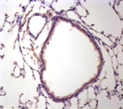
a
*
*
CS
-
+
-
+
b
TERT- positive area per small airway (µm²)
**
TA-65
-
-
+
+
TERT
CS
-
+
-
+
TA-65
-
-
+
+

