Slide 1
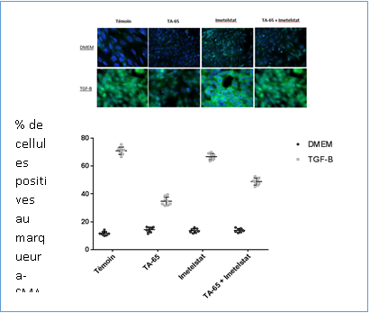
a
b
TA-65 + Imetelstat
Control
TA-65
Imetelstat
Control
TA-65
Imetelstat
DMEM
DMEM
TGF-β1
TGF-β1
α-SMA
α-SMA
MPLF
MEF

