Slide 1
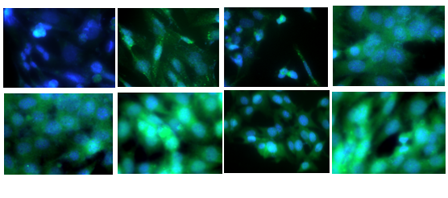
a
TA-65 + Imetelstat
Untreated
TA-65
Imetelstat
DMEM
TGF-β1
Catalase

