Slide 1
Supp Fig S1. Bomedemstat strongly suppresses growth of a LSD1i-sensitive SCLC PDX model.

Slide 2
Supp Fig S2. Quantification of bomedemstat-induced protein expression changes in FHSC04.
A
B
C
D
E

Slide 3
Supp Fig S3. Bomedemstat activates NOTCH signaling and inflammatory gene expression pathways in mSCLC cell lines.

Slide 4
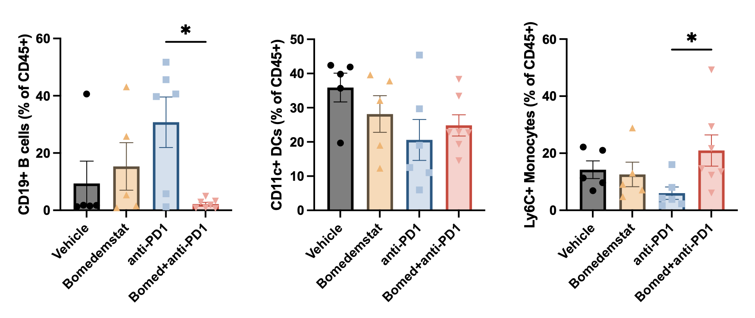
Supp Fig S4. Quantification of additional immune cell subsets in an immunocompetent syngeneic murine model of SCLC treated with bomedemstat and PD1 inhibition
A
B
C
Notes:
/Users/jhiatt/Library/CloudStorage/OneDrive-FredHutchinsonCancerResearchCenter/RESEARCH/Projects/LSD1_AND_REST/LSD1/02052021_03OVA_tumors.pzfx alias

Slide 5
Supp Fig S5. Gene set enrichment analysis results for all MSigDB Hallmark pathways in RP-48_{OVA-LLO190} flank tumors.
A
B

Slide 6
Supp Fig S6. Tumor growth kinetics and gating strategy from 10 day treatment course immunocompetent flank tumor experiment.
A
B
Representative vehicle-treated tumor
Side scatter
Side scatter
Side scatter
Side scatter
Forward scatter
Viability dye
CD45
H-2K^{b}
Representative bomedemstat+anti-PD1-treated tumor
Side scatter
Side scatter
Side scatter
Side scatter
Forward scatter
Viability dye
CD45
H-2K^{b}

Slide 7
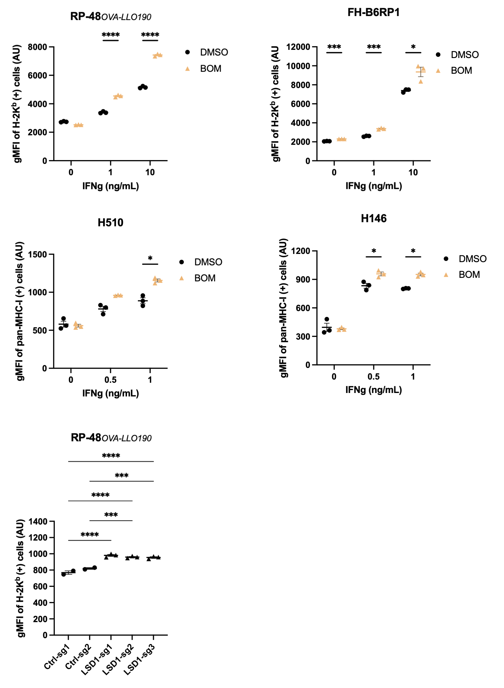
Supp Fig S7. LSD1 inhibition-induced MHC-I surface expression intensity in ASCL1+ models.
A
B
C
D
E
Notes:
/Users/jhiatt/Library/CloudStorage/OneDrive-FredHutchinsonCancerResearchCenter/RESEARCH/Projects/LSD1_AND_REST/LSD1/2022 Manuscript/202204 CCR sub/220525 revision/LSD1 CCR resub figure layouts.pzfx

Slide 8
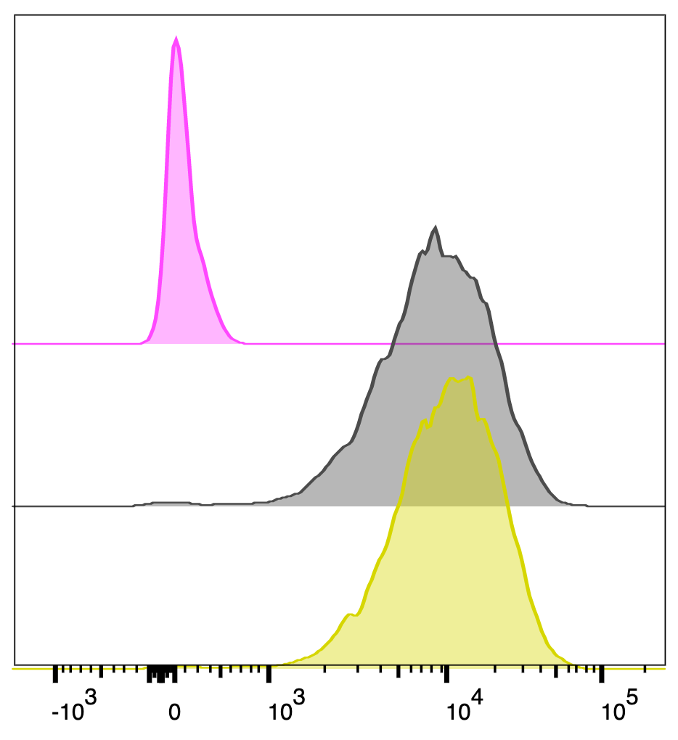
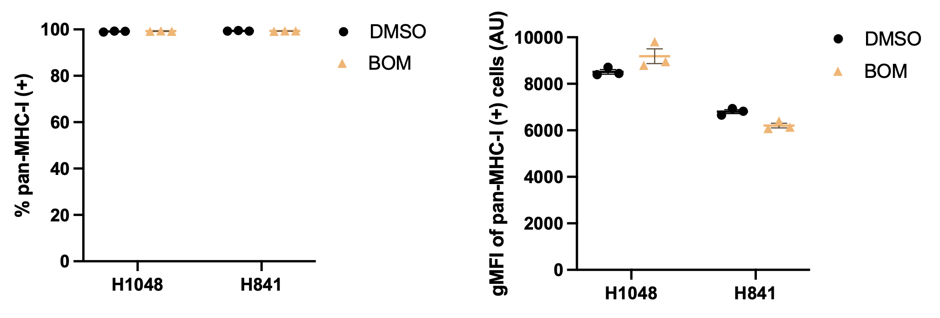
Supp Fig S8. Absence of bomedemstat effect on surface MHC-I levels in ASCL1-low models.
A
B
C
H1048
DMSO
Isotype
Events (normalized to mode)
DMSO
pan-MHC-I
BOM
pan-MHC-I
pan-MHC-I fluorescence intensity
Notes:
/Users/jhiatt/Library/CloudStorage/OneDrive-FredHutchinsonCancerResearchCenter/220525 CCR Revisions/LSY Prism Data Files/human cells/Wrong IFNG/H1048 and H841.pzfx
Histogram: /Users/jhiatt/Library/CloudStorage/OneDrive-FredHutchinsonCancerResearchCenter/220525 CCR Revisions/LSY Prism Data Files/human cells/Wrong IFNG/H1048-FCS file

Slide 9
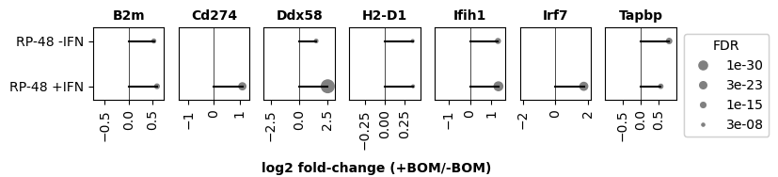
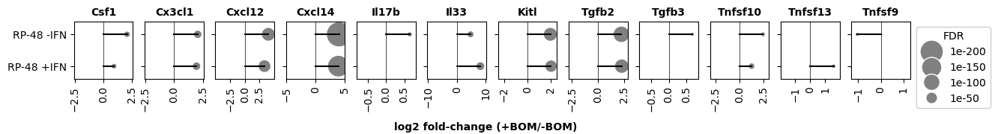
Supp Fig S9. Bomedemstat-induced differential expression of cytokine and other immune-related transcripts.
A
B

Slide 10
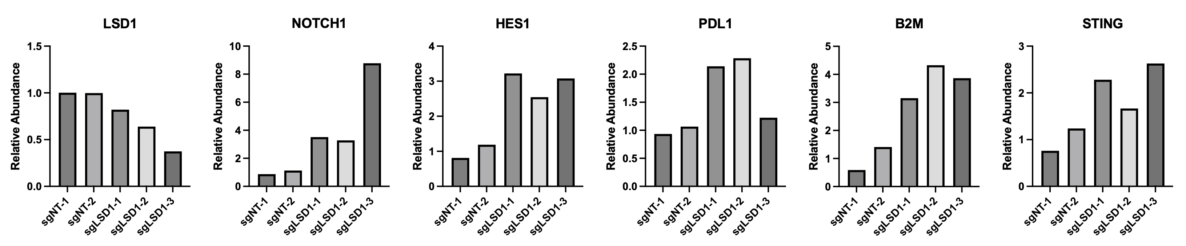
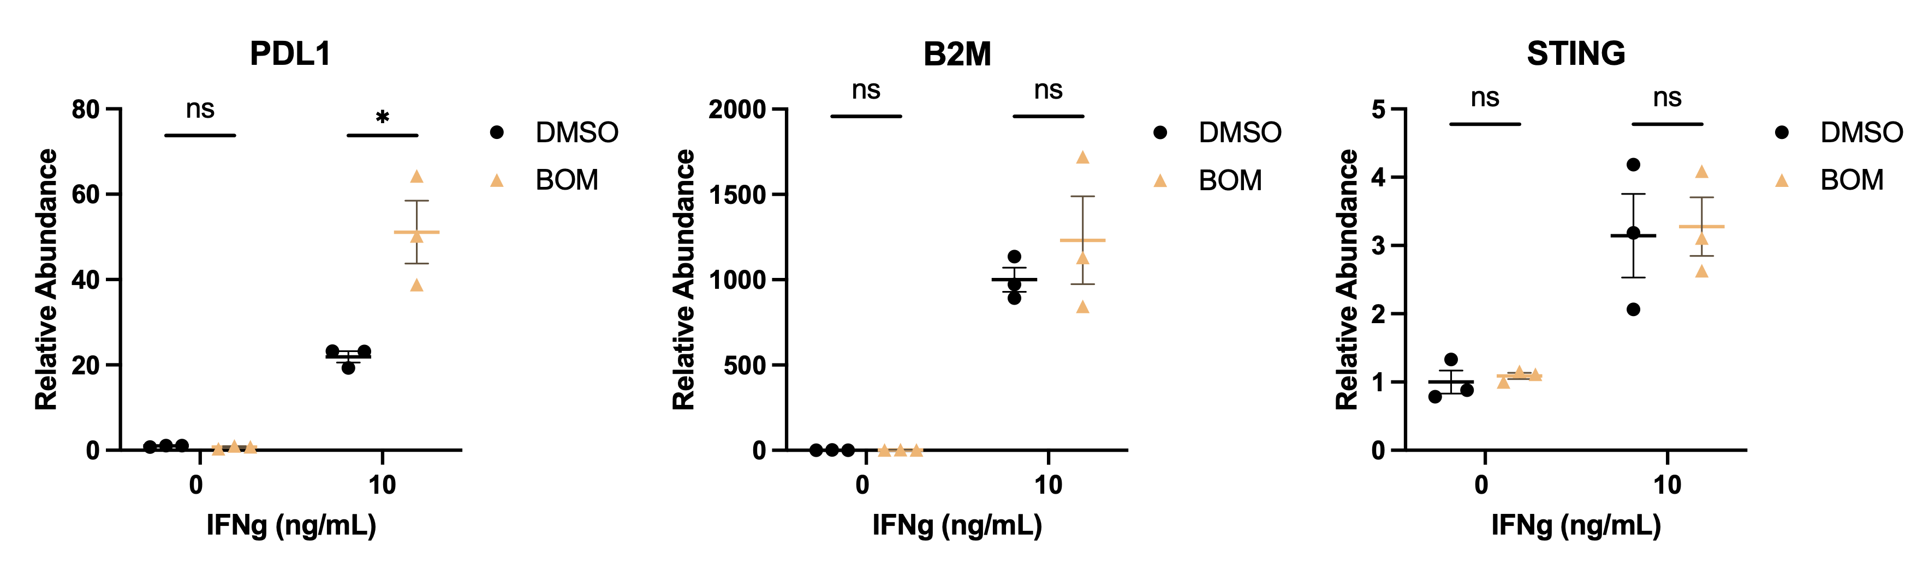
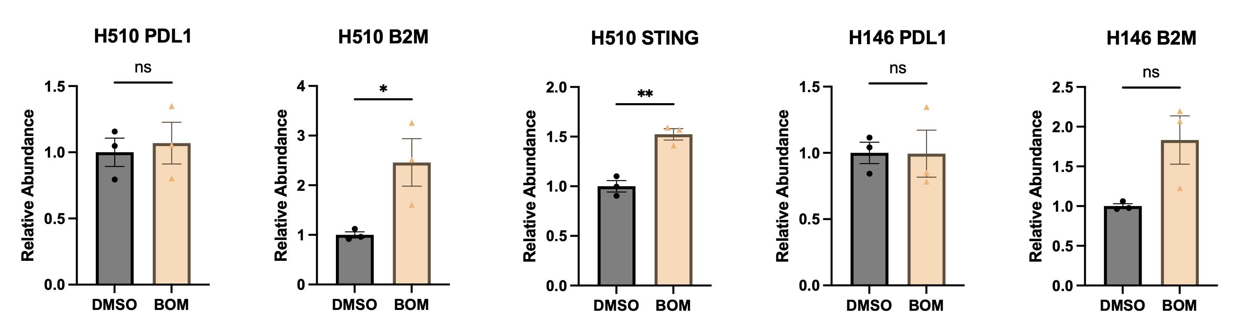
Supp Fig S10. Quantification of molecular changes induced by LSD1 inhibition in cell line models
A
RP-48_{OVA-LLO190} CRISPR
B
RP-48_{OVA-LLO190} BOM
C
HUMAN
Notes:
/Users/jhiatt/Library/CloudStorage/OneDrive-FredHutchinsonCancerResearchCenter/220525 CCR Revisions/HA Prism Data Files/220620_western_quant.pzfx

Slide 11
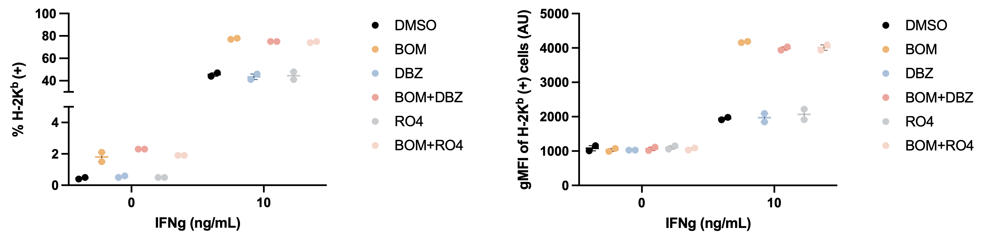
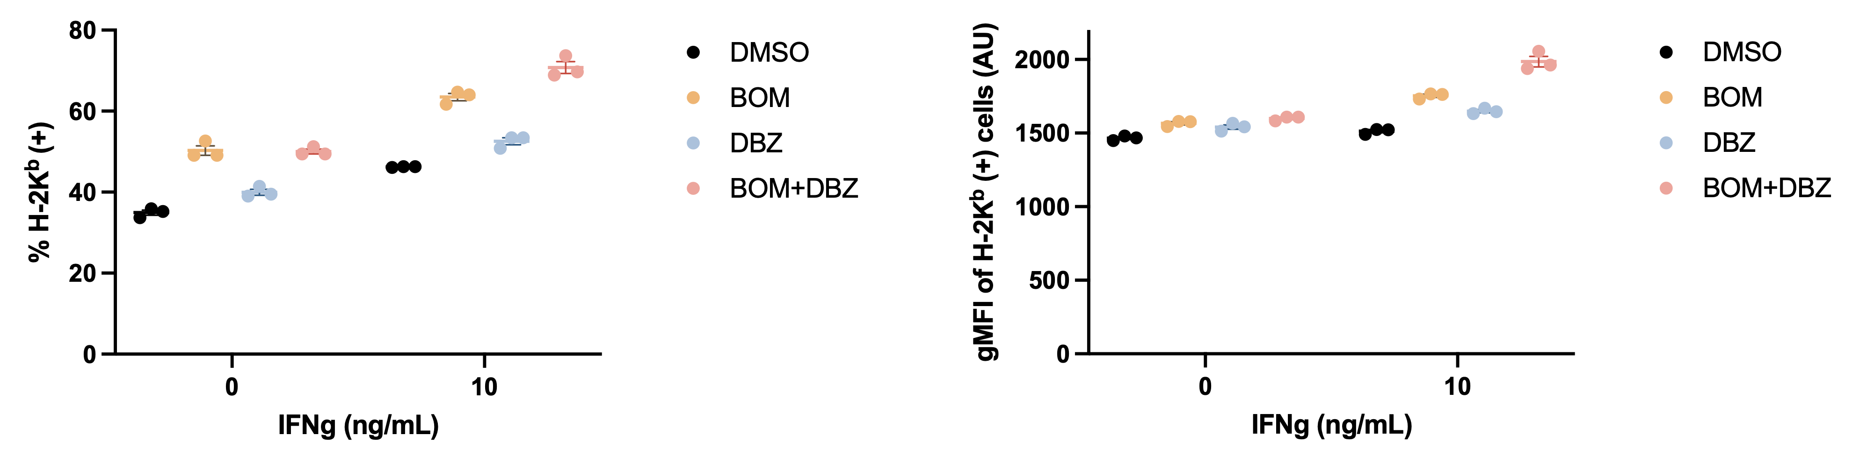
Supp Fig S11. NOTCH signaling blockade does not rescue bomedemstat-induced MHC-I upregulation.
A
IFNg | - | - | - | - | - | - | + | + | + | + | + | +
DBZ | - | - | - | - | + | + | - | - | - | - | + | +
RO4 | - | - | + | + | - | - | - | - | + | + | - | -
BOM | - | + | - | + | - | + | - | + | - | + | - | +
NOTCH1^{ICD}
- 100
HES1
- 37
⍺-TUB
- 50
B
RP-48
C
RP-48
D
E
FH-B6RP1
FH-B6RP1
Notes:
/Users/jhiatt/Library/CloudStorage/OneDrive-FredHutchinsonCancerResearchCenter/220525 CCR Revisions _Teams_/LSY Prism Data Files/B6-03 OVA GSI 10 days/RP048OVA GSI 10d aggregated.pzfx
/Users/jhiatt/Library/CloudStorage/OneDrive-FredHutchinsonCancerResearchCenter/220525 CCR Revisions _Teams_/LSY Prism Data Files/K7127 T1- GSI 4 DAYS treatment/K7127 GSI 4d aggregated.pzfx

