Slide 1
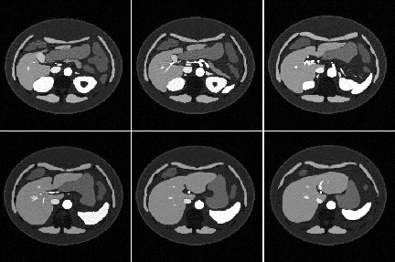
Video 1: Movie corresponding to Figure 2
GRASP-Pro reconstruction
Matrix size = 256x256x48
Voxel size = 1.37x1.37x5mm³
5 spokes per frame for each slice

Slide 2
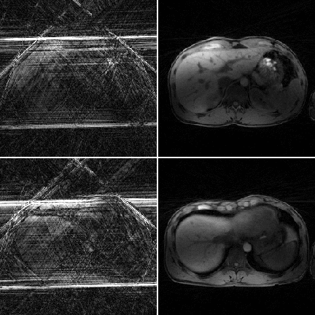
Video 2: Movie corresponding to Figure 3
NUFFT
(Before Recon)
GRASP-Pro
(After Recon)
Matrix size = 256x256x48
Voxel size = 1.37x1.37x5mm³
Temporal resolution = 0.78s/volume
5 spokes per frame for each slice

Slide 3
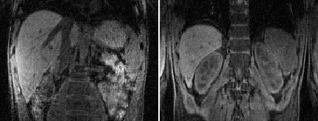
Video 3: Movie corresponding to Figure 5b
Matrix size = 256x256x26
Voxel size = 1.77x1.77x5mm³
Temporal resolution = 0.68s/volume
5 spokes per frame for each slice

Slide 4
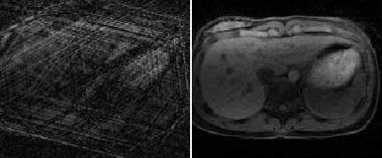
Video 4: Movie corresponding to Figure 7
NUFFT
(Before Recon)
GRASP-Pro
(After Recon)
Matrix size = 256x256x48
Voxel size = 1.37x1.37x5mm³
Temporal resolution = 0.78s/volume
5 spokes per frame for each slice

Slide 5
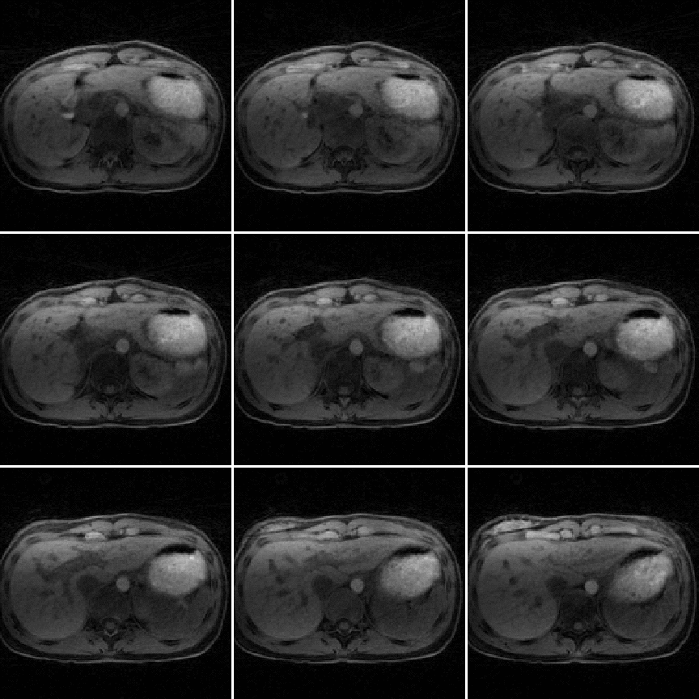
Video 5: Movie corresponding to Figure 9
GRASP-Pro reconstruction
Matrix size = 256x256x48
Voxel size = 1.37x1.37x5mm³
Temporal resolution = 0.47s/volume
3 spokes per frame for each slice

Slide 6
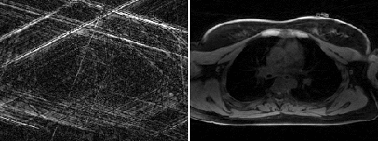
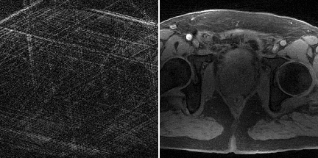
Video 6: Movie corresponding to Figure 10
Matrix size = 256x256x48
Voxel size = 1.37x1.37x5mm³
Temporal resolution = 0.76s/volume
5 spokes per frame for each slice
Matrix size = 224x224x26
Voxel size = 1.07x1.07x3mm³
Temporal resolution = 0.63s/volume
5 spokes per frame for each slice

