Slide 1
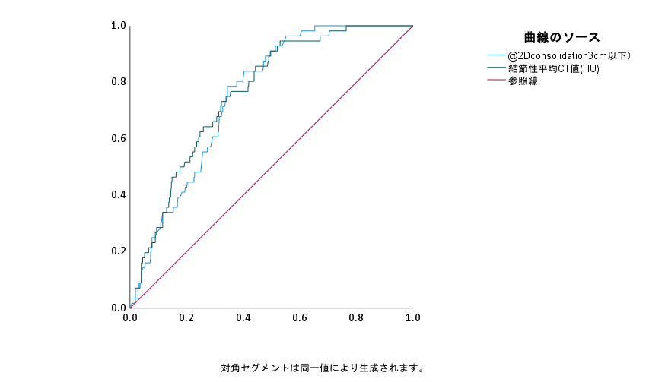
Supplement Figure 1
Sensitivity
AUC 95%CI Cut-off value
Solid-part size .754 .701-.806 1.83 cm
Average solid CT value .761 .705-.818 -103 HU
Solid-part size
Average solid CT value
1-Specificity
Receiver-operating characteristics area under the curve for solid-part size and average solid computed tomography value to identify lymph node metastasis. CT, computed tomography; HU, Hounsfield units.

