Slide 1
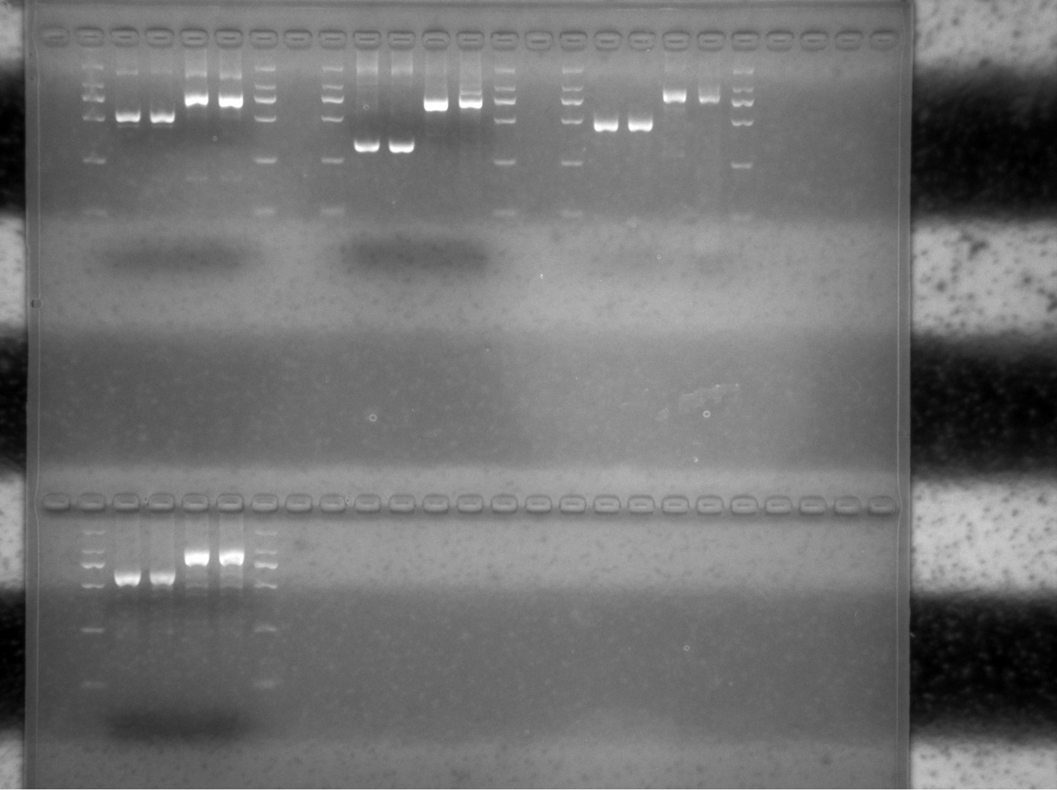
pavcf1
pavcf2
pavcf3
pavcf4
Additional file 4. Uncropped images for the blots in Figure S3.

Slide 2
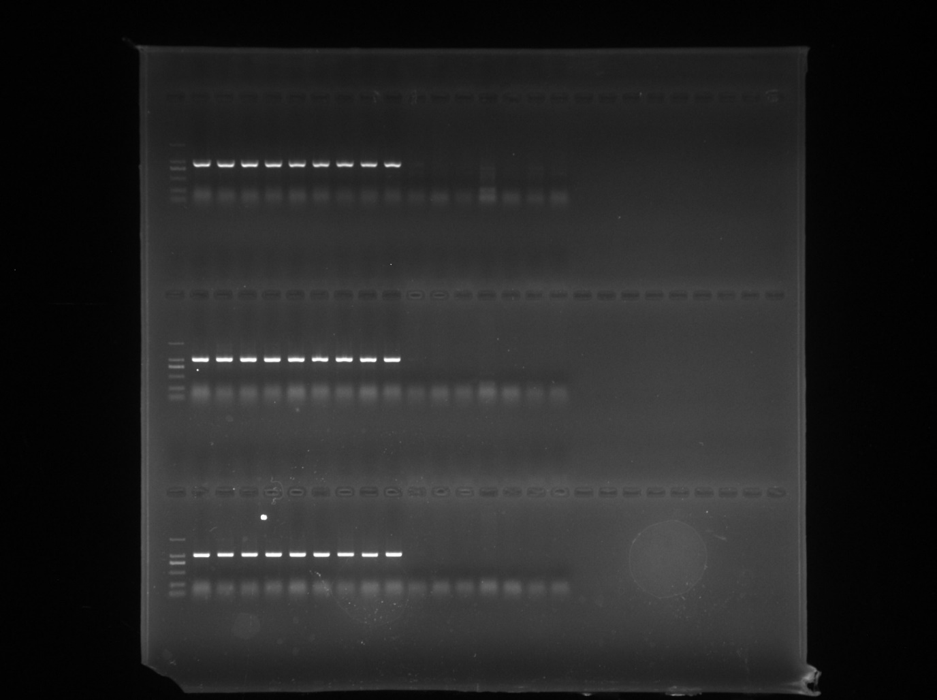
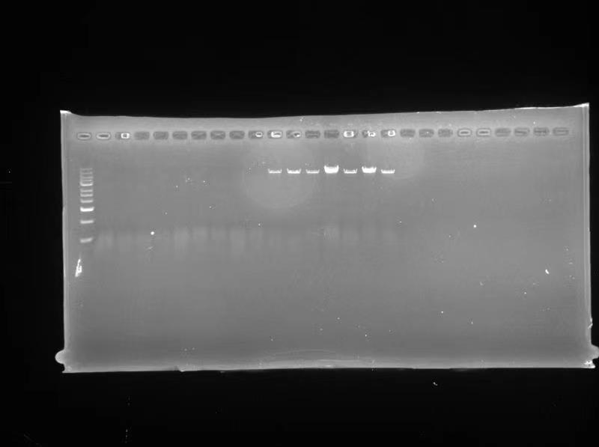
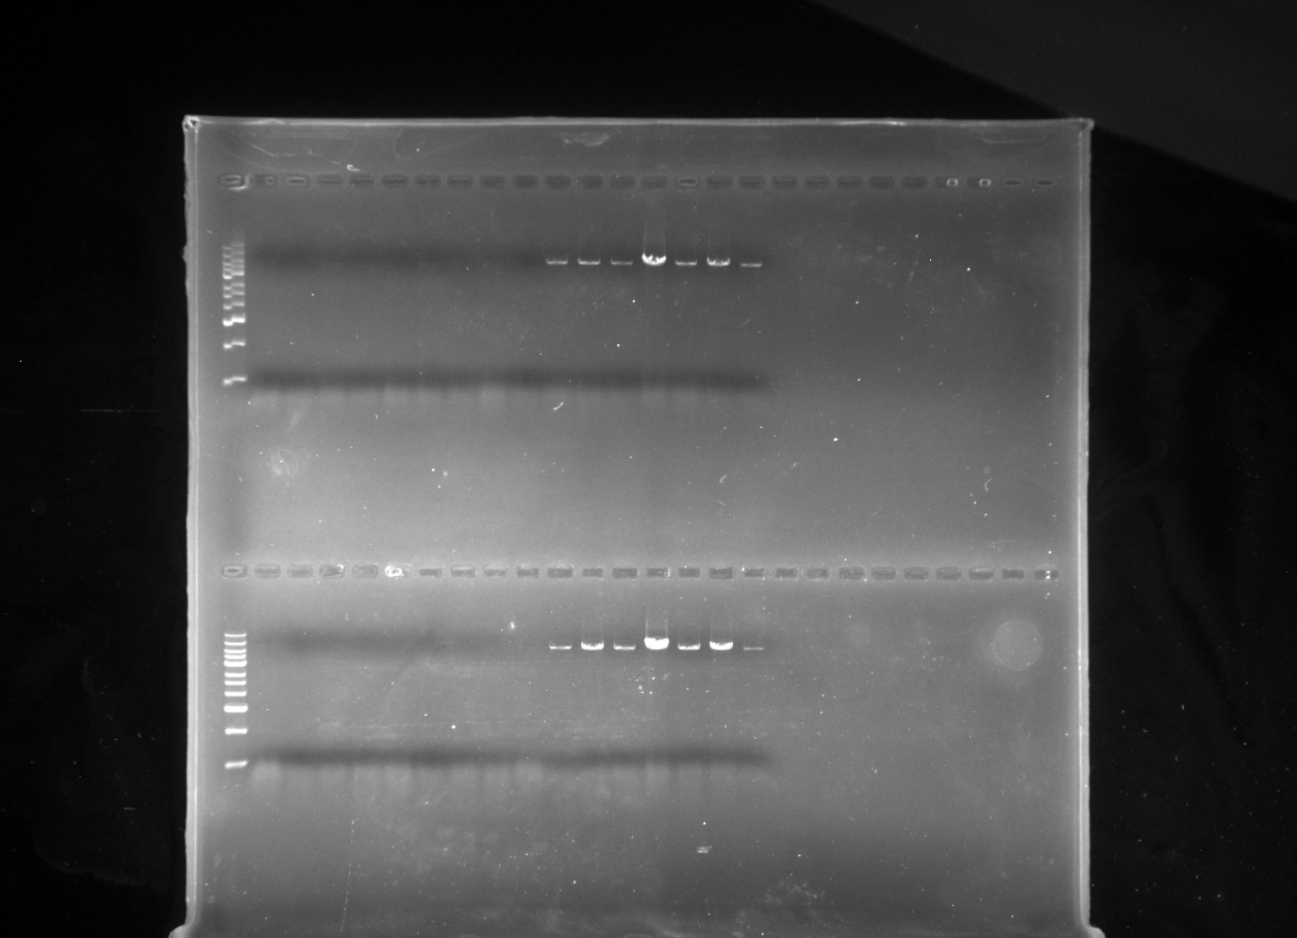
13 Kb-1F, 13 Kb-2R
13kb-1F, 13kb-1R
13kb-2F, 13kb-2R
Additional file 4. Uncropped images for the blots in Figure S28.

