Slide 1
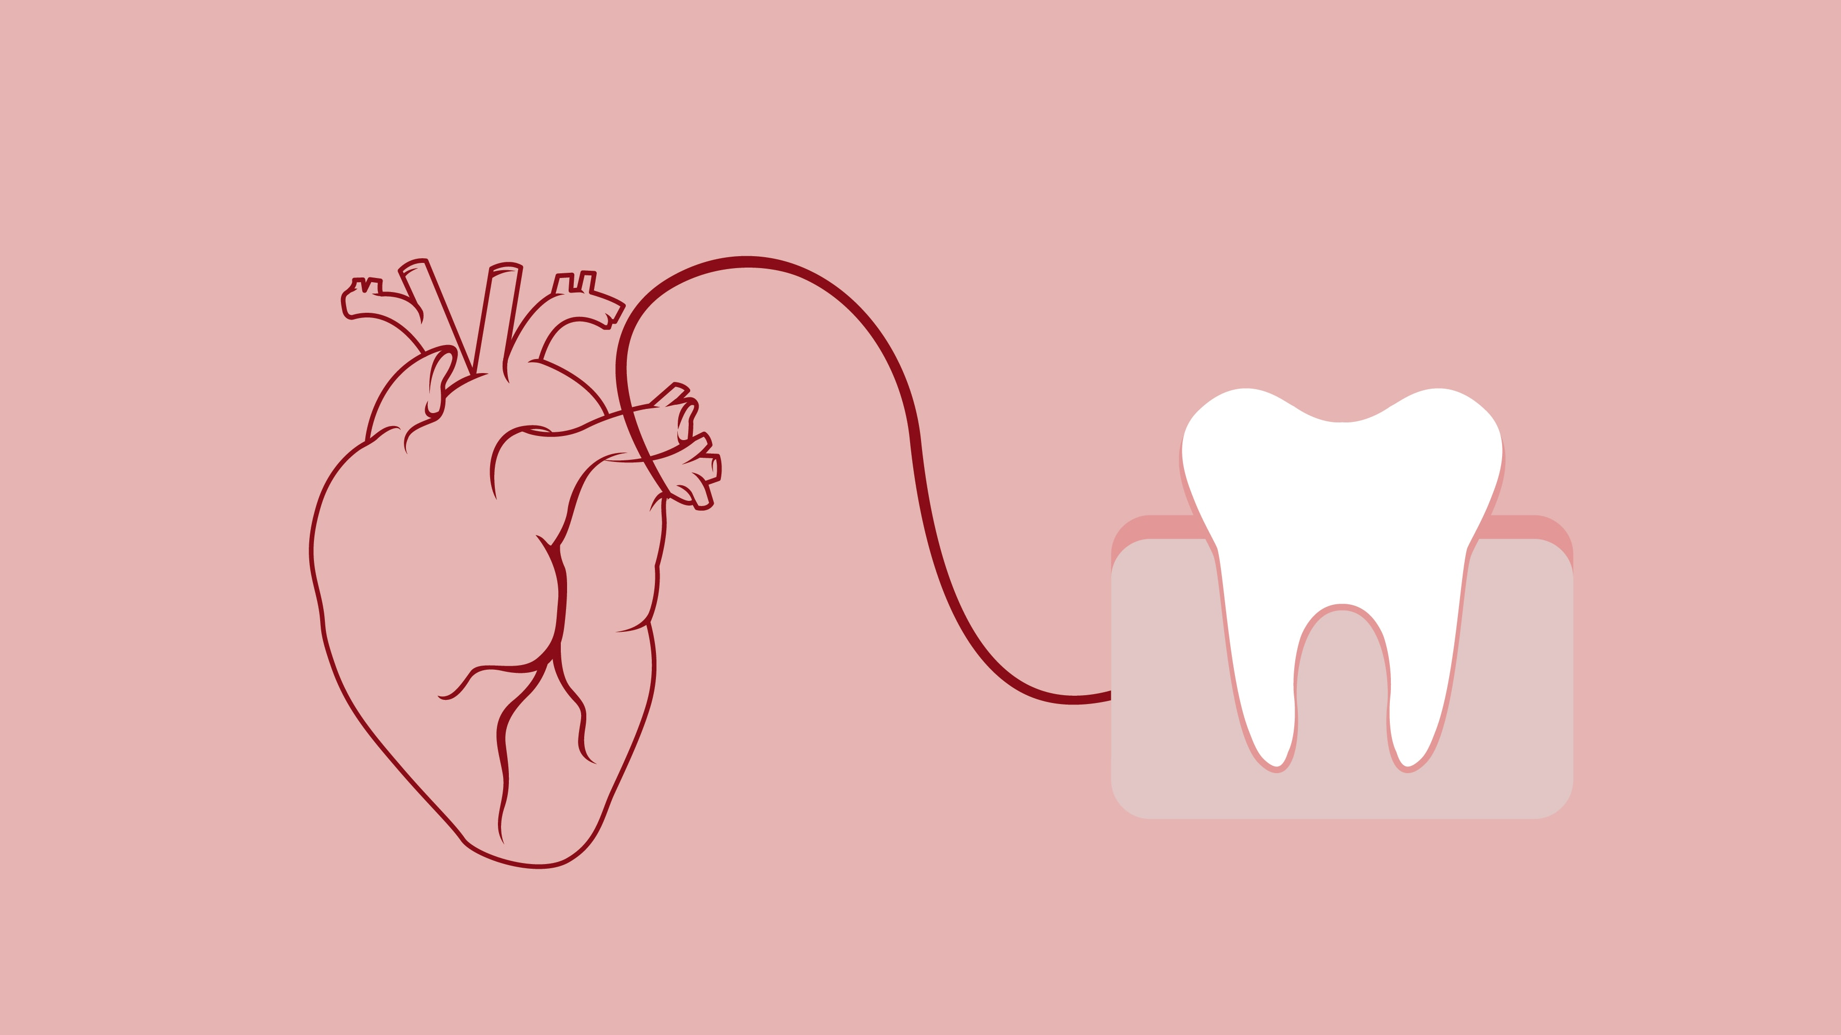
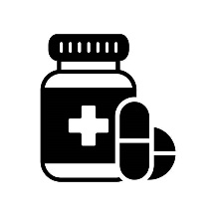


Antibiotic prophylaxis before dental procedures to prevent infective endocarditis
Summary Data showed a non-significant decrease in the rate of IE when high-risk patients take AP prior to invasive dental procedures
Study design
Systematic review using CENTRAL, MEDLINE via Ovid and EMBASE
336 studies
Exclusion
Duplicates n=72
Exclusion after screening of abstract/title n=50
Exclusion after screening of main text n=191
Antibiotic prophylaxis before
dental procedures
PROSPERO
CRD42020175398
23 studies
Exclusion
In-depth screening n=22
Risk of bias
Low
Medium
High
1 study
High-risk of IE
Low-risk of IE
Log Risk Ratio:
Tubiana et al, 2017 -0.94 (-2.10-0.22), P=0.11
Moderate of IE
-2.5 -1.5 -0.5 0.5
Outcomes Evidence in favor or against the use of AP before dental procedure scare especially at low and moderate risk
More studies needed to draw substantial conclusion

