Slide 1
Participating Studies
Study | Sample Size | Metabolomic platform | Statistical analysis
NECS N=195 | e2e2, e2e3 = 47 e3e3 = 128 e3e4 = 20 | Metabolom 1138 metabolites < 20% missing values | Regression adjusted by age, sex, education, batch Multiple imputation (5 times)
ARIVALE N=634 | e2e2, e2e3 = 71 e3e3 = 415 e3e4, e4e4 = 148 | Metabolom 722 metabolites with < 20% missing values | Regression adjusted by age, sex, education, BMI and statin use
BLSA N=1006 | e2e2, e2e3 = 139 e3e3 = 583 e3e4, e4e4 = 267 | Biocrates 465 metabolites with < 20% missing values | Regression adjusted by age, sex, education, batch
LLFS N=1580 | e2e2, e2e3 = 263 e3e3 = 1067 e3e4, e4e4 = 250 | LC-MS 193 metabolites | Mixed effect linear models adjusted by age, sex, education, genome-wide PCs and relatedness between family members
LGP N=147 | e2e2, e2e3 = 24 e3e3 = 106 e3e4, e4e4 = 17 | LC-MS 412 metabolites | Mixed effect linear models adjusted by age, sex, education, genome-wide PCs and relatedness between family members
Supplement Figure 1

Slide 2
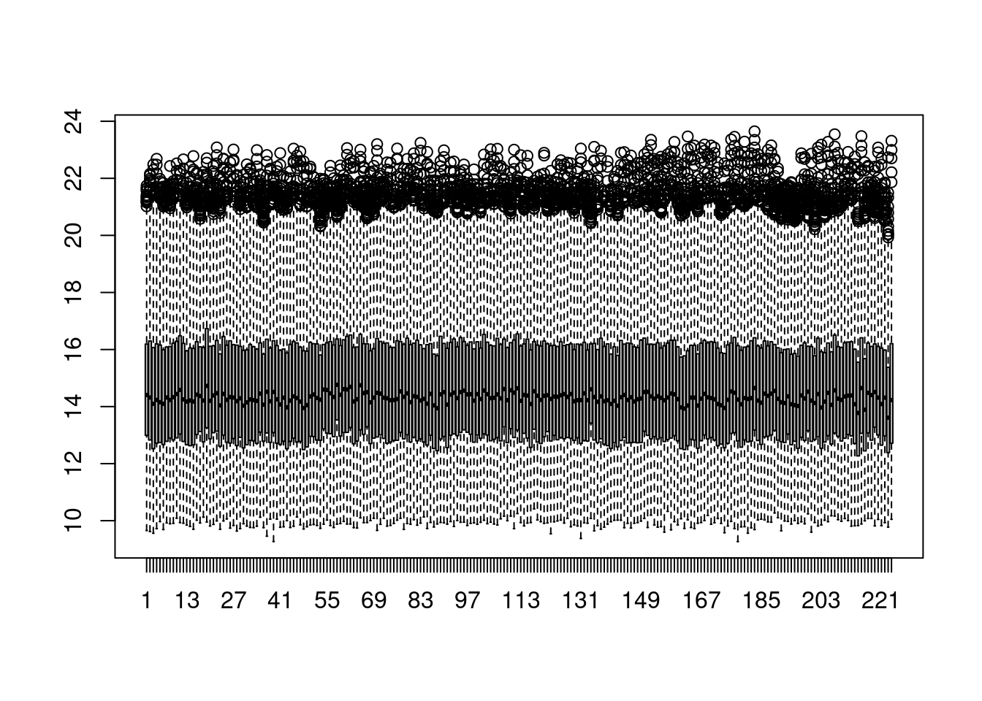
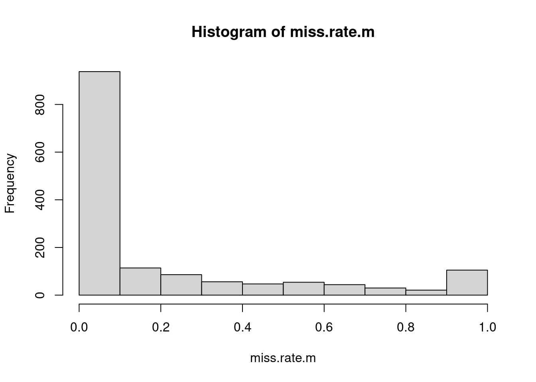
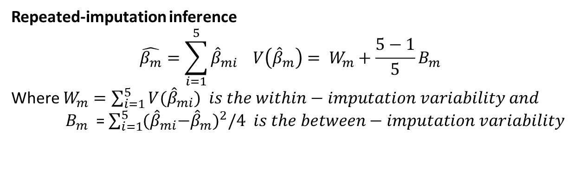
Supplement Figure 2:NECS QC and Analysis
Repeated-imputation inference
$$\hat{β_{m}}=\sum_{i=1}^{5}{{\hat{β}}_{mi} V\left({\hat{β}}_{m}\right)= W_{m}}+\frac{5−1}{5}B_{m}$$
Where $W_{m}=\sum_{i=1}^{5}{{V(\hat{β}}_{mi}) is the within−imputation variability and}$
${ B}_{m}$ = $\sum_{i=1}^{5}{{{(\hat{β}}_{mi}−{\hat{β}}_{m})}^{2}/4 is the between−imputation variability}$

Slide 3
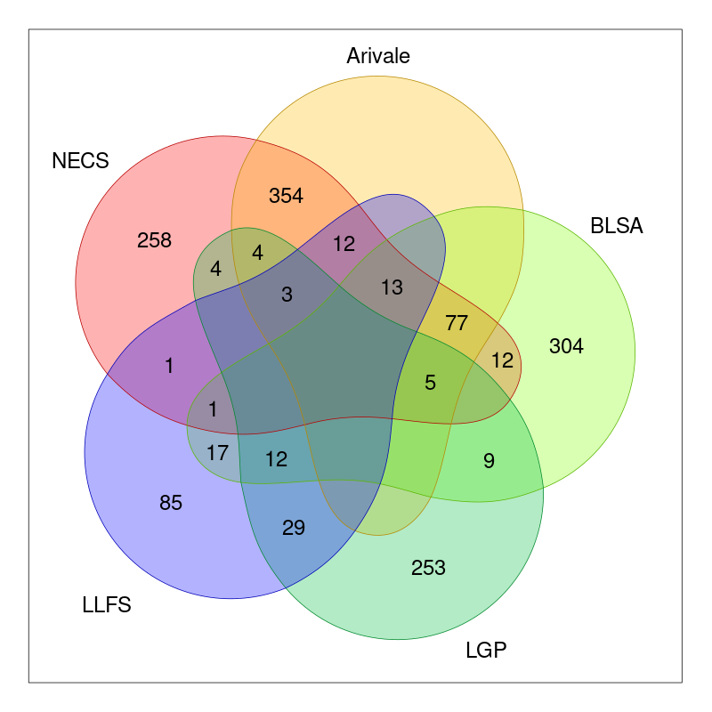
Supplement Figure 3
Venn diagram of overlapping metabolites

Slide 4
Supplement Figure 4
Forest plots of the study specific effects of E2=e2e2, e2e3 vs E3=e3e3 and meta-analysis results for various metabolites. The genetic effects on the x-axis are in log-scale. The panels in the right display the distribution of the log-transformed levels of these two lipid species by APOE groups and age strata by APOE groups in LLFS participants.

Slide 5
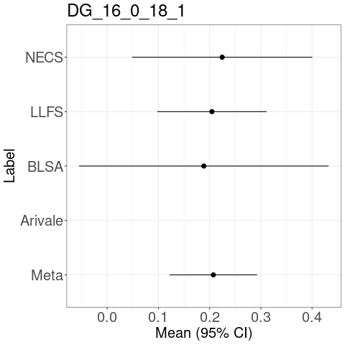
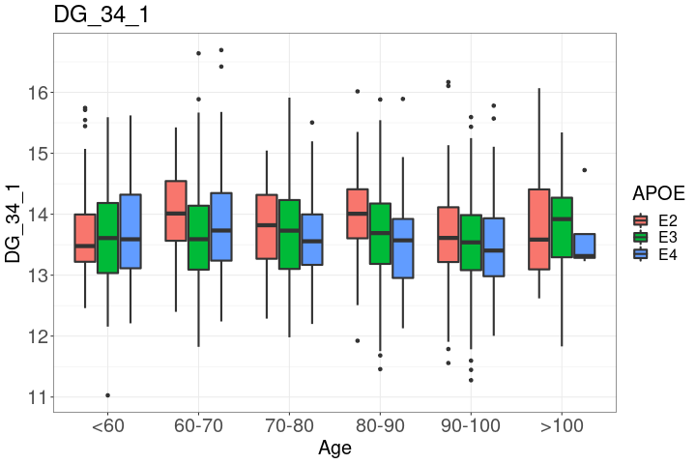

Slide 6
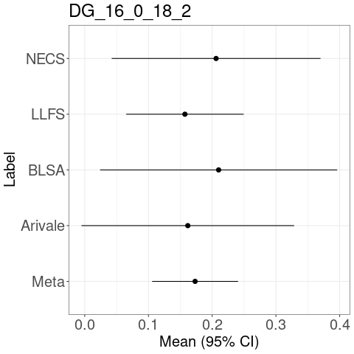
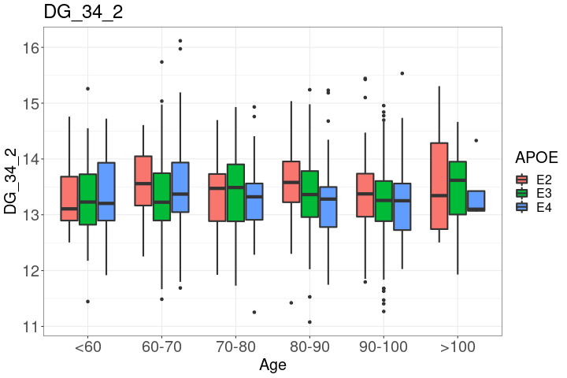

Slide 7
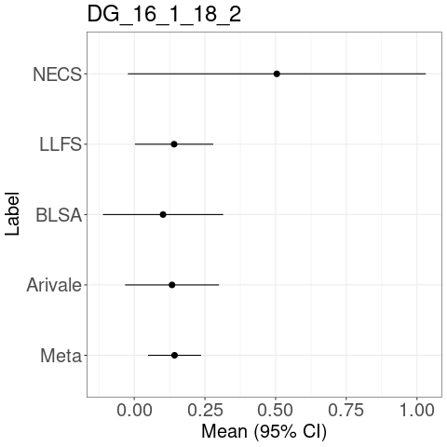
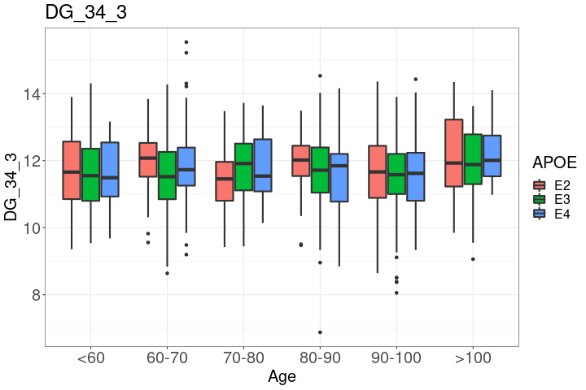

Slide 8
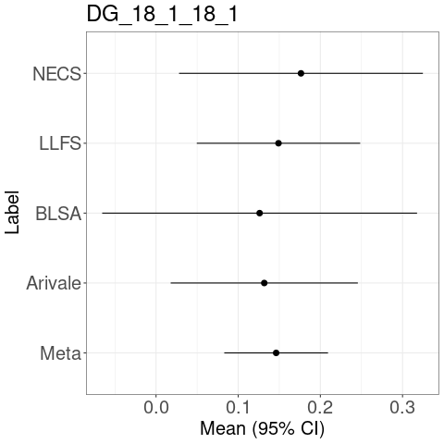
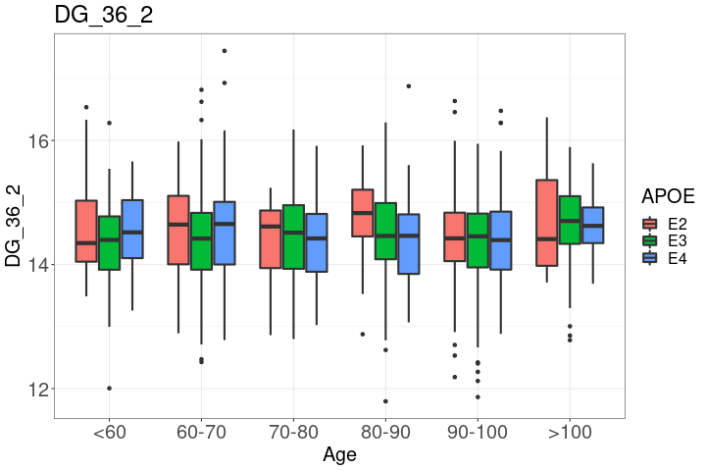

Slide 9
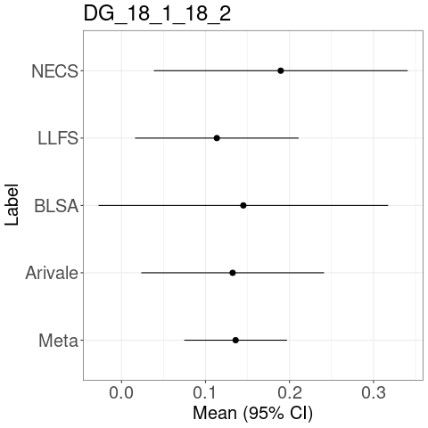
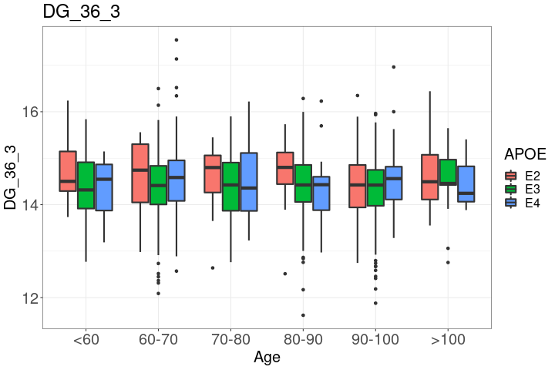

Slide 10
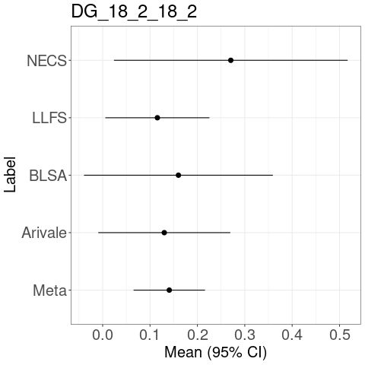
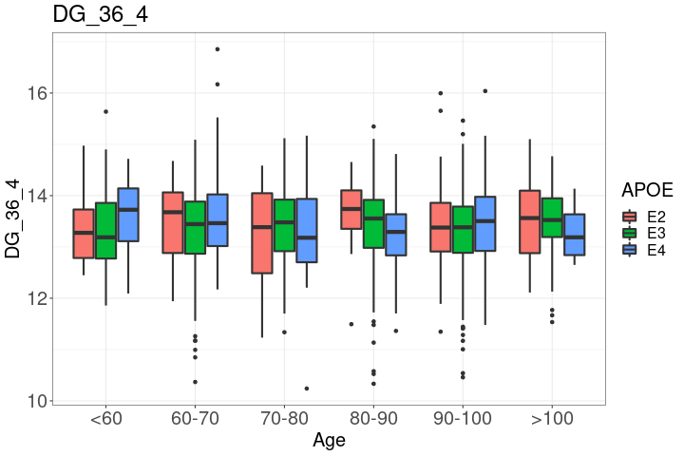

Slide 11
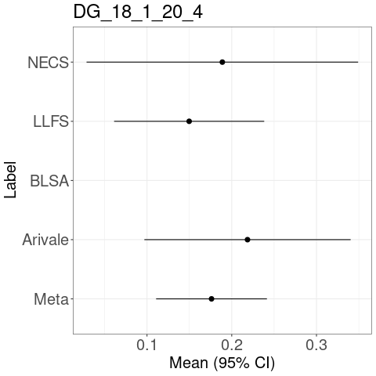
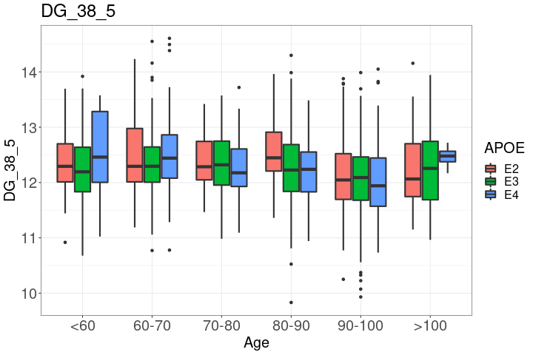

Slide 12
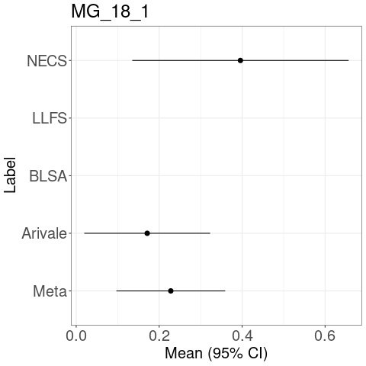

Slide 13
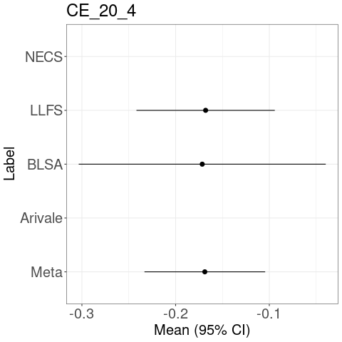
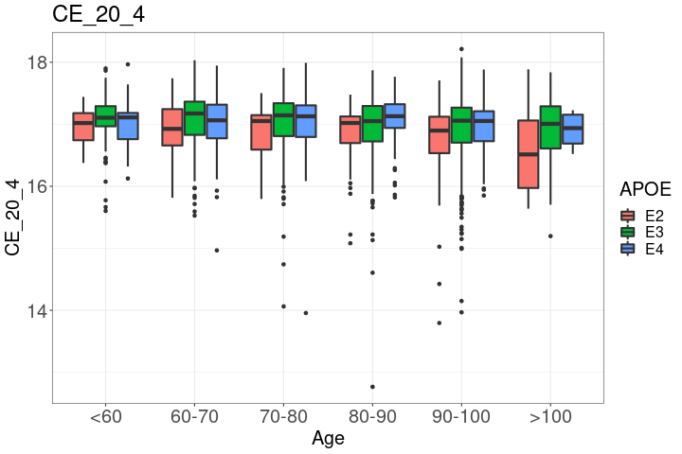

Slide 14
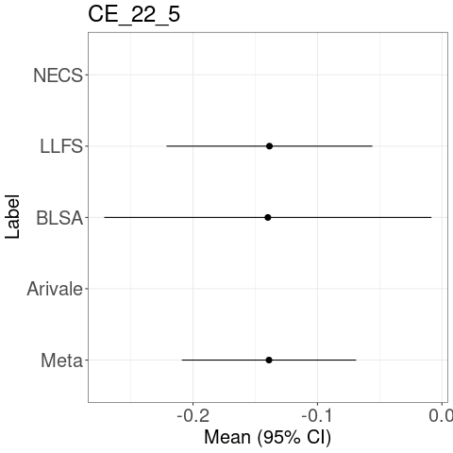
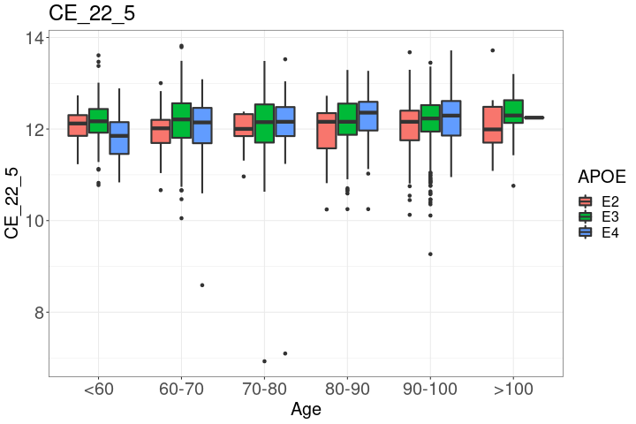

Slide 15
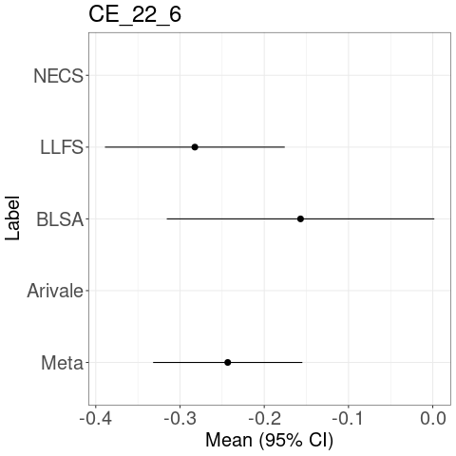
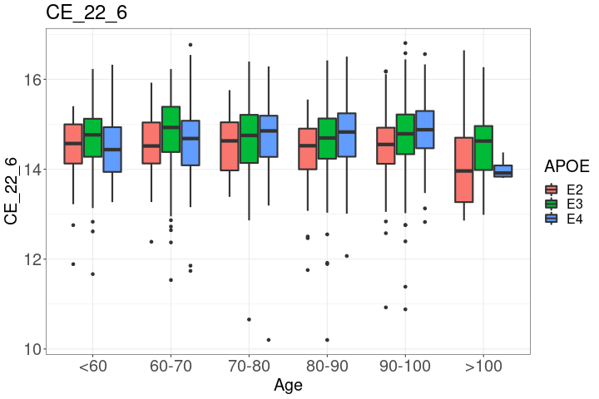

Slide 16
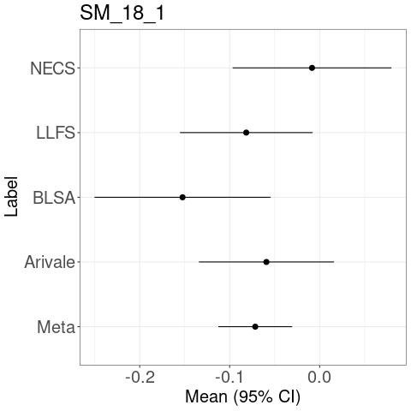
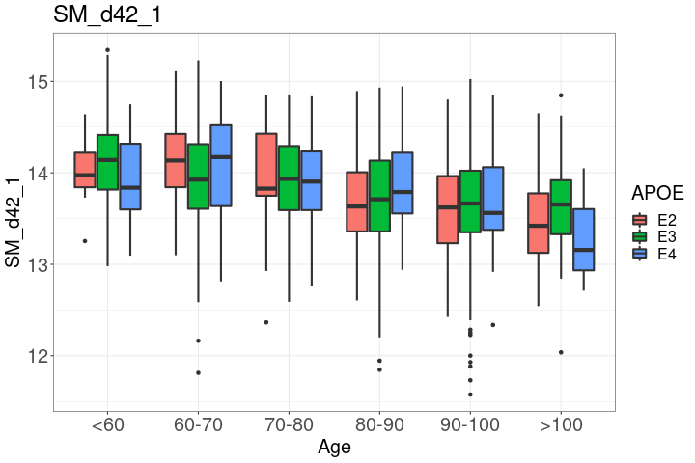

Slide 17
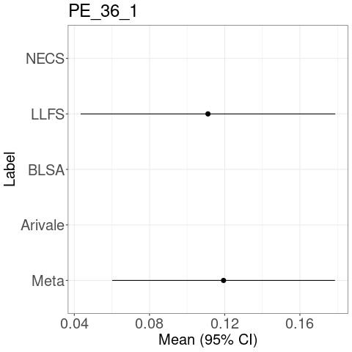
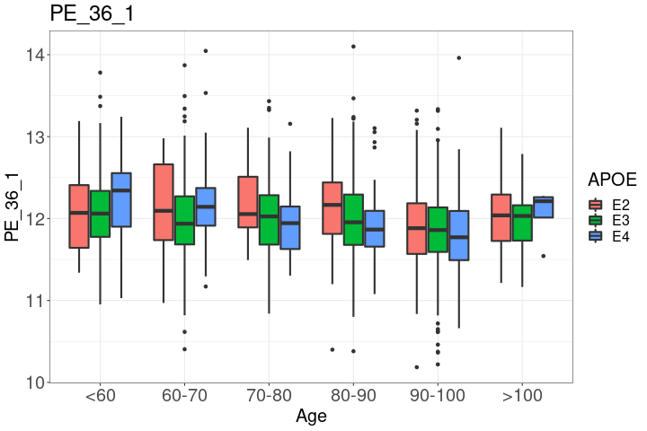

Slide 18
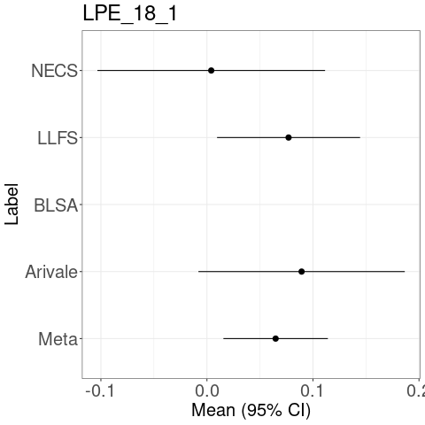
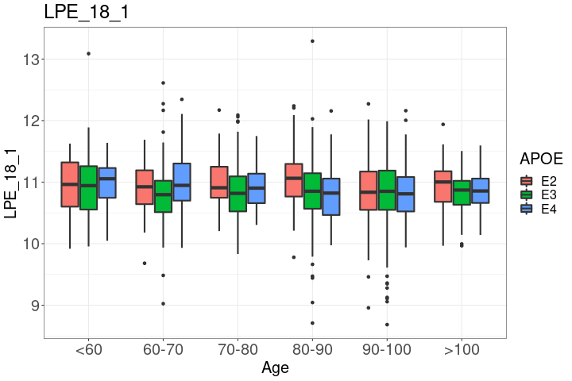

Slide 19
