Slide 1







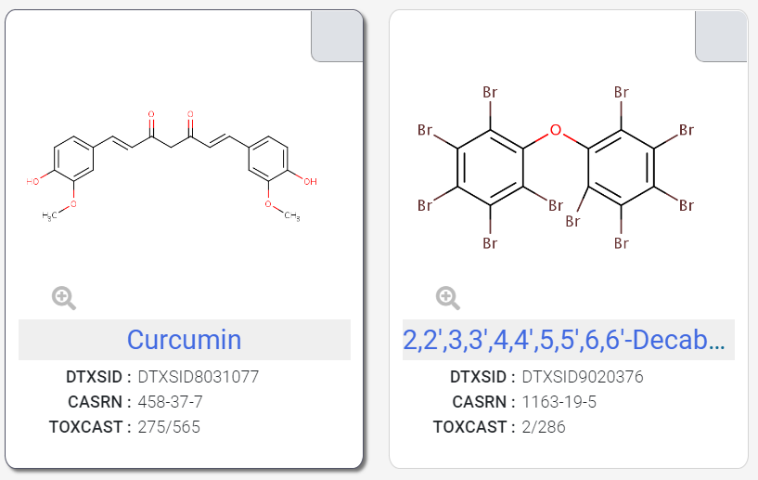
Supplemental Figure 1: Test Chemical Structures

