Slide 1
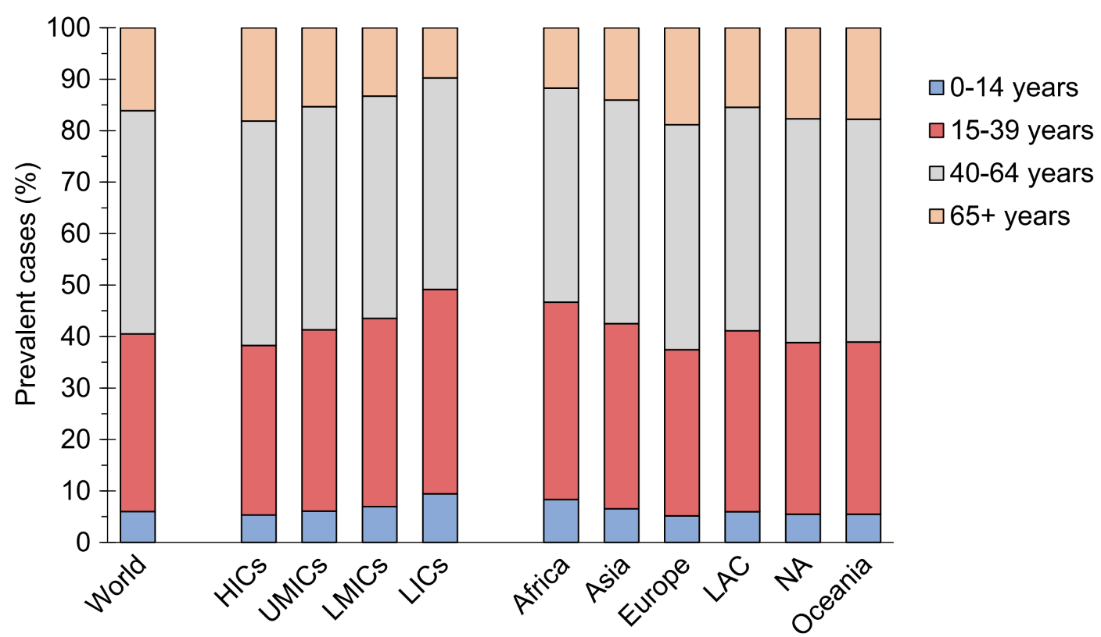
Distribution of prevalent cases of type 1 diabetes by current age, and by income groups and regions defined by UN population estimates
Rosengren and Dikaiou (2022) Diabetologia DOI 10.1007/s00125-022-05857-5
© Green et al. Distributed under the terms of the CC BY 4.0 Attribution License (http://creativecommons.org/licenses/by/4.0/)

Slide 2
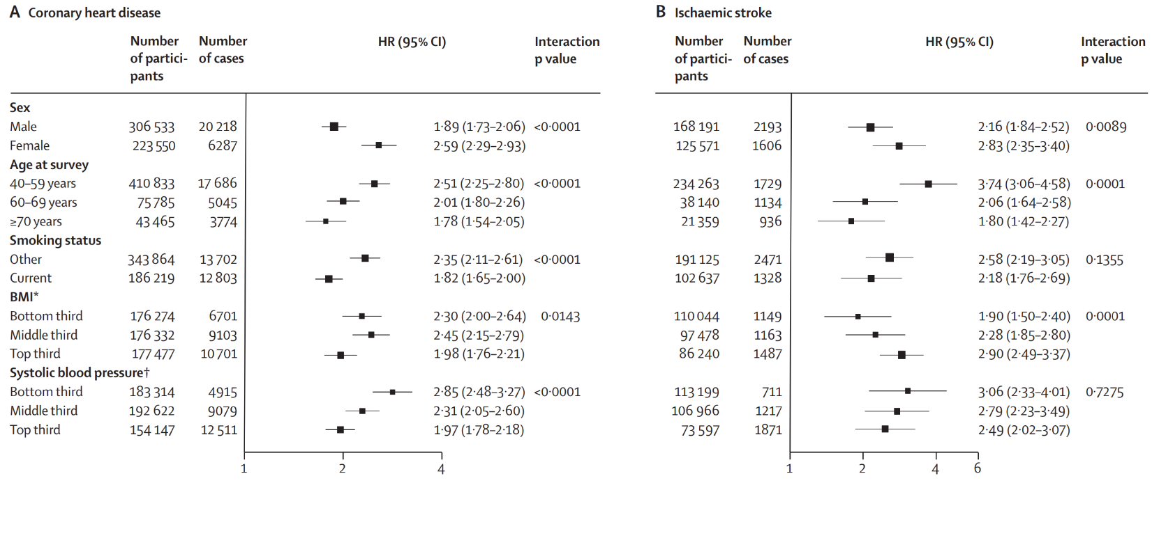
HRs for (a) CHD and (b) ischaemic stroke in people with diabetes at baseline vs those without, by individual characteristics
Rosengren and Dikaiou (2022) Diabetologia DOI 10.1007/s00125-022-05857-5
© 2010 Elsevier Ltd, reproduced from The Emerging Risk Factors Collaboration (2010), published as Open Access

Slide 3
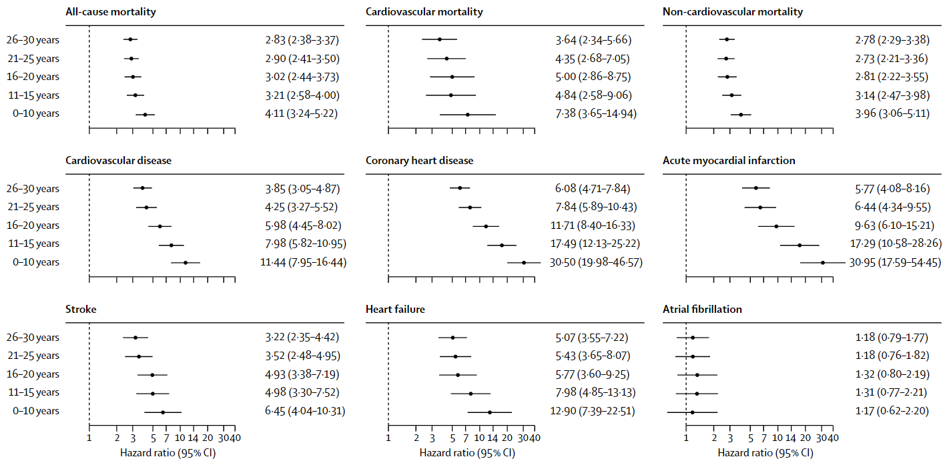
Forest plot showing adjusted HRs for mortality and cardiovascular outcomes, according to age at type 1 diabetes diagnosis
Rosengren and Dikaiou (2022) Diabetologia DOI 10.1007/s00125-022-05857-5
© Elsevier. Reproduced from Rawshani et al (2018) with permission

Slide 4
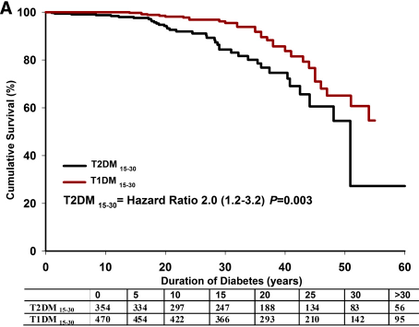
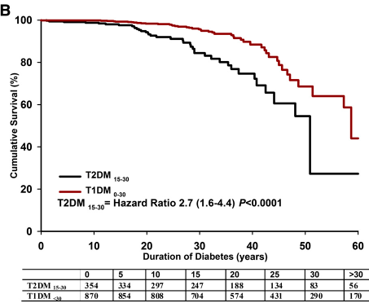
Kaplan–Meier survival curves for (a) individuals with type 2 diabetes and type 1 diabetes, aged 15–30 years and for (b) individuals with type 2 diabetes, aged 15–30 years, and all individuals with type 1 diabetes (age of onset <30 years)
Rosengren and Dikaiou (2022) Diabetologia DOI 10.1007/s00125-022-05857-5
© The American Diabetes Association. Reproduced from Constantino et al (2013) under the terms of the Creative Commons Attribution-NonCommercial-NoDerivs 3.0 Unported License (https://creativecommons.org/licenses/by-nc-nd/3.0/)

