Slide 1
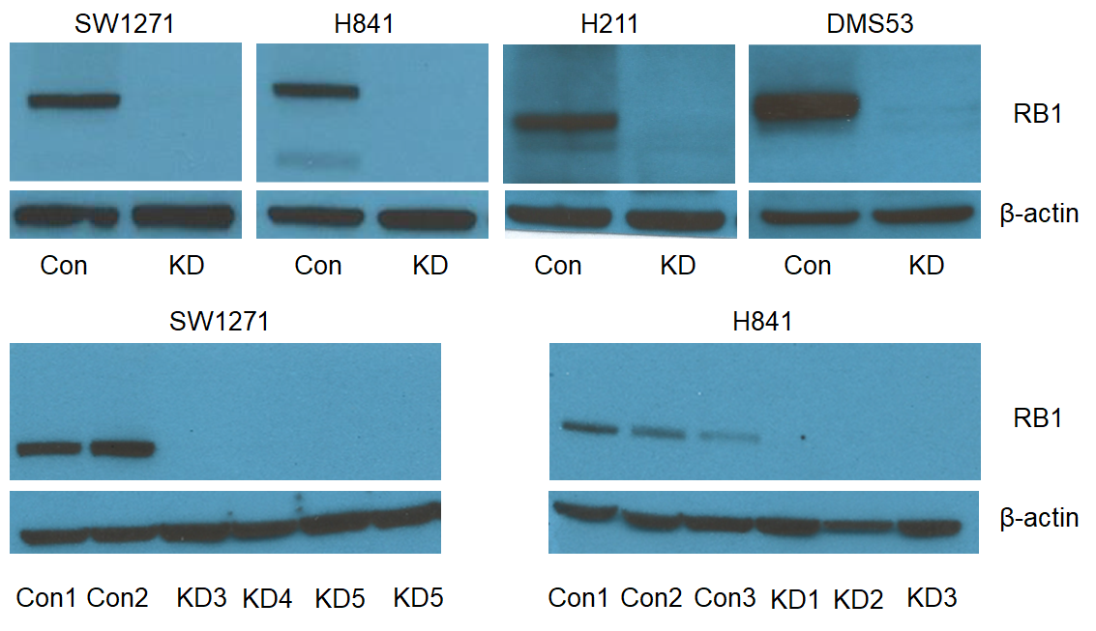
A: Pools
B: Clones
Supplement Figure 1. Validation of CRISPR RB1 knockout in wt RB1 SCLC cells. Western blot analysis of RB1 expression in cell lysates from wt RB1 pools (panel A) and clones (panel B) in control (Con, pLKO) and CRISPR knockout (KO) cells after stable selection for antibiotic resistance. β-actin was used as a loading control.

Slide 2
Genomic
(n=111)
IHC
(n=55)
n=9
Supplement Figure 2. Overlap in Genomic and IHC Cohorts.

Slide 3
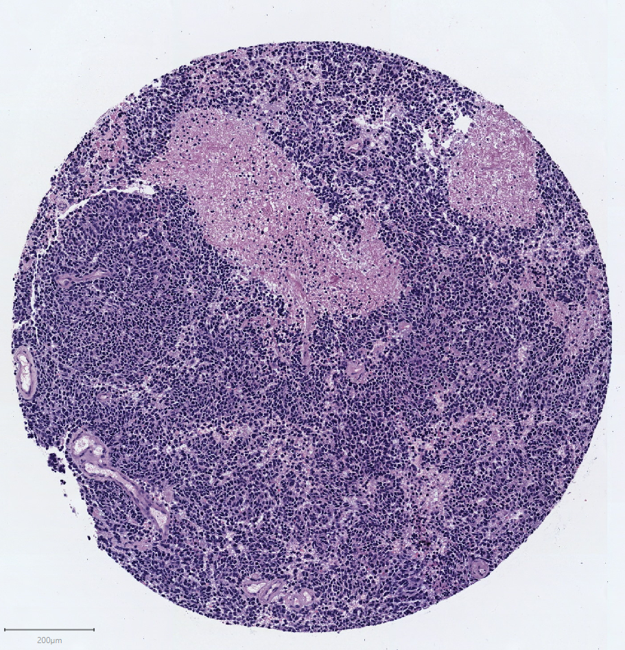
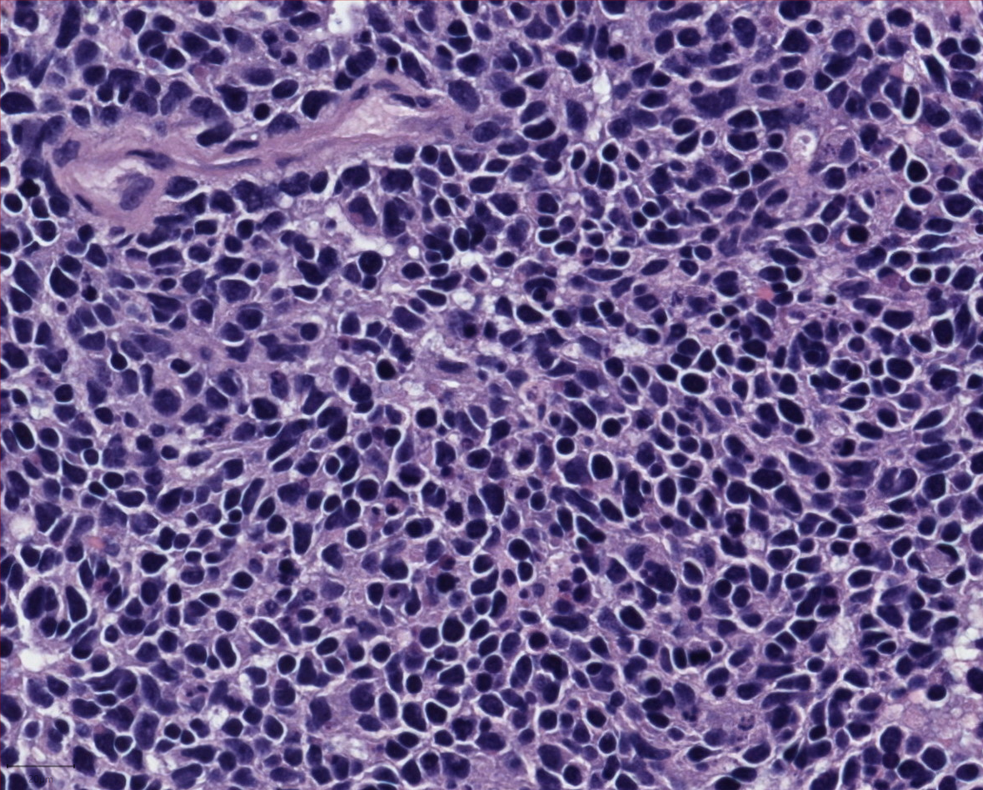
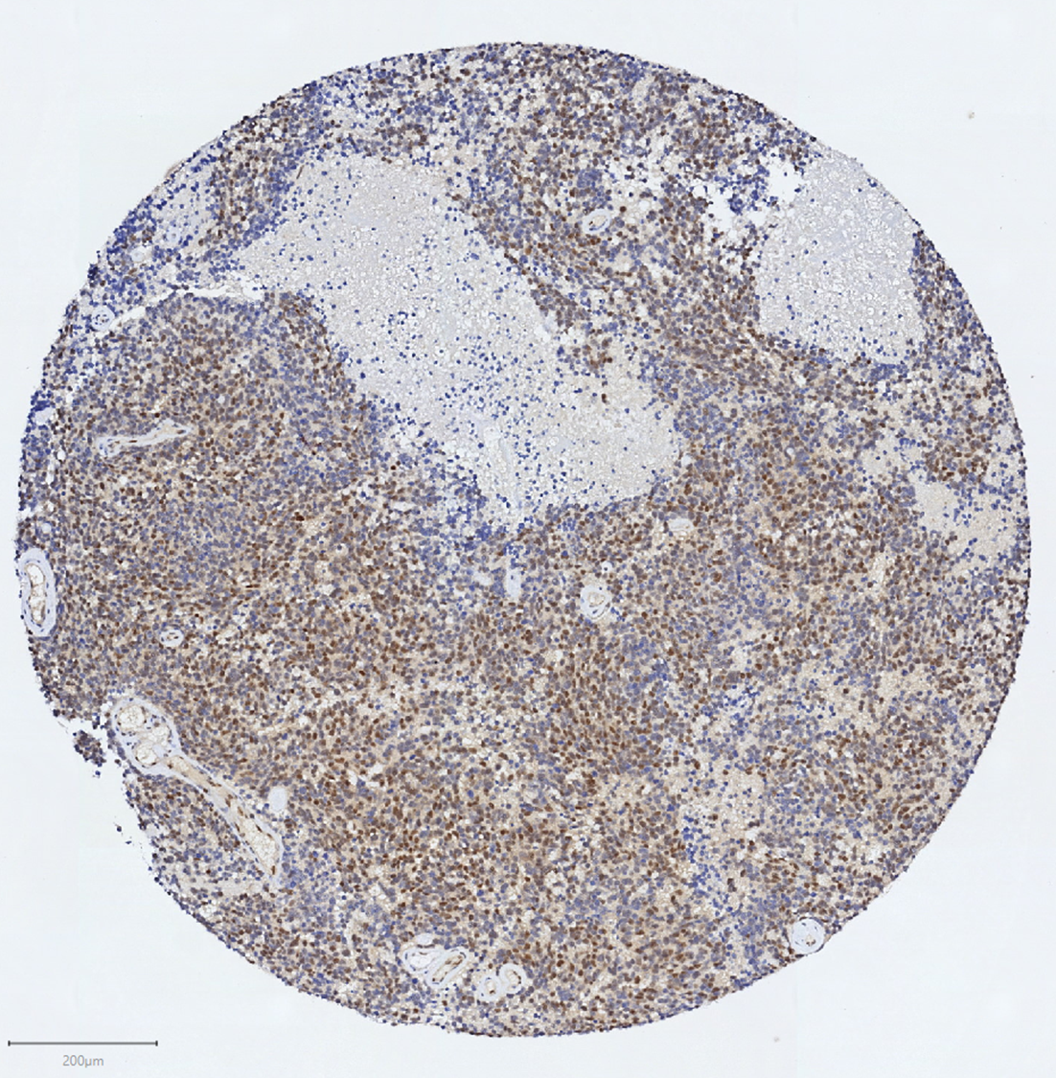
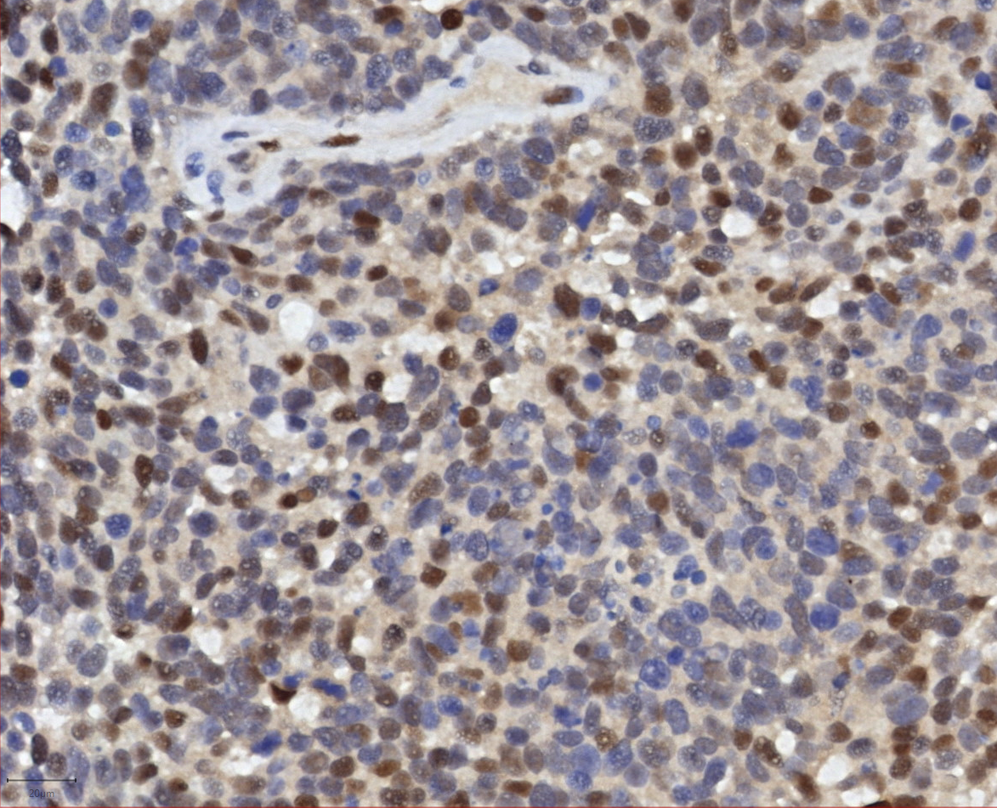
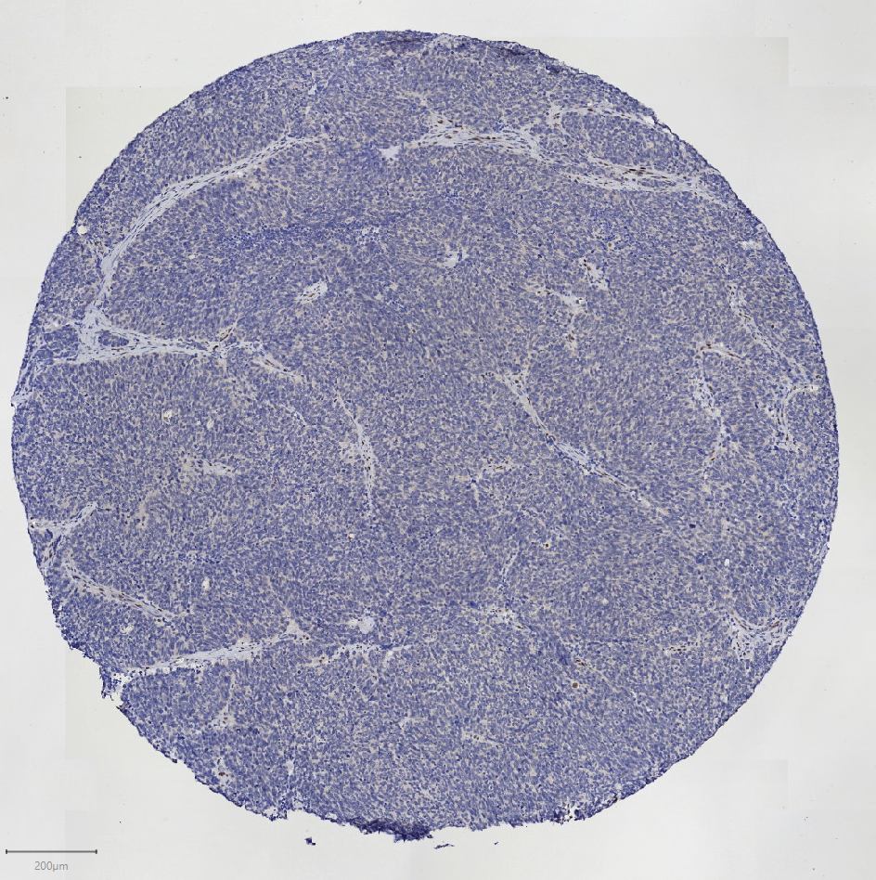
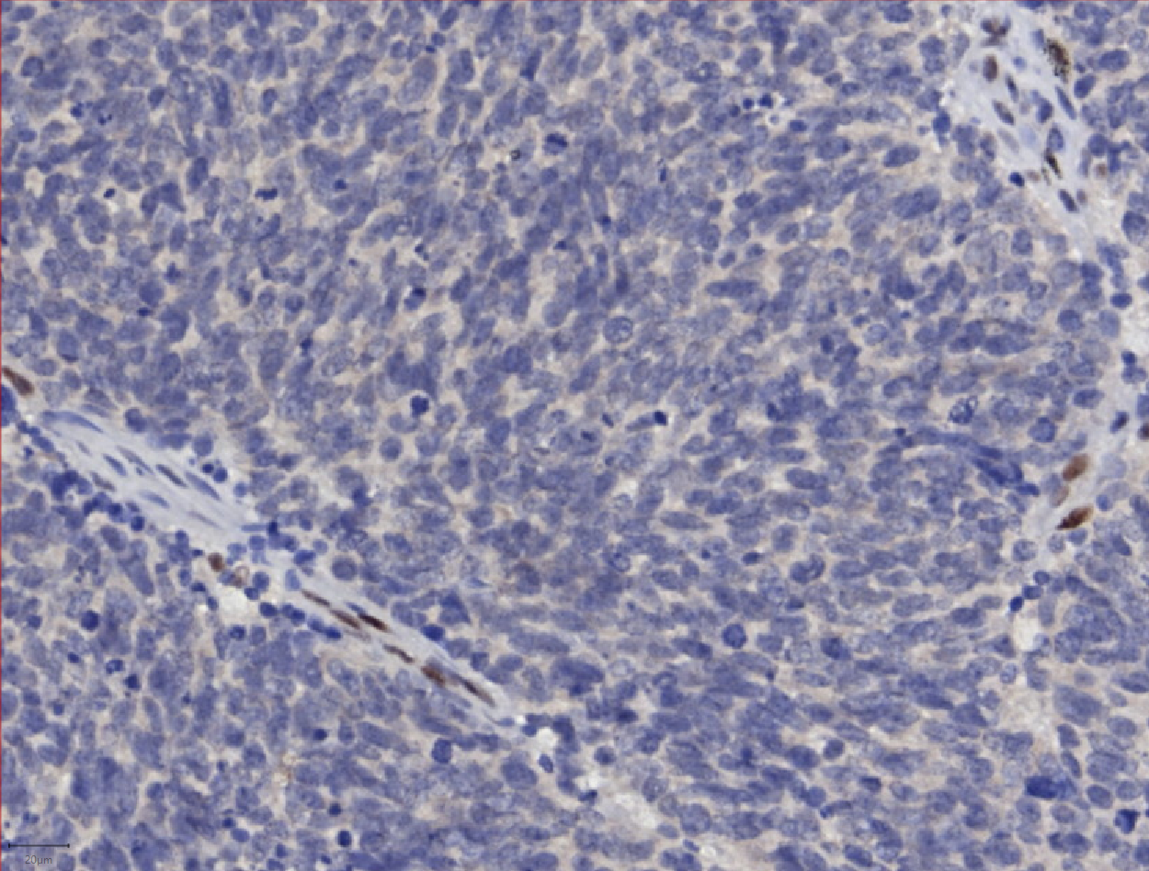
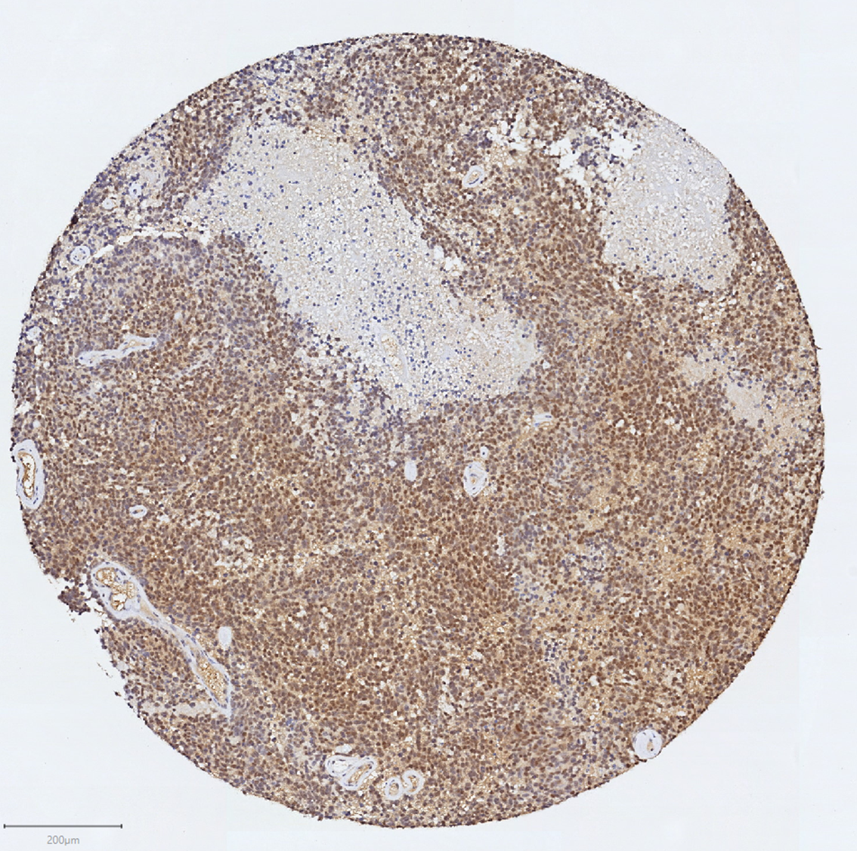
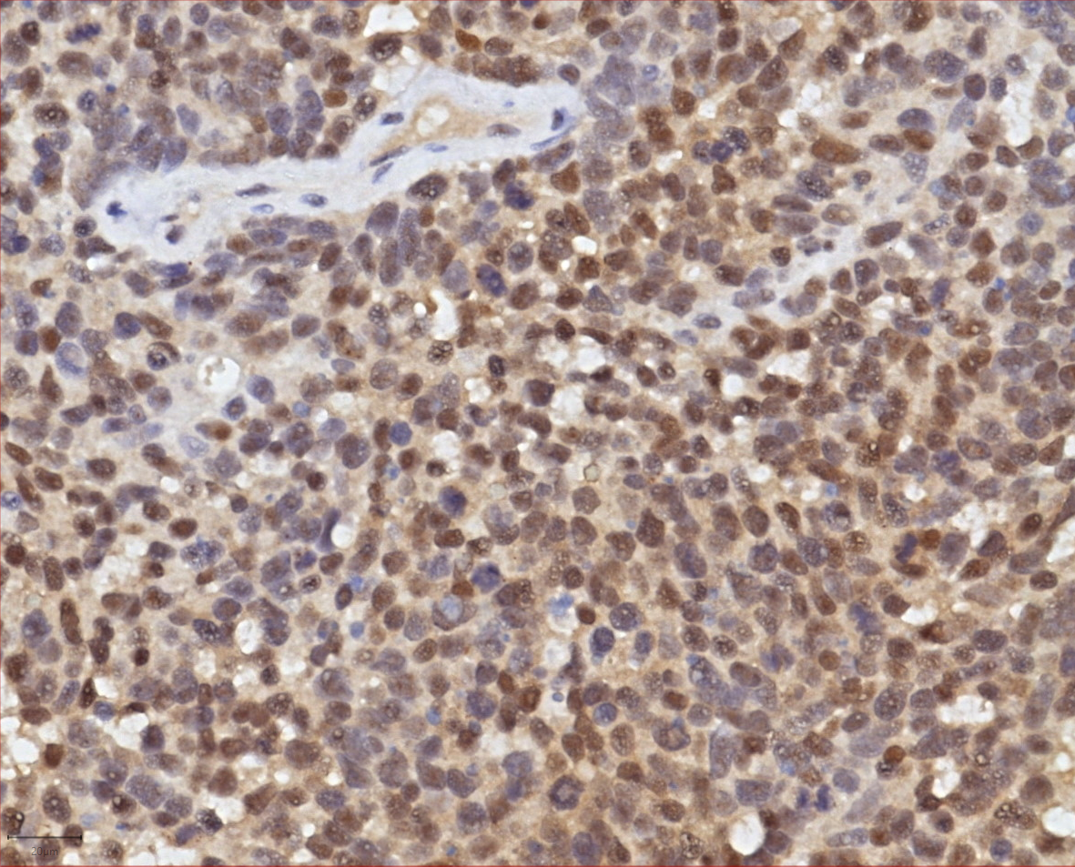
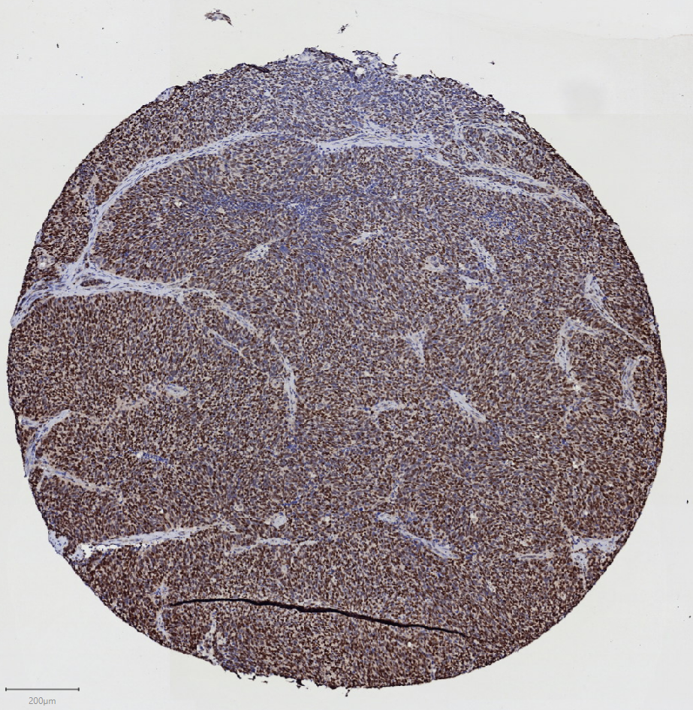
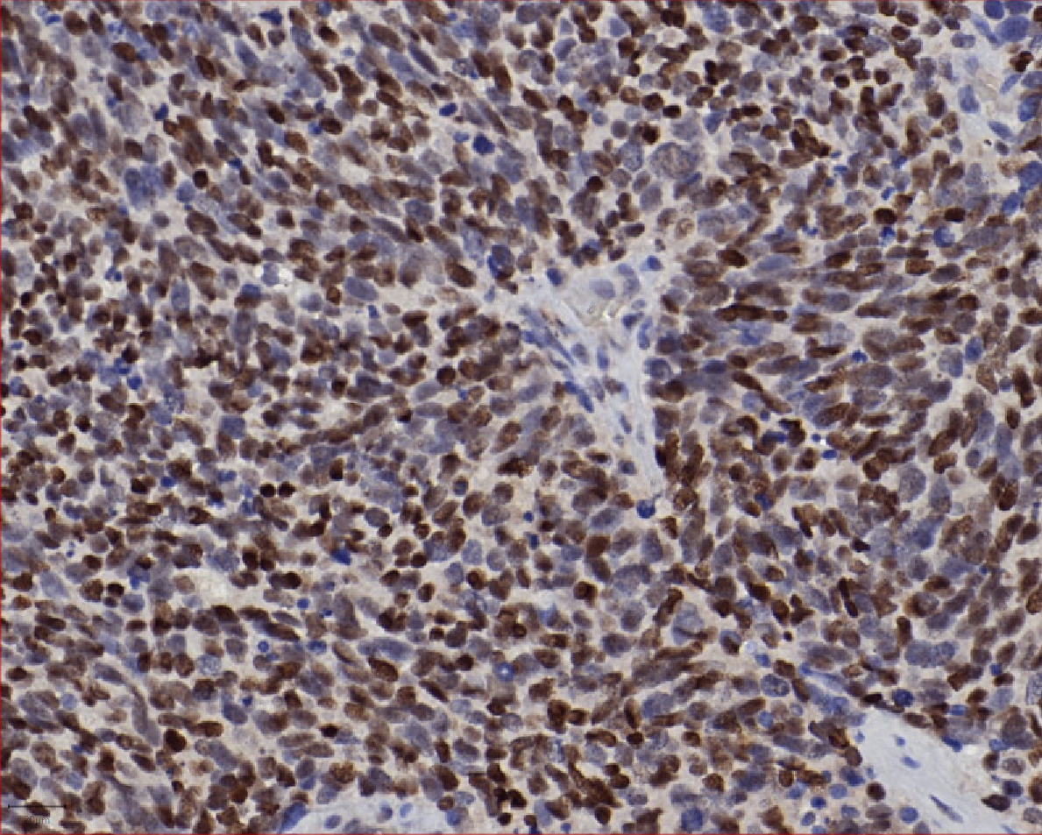
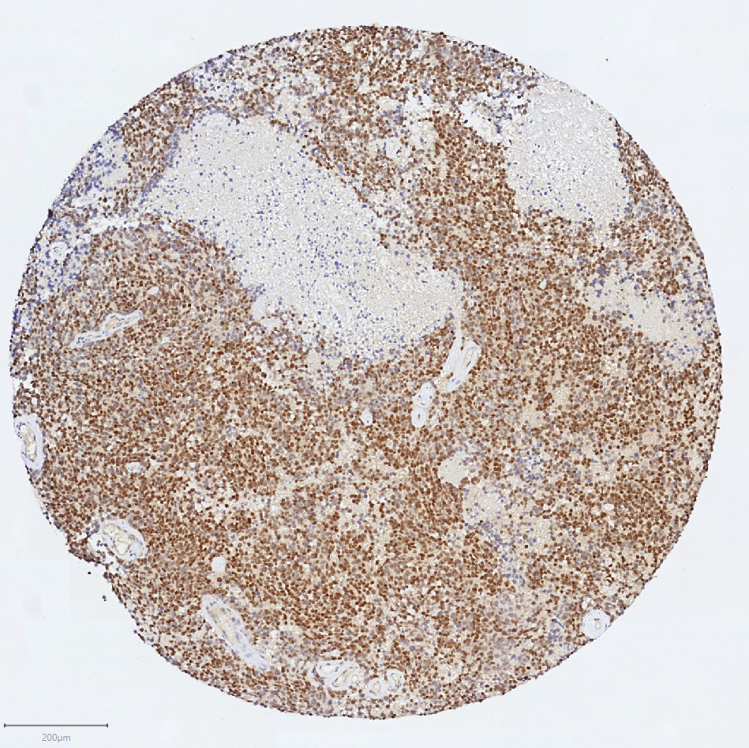
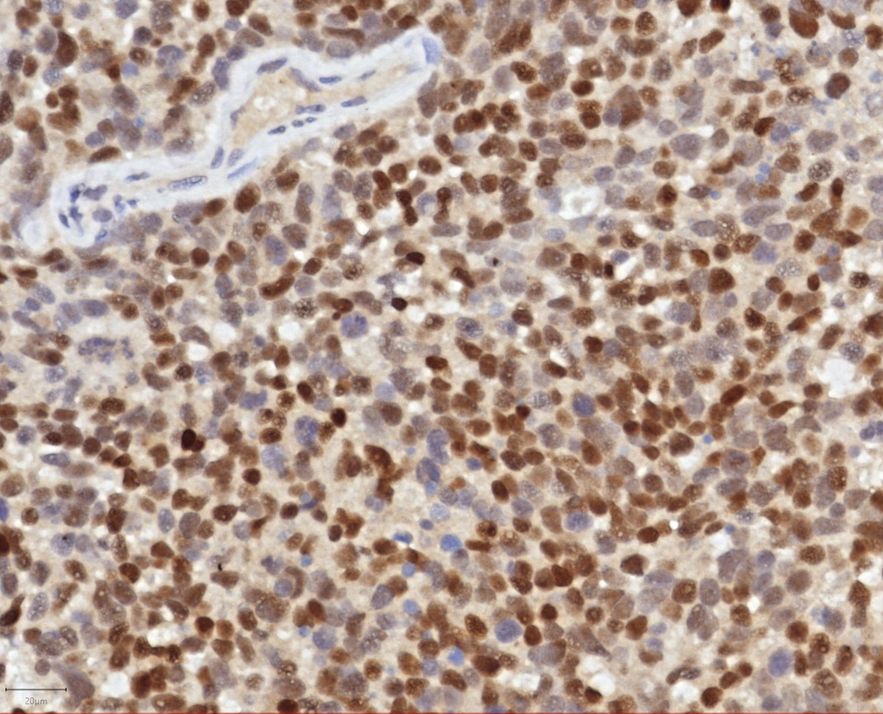
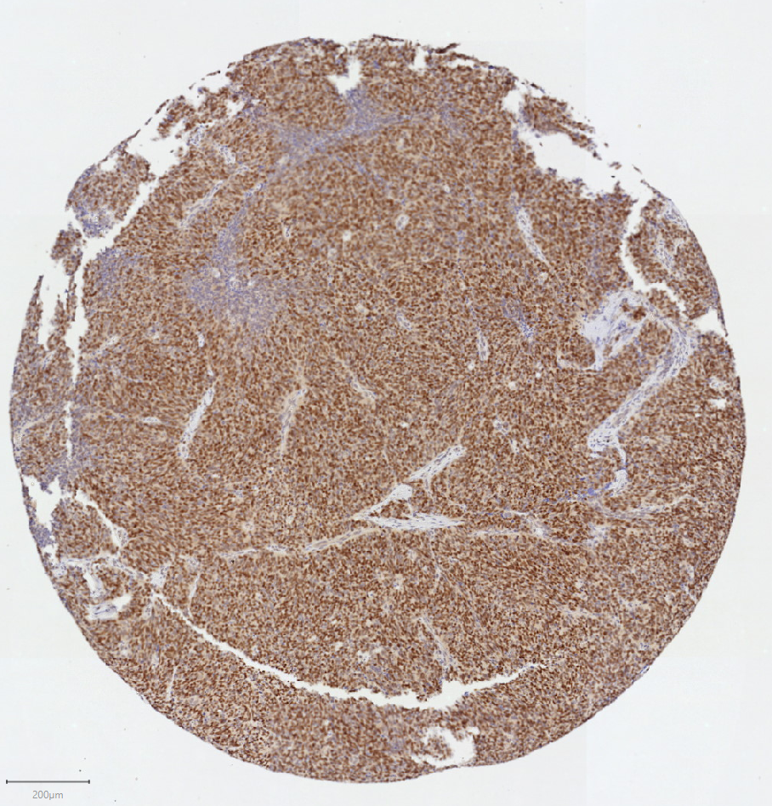
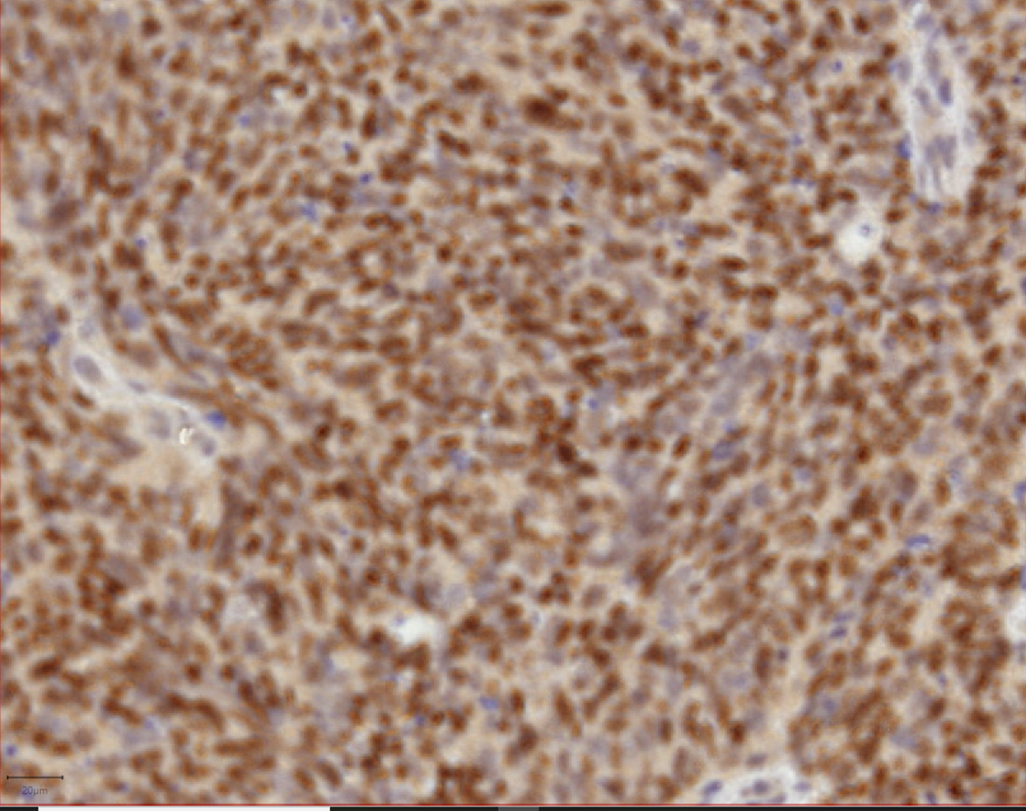
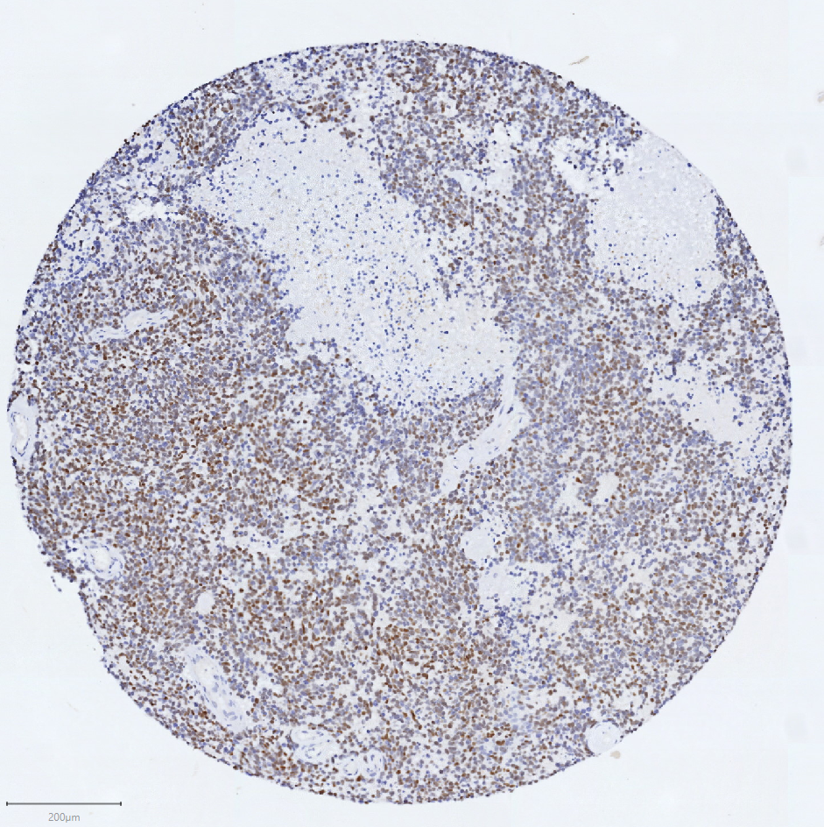
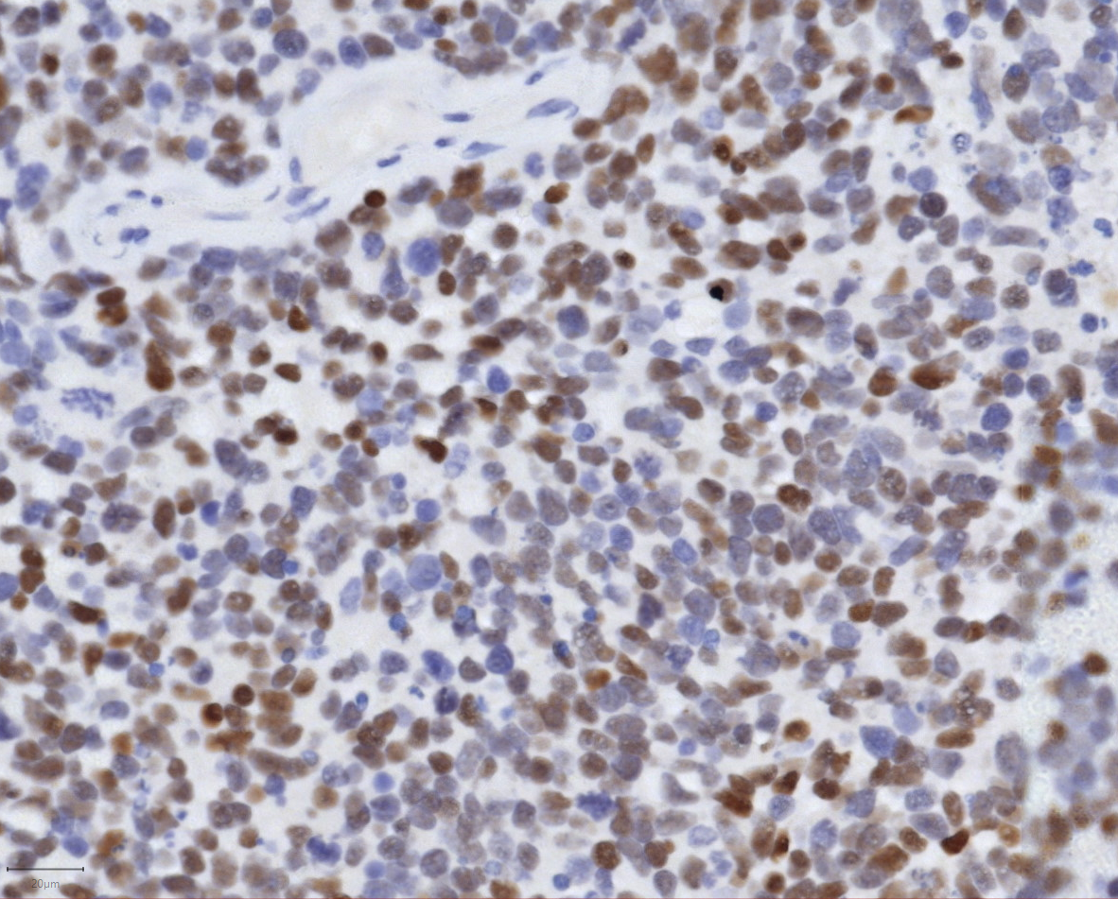
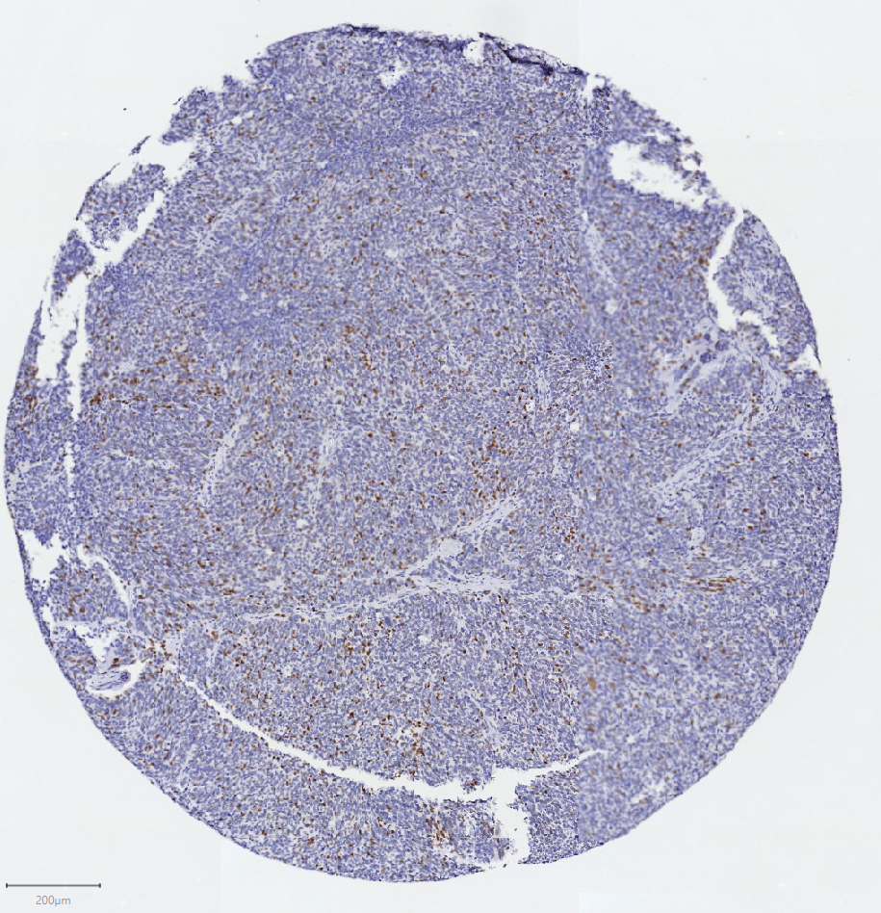
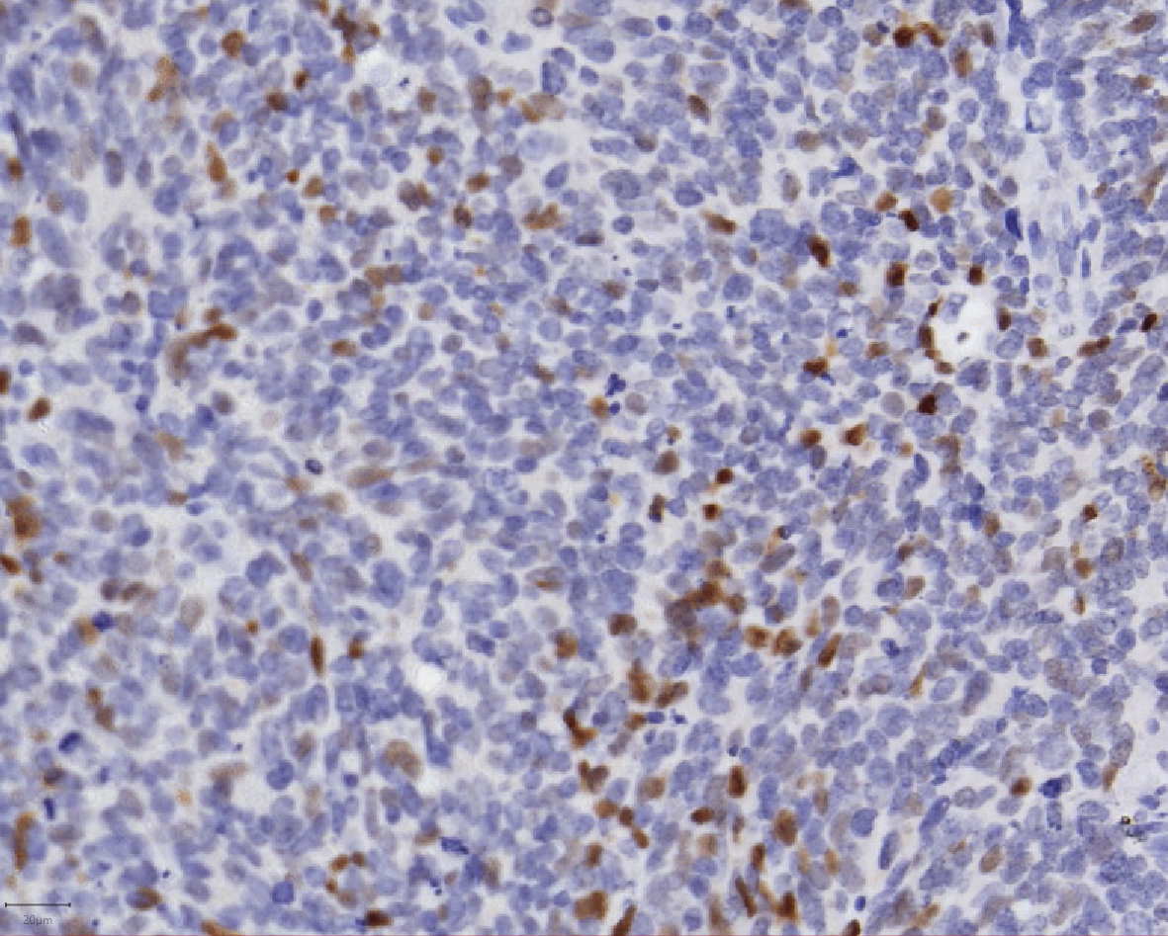
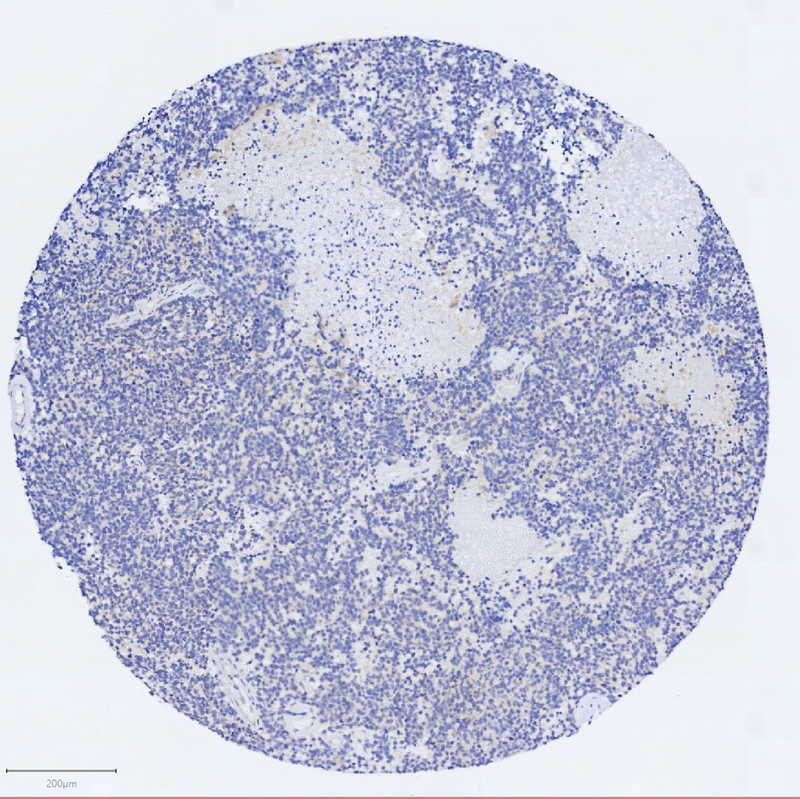
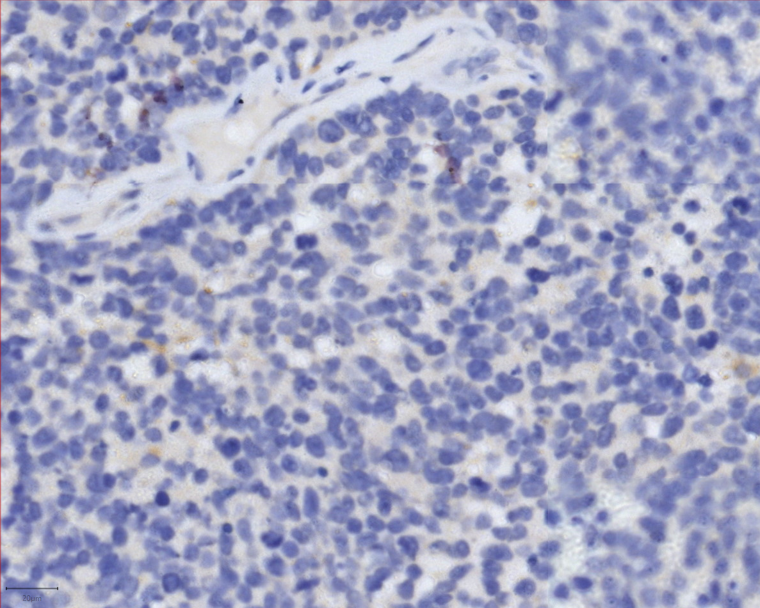
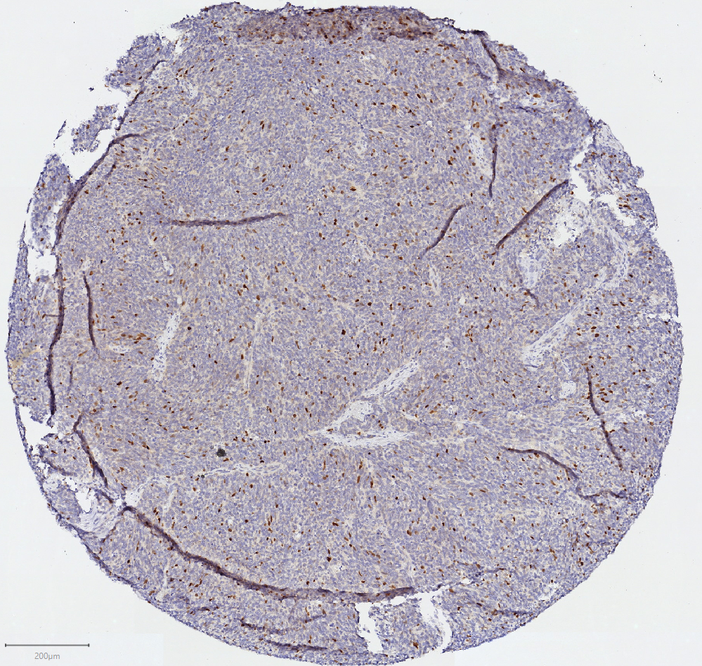
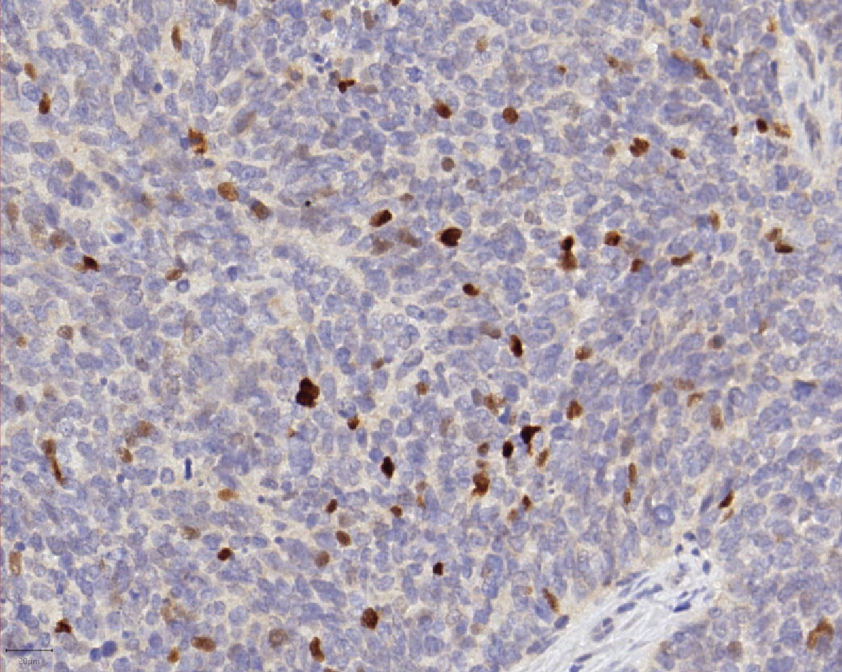
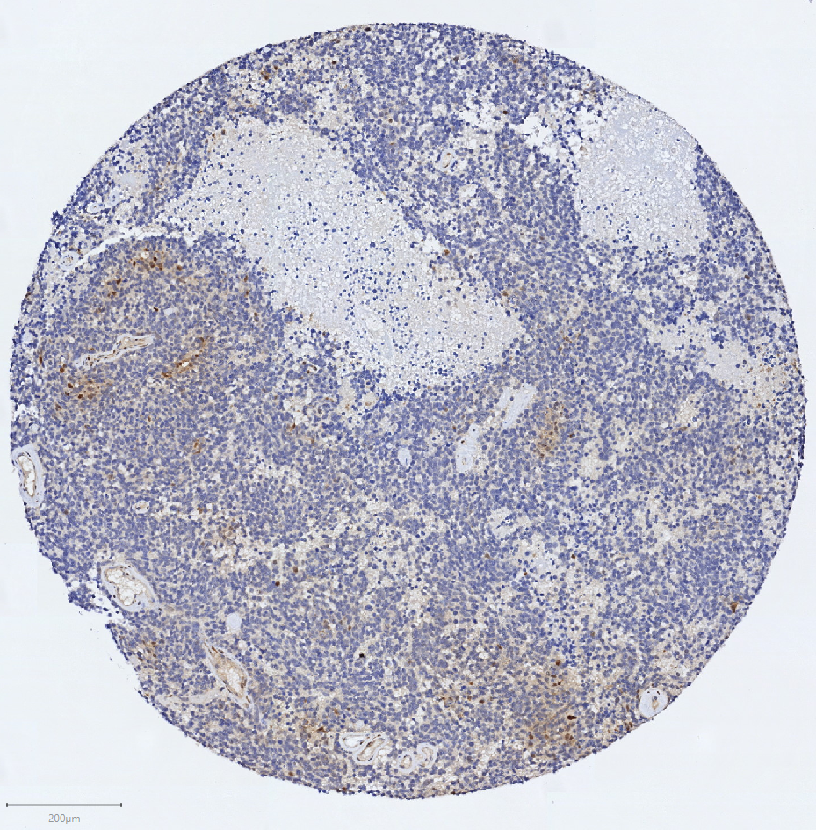
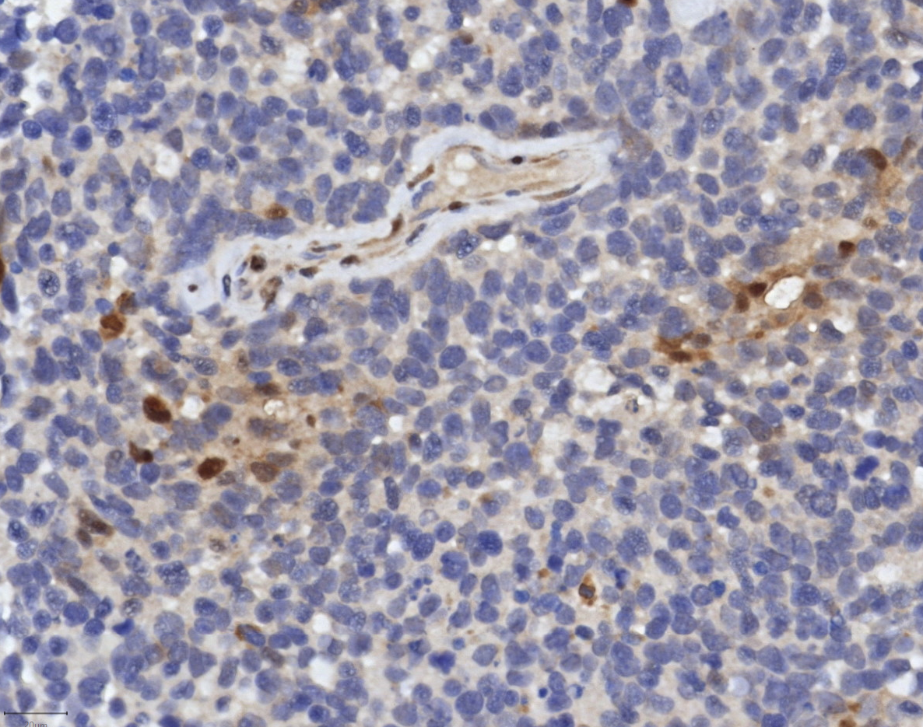
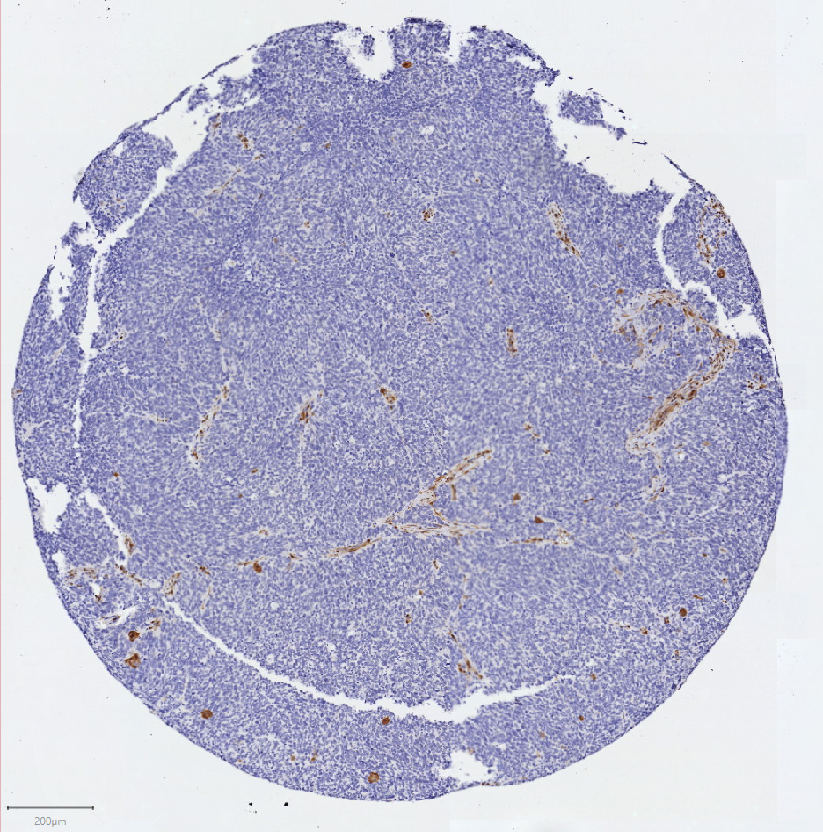
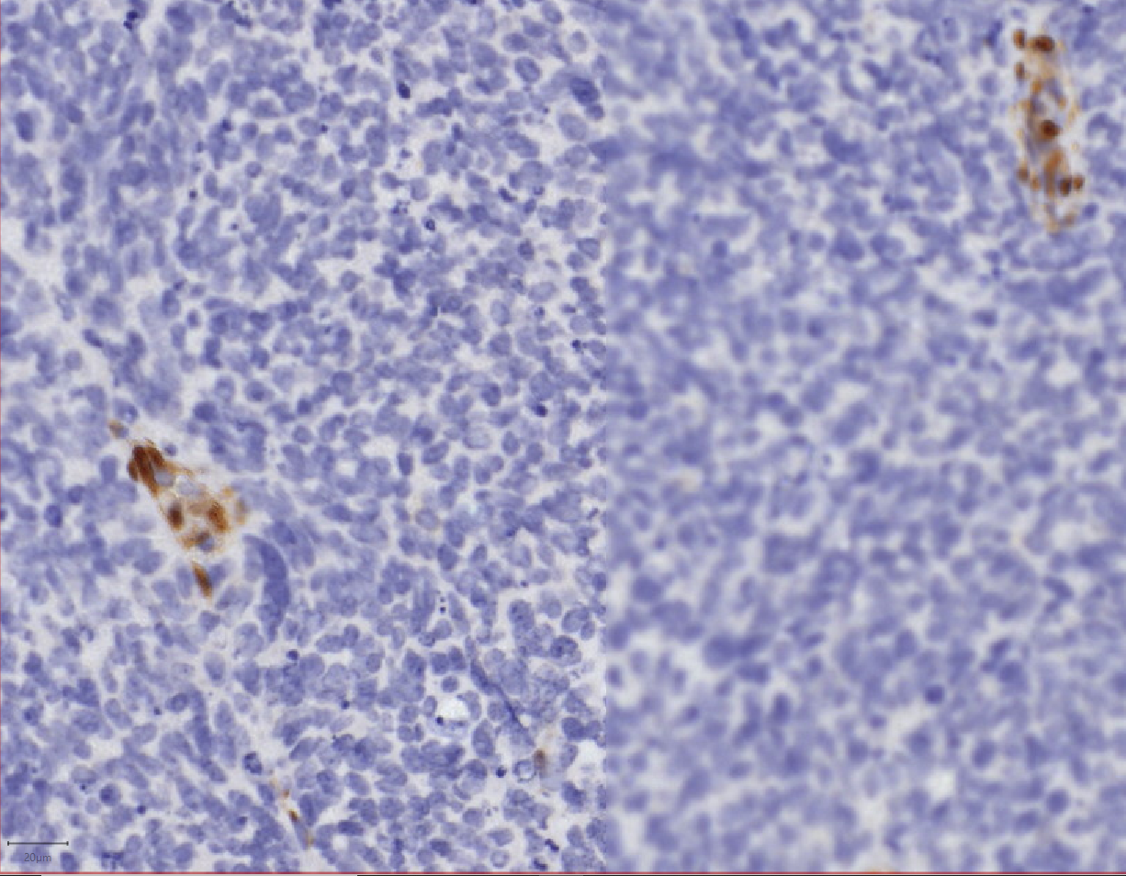
H&E
Supplement Figure 3. Complete IHC profile for two patient biopsies. The biopsy of PID 471 (left) was chosen to represent an RB1 positive, NE positive tumor specimen. The biopsy of unknown PID (right) was chosen because it was the only POU2F3 positive tumor specimen. This H&E core was fragmented and not shown. H scores are listed to the right of images. White box shows approximate region magnified on the right.
RB1
180
RB1
0
INSM1
270
INSM1
270
ASCL1
270
ASCL1
270
NEUROD1
50
NEUROD1
40
POU2F3
0
POU2F3
30
YAP1
2
YAP1
0

Slide 4
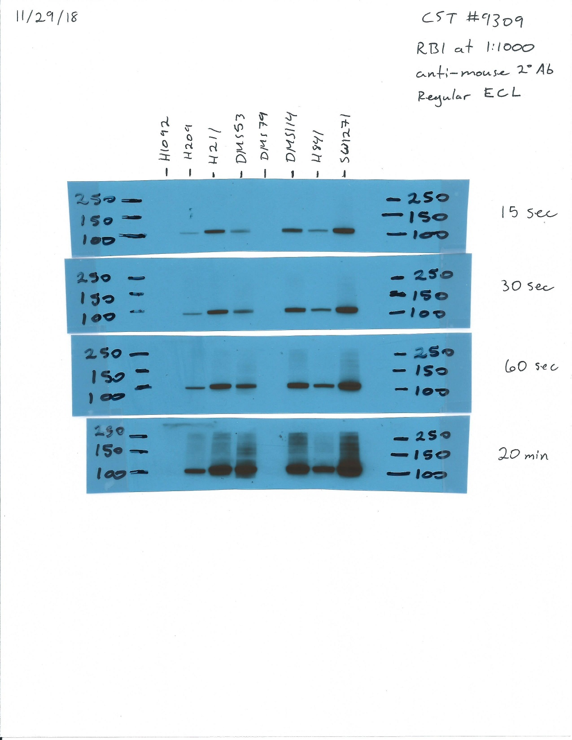
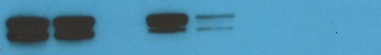
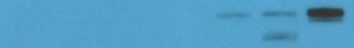
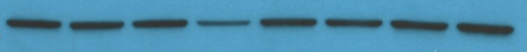
H211
DMS114
SW1271
DMS53
H841
H1092
DMS79
H209
RB1
INSM1
YAP1
β-actin
Supplemental Figure 4. Validation of RB1 expression and correlation with INSM1 and YAP1 expression in SCLC cells. Western blot analysis of wt RB1 (black text) and mutant RB1 (red text) cell lysates for expression of RB1, INSM1, and YAP1. β-actin was used as a loading control. These represent different protein lysates than those prepared for Figure 2B.

Slide 5

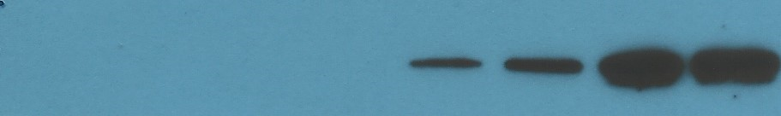

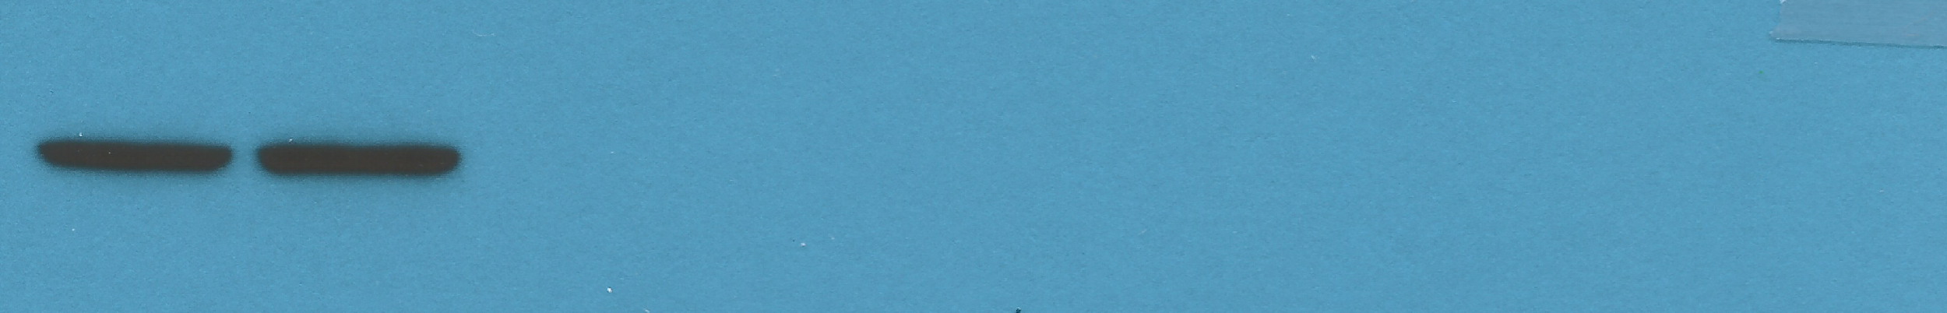


H211
DMS53
H841
SW1271
C KO C KO C KO C KO
53 kDa
INSM1
Supplement Figure 5. Effect of RB1 knockout in wt RB1 SCLC cells. Western blot analysis of stable control pLKO (C) and CRISPR knockout (KO) lysates for expression of the four transcriptional regulatory proteins (ASCL1, NEUROD1, POU2F3, YAP1), the neuroendocrine protein INSM1. ACTB (β-actin) was used as a loading control. Molecular weight markers are shown to the left.
54 kDa
YAP1
34 kDa
ASCL1
40 kDa
NEUROD1
47 kDa
POU2F3
45 kDa
ACTB

Slide 6
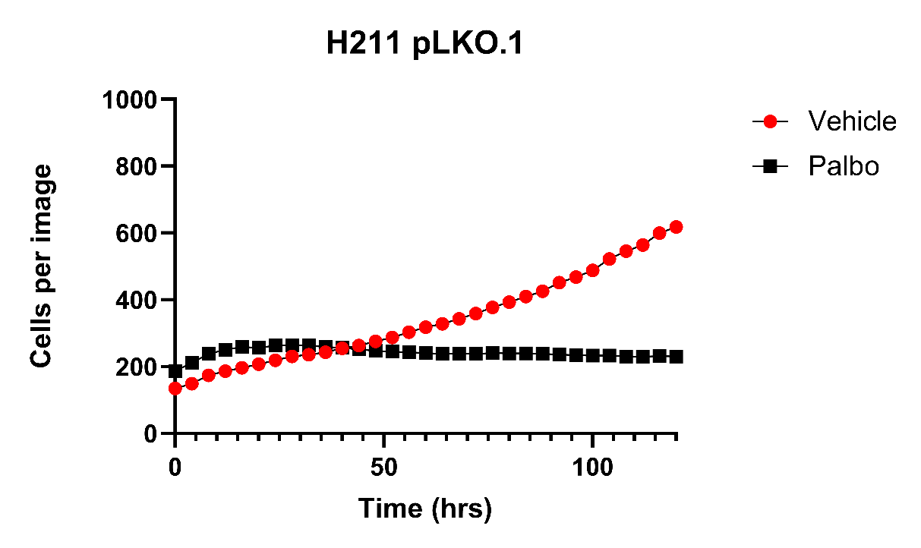
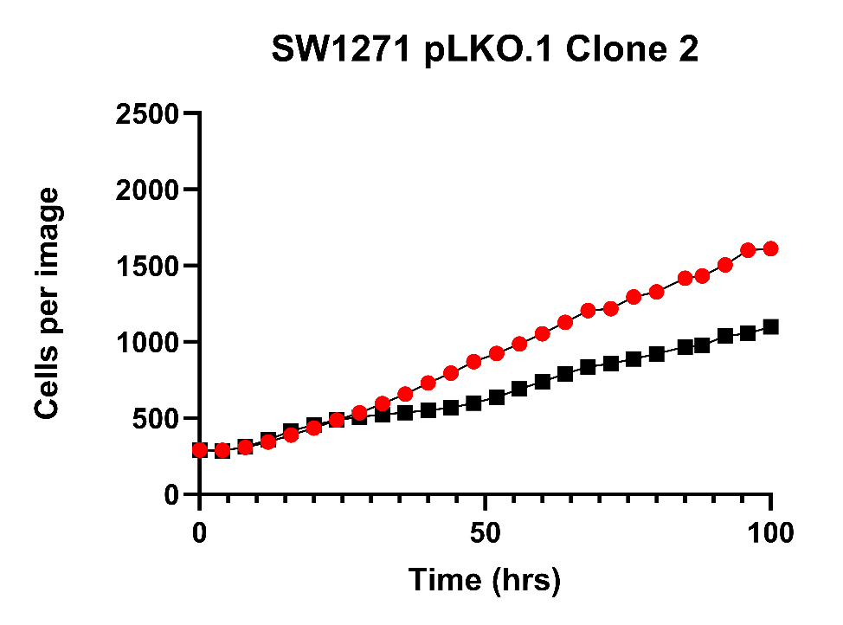
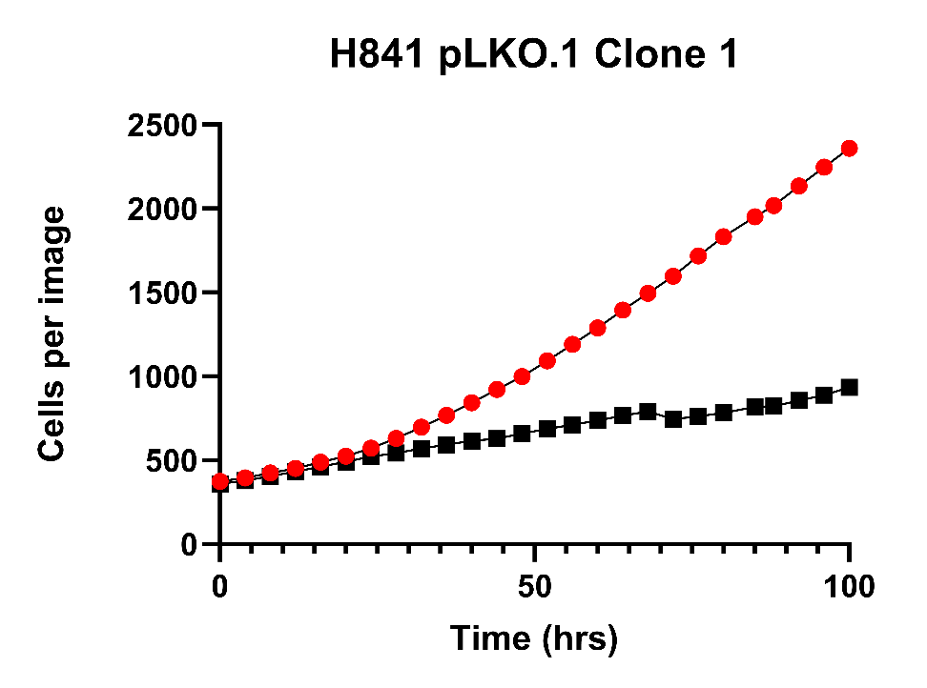
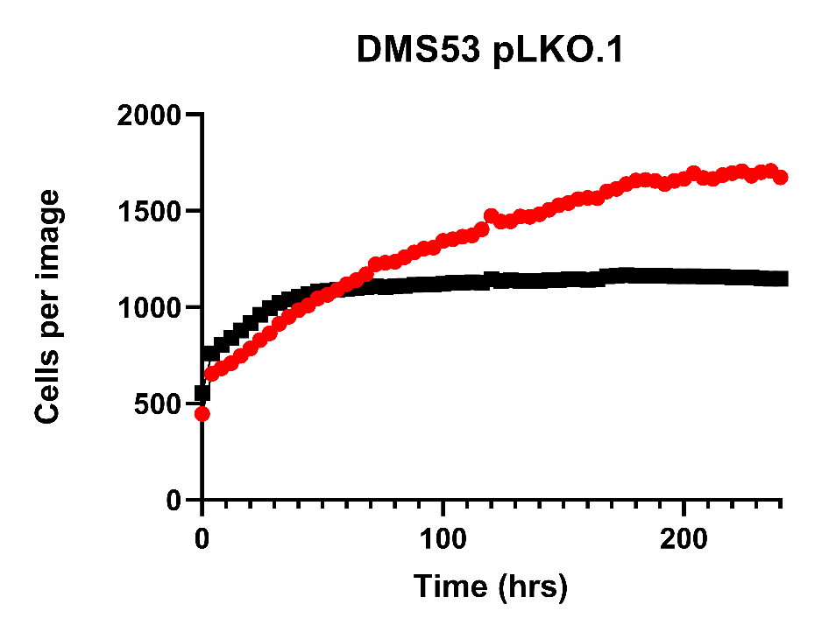
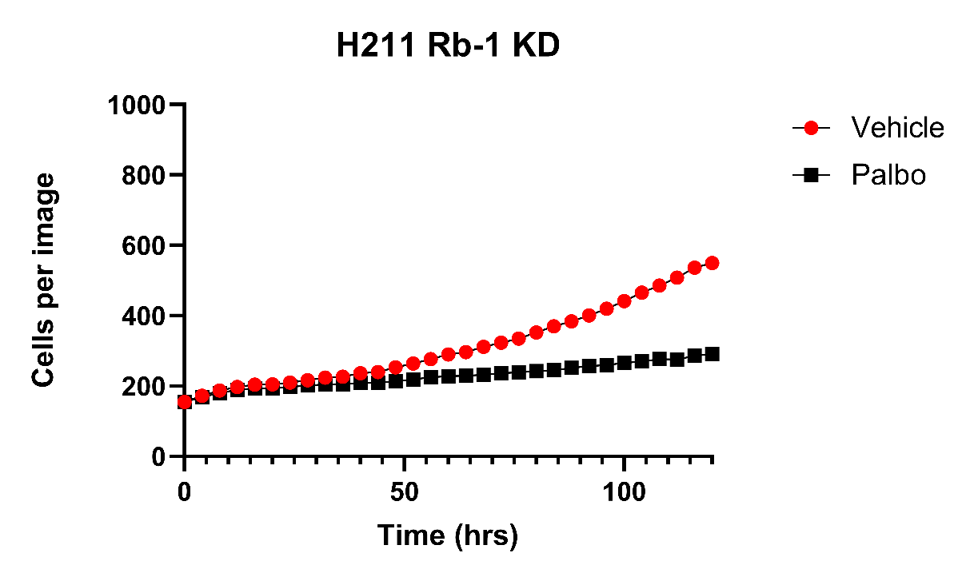
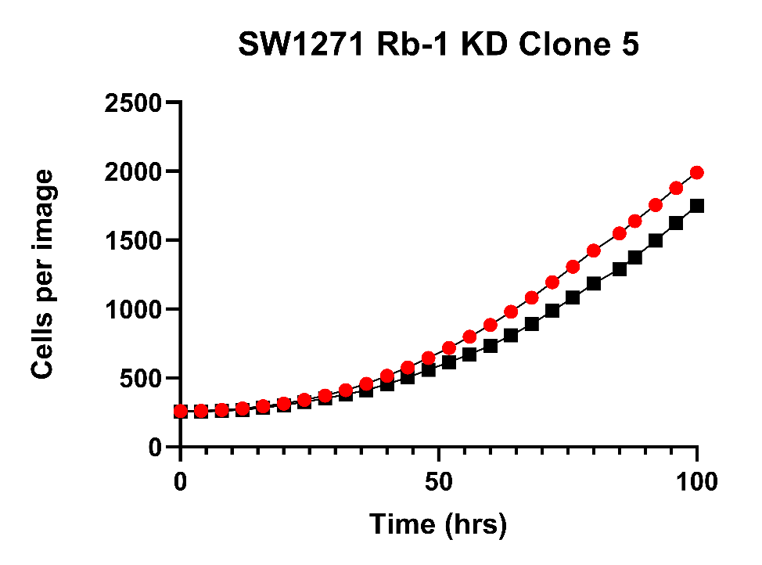
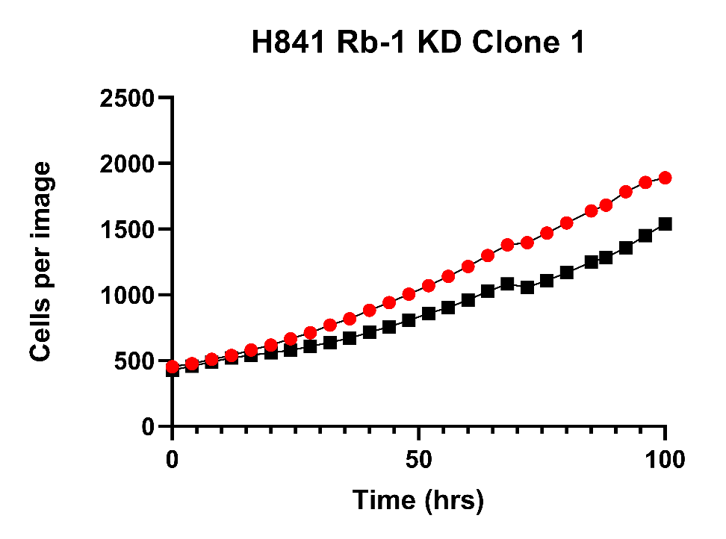
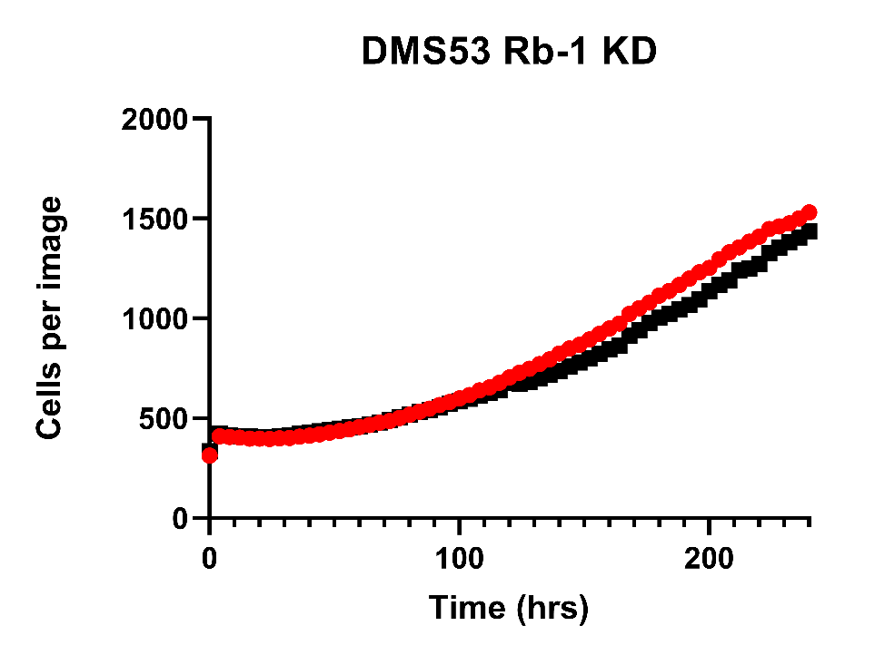
Supplement Figure 6: Growth inhibition by 1.0 µM palbociclib in vector control (pLKO) and matching RB1 CRISPR knockout (Rb-1 KD) wt RB1 cells was determined by continuous measurement in an IncuCyte ZOOM. Results show mean of six replicates for each time point. Error bars are not shown to promote clarity. (See Figure 3C for statistical analyses of differences in growth inhibition by palbociclib).

Slide 7
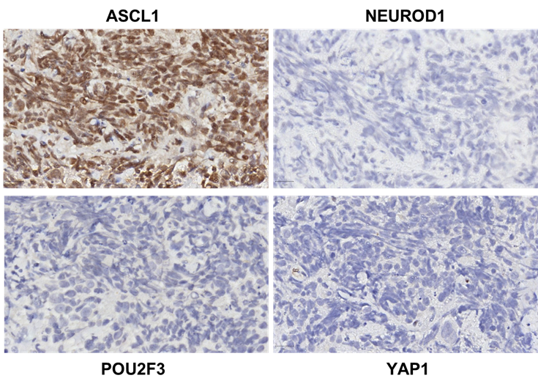
Supplement Figure 7. Additional IHC analysis of patient 2 biopsy. This biopsy specimen is the same as that used in Figure 4C. The conditions used for IHC staining were identical to those used for the TMAs.

