Slide 1
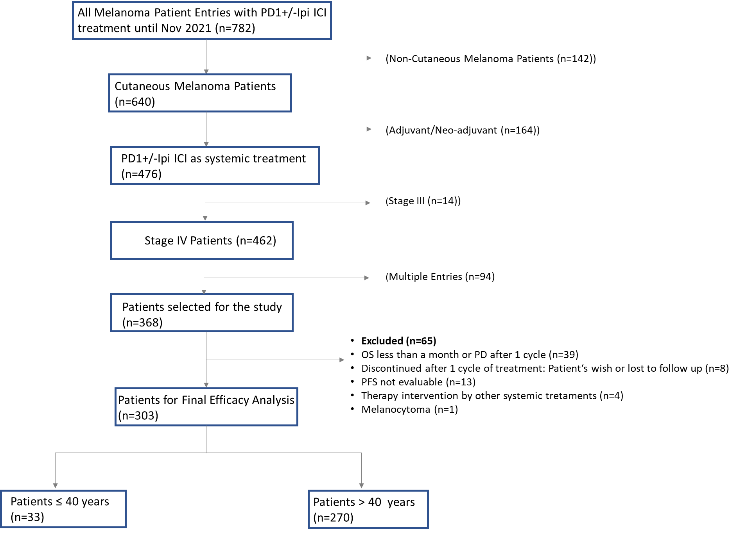
Supplemental Figure 1.
Notes:
Figure 1. Consort diagram of the study population

Slide 2
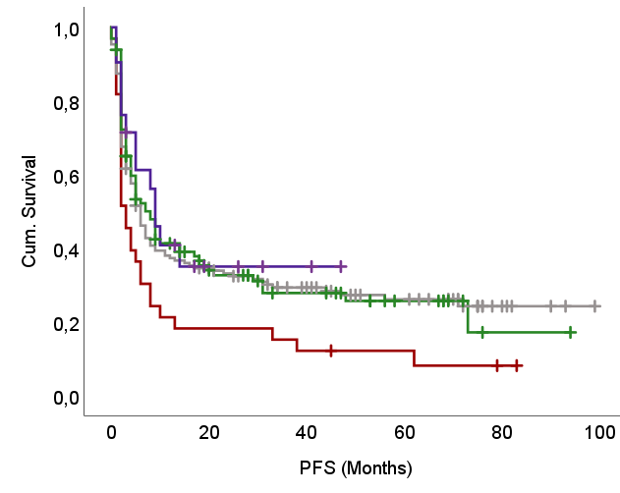
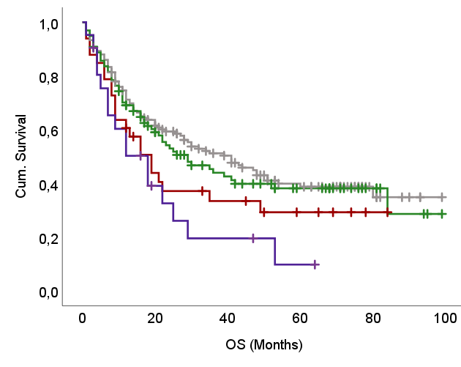
Supplemental Figure 2.
A)
B)
Age (Years)
≤ 40
41-65
66-79
≥ 80
Age (Years)
≤ 40
41-65
66-79
≥ 80
0.062
0.039
(n=21)
(n=151)
(n=151)
(n=33)
(n=98)
(n=98)
(n=33)
(n=21)

Slide 3
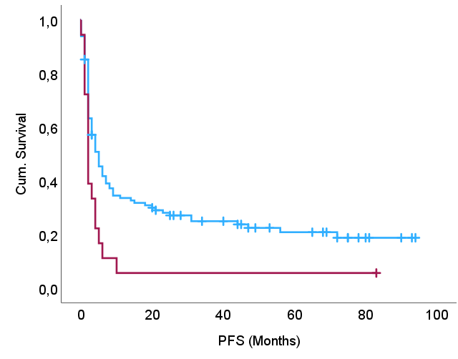
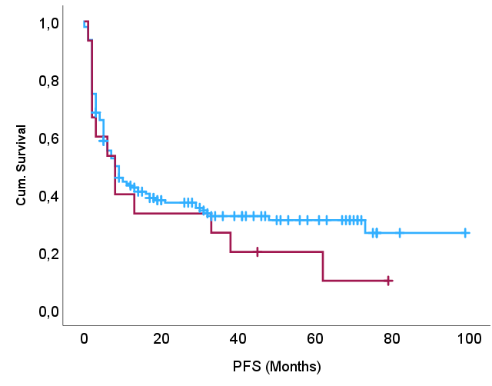
Supplemental Figure 3.
(A) Others
(B) First Line
Age (Years)
≤ 40
> 40
Age (Years)
≤ 40
> 40
0.329
0.009
(n=115)
(n=155)
(n=18)
(n=15)

