Slide 1
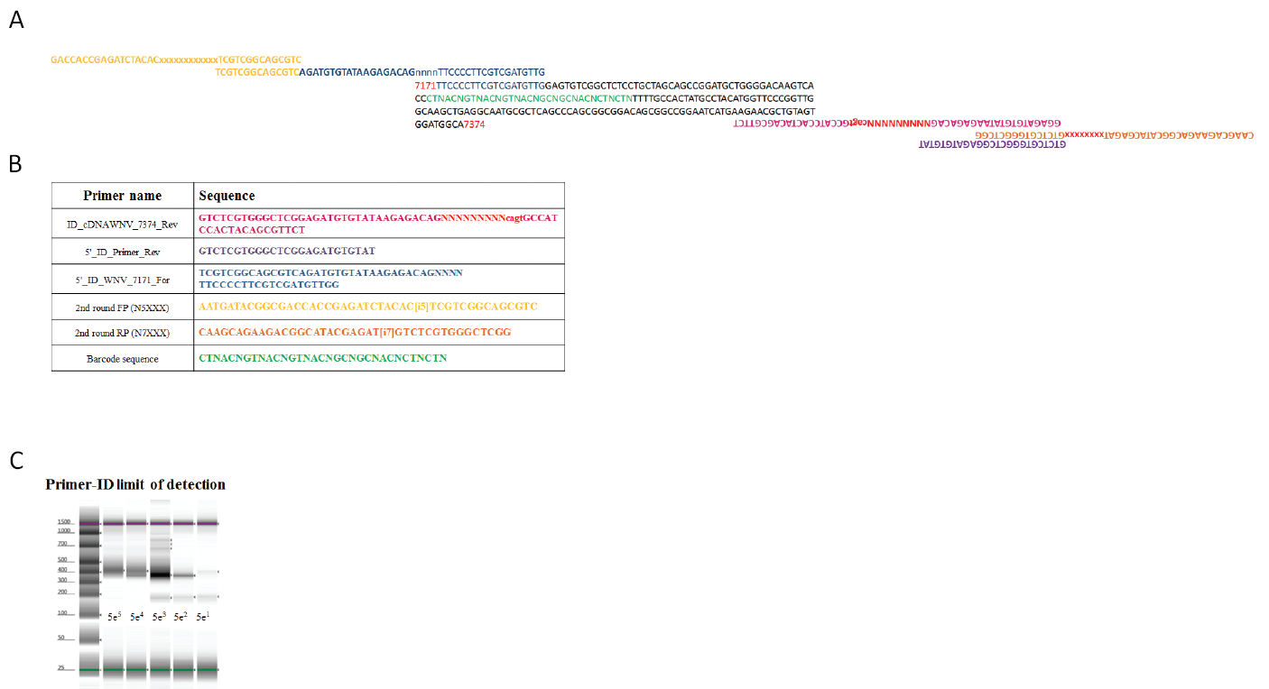
Supplementary Methods Figure 1
Notes:
From Dalit: As for the originals for the figures you mentioned, I have done them in photoshop, but don't have it installed on my pc anymore. They have been erased once I left CSU so I can't send them to you, unless you have photoshop on your computer, then I can try to send the "unidentified" version that my laptop just isn't able to open under these circumstances.

