Slide 1
Supplemental Figure 1. Trajectory of Platelet Indicies & Clinical Outcomes (without imputation)
A.
Platelet Count
B.
MPV
C.
IPF (%)
Critical Illness
All Cause Mortality

Slide 2
Supplemental Figure 2. Adjusted Odds Ratio for A. Critical Illness and B. Death based on platelet Count, MPV & IPF (%) following removal of platelet count < 150 x 10⁹/L. Adjusted Odds Ratio for C. Critical Illness and D. Death based on platelet Count, MPV & IPF (%) following removal of platelet count < 100 x 10⁹/L.
A.
C.
B.
D.

Slide 3
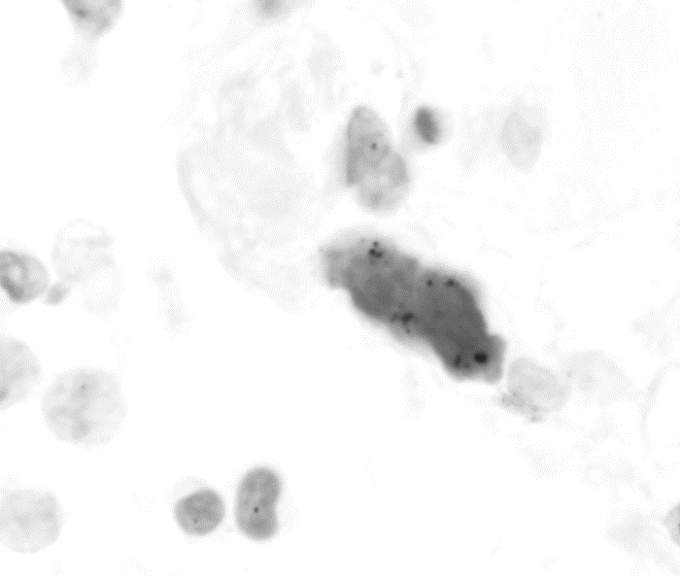
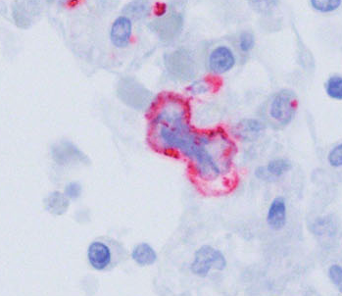

Supplemental Figure 3. In Situ Hybridization of a Megakaryocyte from a COVID-19 Patient
RNAscope of lung megakaryocytes with negative sense probe which detects replicating SARS-CoV-2 virions, and corresponding CD61 IHC.
A.
In Situ Hybridization
SARS-CoV-2
sense probe
IHC
CD61

Slide 4
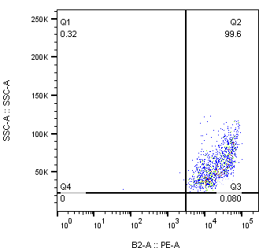
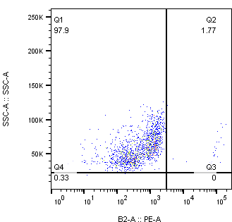
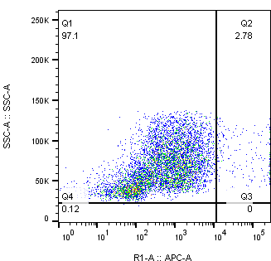
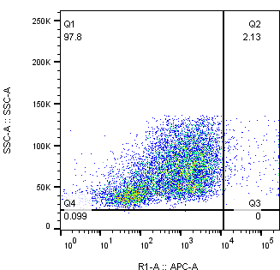
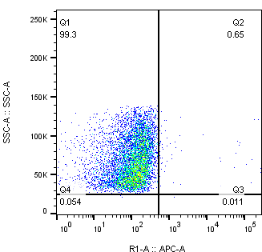
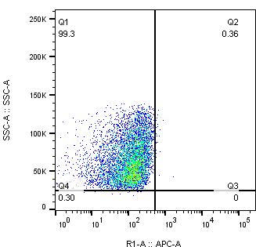
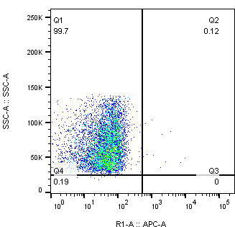

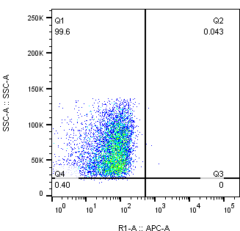
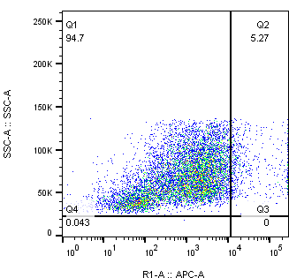

Supplemental Figure 4 A) Surface expression of ACE2, CD147, DC-SIG, L-SIGN, CLEC10A, CLEC4G, and ASGR1 as determined by flow cytometry of CD34-derived megakaryocytes.
CD34-Derived Megakaryocytes
A.
Isotype Ctrl
ACE2
Isotype Ctrl
CD147
Isotype Ctrl
CD209/ DC-SIGN
CD299/ DC-SIGN L
CD301 –CLEC10A
LSECtin/CLEC4G
Isotype Ctrl
ASGR1

Slide 5
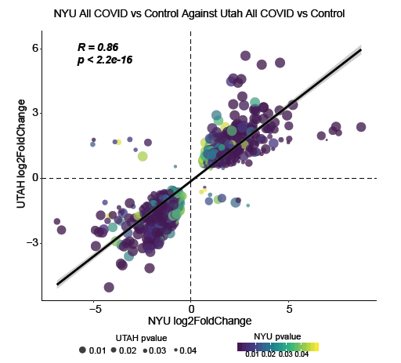
Supplemental Figure 5.
A.
B.

Slide 6
Supplemental Figure 6. Expression of A) SARS-CoV-2 B) S100A9 and C) S100A8, in CD34-derived megakaryocytes following incubation with SARS-CoV-2 or vehicle control. Cells were pretreated with a CD147-activity blocking antibody (UM8D6, 15 μg/mL) or IgG control (15 μg/mL) for 30 min prior to the addition of SARS-CoV-2.

Slide 7
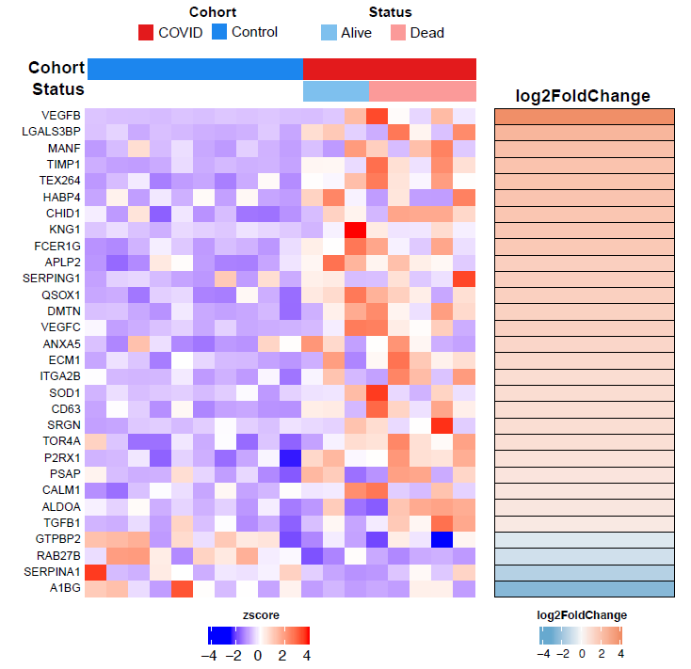
Supplemental Figure 7 Platelet degranulation pathway as determined by GO analysis.

