Slide 1
The full uncropped blot for Figure 2K
The blots were imaged on LiCor

Slide 2
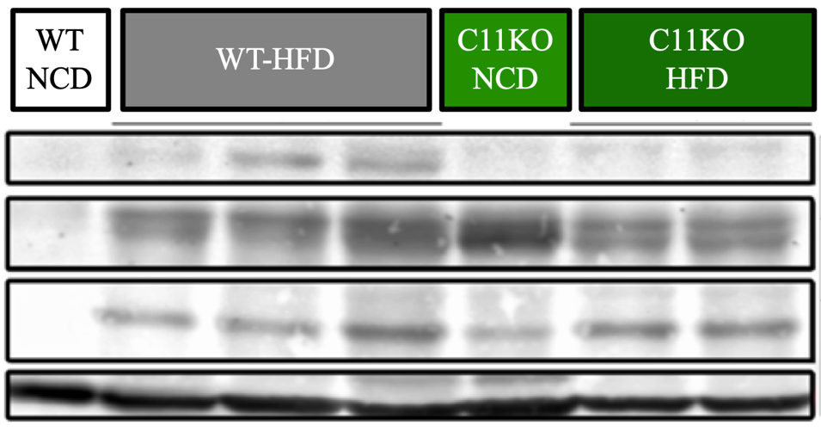
The full uncropped blot for Figure 5A
A.
WT
NCD
WT
HFD
C11KO
NCD
Casp11KO
HFD
The blots were imaged on LiCor
Casp11 (FL)
[~38, 48 kDa]
GSDMD (FL)
[~53 kDa]
GSDMD (N)
[~31 kDa]
Β-Actin
[~42 kDa]

