Slide 1



Towards a national data infrastructure for the reuse of health data recorded by nursing home physicians
Program: Learning from Data
October 2020

Slide 2
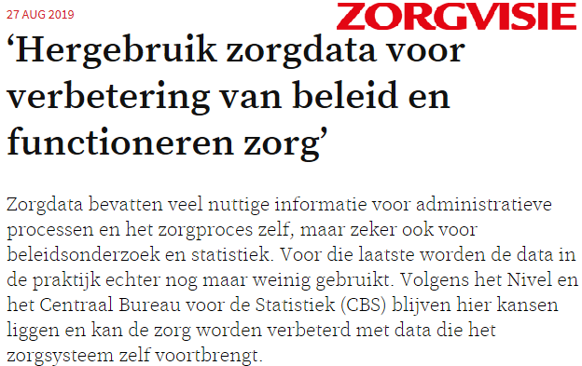
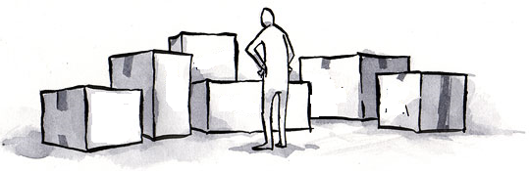
Much information is
recorded, however it is
fragmented,
not very well findable,
not very well comparable,
usually not fit to reuse for secondary purposes (not FAIR)

Slide 3

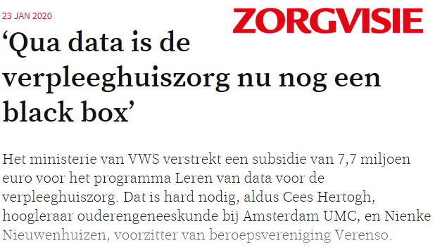
Program Leren van Data (2019-2024)

Slide 4
Aims of the program
Stimulating the reuse of information from electronic health records in medicine for older adults, by
Working towards standardization of information in electronic health records
Collecting and reusing existing health records for:
  improvement of quality of care, research purposes, and policy purposes

Slide 5
Towards.. A Learning Health System
Health care providers
Policy
Feedback information
Data
Publications
Research
Quality of care improvement
Knowledge development

Slide 6



Program Learning from Data
Pillar 1
Improving standardization and defining a minimal dataset
Pillar 2
Collecting and analyzing health data from one EHR system
Pillar 3
Setting up a nation-wide registry, to collect a minimal dataset from all EHR systems

Slide 7
Pillar 3: Nation-wide registry:
Registry Learning from Data in Nursing Homes
The Registry focusses on:
Collecting a minimal set of data recorded by nursing home physicians in all different EHR systems.
Health care provision financed through the Dutch Long-term Care Act
The Registry does not focus on the exchange of information from health care records between health care settings

Slide 8
Pillar 3.1: Governance
Who can use which data, for what purposes, and under which conditions.
The governance framework describes:
The aim of collecting and reusing routinely recorded health records
Different governing bodies in the framework and its structure
Members of the governing bodies and their tasks and responsibilities
Legal framework

Slide 9

Interviews
Aim:
Exploring the wishes, expectations, needs and interests of stakeholders with regard to the Registry Learning from Data in Nursing homes and its governance.
With stakeholders from
The program’s consortium
Umbrella organizations
Patient organizations
Professional associations
Research community
Government

Slide 10
Interview topics
Aim and necessity of the Registry
Data governance
  Who may access which data, under what conditions, and for what purpose
  Privacy measures
Governing bodies
  Which organizations
  Tasks and responsibilities
  Own role

