Slide 1
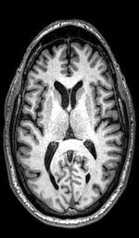
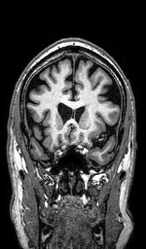
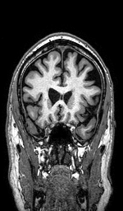
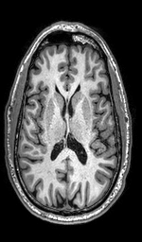
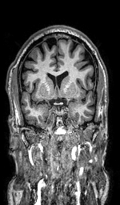
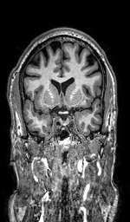
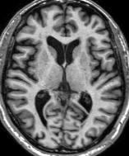
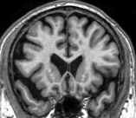
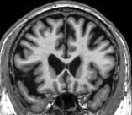
Supplementary Figure 2. Coronal views, Cavum Septum Pellucidum present in two of the three Ex-Football Players, P1, P4.
R
P1. Cavum septum pellucidum present.
Age at Entry into tPBM study: 65 Yr.
Age First Exposure to Football: 10 Yr., Pop Warner
Years played Football: 14
Years played Pro-Football: 1.5, CFL
Position: Middle Linebacker
Fronto-temporal cortical atrophy
R
P1
R
P2. Cavum septum pellucidum not present.
Age at Entry into tPBM study: 55 Yr.
Age First Exposure to Football: 7 Yr., Pop Warner
Years played Football: 15
Years played Pro-Football: 0, College only
Position: Tackle, Offensive Lineman
Some fronto-temporal cortical atrophy.
P2
R
P4. Cavum septum pellucidum present.
Age at Entry into tPBM study: 74 Yr.
Age First Exposure to Football: 13 Yr.
Years played Football: 11
Years played Pro-Football: 4, NFL
Position: Defensive End, and
Offensive Lineman, all positions
Fronto-temporal cortical atrophy
P4

