Slide 1

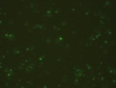
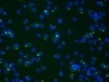
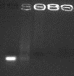

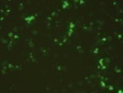
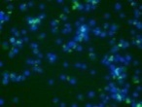
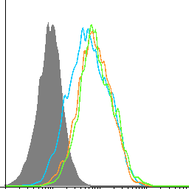
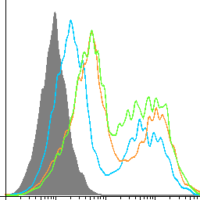
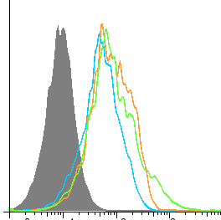
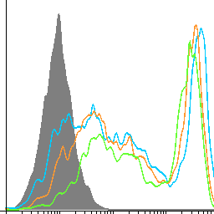
Qian et al., Supplementary Figure 1
A
Free siRNA
B
DAPI
FITC
Merged
10:1
30:1
90:1
60:1
2 μg/ml
10 μg/ml
Control
C
Chitosan 2 μg
Chitosan 10 μg
MHC I
MHC II
CD80
CD86
D
Supplementary Figure 1. Formulation of the chitosan-SRA siRNA complex and the chitosan effects on phenotype or antigen-presenting function of dendritic cells (DCs). A. Complexing of chitosan with SRA siRNA at different weight ratios as indicated. B. The uptake of FITC-labeled chitosan by DC1.2 cells was examined under fluorescence microscope. C. Chitosan treatment shows little effect on maturation/activation of DCs in culture. D. Bone marrow-derived DCs were treated with chitosan at indicated doses and loaded with OVA₂₅₇₋₂₆₄ peptides prior to co-culture with OVA₂₅₇₋₂₆₄-specific OT-I cells. T cell proliferation was determined by ³H-thymidine uptake assays.

Slide 2
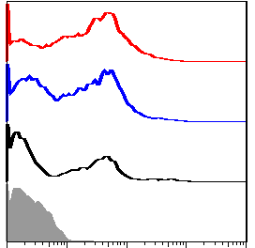
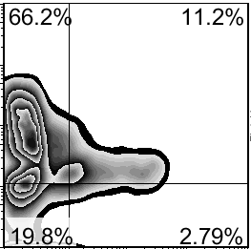
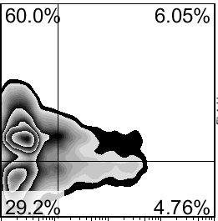
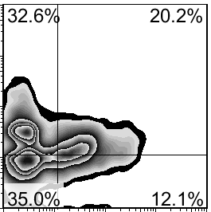
Qian et al., Supplementary Figure 2
A
B
Scram siRNA
+ hspp10-gp100
SRA siRNA
+ hsp110-gp100
74.8%
Control
Count
60.9%
IL-12
48.7%
CD11c
CD11c
Black: Chitosan alone
Blue: Chitosan Scram siRNA + hsp110-gp100
Red: Chitosan SRA siRNA + hsp110-gp100
Supplementary Figure 2. The chitosan-SRA siRNA complex promotes the recruitment of CD11c⁺ cells and their IL-12 expression in the peritoneal cavity following i.v. immunization of B16-gp100 tumor-bearing mice (n=3) with the hsp110-gp100 chaperone vaccine.
Notes:
Supplemental 3 Chitosan can recruit CD11c positive dendritic cells into peritoneal cavity. WT C57BL/6 mice (n=3) were treated with 200ul 1.5mg/ml FITC-chitosan by i.p injection for 1 day, 3 day or 5 day. Cells in peritoneal cavity were stain with PE-F4/80, APC-CD11c for flow cytometry.
Supplemental 4 Chitosan can promote the maturation of dendrtic cells in vivo. A. chitosan can promote the maturation of dendritic cells in vivo, however, there are no difference in three groups. Cells in peritoneal cavity were collected from B16-gp100 tumor bearing mice after siRNA and protein complex treatment, followed by stained with CD11c CD80,CD86 antibody. B. chitosan combined with protein complex vaccine increased the CD11c positive cells infiltration in peritoneal cavity and increased the IL-12 production.
2

Slide 3
Qian et al., Supplementary Figure 3
Supplementary Figure 3. Elevation of anti-gp100 antibodies in mice treated with the hsp110-gp100 plus the chitosan-SRA siRNA compared to those only receiving chaperone vaccine.

Slide 4


Qian et al., Supplementary Figure 4
Negative
Positive
Supplementary Figure 4. Negative and positive controls for ELISPOT.

