Slide 1
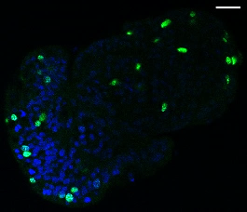
Additional Figure S1. Proliferation in the enteroids.
Graph demonstrating the percentage of proliferating (EdU+) cells within enteroids over 7 days of culture., alongside z-stack image of proliferating (EdU+) cells within a 14 h enteroid.
14 h
EdU
Proliferating
Non-proliferating

