Slide 1
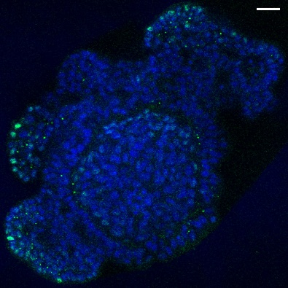
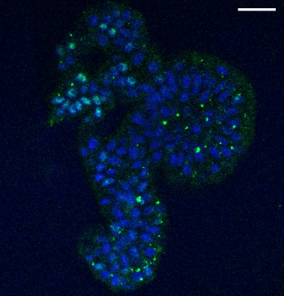
Additional Figure S3. Cell-type gene expression in chicken enteroid cultures.
A Expression of stem cell (LGR5, TNFRSF19, OLFM4, CDCA7, LRIG1, BMI1), Paneth cell (FZD5, LYZG2, LYZ1), enteroendocrine cell (REG4), goblet cell (MUC2) and enterocyte (KRT20, ANPEP) genes in 1 day chicken enteroid cultures. B Confocal images of chicken enteroids at 2 days of culture stained for SOX9 (green, proliferating cells) and counterstained with DAPI (blue). Scale bar: 20 µm. Images are representative of data from at least 3 independent cultures each containing 2 - 3 embryos.
A
B
SOX9
SOX9

