Slide 1
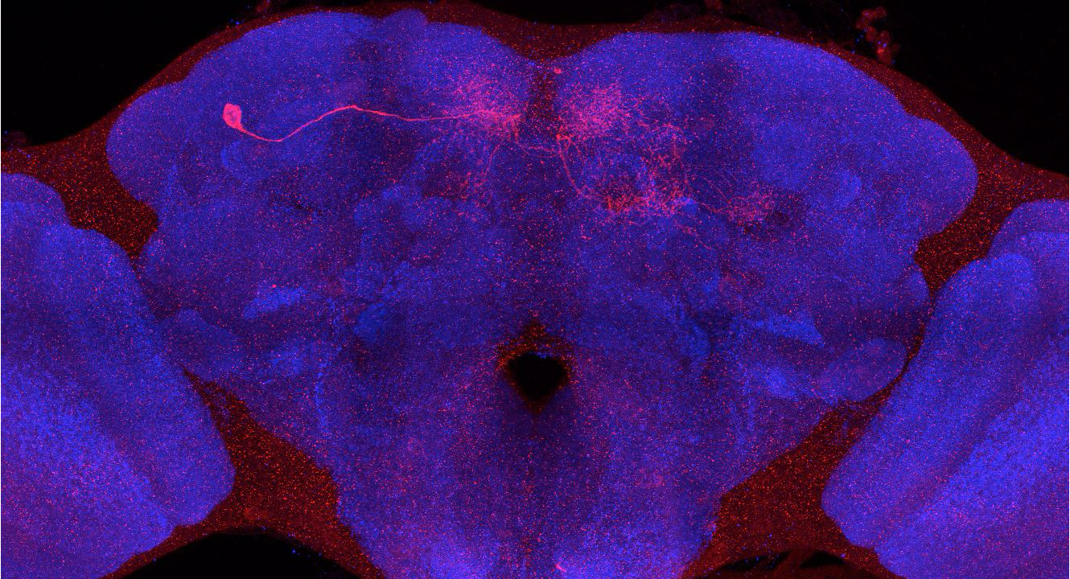
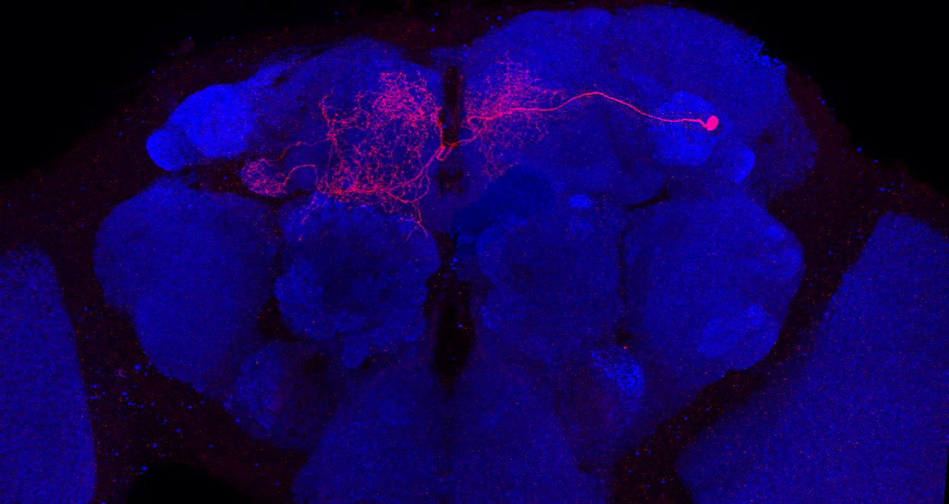
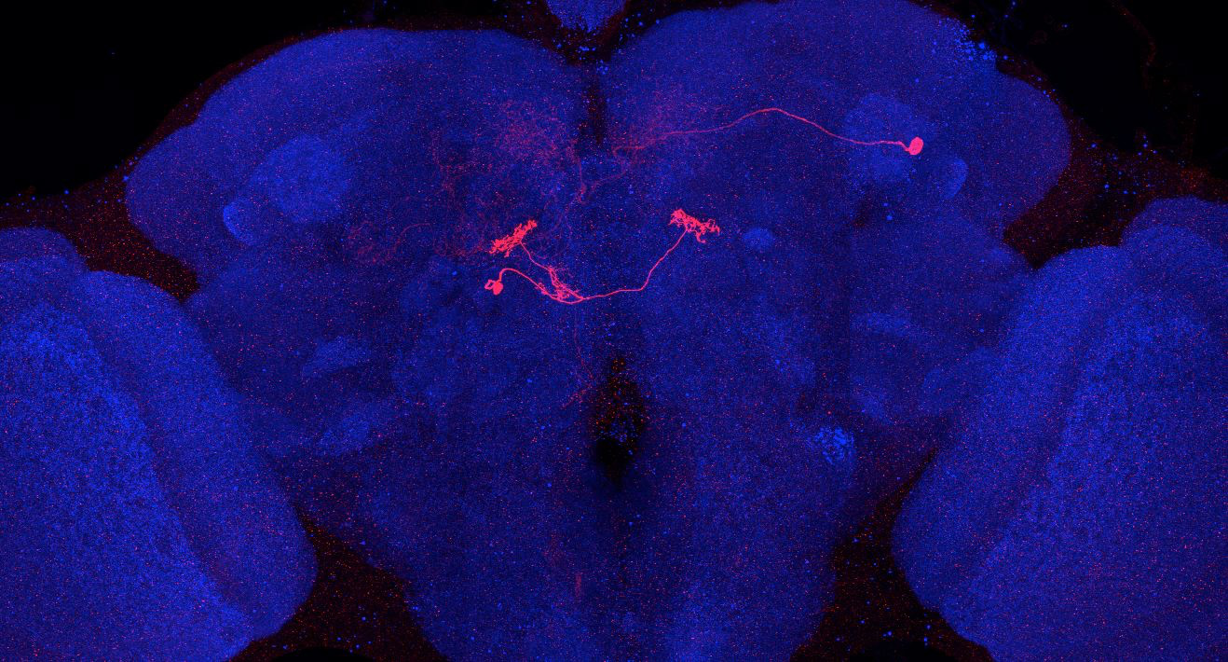
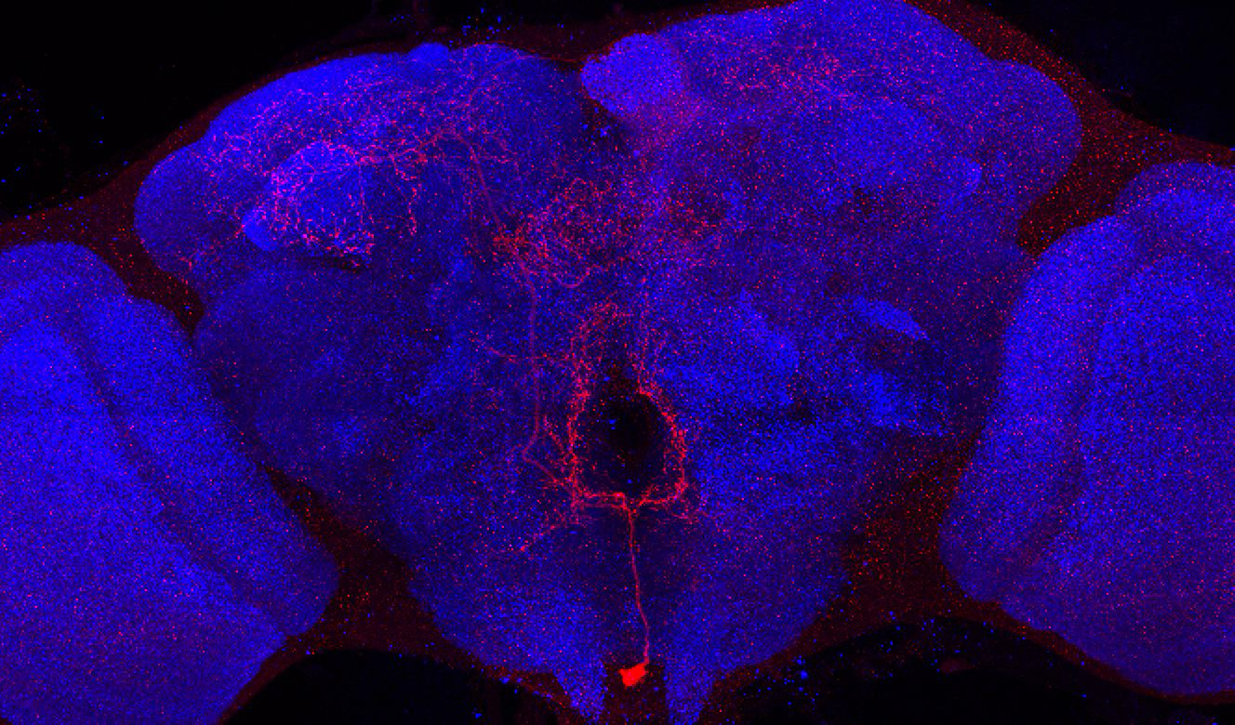
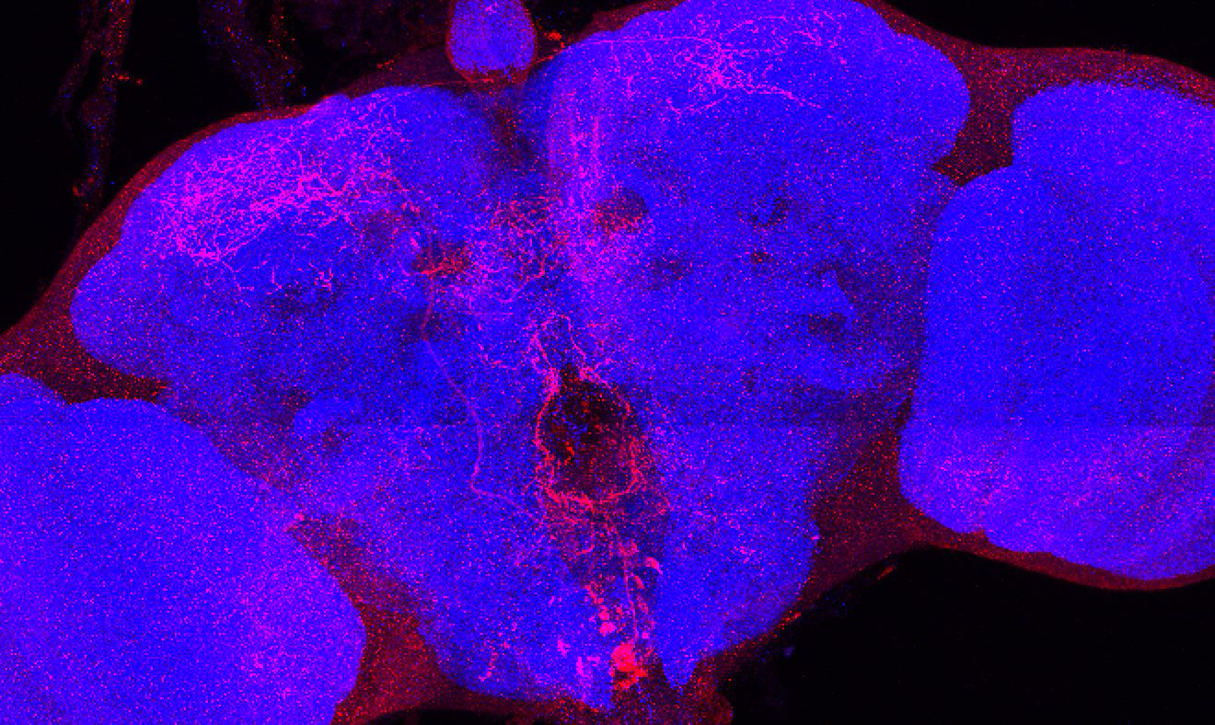
Adult immortalized anatomy of larval neuron DAN-g1
DAN-d1: axon tufts
DAN-d1
SS01716_Brain 1
SS01755_Brain 1
SS01755_Brain 2
Adult immortalized anatomy of larval neuron OAN-g1
SS04268_Brain 1
SS20844_Brain 1

