Slide 1
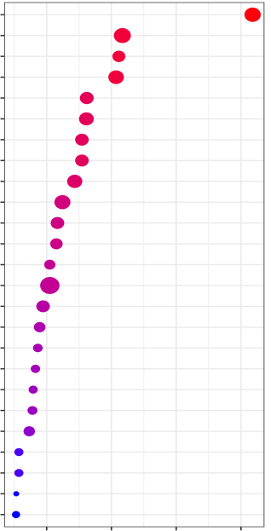
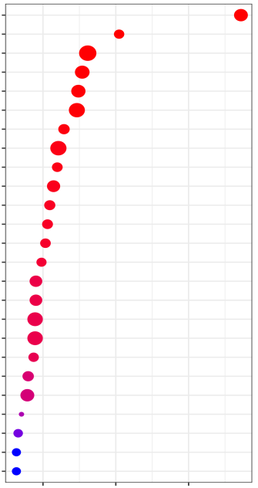


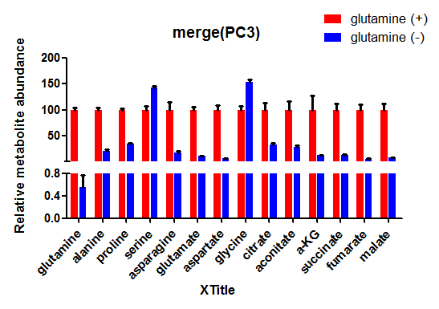
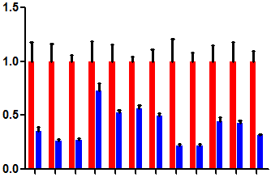
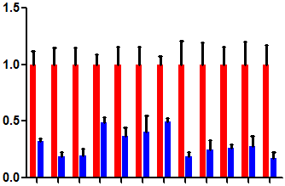
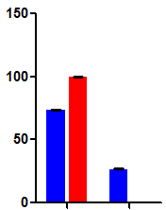
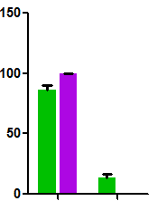
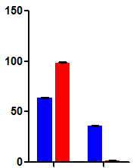
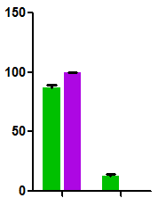
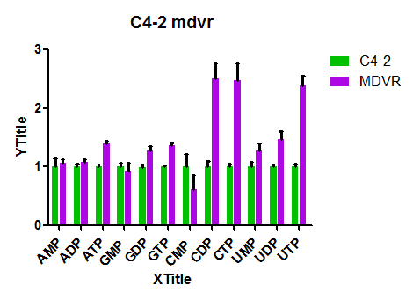
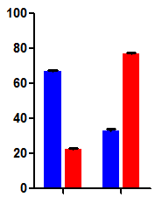
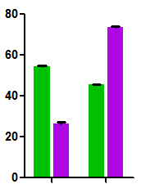
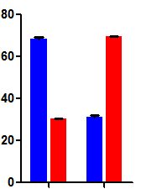
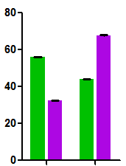
Fig.S2
B
A
Pathways enriched in PC3
Pathways enriched in C4-2MDVR
Pyrimidine Metab.
Nucleotide Sugars Metab.
Purine Metab.
Pentose Phosphate Pathway
Alanine Metab.
Tryptophan Metab.
Glycolysis
Aspartate Metab.
Gluconeogenesis
Spermidine Biosyn.
Cardiolipin Biosyn.
Betaine Metab.
Starch and Sucrose Metab.
Methionine Metab.
Methylhistidine Metab.
Phosphatidylcholine Biosyn.
Glycerolipid Metab.
Warburg Effect
Glycine and Serine Metab.
Galactose Metab.
Beta-Oxidation of Fatty acids
Catecholamine Biosyn.
Lactose Syn.
Amino Sugar Metab.
Glutathione Metab.
Pyrimidine Metab.
Purine Metab.
Phosphatidylethanolamine Biosyn.
Lactose Syn.
Pantothenate Biosyn.
Phosphatidylcholine Biosyn.
Aspartate Metab.
Cardiolipin Biosyn.
Galactose Metab.
Nucleotide Sugars Metab.
Starch and Sucrose Metab.
Fructose and Mannose Degrad.
Amino Sugar Metab.
Gluconeogenesis
Alanine Metab.
Phosphatidylinositol Phosphate Metab.
Thiamine Metab.
Phenylacetate Metab.
Selenoamino Acid Metab.
Riboflavin Metab.
Trehalose Degrad.
Pyruvate Metab.
Glycolysis
Cysteine Metab.
Oxidation of Fatty Acids
Enrichment
Ratio
3
4
5
6
7
8
9
P-value
0.025
0.020
0.015
0.010
0.005
0.000
0.5 1.0 1.5 2.0
2.5 5.0 7.5
C
PC3
-log10 (p)
DU145
-log10 (p)
complete
Gln (-)
complete
Gln (-)
Relative metabolite abundance
Relative metabolite abundance
ATP
ADP
GMP
UMP
UTP
GDP
GTP
CTP
UDP
ATP
CDP
ADP
GMP
UMP
UTP
AMP
CMP
GDP
GTP
CTP
UDP
AMP
CDP
D
CMP
IMP
IMP
ATP
ATP
LNCaP
PC3
***
**
***
**
C4-2
C4-2MDVR
γ-¹⁵N-glutamine labeled
metabolites (% of pool)
γ-¹⁵N-glutamine labeled
metabolites (% of pool)
***
***
**
**
Labeled
-
+
-
+
Labeled
-
+
-
+
E
Glutamate
Glutamate
Aspartate
Aspartate
***
***
***
***
***
***
***
***
α-¹⁵N-glutamine labeled
metabolites (% of pool)
α-¹⁵N-glutamine labeled
metabolites (% of pool)
Labeled
-
+
-
+
Labeled
-
+
-
+

Slide 2
Supplementary Fig. 2 Glutamine nitrogen is largely enriched in nucleotide biosynthesis. A and B, Pathway enrichment analysis showing metabolic pathways that are enriched in PC3 (A) and C4-2MDVR (B) cells. C, Metabolite abundance of nucleotides and derivatives in PC3 and DU145 cells treated with complete medium or glutamine-depleted medium. D, Amide (γ)-¹⁵N-glutamine tracing analysis showing the incorporation of glutamine into IMP and ATP in the indicated PCa cell lines. E, Amine (α)-¹⁵N-glutamine tracing analysis showing the incorporation of glutamine into glutamate and aspartate in the indicated PCa cell lines. Data are depicted as mean ± s.d. * P < 0.05, ** P < 0.01 and *** P < 0.001 by two-tailed Student’s t-test.

