Slide 1
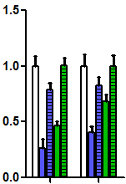
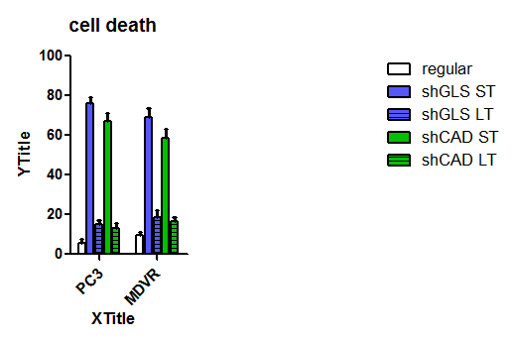
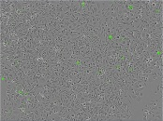
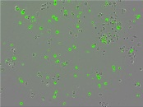
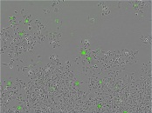
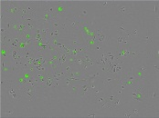
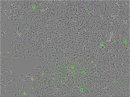

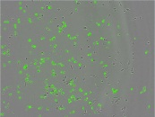

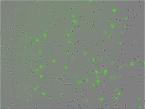
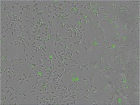
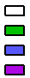
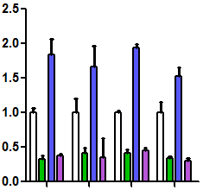
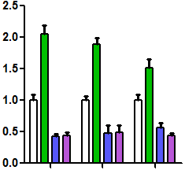
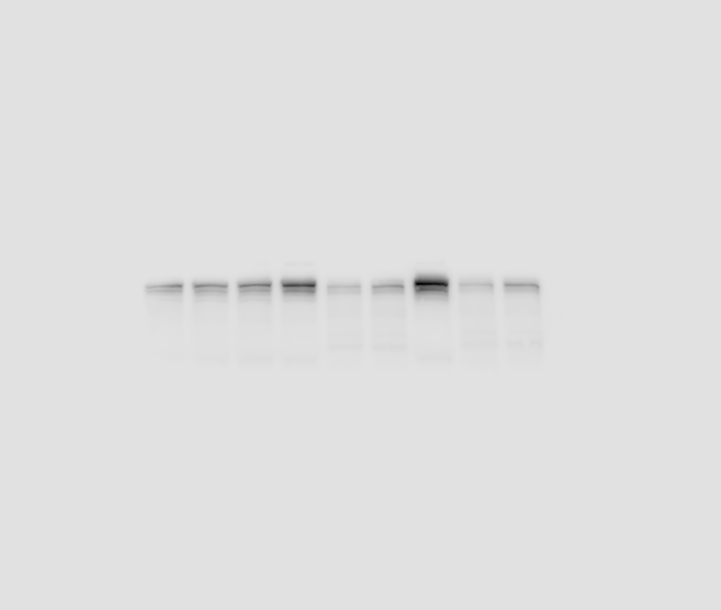
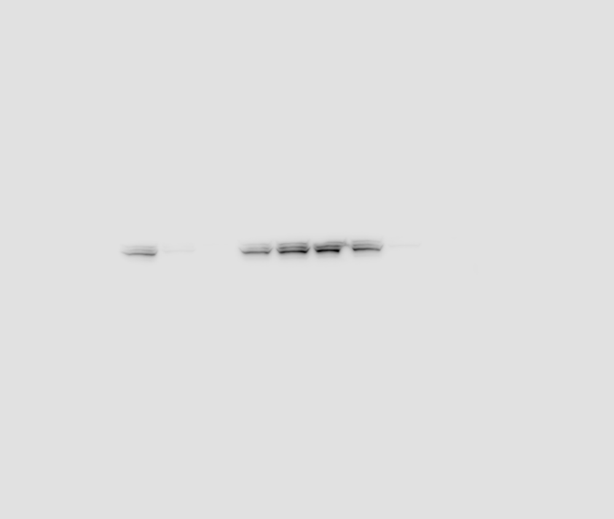

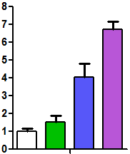
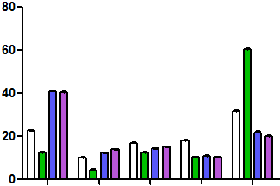
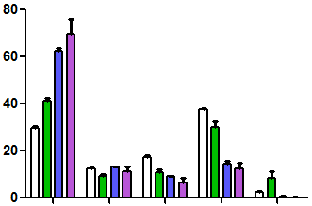
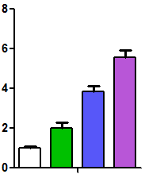
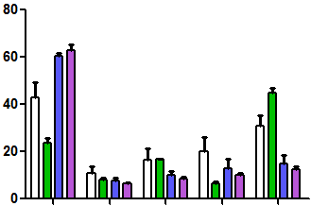
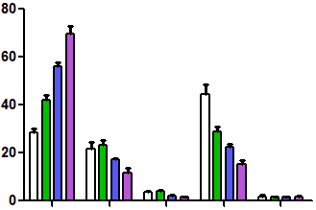
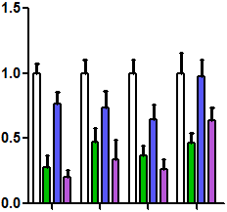
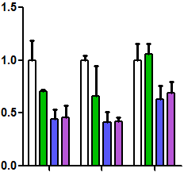

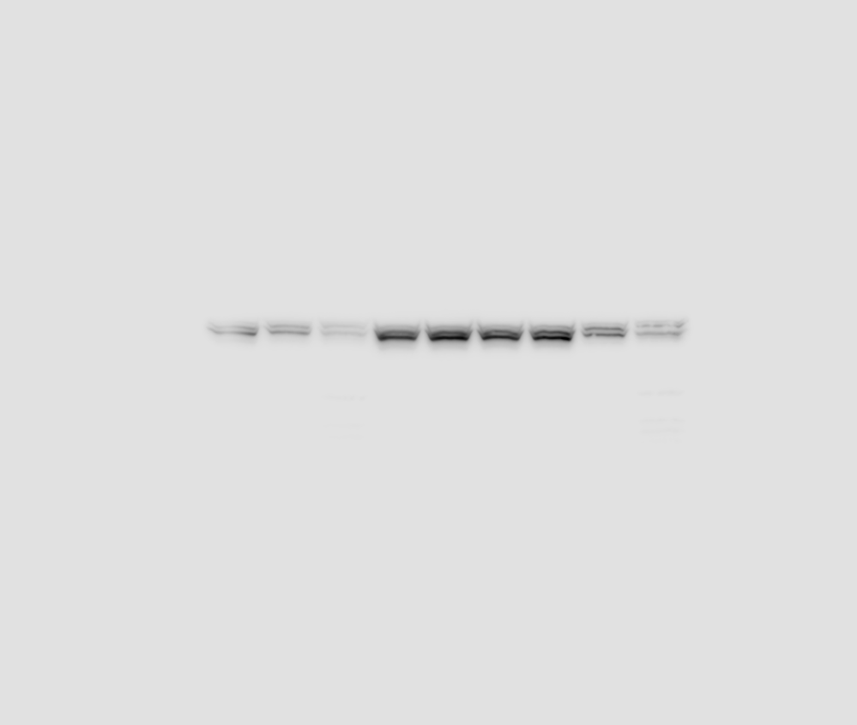
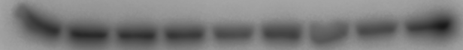
Fig.S5
A
shCtrl
shGLS1-1 (ST)
shGLS1-1 (LT)
shCAD-1 (ST)
shCAD-1 (LT)
shCtrl
shGLS1-1 (ST)
shGLS1-1 (LT)
shCAD-1 (ST)
shCAD-1 (LT)
***
***
***
***
PC3
***
***
***
***
Relative cell viability
Cell death (%)
C4-2
MDVR
PC3
MDVR
PC3
MDVR
Stable
B
C
Pyrimidine synthesis
Glutaminolysis
shCtrl
shCAD-1
shGLS1-1
shCAD-1+
shGLS1-1
shGLS1-1+shCAD-1
shGLS1-2+shCAD-2
***
***
C4-2
MDVR
shGLS1-1
shGLS1-2
shCAD-1
shCAD-2
***
***
***
***
shCtrl
shCtrl
shCtrl
**
***
***
***
***
***
***
***
***
***
***
***
***
CAD
***
***
GLS1
Relative metabolite abundance
Relative metabolite abundance
actin
D
F
DHOA
OA
UMP
CTP
Glu
α-KG
Fum
H
Glutamine (PC3)
Aspartate (PC3)
UTP (PC3)
***
***
***
***
***
***
Relative metabolite abundance
¹³C₅-glutamine labeled
metabolites (% of pool)
¹³C₅-glutamine labeled
metabolites (% of pool)
***
m+0
m+1
m+2
m+3
m+4
m+0
m+1
m+2
m+3
m+4
E
Glutamine (MDVR)
G
Aspartate (MDVR)
I
UTP (MDVR)
***
**
***
***
***
**
***
Relative metabolite abundance
¹³C₅-glutamine labeled
metabolites (% of pool)
¹³C₅-glutamine labeled
metabolites (% of pool)
J
m+0
m+1
m+2
m+3
m+4
m+0
m+1
m+2
m+3
m+4
C4-2
MDVR
K
Pyrimidine synthesis
Glutaminolysis
Dox+Tet-
Tet-shGLS1-1
Tet-shCAD-1
Tet-shGLS1-1+shCAD-1
***
***
***
*
**
*
shCtrl
shCAD-1
shGLS1-1
shCAD-1+
shGLS1-1
*
*
*
n.s
**
**
*
Dox+
0h
12h
24h
0h
12h
24h
0h
12h
24h
***
**
***
**
*
**
n.s
CAD
n.s
GLS1
Relative metabolite abundance
Relative metabolite abundance
actin
DHOA
OA
UMP
CTP
Glu
α-KG
Fum

Slide 2
Supplementary Fig. 5 Reciprocal regulation between glutamine carbon and nitrogen metabolism in PCa. A, Cellular viability and apoptosis assays in PC3 and C4-2MDVR cells treated with either short-term (ST) or long-term (LS) knockdown mediated by shRNAs targeting GLS1 or CAD. B, Western blot showing knockdown of either GLS1 or CAD or in combination mediated by shRNAs in C4-2MDVR cells. C, Metabolite profiling results showing levels of representative metabolites in pyrimidine synthesis and glutaminolysis upon indicated treatment in C4-2MDVR cells. D-E, Relative intracellular glutamine levels in PC3 (D) and C4-2MDVR (E) cells. F and G, ¹³C₅-glutamine tracing analysis showing each isotopologue fraction of glutamine-labeled aspartate in PC3 (F) and C4-2MDVR (G) cells. H and I, ¹³C₅-glutamine tracing analysis showing each isotopologue fraction of glutamine-labeled UTP in PC3 (H) and C4-2MDVR (I) cells. J, Western blot showing doxycycline-induced knockdown (100 ng.ml) of either GLS1 or CAD or in combination mediated by shRNAs in C4-2MDVR cells. K, Metabolite profiling results showing levels of representative metabolites in pyrimidine synthesis and glutaminolysis upon indicated treatment in C4-2MDVR cells. DHOA, dihydroorotate. OA, orotate. Glu, glutamate. α-KG, α-ketoglutarate. Fum, fumarate. Data are depicted as mean ± s.d. * P < 0.05, ** P < 0.01 and *** P < 0.001 by two-tailed Student’s t-test or ANOVA.

