Slide 1
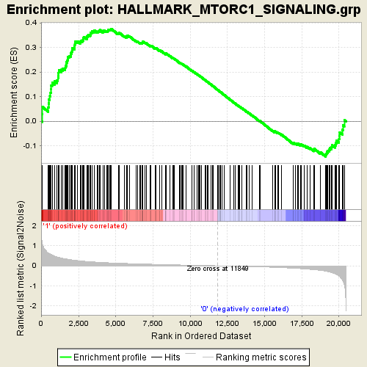
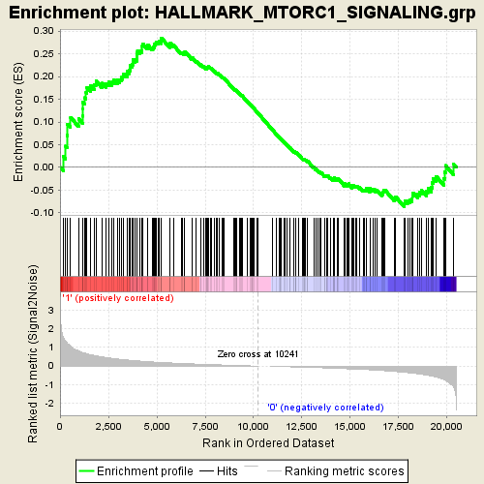
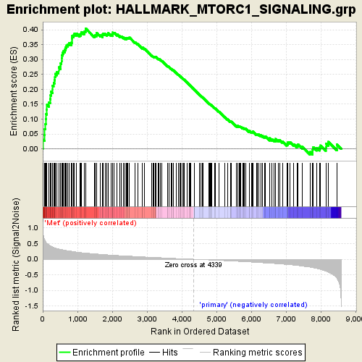
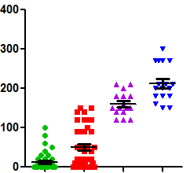
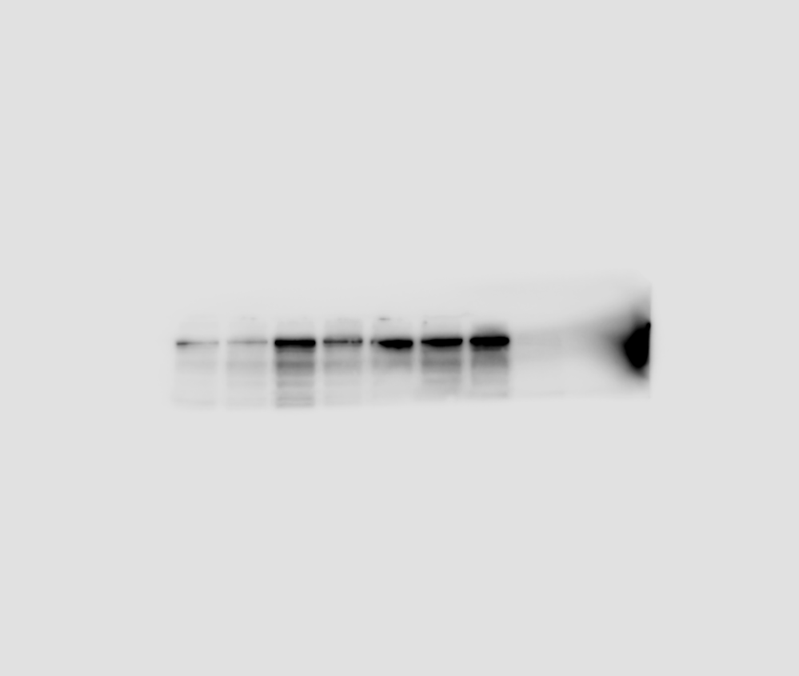
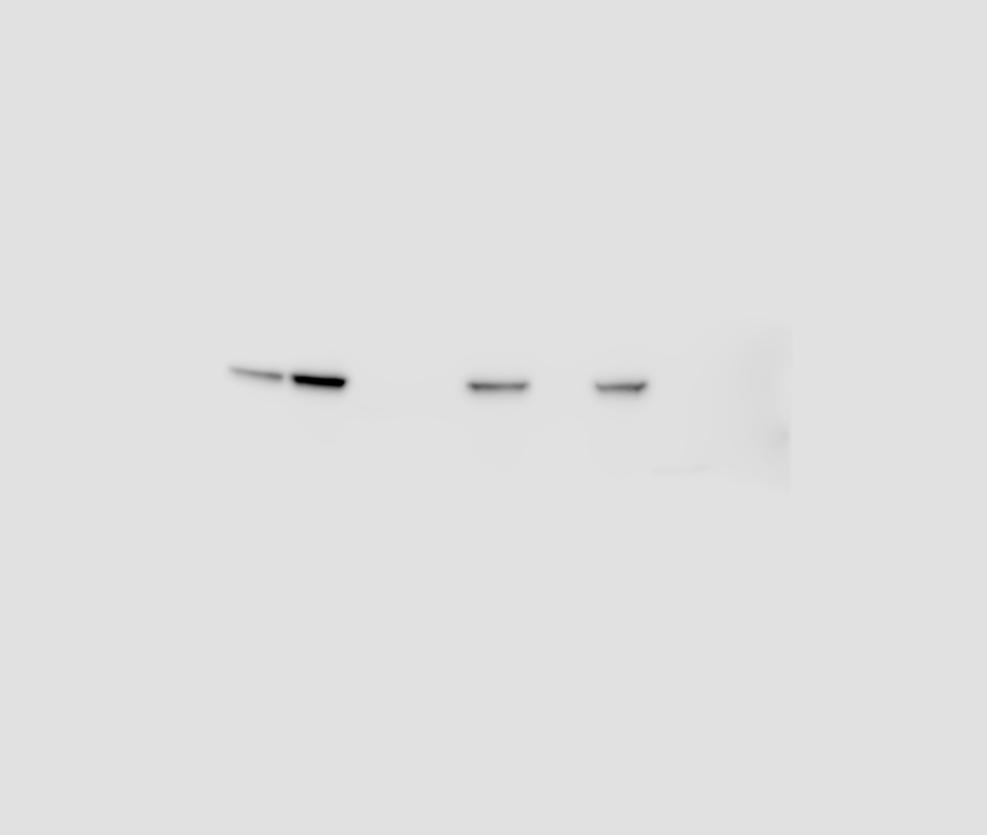
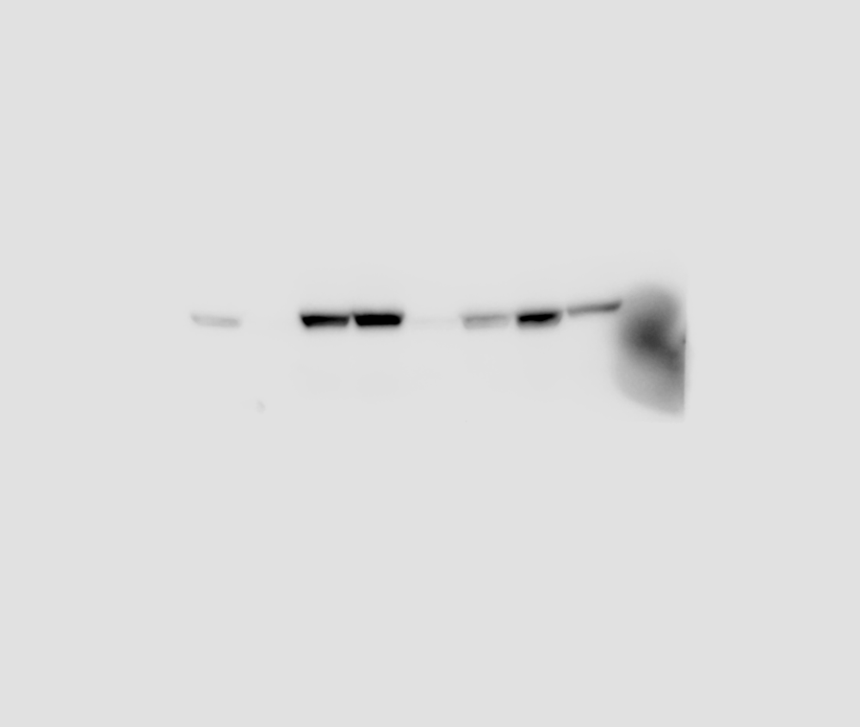
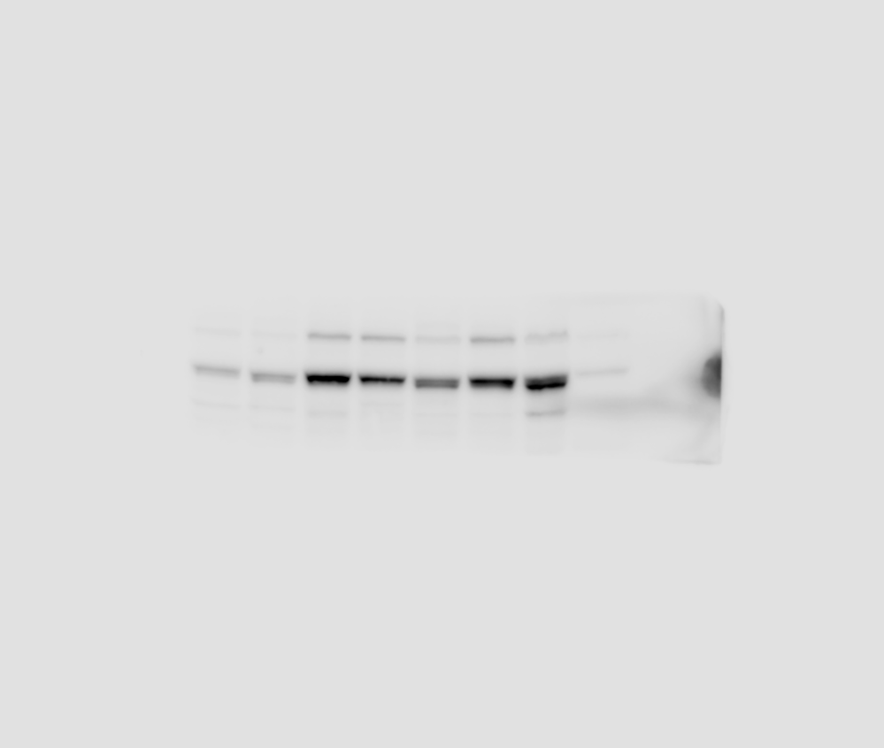

Fig.S6
A
GSE32936
Beltran 2011
GSE6919
B
mTORC1 Signaling
mTORC1 Signaling
mTORC1 Signaling
p-CAD^{S1859} expression
0.4
0.3
0.2
0.1
0.0
0.4
0.3
0.2
0.1
0.0
0.5
0.4
0.3
0.2
0.1
0.0
***
***
ES
ES
ES
Q-Score
SCNC
Adeno
SCNC
Adeno
Metastatic
Primary
Benign
Aceno
CRPC
SCNC
C
C4-2MDVR
LAPC4
22RV1
LNCaP
DU145
PC3
293T
p-CAD
PTEN
p-AKT
p-S6K
actin
Supplementary Fig. 6 PI3K-AKT signaling phosphorylates CAD in advanced PCa. A, GSEA of mTORC1 Signaling signatures in SCNC/metastatic and adenocarcinoma samples from indicated datasets. B, Plot of Quick-score quantifying phosphorylated CAD^{S1859} expression across a series of TMAs shown in Fig. 7B. C, Western blot assessment of phosphorylated CAD^{S1859}, PTEN, phosphorylated AKT^{S473} and phosphorylated S6K^{T389} protein levels in a panel of PCa cell lines. 293T cells were used as a positive control for phosphorylated CAD^{S1859} detection. Data are depicted as mean ± s.d. * P < 0.05, ** P < 0.01 and *** P < 0.001 by two-tailed Student’s t-test or ANOVA.

